Slide 1
Asia
Pacific
Fundraisers'
Network (APFN)
Luong Thi Hong Thuy
Director, External Relations and Development Department ,Vietnam RC
Steering Group Member, Asia Pacific Fundraisers Network
2022 Southeast Asia Leaders Meeting
6-7 October 2022 | Brunei

Slide 2
ABOUT APFN
WHO WE ARE ?
Established in 2010 based on the 2006 commitment by Asia Pacific leaders to be a sustainable network of fundraising professionals and mutual network for learning and sharing
WHAT'S OUR GOAL?
APFN is a National Society-led initiative with the goal of supporting the fundraising and resource mobilization growth of Asia Pacific National Societies
HOW WE WORK
Skillshares, webinars, peer to peer support, knowledge sharing, documentation of best practice and guidebooks, and many more
OUR MEMBERS
All Asia Pacific National Societies

Slide 3
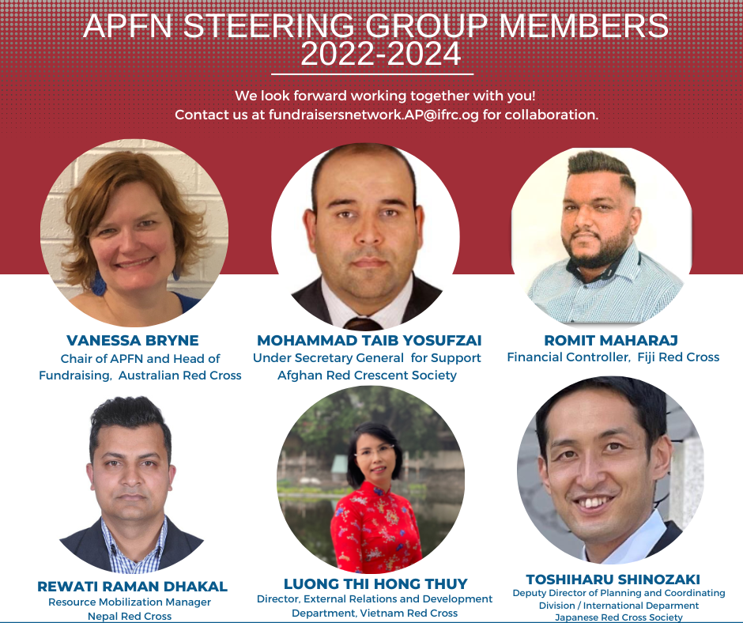

Slide 4
2022 KEY PROGRESS
Preparations for the Virtual AP Fundraising Skillshare
With the theme, Reconnecting, innovating, inspiring, a virtual fundraising skillshare will be held on 23-24 Nov 2022. The preparation of this event is bringing together a motivated group of fundraisers from the Movement as planning committee which shows once again the commitment towards APFN
Working on a Peer to Peer Model
Peer to peer support, as one of APFN’s flagship programs, is currently being reviewed to identify the most relevant working model to allow more peer to peer exchanges among National Societies.
Election of Steering Group Members
Engagement of a dedicated secretariat staff
The new APFN Chair has been elected from Australia Red Cross. Other Steering Committee members include Nepal Red Cross Society, Japanese Red Cross Society, Fiji Red Cross, Vietnam Red Cross and Afghan Red Crescent Society.
Philippine Red Cross hosted the secretariat staff and APFN was able to fundraise to cover the costs. This is recognized as a strategic priority to enhance support as a self-sustained network of National Societies.
Facilitated/hosted 5 webinars
Identifying key priorities to achieve in 2022
·Expanding Income through First Aid (31 May 2022)
·Leveraging Partnerships with Post Office (27 April 2022)
·Global RM Discussion on Ukraine Crisis (14 March 2022)
·Convert Social Media Followers to Donors (28 February 2022)
·Digital Fundraising in Practice (26 January 2022)
The identified priorities are as follows: Training (webinars and skillshares), Peer to Peer Support, eNewsletters, and Movement Sharing Platform.

Slide 5
ORGANIZING A FACE TO FACE SKILLSHARE ON ALL LEVELS OF FUNDRAISING.
LOOKING FORWARD
2023 PLANS
APFN aims to resume hosting face to face annual meetings and skillshares to ensure relationship development and ongoing skill-building within the network.
CONTRIBUTE TO THE DEVELOPMENT OF THE SHARING PLATFORM - RM COMMUNITY OF PRACTICE.
HOST MONTHLY WEBINARS IN BETWEEN THE SKILLSHARES
Our practitioners need a platform where we can share insights, access resources and facilitate peer to peer exchanges with National Societies within our region and from across the world.
·Webinars ensure ongoing learning opportunities for our fundraising practitioners. APFN encourages Southeast Asia National Societies to support as a speaker or participant.
FACILITATE MORE PEER TO PEER AMONG NATIONAL SOCIETIES.
KNOWLEDGE SHARING & COMMUNICATIONS
Peer-to-peer support, among others, provides APFN an opportunity to mobilize its member National Societies and National Societies in other parts of the world that have diverse experience and learning in fundraising and resource mobilization
·APFN aims to send out monthly e-newsletters to allow flow of information, sharing of interesting practices from within and outside the Movement and cascade relevant initiatives.

Slide 6
KEY RECOMMENDATIONS
APFN would like to propose continuous collaboration with Southeast Asia National Societies through the following initiatives and support:
Sharing of leads among Asia Pacific National Societies and within the subregion. APFN encourages sharing of information to support Asia Pacific National Societies in strengthening corporate partnerships and share opportunities in which National Societies can leverage partnerships.
Leadership support. APFN requests our leaders to support active engagement of their respective fundraising practitioners with the network through peer to peer support, participation to our webinars and skillshares, sharing of best practice, and other network activities.
Financial contribution. The network, however, needs to sustain its activities which depends primarily on the commitment of its members like voluntary financial contribution. APFN is proposing co-financing modalities.
·Empowerment and investment in fundraising. We encourage our leaders to make fundraising and resource mobilization a priority as it is crucial to achieve financial independence to carry out our humanitarian mandate.

Slide 7
SAVE THE DATE
NOVEMBER 23-24, 2002
Zoom
2022 ASIA PACIFIC VIRTUAL FUNDRAISING SKILLSHARE
CONTACT
Reconnecting. Innovating. Inspiring
Email: fundraisersnetwork.AP@ifrc.org

Slide 8
THANK YOU !
fundraisersnetwork.AP@ifrc.org
LETS GET STARTED

