Slide 1
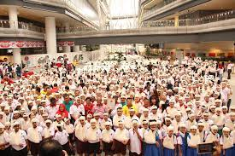
SEA Leaders Meeting 2022
SEA NETWORK FOR FIRST AID
OUR VISION AHEAD

Slide 2
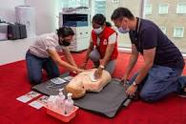
SEA NETWORK FOR FIRST AID
WORKING TOWARDS THE FIRST AID VISION 2030
WHAT IS IT THAT WE WANT?
HOW DO WE WORK TOWARDS THE VISION 2030?
SERVING HUMANITY SAVING LIVES

Slide 3
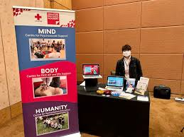
WHAT IS FIRST AID ?
First Aid is immediate assistance provided to an ill, injured or emotionally distressed persons until professional help arrives. Concerned not only with resuscitation and physical illness or injury but also with initial care, including psychological first aid.
SERVING HUMANITY SAVING LIVES

Slide 4
FIRST AID VISION
UNIVERSAL – Available to all - one person trained in first aid in every home, workplace and school;
FORCE FOR HUMANITY – Partner of choice by public authorities and other stakeholders
BUILDING RESILIENCE, ACCOUNTABILITY & TRUST- Mainstreamed by all National Societies – core work of National Societies
SERVING HUMANITY SAVING LIVES

Slide 5
FIRST AID – REALIZING THE VISION
Accessible and inclusive first aid is required to support the resilience of diverse individuals, families and communities in both their physical and psychological wellness.
SERVING HUMANITY SAVING LIVES

Slide 6
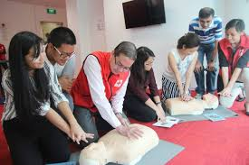
FIRST AID – PRIORITY ACTION AREAS
First Aid Education;
Standards and Qualifications;
Research, Evidence and Evaluation;
First Aid in Schools
Commercial First Aid;
Prehospital Emergency Care & Operations
SERVING HUMANITY SAVING LIVES

Slide 7
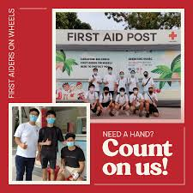
REALIZING THE FIRST AID VISION
What can a SEA Network for First Aid do?
OBJECTIVES
To help build capacity for both physical first aid and psychological first aid in every SEA NS in order for them to facilitate the realization of the vision;
Be a reference point and platform for NSes to build strong and credible FA and PFA programmes, maintaining high standards;
Build credible customized FA and PFA programmes relevant to the norms and environment in SEA;
SERVING HUMANITY SAVING LIVES

Slide 8
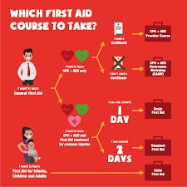
REALIZING THE FIRST AID VISION cont’d
What can a SEA Network for First Aid do?
OBJECTIVES
Facilitate collaboration amongst SEA Youth to champion “First Aid in Schools”, e.g. ToT for Youth Leaders to multiply the effort;
Build capacity in SEA NSes to position each NS to be in the forefront of Commercial First Aid in the country and the vendor of choice.
SERVING HUMANITY SAVING LIVES

Slide 9
REALIZING THE FIRST AID VISION cont’d
ANY THOUGHTS & COMMENTS?
SERVING HUMANITY SAVING LIVES

