Slide 1
Update on the
Statutory Meetings
South East Asia Leadership meeting - September 2021

Slide 2
Objectives and agenda for today
Where we stand on preparations of the IFRC General Assembly including elections.
Preparations for the 2022 Council of Delegates
Follow up of the 33rd International Conference – Reporting system

Slide 3
IFRC General Assembly
Update

Slide 4
23rd session of the IFRC General Assembly
Consultation on the content and its timetable
Secretary General will incorporate the input of the National Societies and submit it for approval to the Governing Board (04-07 October 2021)
Convocation and Agenda to be sent 5 months before the opening
(Rule 7 – IFRC Constitution 2019)
Dispatch of official documents: 40 days prior to the General Assembly
(Rule 8.3 – IFRC Constitution 2019)
Statutory Deadlines
05 July – 14 September 2021: consultation on the draft provisional agenda

Slide 5
23rd session of the IFRC General Assembly
Draft Provisional Agenda – key items

Slide 6
IFRC General Assembly
Elections and Appointments

Slide 7
Election of the Governing Board
25 positions up for election:
1. President
2. 4 Vice-presidents
1 from each region: Africa, Americas, Asia and Europe
3. 20 National Societies
5 NS per region
For each region, 2 lists according to gender (male and female representatives)
Ensuring maximum 3 male or 3 female representatives in each region

Slide 8
Election of the Governing Board (cont.)
Electronic voting
Head of delegation to cast the vote
Timeline of the election calendar :
Shared with NS upon confirmation of the date of the General Assembly
Deadline for submission of candidature:
60 days prior to the General Assembly

Slide 9
Election of 1 member – Youth Commission
Election of one member from the Africa region following a vacancy
Electronic voting
Youth delegate to cast the vote
Timeline of the election calendar :
Shared with NS upon confirmation of the date of the General Assembly
Deadline for submission of candidature:
60 days before the last ordinary meeting of the Governing Board before the General Assembly

Slide 10
Appointment of 2 members, Compliance and Mediation Committee
Election of one member from each the Africa and Europe regions following 2 vacancies
Timeline of the appointment calendar :
Shared with NS upon confirmation of the date of the General Assembly
Deadline for submission of candidature:
60 days before the last ordinary meeting of the Governing Board before the General Assembly

Slide 11
Council of Delegates
2022
Structure
Workshops and proposed resolutions

Slide 12
CoD 2022: Structure
Statutory Agenda items
Informal / exploratory workshops
Others
‘Journey to the CoD’ items
Medals/Awards
Resolutions
Progress reports
Notes:
The slide shows the mapping of the main elements that make up the structure of how the CoD could look in 2022.
We broke this down into two categories:
‘Statutory Agenda items’ (i.e., the ‘essentials’) including medals/awards, resolutions and progress reports; and
what we call a ‘journey to the CoD’ which would include exploratory workshops to take place beforehand the formal plenary of the CoD.

Slide 13
OVERVIEW: CoD 2022: “Hybrid” format containing virtual and in-person elements ‘Two-step approach’ - virtual workshops - in-person plenary
Virtual workshops
Early 2022
TBD 2022
JOC's working assumption of May 2022 timeline!
In-person plenary
Notes:
The Standing Commission in June 2021 has decided that the CoD 2022 will have a “Hybrid” format containing in-person and virtual elements.
The virtual workshops would lead to an in-person plenary, either in May or December 2022. However, the Standing Commission current preparation is based on a working assumption that the CoD would take place in May 2022.
The virtual workshops are part of the official programme of the CoD. They will take place from January to April 2022.

Slide 14
CoD 2021: ‘Journey to the CoD’ - List of Workshops
What we do
Counter-terrorism and sanctions
Mvt. Approach to Education
How we work
Investing in Movement communications
Mvt. approach to diversity and inclusion
Autonomous weapons
Monitoring framework for the Movement-wide principles and SoPs for virtual fundraising hub
Protection within the Movement
Notes:
As previously said, a series of virtual workshops taking place from January to April 2022. See the ist of the confirmed workshops on the slide.
These workshops are included into the official programme.
A consolidated outcomes of these workshops will be presented at the beginning of the CoD plenary session
The outlines of these workshops are in preparation and will be shared with National Societies in November.

Slide 15
CoD 2021: ‘Statutory Agenda Items’ - Proposed Resolutions
Climate and Environment Charter
Movement action plan on War in Cities
Movement-wide Strategy on Migration
Strengthening Anticipatory Humanitarian Action
Patient Quality and Safety Initiative
New action plan on elimination of nuclear weapons
Urban resilience
Establish Movement RFL Medal
Notes:
Except the proposed resolution on “Climate and Environment Charter” which has its own consultation process, the draft elements of these resolutions have already been shared with National Societies for comments in March. With feedback received, the draft zero version of these proposed resolutions is now prepared and will be published for another round of consultation by the end of September. Stay tuned!

Slide 16
Follow up of the
33rd International Conference
New reporting system
Notes:
For this part, we would now like to introduce the new reporting system of the 33rd International Conference in particular on the thematic pages to report on follow-up.

Slide 17
IC new follow-up reporting system
Easy & simple
Early & dynamic
Demonstrate implementation progress
Encourage early implementation
Collect information for final consolidated report
Complementary process
Notes:
The main aims of this IC new reporting system are:
user friendly and simple
ready early and allows for more flexibility and a more dynamic reporting of the 33rd IC. To demonstrate the advancement of their commitments, National Societies are welcome and have the opportunity to submit more than one report on the same resolutions/pledges anytime at their own convenience from now until the next IC.
It’s a complementary process on the substance follow-up carried by the technical experts.
There is no midterm review reporting foreseen, but there will be illustrations on the website to demonstrate the overall progress on the accomplishment of the resolution/pledge implementation. We therefore encourage National Societies to start submitting their implementation reports now no matter on whether they are fully implemented or not.
Lastly data/information collected will be used to prepare for the final consolidated report.

Slide 18
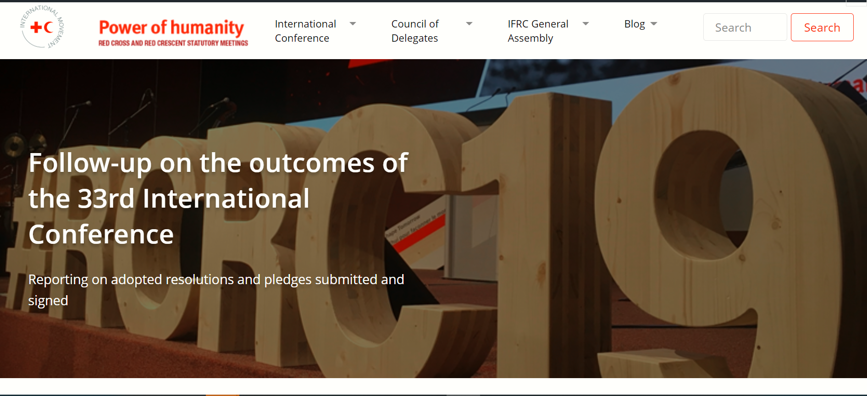
Website: www.rcrcconference.org
Contact: conferences@rcrcconference.org
Notes:
How the reporting system looks:
This system is integrated into the statutory meetings website (www.rcrcconference.org).
There is a special page for the follow up on the outcomes of the 33rd IC. From this page, conference members can access to the thematic page of the six resolutions that require active follow up from the members.
The thematic page is designed to be a one-stop place where all information related to the follow up of that particular resolution can be found.
Online reporting form:
Aiming of not going into detail on the substance side, there is only one set of generic questions for the six resolutions.
To make it simple, there is only 5 questions with multichoice answers.
A comment box is also available for NSs to provide written feedback and there is also a possibility to attach official report.
To prepare for the online reporting, National Societies can also download the Word version of the questionnaire.
Please contact conferences@rcrcconference.org for any inquires.

