Slide 1
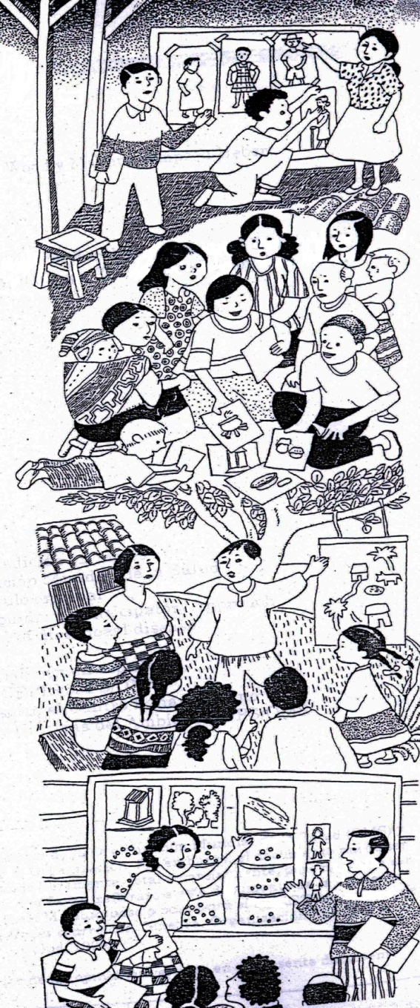
PHAST process

Slide 2
Seven steps to community planning for the prevention of diarrhoeal disease
Step 2
Step 3
Planning for solutions
Problem analysis
Step 4
Step 5
Step 6
Step 7
Step 1
Problem identification
Selecting options
Planning for new facilities and behaviour change
Planning for monitoring and evaluation
Paticipatory evaluation

Slide 3
The PHAST Process
Step
Activity
Tool
A STEP may contain one or more activities aimed at achieving one overall objective.
An ACTIVITY is what the group works through to discover the information and skills necessary to reach an understanding or take an action.
TOOLS are the techniques and materials the facilitator uses to help the group work through an activity.

Slide 4
STEP 1: PROBLEM IDENTIFICATION
Step 1. Problem identification
Step 1
Problem identification
Activity
1. Community stories
2. Health problems in our community
Tool
1. Unserialised posters
2. Nurse Tanaka
In this step there are two activities
ACTIVITY 1: COMMUNITY STORIES
The objective of activity is;
  To enable the group members to identify important issues and problems facing their community
  To help build a feeling of team spirit and mutual understanding
  To generate group self esteem and creativity
    UNSERIALISED POSTERS TOOL

Slide 5
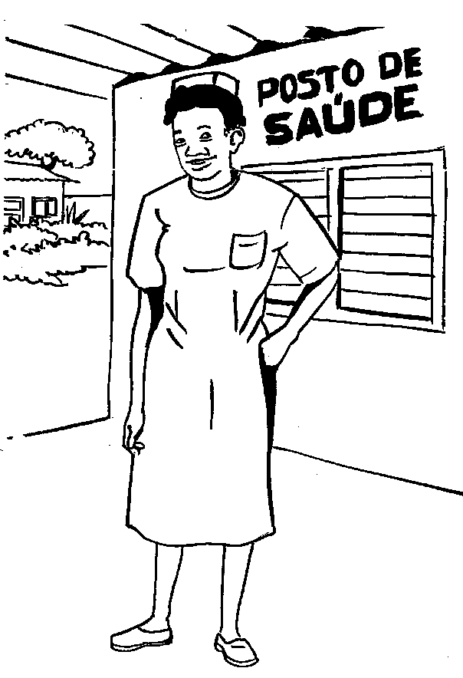
Step 1. Problem identification
ACTVITY 2: HEALTH PROBLEMS IN OUR COMMUNITY
The activity is designed to help identify important health problems in the community and to discover which ones can be prevented by community action.
NURSE TANAKA TOOL

Slide 6
STEP 2: PROBLEM ANALYSIS
Step 2. Problem analysis
Step 2
Problem analysis
Activity
1. Mapping water and sanitation in our community
2. Good and bad hygiene behaviors
3. Investigating community practices
4. How diseases spread
Tool
1. Community mapping
2. Three –pile sorting
3. Pocket chart
4. Transmission routes
ACTIVITY 1: MAPPING WATER AND SANITATION IN OUR COMMUNITY
This assists the participants to map those water and sanitation problems which could lead to diarrhoeal diseases.
COMMUNITY MAP TOOL

Slide 7
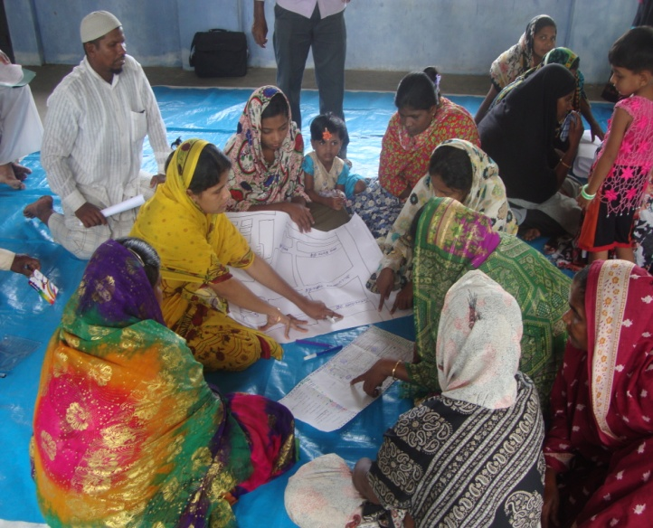
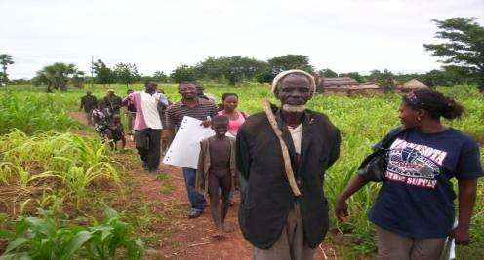
ACTIVITY 1. MAPPING WATER AND SANITATION IN OUR COMMUNITY
Step 2. Problem analysis
A community mapping exercise helps the community to identify critical problems and possible interventions, including toilets, grey water and solid waste management.
Transect walk

Slide 8
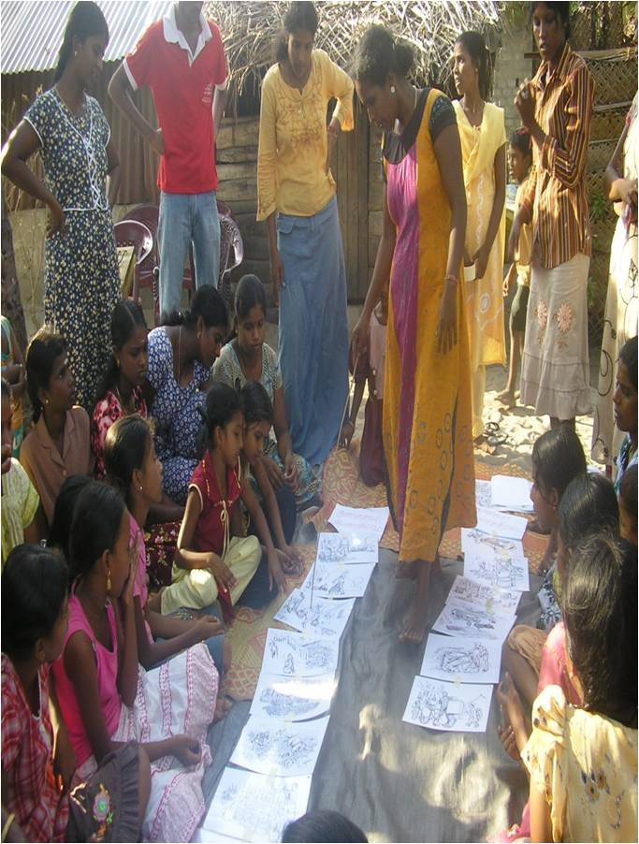
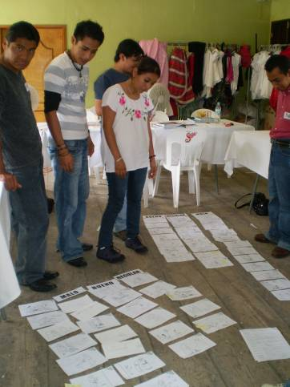

ACTIVITY 2: GOOD AND BAD HYGIENE BEHAVIOURS
Step 2. Problem analysis
The activity helps the group to look more closely at common hygiene and sanitation practices and to identify how these may be good or bad for health.
    √ 3 PILE SORTING TOOL

Slide 9
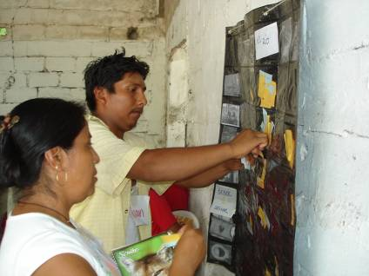
ACTIVITY 3: INVESTIGATING COMMUNITY PRACTICES
Step 2. Problem analysis
The purpose of the activity is to help the group collect and analyze data on actual water ,sanitation and hygiene practices in the community.
POCKET CHART TOOL

Slide 10
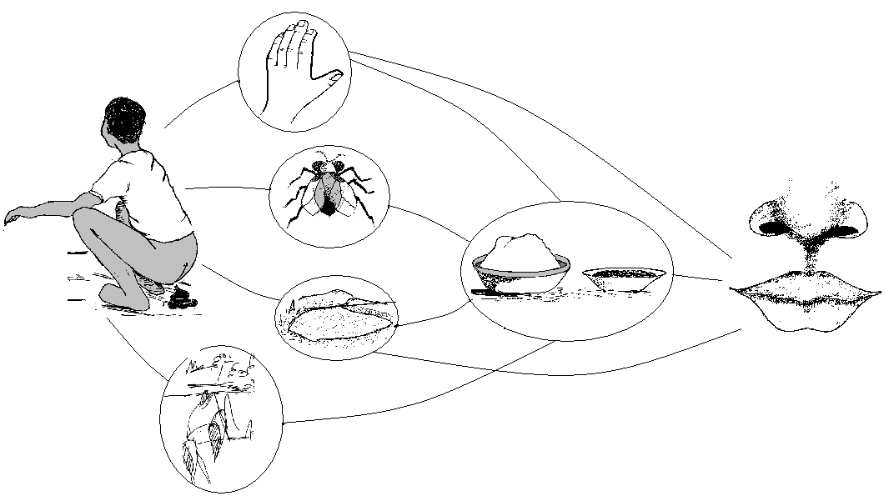
ACTIVITY 4: HOW DISEASES SPREAD
Step 2. Problem analysis
The purpose is help the participants discover and analyze how diarrheal can be spread through the environment and the tool used is faucal oral transmission routes.
This tool is normally used to look at how faeces can contaminate the environment and lead to diarrhoeal.
TRANSMISSION ROUTES TOOL

Slide 11
PHAST STEP 3:PLANNING FOR SOLUTIONS
Step 3. Planning for Solutions
Step 3
Planning for solutions
Activity
1. Blocking the spread of disease
2. Selecting the barriers
3. Task of men and women and women in the community
Tool
1. Blocking the routes
2. Barriers chart
3. Gender role analysis
Activity 1: Blocking The Spread Of Diseases
Blocking the spread of diseases helps the participants to discover ways to prevent diarrhea diseases from being spread via the transmission routes identified in the previous activity.
    Faucal Oral route barrier tool

Slide 12
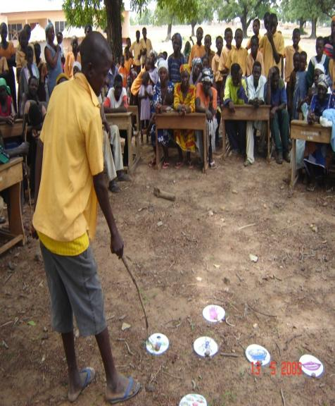
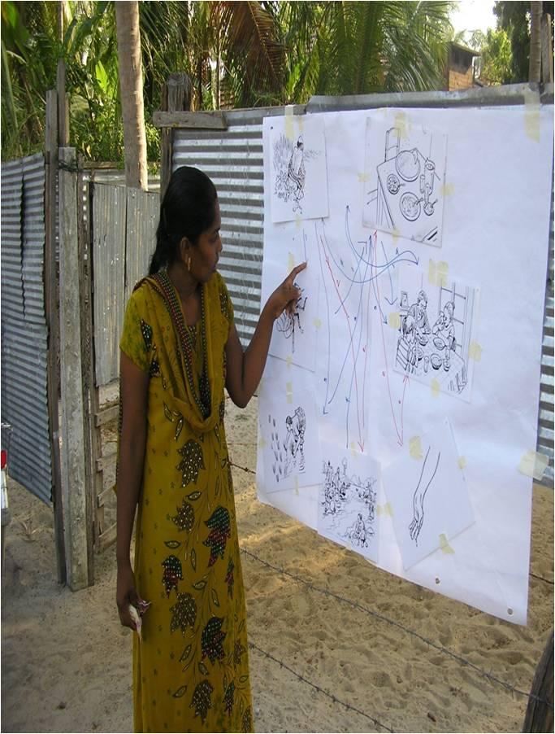
ACTIVITY 4: HOW DISEASES SPREAD
Step 2. Problem analysis
Open discussion on hygiene and sanitation issues among school children and Community

Slide 14
Activity 2: Selecting The Barriers
Step 3. Planning for Solutions
This activity helps the group to analyze
the effectiveness and ease of actions to block transmission routes and choose which they want to carry out themselves.

Slide 15
Barrier chart
Step 3. Planning for Solutions
 | Easy to do | In between | Hard to do
Effective | 1
In between
Not effective

Slide 16
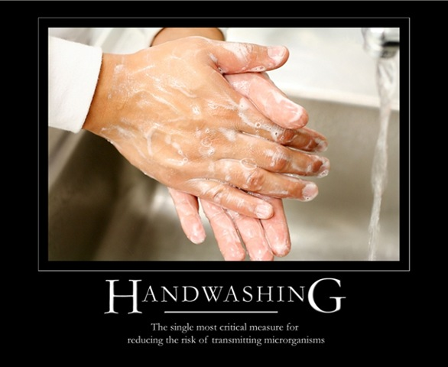
Question
Can you list critical time for Hand washing?

Slide 17
Hand washing at critical times
Before eating
Before handling food /water
Before feeding baby
After defecation
Before breast feeding
After handling baby’s faeces

Slide 18
Activity 3: Tasks for Men and Women
The activity identifies which are the roles undertaken by men, women and children and who would be able to take additional tasks to introduce changes necessary to prevent diarrheal diseases.
The purpose of this tool is to:
Raise awareness and understanding of which household and community tasks are done by women and which are done by men
To identify whether any change in task allocation would be desirable and possible
    GENDER TASK ANALYSIS /24 HOUR CALENDAR TOOL

Slide 19
Gender Sensitive Programming
Gender is the culturally defined division of work and areas of responsibility, authority and cooperation between men and women .
For every improvement related to health and hygiene one must therefore ask if it concerns men, women or both and whether either category has specific needs, priorities and resources.
Communication channels and messages must be developed for both men and women.

