Slide 1
Question
What makes schools unsafe?
What are the fears/ dangers for children, teachers…?
Notes:
Slide 1: Distribute 1-2 piece of paper to each participant and markers/crayons
Ask participants to draw pictures or write down (if they like)1-2 examples of dangers/fears that they feel about the school unsafe and write down a short explanation on the picture (3 mins)
Meanwhile, place the poster “Hazard” and “Vulnerability” in the middle of the room.
Once they are ready, ask them if they heard about the word “Hazard” and “Vulnerability” and ask what those words mean. {usually if the schools or community under RC projects, they heard this word, but may not clearly understand what it means.}.
Regardless of any answer, let them to cluster the examples into the category of “Hazards” and “Vulnerabilities”. {Usually participants will have a mix of hazards (flood, earthquake) and vulnerabilities(old building, water}.
From the floor, take 2-3 examples and ask participants if it is hazard or vulnerability. {it is normal they confuse together and their answers are different}
Ask if they want to know clearly about the definition what Hazard and vulnerability means. If they say yes, open next Slide

Slide 2
What is Hazard & Vulnerability ?
Hazard means dangerous condition, threat or potential for causing injury, damage
Vulnerability means an extent to likely be damaged or disrupted by the impact of Hazard.
Notes:
Slide 2:
Explain what hazard and vulnerability means. {Repeat a main message “We cannot avoid any problems (Hazards), however we can be prepared to and respond to (Vulnerability)”.
Open next slide

Slide 3
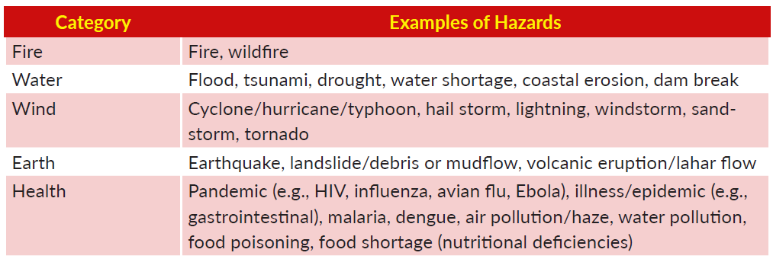
More examples of Hazards
Notes:
Slide3; Explain here are more examples of hazards.

Slide 4
Disaster = Hazard + Vulnerability. Risk is not only about disasters, but more than that…
Notes:
Slide 4.
Explain “If Hazard comes alone, and you are prepared well, it is not a disaster. But if you are not prepared which is vulnerable, then it becomes disaster. And we call it disaster risk”
Explain that the Risk is not only about disasters, but more than that…by putting the poster "Risk” on top of “Hazard” and “Vulnerability” as like picture 1

Slide 5
… Comprehensive Risk approach…
Notes:
Slide 5:
Continue explain “Risk is very comprehensive and various. These are more examples of risks more than disasters…”
Risk can come from Hazard and Vulnerability including Health problem, school problem and technical problems.
Give few minutes for them to read. Once they are clear, ask if they would like to move their examples into different category.
If yes, let them do it (2mins) {They can change according to their understanding of Hazard and Vulnerability presentation}.

Slide 6
Activities to reduce risks?
What can be done to reduce risks in and around schools?
Give examples of activities (from teachers, from children, from Red Cross or Red Crescent or other actors…?)
Notes:
Slide 6;
Preparation:
three pieces of strings/rope.
3-key-word posters; “Safe Learning Facilities” “Disaster Management Actions” “Education/Knowledge” (A4 size)
Now lets do small exercise again. Distribute 1-2 piece of paper to each participant.
Brainstorm participants to write down 1-2 examples of activities can be able to reduce risks at your school (3 mins)
{Meanwhile put the three “circles” with string or rope on the floor overlapped on the poster “risk “in the middle of the floor. Refer picture 2)

Slide 7
Cluster into “3 pillars”
1. Safe Learning Facilities (eg. building)
2. School Disaster Management (eg. evacuation route, fire extinguisher, first aid training)
3. Risk Reduction and Resilience Education (curriculum, awareness session)
Notes:
Slide 7;
A. Finished writing, explain quickly the meaning of each circle as follows by showing 3-KEY WORD Posters.
Three circles here mean 3 comprehensive clustering actions to reduce your risks at school defined at a global level.
We call them 3 pillars of Comprehensive School Safety Framework. Pillar (1) “Safe Learning Facilities”, (2) “Disaster Management Actions” and (3) “Education / knowledge” {put those 3-key -word posters inside the each circle}
B. Ask each participant to read out activities (they wrote) loud and put them inside the 3 circles. If time is not sufficient, have all participants organize their ideas by themselves inside the circles.
C. Ask them if they are clear about the school safety three pillars.

Slide 8
This is
Notes:
Slide 8; If yes, explain that this is the risk reduction and this is the School Safety. Congratulate on their actions!

Slide 9
Key messages…
School safety is not only about disasters
Everyone can contribute to school safety
School safety is best achieved in peer to peer support (partnerships)
Notes:
Slide 9; Highlight about key messages as a summary. Through this exercise, we learnt …

Slide 10
How do you feel now?
Notes:
Slide 10; Now how do you feel? Is it clear?

Slide 11
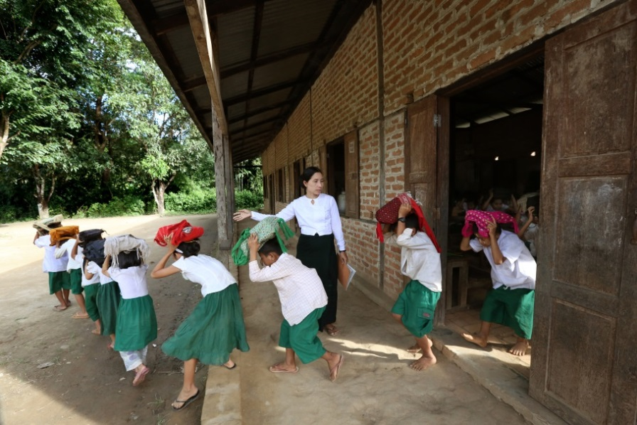
THANK YOU and Any Questions?
Notes:
Slide 11; Thank you very much for your active participation and great work. Any more questions? Applause

