Slide 1
Beneficiary Communication
People need information as much as water, food, medicine and shelter. Information is aid.

Slide 2
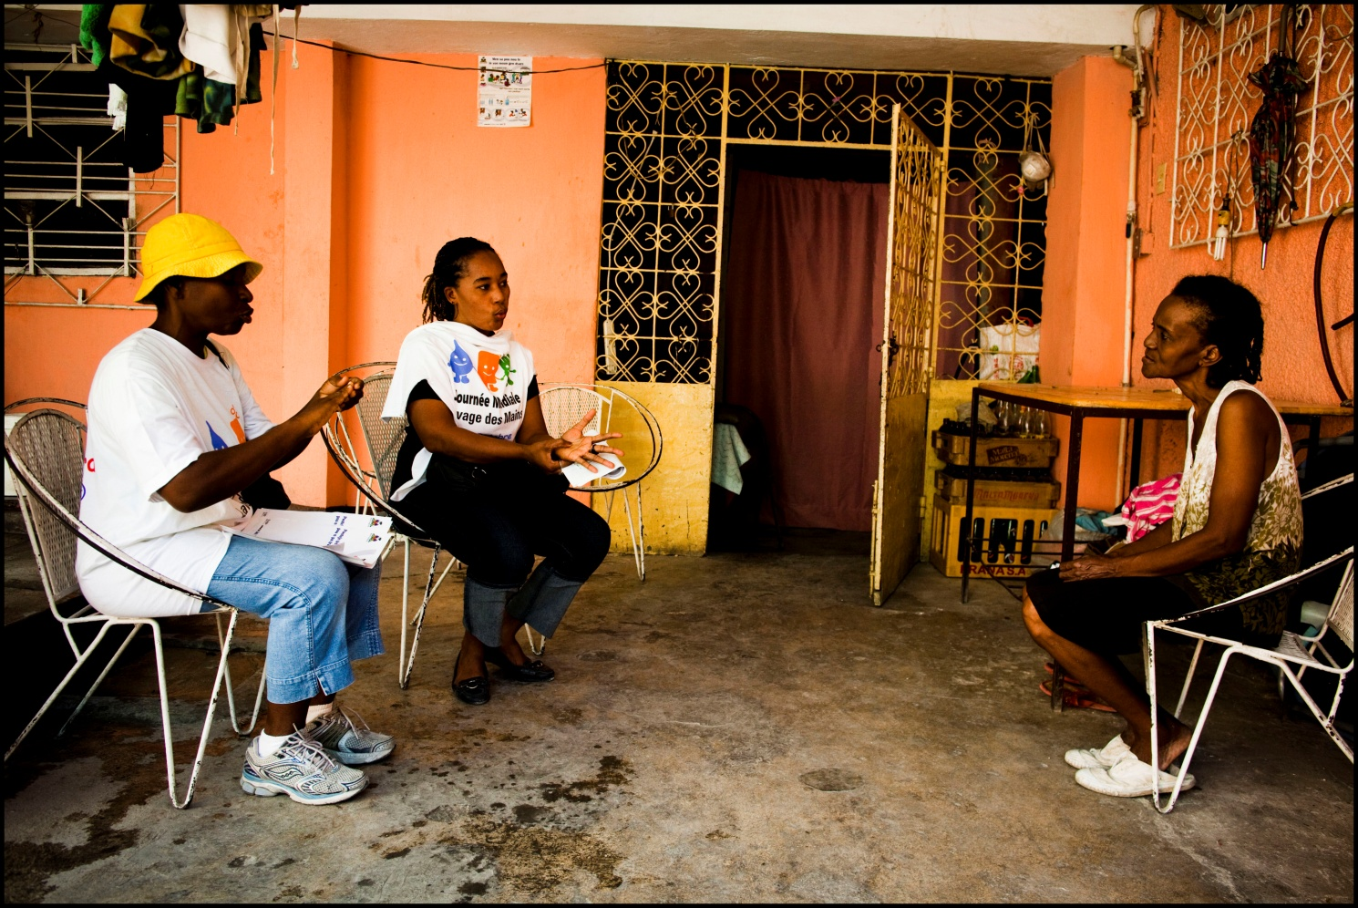
Module two: Importance of communication with beneficiaries
Notes:
http://www.youtube.com/watch?v=Uibg0JREldc
Video is saved at T Drive at T:\Communications\Beneficiary communications\OUTPUTS CAROLINE AUSTIN\OUTPUT 1 TRAINING MATERIAL\USEFUL TRAINING VIDEOS

Slide 3
Module two: Importance of communication with beneficiaries
“People need information as much as water, food, medicine or shelter. Information can save lives, livelihoods and resources (...)Information bestows power. Lack of information can make people victims of disaster.”
IFRC World Disasters Report 2005

Slide 4
Module two: Importance of communication with beneficiaries
Information is a right and it is empowering. People can take informed decisions on their own lives only if they have correct and timely information.
Communicating with, involving and listening to people means that we provide a better service to them. It can assist in accountability. Improving accountability starts with a process of communication. We have a duty to be accountable to our beneficiaries and to make a deliberate effort to communicate with, listen to and respond to their concerns. People we work with have a right to know about and have a voice in actions that affect them.

Slide 5
Module two: Accountability and communication
Some definitions of accountability………….
ACCOUNTABILITY: Making sure the men, women and children affected really do have a say in planning, implementing and judging our response to their emergency. – ECB Project
ACCOUNTABILITY: The processes through which an organization makes a commitment to respond to and balance the needs of stakeholders in its decision-making processes and activities. – GAP
ACCOUNTABILITY is the means by which power is used responsibly. – HAP
ACCOUNTABILITY means explaining what you have done and taking responsibility for the results of your actions. This includes explaining how you have used funds. – Mango
Other?...............

Slide 6
Module two: links between accountability and communication
Meeting our commitments to accountability is a process that starts with the capacity to listen and respond to those affected.
Giving communities affected by disasters a real voice that enables them to advocate in their own interests on issues related to their recovery and ensuring that beneficiaries play a greater role in their own recovery, therefore improving the quality of our work.
As communicators we have a role to assist and facilitate communication with affected communities. BCA is a responsibility not a choice for everyone involved in programmes.

Slide 7
Module two: Building blocks to accountability
Transparency
Complaints and Response
Participation
Monitoring and Evaluation
Notes:
Note that this is taken directly from British Red Cross AtB framework.

Slide 8
Module two: Transparency
Transparency
Complaints and Response
Participation
Monitoring and Evaluation
Notes:
We will provide timely and accessible information to beneficiaries that will enable them to make informed decisions about if, how and when to engage with the organization.

Slide 9
Transparency
We will provide timely and accessible information to beneficiaries that will enable them to make informed decisions about if, how and when to engage with the organization.
Timely: considering when to provide the information. ie. Communicating before we do an assessment what we are doing.
Accessible: making sure everyone hears it. I.e. this usually means communicating in a variety of ways, through community meetings, posters, radio, volunteers. Making sure you access everyone.

Slide 10
Module two: Participation
Transparency
Complaints and Response
Participation
Monitoring and Evaluation
Notes:
Involve people at every stage. We will enable beneficiaries to play an active role in the decision-making processes and activities that affect them.

Slide 11
Module two: Participation
Transparency
Complaints and Response
Participation
Monitoring and Evaluation
Notes:
Involve people at every stage. We will enable beneficiaries to play an active role in the decision-making processes and activities that affect them.

Slide 12
Module two: Monitoring and Evaluation
Transparency
Complaints and Response
Participation
Monitoring and Evaluation
Notes:
We will monitor and review progress against goals and targets with the input from beneficiaries, as well as to integrate learning from this into future decision making and to report on the results.

Slide 13
Module two: Complaints and Response
Transparency
Complaints and Response
Participation
Monitoring and Evaluation
Notes:
We will set up mechanisms through which beneficiaries can make complaints in relation to our programme/project decision and/or actions and through which these are reviewed and acted upon.

Slide 14
Module two: further resources on accountability
http://www.hapinternational.org/ case studies and tools to implementing AtB and good section on communicating at http://www.hapinternational.org/case-studies-and-tools/sharing-information.aspx i.e. information on noticeboards, messaging, feedback mechanism (in multiple languages).
One world trust accountability database gives you information on communicating with affected communities at http://oneworldtrust.org/apro/.
Handout on AtB and Beneficiary Communications

