Slide 1
Beneficiary Communication
People need information as much as water, food, medicine and shelter. Information is aid.

Slide 2
Module three: building a simple communications to beneficiaries plan and feedback loops

Slide 3
Building a feedback loop: Communication Needs Assessment
1. | Who is the audience?
2. | What are the objectives of communication?
3. | What methods will you use to deliver your message?
4. | How will you ensure feedback is acted on?

Slide 4
1. Who is your audience?
Who is the audience? Who is affected by the crisis?
Consider directly affected and indirectly affected populations.
Affected: those in the immediate area of the disaster
Indirectly affected: communities, friends and family who also need information or maybe be in the vicinity of your programme or the disaster.

Slide 5
2. Objectives of communication
Ask what are the information needs? What kind of information do they need? i.e. health, shelter, water?
How should these needs be assessed?

Slide 6
2. How to assess audience information needs – objectives
Ask those affected by the disaster directly in your assessment (VCA or other tools)
Research humanitarian websites (refer handout)
Local organizations
Government departments
Others?

Slide 7
3. What methods might you use to deliver messages or receive feedback?
Ask those affected by the disaster directly in your assessment.
Find out most trusted channels.
Consider asking them about the time they want to hear your message. i.e. at night?
Is this accessible to all members of the community?
Ask for mobile usage, tv usage and access, radio access and strength.
Consider social media channels to disseminate your information.
Consider literacy issues.
2. Other specialist agencies (CDAC, Infoasaid)

Slide 8
Global Map of Social Networking 2011 @ http://visual.ly/global-map-social-networking-2011

Slide 9
Mapping communication channels and methods to deliver your message
http://cdac-haiti.org/humanitaire/campagne

Slide 10
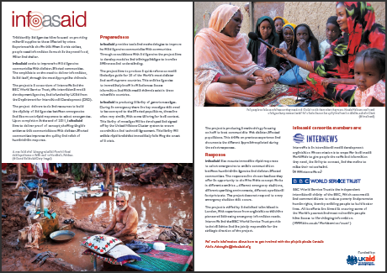
Media and communication landscape guides at http://infoasaid.org/media-and-telecoms-landscape-guides-0

Slide 11
Ushahidi: http://www.ushahidi.com/products

Slide 12
Video on BC in Haiti: communication channels
Notes:
The video looks at the broader response efforts and how BC fits within that context.
The link appears below to play.
http://www.youtube.com/watch?v=uBVM9e9Skhs or access the video at T Drive at T:\Communications\Beneficiary communications\OUTPUTS CAROLINE AUSTIN\OUTPUT 1 TRAINING MATERIAL\USEFUL TRAINING VIDEOS
Video on Haiti communication conduits and innovative ways to present information. What did the video show you? Innovative ways to present information in local transport of tap taps.

Slide 13
4. Feedback loops: build on community assets
Work with community structures or conduits as a starting point to build your feedback loop.
Conduits are people or structures which disseminate information.
Some examples of ‘conduits’ may include:
community leaders
religious leaders
Hairdressers
doctors/health care professionals

Slide 14
4. Feedback loops: tips
Have contact details of a real person – not a prerecorded message – on all print communications
take notes at all community meetings
make sure feedback and evaluations systems are in place from an early date
gather data during community meetings, outreach, or other face to face contact
record data and feedback gathered at call centres (if applicable)
recruit local people for recovery roles (if appropriate)
debrief staff in the field regularly to ensure information and knowledge is retained
don’t wait for feedback to come to you – be proactive and ask for it!
Notes:
Source Australian Red Cross Communicating in Recovery resource.

Slide 15
Module three: feedback loops in PMI / IRC Aceh programme

Slide 16
Feedback loops: Examples

Slide 17
Feedback loops: examples
Notes:
World Vision

Slide 18
Module three: building a simple communications to beneficiaries plan
Group work: Think of the programme you currently work in and brainstorm the following questions for 15 minutes with group members:
Who are the directly and indirect beneficiary audience?
What information do they need to know?
What could you build on in your programme to communicate more effectively beneficiaries?
What are the gaps in the information you currently provide?
What are some of the opportunities in your country context?
Nominate someone to present your group work - 5 minutes

