Slide 1
Beneficiary Communication
People need information as much as water, food, medicine and shelter. Information is aid.

Slide 2
Module One: what is beneficiary communication?
Beneficiary communication aims to save and improve lives through the provision of timely, relevant and accurate information and support an environment of transparency and accountability through the creation of feedback mechanisms

Slide 3
Module One: what is beneficiary communication?
Communication with beneficiaries aims to provide us with critical data about the humanitarian situation to increase the speed, transparency, relevance and effectiveness of the work we do with communities.
Equally, these communities can voice their views and concerns, and take a more active role in the decisions made by humanitarian actors. This will contribute to well-informed and better quality programming that has a greater impact on reducing vulnerability and may in turn lead to more safe and resilient communities.

Slide 4
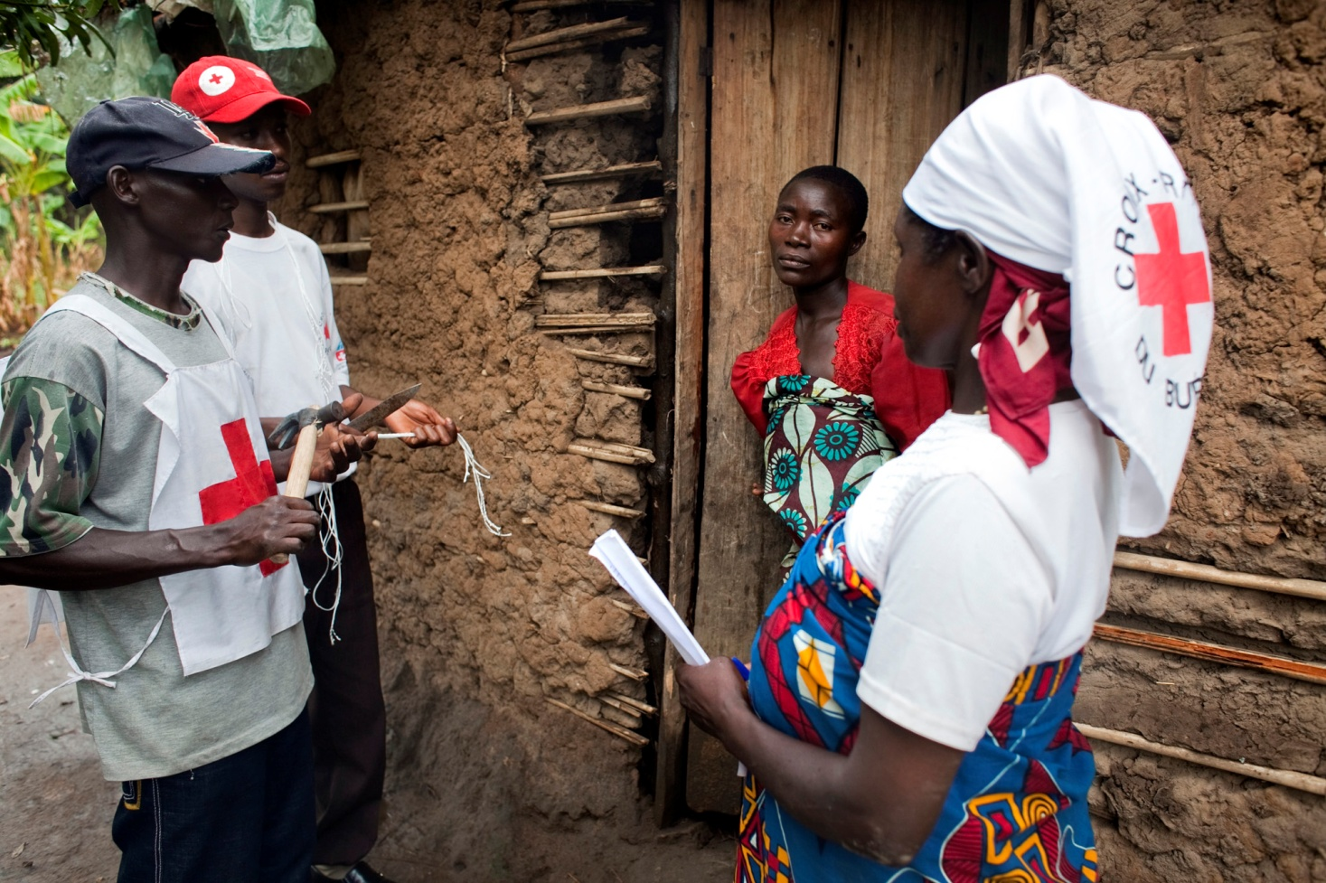
Module One: differences between one and two way communication?
Notes:
Ask people to bring their own experiences.

Slide 5
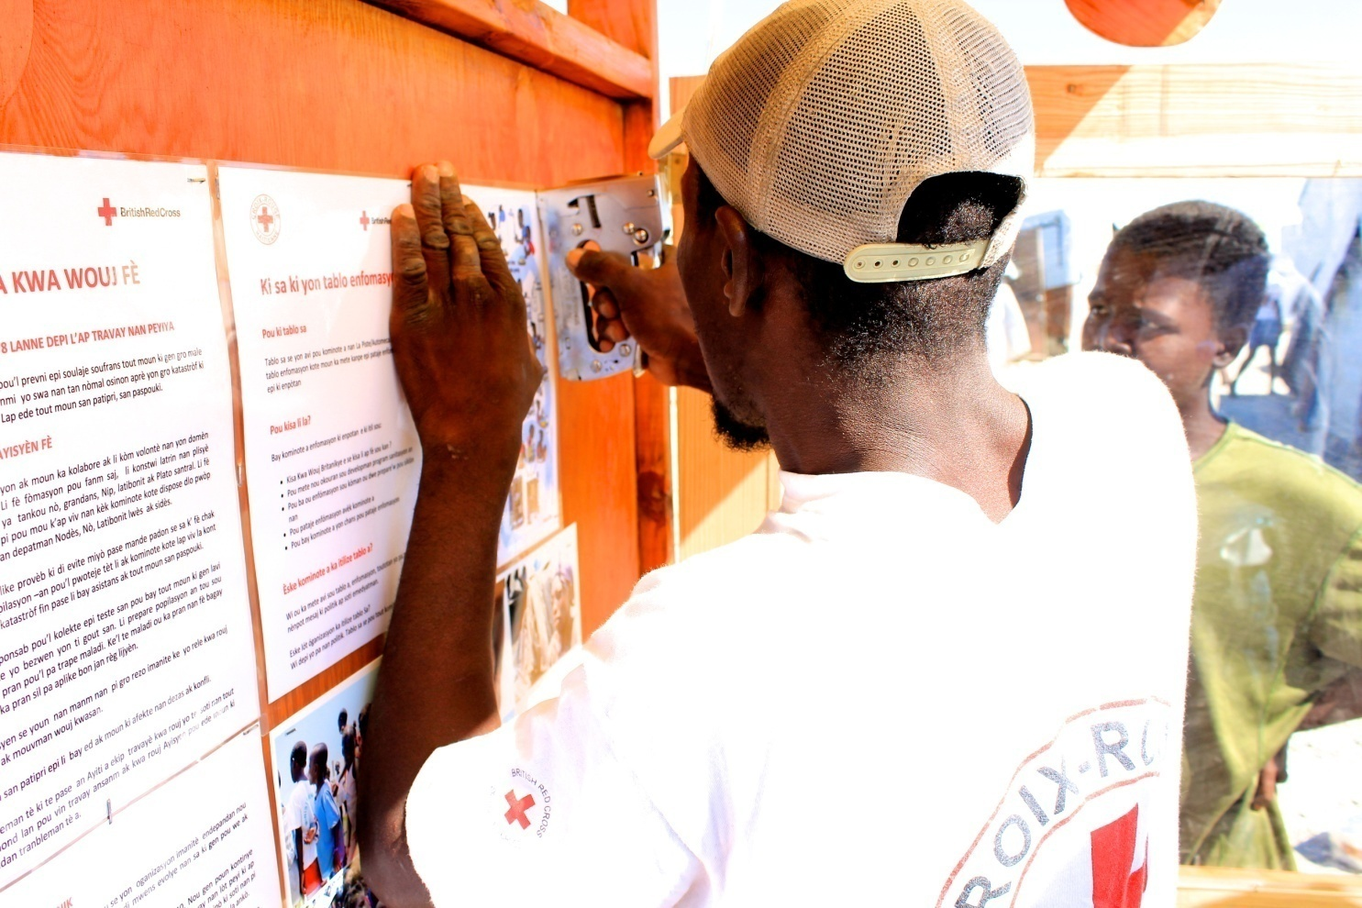
Module One: differences between one and two way communication?

Slide 6
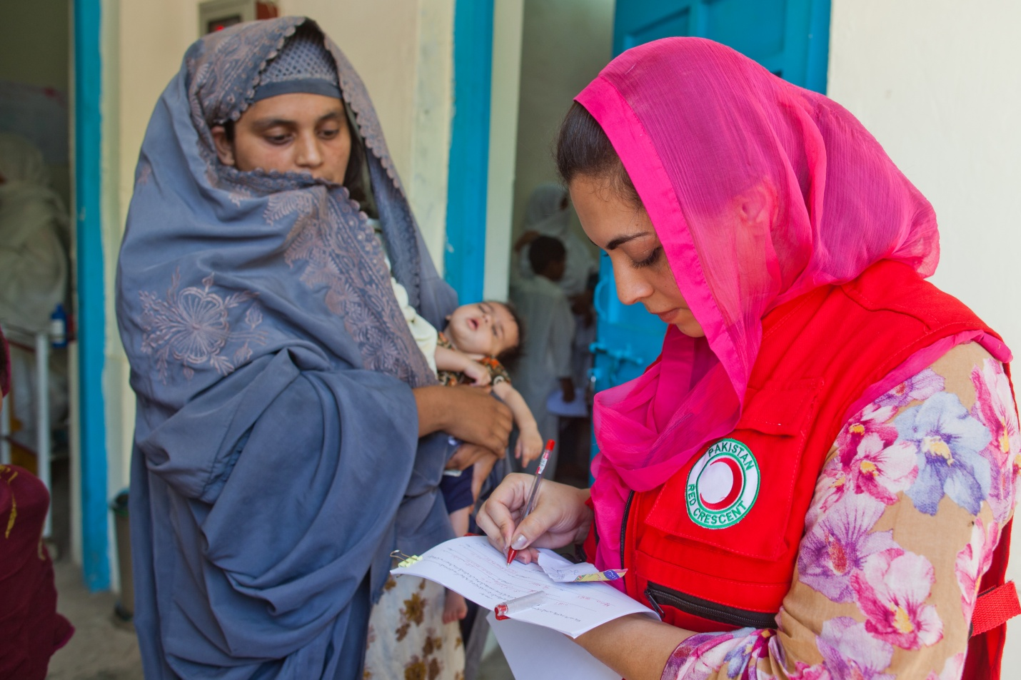
Module One: Goal of Beneficiary Communication is two way dialogue

Slide 7
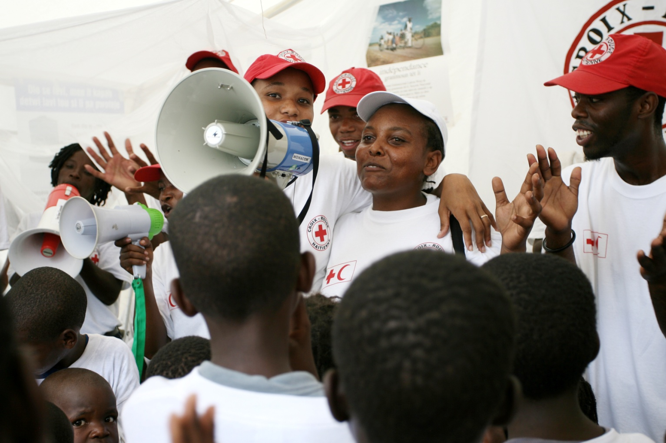
Module One: Video on one and two way communication: Haiti
Notes:
http://www.youtube.com/watch?v=WMwe4GwSGxI
Video is saved at T Drive at T:\Communications\Beneficiary communications\OUTPUTS CAROLINE AUSTIN\OUTPUT 1 TRAINING MATERIAL\USEFUL TRAINING VIDEOS

Slide 8
Module One: what is beneficiary communications?
Training activity: one and two way communication.
What are examples of one and two way communication from your programme?

Slide 9
Module one: one and two way communication: Haiti
Activity: identify one and two way communication within the video of beneficiary communications in Haiti.

Slide 10
Module one: one and two way communication: comparison
One way communication | Two way communication
Static | Interactive
Includes warnings, behavioral change messages | Includes feedback or consultation with affected communities. Having a dialogue.
Does not include a feedback loop i.e. no phone numbers or avenues to provide information to Red Cross Red Crescent | Includes a feedback loop i.e. information on how affected persons can contact Red Cross Red Crescent to provide information
Does not allow communities to feedback, complain or participate in programmes | Provides complaints or feedback mechanisms to allow beneficiaries to provide information

Slide 11
Module one: communicating across the programme cycle
Development Phase
Context | Define risks in communicating information in your context i.e. political, define as many options for communication channels as possible just in case communication infrastructure fails, consider the economic considerations and accessibly of different mechanisms.
Stakeholder | Define audience for your communications
Methods | Build up trust in your communication in the preparedness programme phase by broadcasting across peoples most preferred channels.
Information needs | Define information needs with communities pre-disaster by asking communities what they need and who needs information.
Partnerships | Are there others in your context that you can partner with or key conduits who you can channel information through?

Slide 12
Module one: communicating across the programme cycle
Emergency Phase
Context | Define channels for communicating information in your context i.e. political, define as many options for communication channels as possible
Stakeholder | Define audience for your communications
Methods | Build into disaster assessments questions that map communication channels.
Information needs | Define information needs with communities by asking communities what they need and who needs information.
Partnerships | Are there others in your context that you can partner with or key conduits who you can channel information through?

