Slide 1
Beneficiary Communication
People need information as much as water, food, medicine and shelter. Information is aid.

Slide 2
Module 5: Methods of Communication
Some examples of ways to engage and communicate with beneficiaries………
Radio
Television
Face to Face
Community meetings, community noticeboards
Sound truck
SMS system
Community and NGO scorecards (CARE)
Beneficiary lead evaluations and reviews and M&E systems

Slide 3
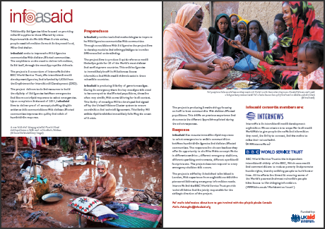
Module 5: Methods of Communication
Mapping methods: landscape and media guides

Slide 4
Module 5: Methods of Communication
Mapping methods: partnerships with other agencies in the area.

Slide 5
Wrap up
Evaluation of training
Keeping in touch and sharing ideas, methods and challenges is important…Suggestion for HOW?
Building plans for your National Society…
Today you thought or wrote down what gaps and opportunities exist
How you might assessment information needs
What tools you might use to communicate

