Slide 1
ROLL OUT of the EPIDEMIC CONTROL for VOLUNTEERS (ECV) toolkit. Dr. Azhar Halim Director, Health and Training PRCS

Slide 2
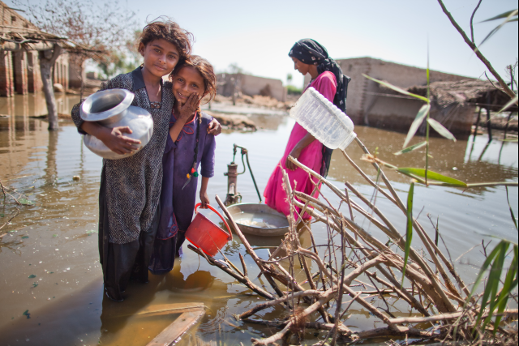
2010 FLOOD –
AGGRAVATED HEALTH RISKS IN THE COUNTRY
Notes:
2010 FLOOD IN THE COUNTRY, ONE-FIFTH UNDERWATER, 20 M AFFECTED. LACK OF CLEAN WATER, POOR SANITATION FACILITIES AND HYGIENIC PRACTICES; CHOLERA OUTBREAK; ALERTS AND OUTBREAKS OF MALARIA, DENGUE, POLIO, MEASLES, AWD, ARI, ETC. ARE PRESENT. GOVERNMENT HEALTH CARE DELIVERY SERVICES CANNOT CATER TO ALL THE HEALTH NEEDS OF THE PEOPLE WITH INSUFFICIENT HEALTH PERSONNEL.

Slide 3
PRCS MOTIVATION and INTEGRATION of ECV
CBHFA
BHUs -Health Promotion activities
Emergency Health Response – Deployment of MHUs
Notes:
PRCS motivation to roll out ECV toolkit is its strength in CBHFA volunteers that has started in 2007 and at the moment expanded in 22 districts affected by 2010 flood. The presence of BHUs with the health promotion activities at the BHU facilities and surrounding villages as well as its mobile health services that can deploy BHU health personnel for emergency health response are areas to integrate ECV which interlink with the CBHFA activities. The PRCS as member of the National Health Emergency and Preparedness Network of the NDMA created by the government of Pakistan, is in a position to support in response to public health in emergencies such as epidemic/outbreak with its network support of RCRC movement.

Slide 4
How we Started -
Introduction with Key Health Program Managers and ERU BHC team
Inclusion in the 2010 flood appeal for health plan and budget to cover 5 Branches as sub component of CBHFA programming.
Training of Trainers for ECV at national level for Branch CBHFA Coordinators, Field Health Coordinators.
Adaptation of ECV Toolkit in local context (Urdu and Sindi) and printing for the use of CBHFA Coaches and volunteers after the Branch level trainings.

Slide 5
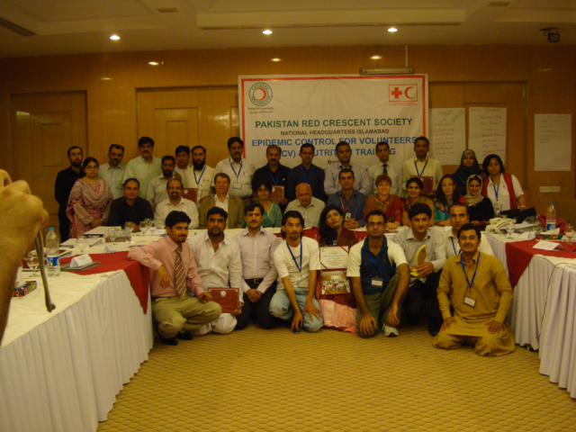
Notes:
21 PRCS Trainers trained on ECV in June 2011 with participants from 6 Branches as capacity building support to PRCS Health team.

Slide 6
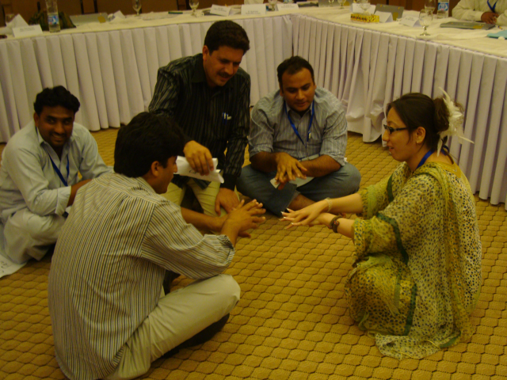
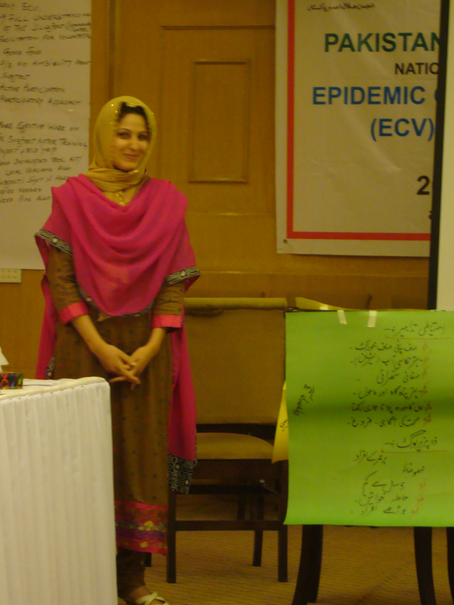
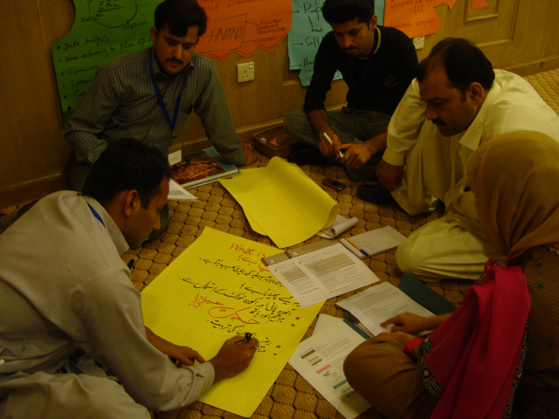
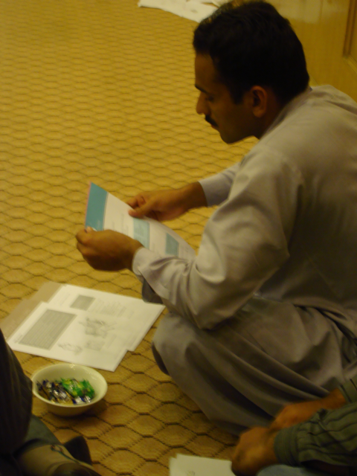
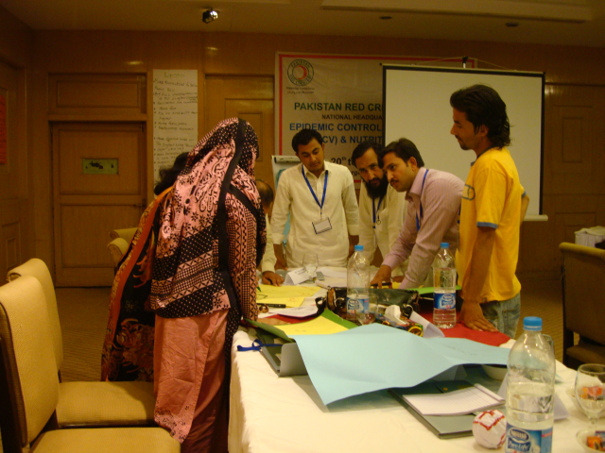
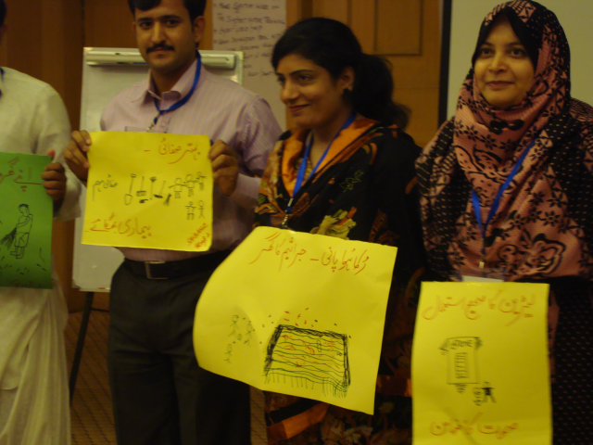
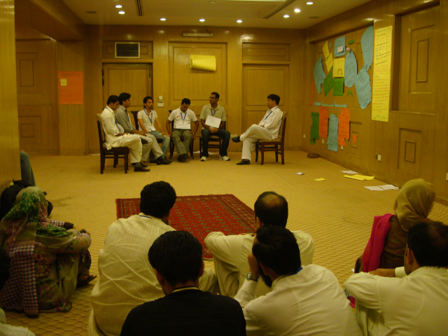

Slide 7
Roll Out ECV-
Facilitating Factors
Hindering/Challenges
Recognize as important and relevant to incorporate in PRCS Health-CBHFA programming
Presence of CBHFA Coordinators in Branches
Integration in CBHFA programming for 2010 flood integrated health interventions.
CBHFA programming as entry point to increase community awareness on epidemic control and response.
Delayed implementation of CBHFA trainings in Branches as entry point for ECV trainings.
2011 Flooding-CBHFA Coordinators involvement in relief activities
Insufficient trainings for CBHFA coaches responsible to train CBHFA volunteers.
Need for technical guidance to Branches
Rapid turn-over of CBHFA staff

Slide 8
Comments and Recommendations to ECV Toolkits and ECV Training Manual
ECV Toolkit - simple and practical tool for CBHFA/community based health workers for community sessions and actions.
ECV Training Manual - good reference for CBHFA Trainers/Facilitators to elaborate on CBHFA Training Module 5: Public Health in Emergencies-preventing and responding to epidemics.

Slide 9
Need more practical exercises – simulation exercise would be good to incorporate in a community setting; field work using the ECV Toolkits.
Strengthen NS collaboration with the Government Health/Provincial and District health
Recognize the strength of CBHFA volunteers in epidemic control.

Slide 10
Session on Volunteers and epidemic control be part of Module 3. Actions in epidemic control.
Update Facilitation skills of Trainers – to use more participatory learning methodology.
Adaptation of ECV Toolkit to local context- to select only common diseases in the country

Slide 11
FUTURE DIRECTIONS:
PRCS to develop NS Guidelines on Epidemic Control and Response
To strengthen collaboration with WHO, Provincial Health and district Health on community level-epidemic response.
Scale up the ECV training in Branches.
Incorporate in CBHFA the formation of community epidemic response teams.

Slide 12
Thank You Shukriya Dhonnobad

