Slide 1
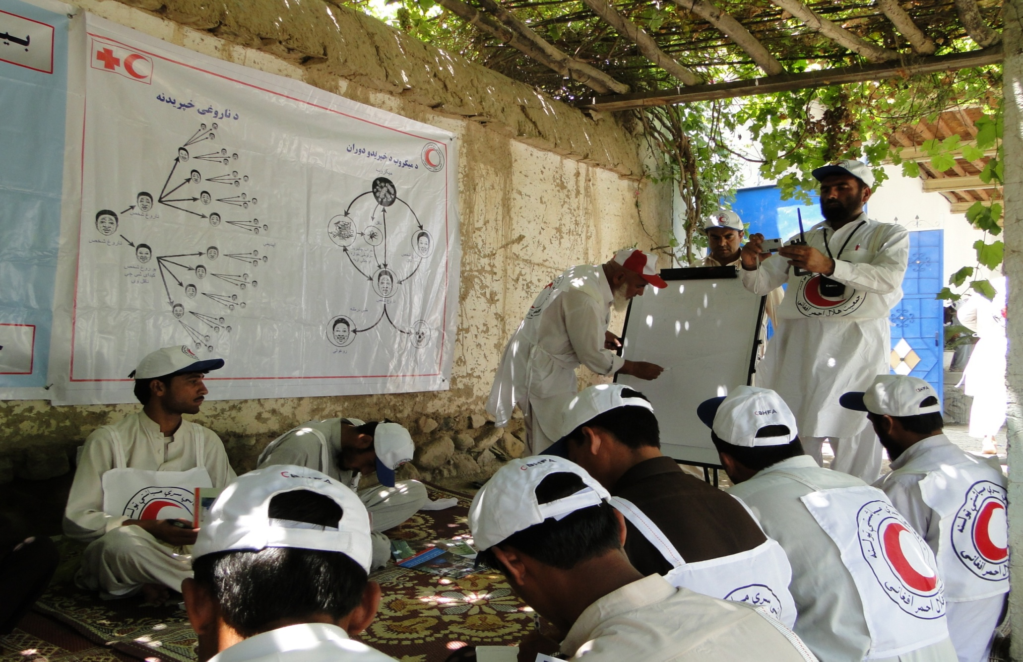
Afghan Red Crescent Society
Implementation of Epidemic Control for Volunteers
Regional Health Meeting
Dhaka-Bangladesh
60-09, March 2012
Dr Salim Bahramand ARCS Health Director

Slide 2
Afghan Red Crescent Society
Outline
Rational
Roll out of ECV
Factors
Challenge
Recommendation in training manual and tool kits

Slide 3
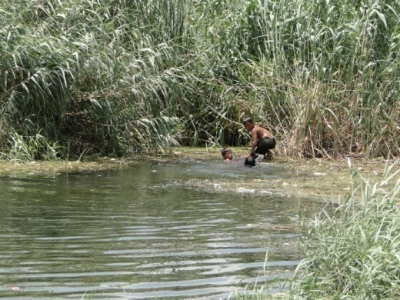
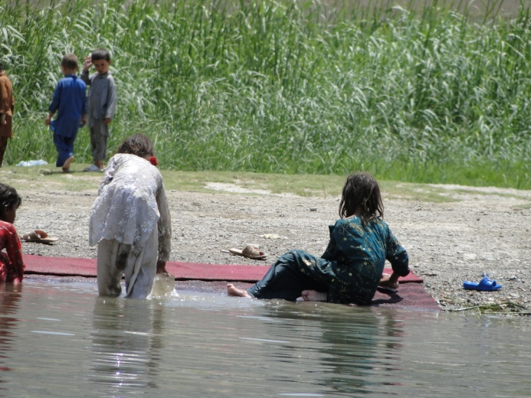
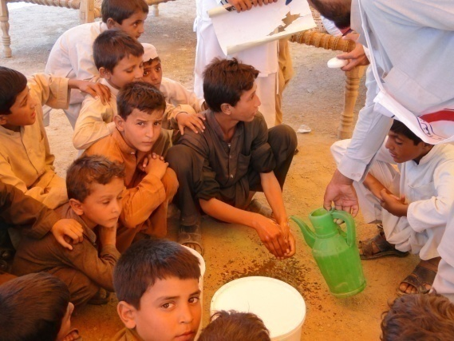
Why ECV integrated in our program?
Afghan Red Crescent Society
Frequency of epidemics and diseases outbreaks
Vulnerability of the people
lack of sanitation facilities
poor hygienic practices
low Health awareness /education
Human resource Capacity of ARCS (existence of CBHFA and youth volunteers in communities)

Slide 4
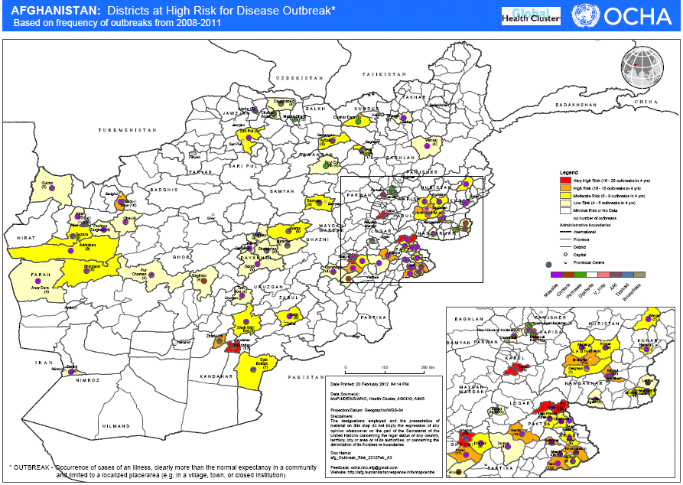

Slide 5
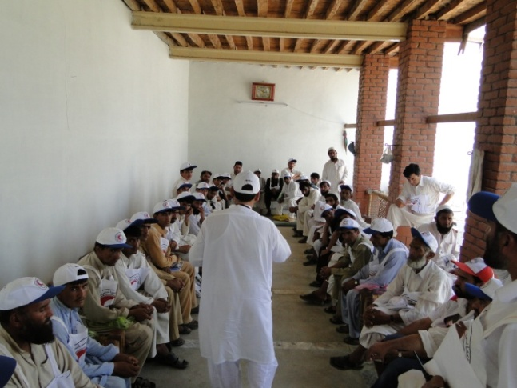
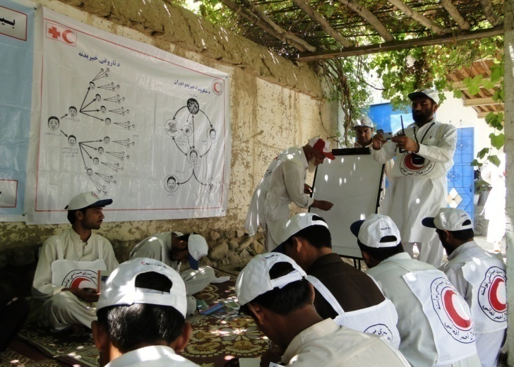
Role out of ECV
Afghan Red Crescent Society
Steps taken:
Needs assessment for conducting ECV
Adaptation of the toolkit and training manual
Translation and printing to two national languages (Dari and Pashto)
Conduct of ECV TOT for CBHFA supervisors and trainers
Conduct ECV training for CBHFA team leaders( 25) in eastern region
Training of CBHFA volunteers (75)- (focused on specific disease , action and community messages tools).

Slide 6
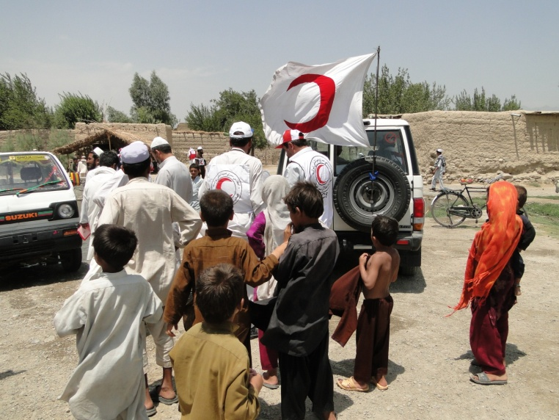
Factors helped NS rolled out of ECV
Afghan Red Crescent Society
Commitment/support of the ARCS senior management
Accessibility of the volunteers.
Good community participation in decision making for implementing of the program.
Commitment of IFRC for technical and financial support of the project.
Proper planning

Slide 7
Challenges
Afghan Red Crescent Society
Translation and printing takes time (need to prepare well in advance)

Slide 8
Recommendation in training manual and tool kits
Afghan Red Crescent Society
Some parts of the training manual as repetitive, particularly the epidemic response cycle (session 2.2 ER –cycle & M3 action in EC). The participants get confused instead learning.
The pictures of the manual should be adapted according to the context of each country
The disease toolkit should be relevant by focusing on diseases that affect the country. ( needs adopting)

Slide 9
Afghan Red Crescent Society
Thanks for your kind attention

