Slide 1
Philippine Red Cross
Typhoon Yolanda (Haiyan) Operation:
Lessons Learned

Slide 2
Presentation Outline
Haiyan Operation – Emergency Relief and Recovery
Auxiliary Role of the PRC
Challenges and Opportunities
Priorities
RCRC Movement Coordination

Slide 3
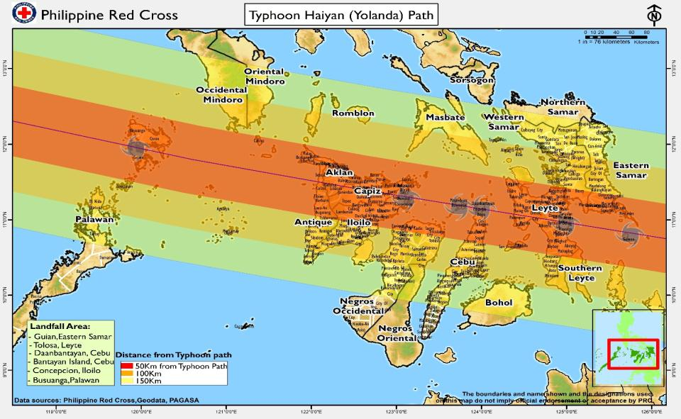
Typhoon Path

Slide 4
Typhoon Haiyan Emergency Relief
and Recovery Efforts

Slide 5
Emergency Relief
Relief | Number of families benefitted
Food items | 390,399
Jerry cans | 258,972
Blankets | 230,003
Plastic mats | 228,774
Mosquito nets | 225,522
Tarpaulin | 182,077
Hygiene kits | 180,872
Cash assistance | 90,779
Hygiene promotion activities | 59,949
Emergency Shelter Repair Kit | 46,160
Kitchen sets | 33,919
Tents | 4,594

Slide 6
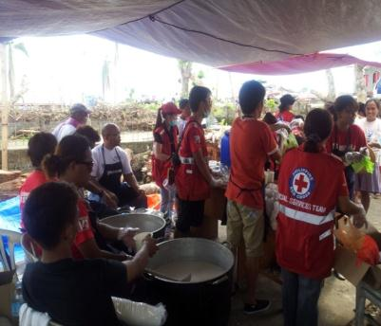
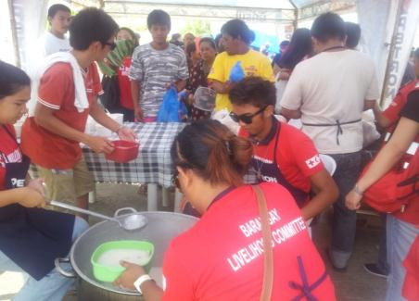
Hot Meals
162,729: Total number of people provided with hot meals.

Slide 7
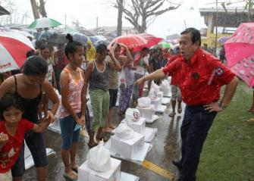
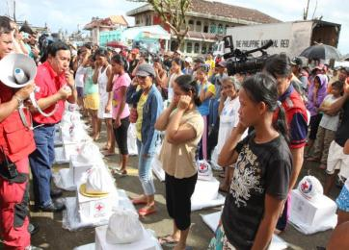
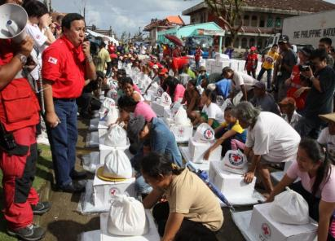
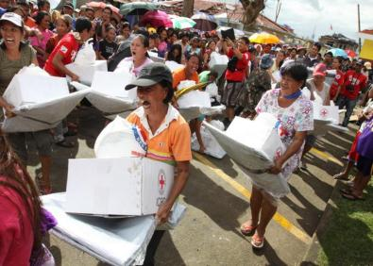
Relief Distribution
Notes:
We are transparent – barcoding and orderly distribution of goods to women with beneficiary cards

Slide 8
First Aid, Ambulance Service and other Health Care Services Provided
Chapters | First Aid Station (individuals served) | Ambulance Transport (individuals served) | Immunization (individuals served) | Health Stations/ Medical Consultation
Tacloban | 521 | 278 | 2,266
Eastern Samar | 128 | -
Western Samar | - | - | 948
Palawan | - |  |  | 1,490
Capiz | 143
Iloilo | - |  |  | 4,293
TOTAL | 792 | 278 | 3,214 | 5,783

Slide 9
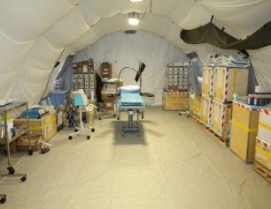
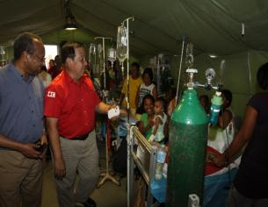
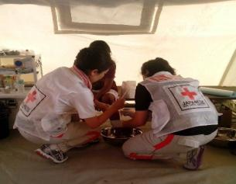
Deployed Basic Health Care Units and
Emergency Field Hospitals
Health Facilities | Area | In-Patient | Outpatient | Deliveries | Surgeries
Emergency Field Hospital | Ormoc, Leyte | 1,226 | 2,886 | 418 | 114
Basic Healthcare Unit | Daanbantayan, Cebu | 0 | 2,232 | 0 | 25
Basic Healthcare Unit | Balangiga, Eastern Samar | 0 | 6,469 | 74 | 0
Rapid Deployment EH | Basey, Western Samar | 321 | 6,669 | 101 | 209
TOTAL |  | 1,547 | 18,256 | 593 | 348

Slide 10
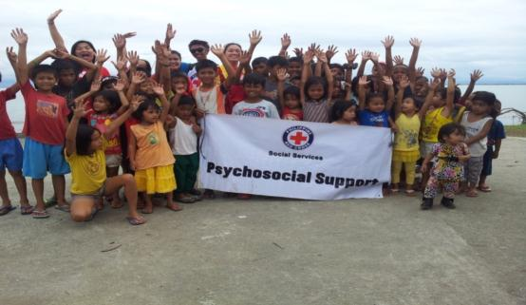
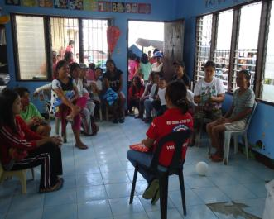
Psycho-social Support
31,539: Total number of people benefited from psycho-social support activities conducted by the Red Cross.

Slide 11
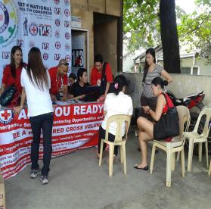
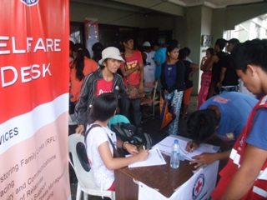
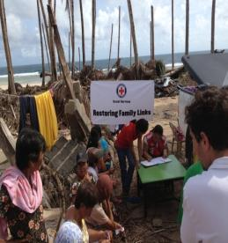
Restoring Family Links (RFL)
8,514: Total number of people assisted through Restoring Family Links.

Slide 12


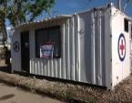

Blood Services
Blood bank refrigerator = 5 units
Provided support for equipment :
5 PRC blood facilities in Tacloban, Ormoc, Basey, Guiuan, and Daanbantayan, Northern Cebu.
5 unit bank refrigerator;
1 unit plasma freezer;
5 unit 10 KVA generator set; and
1 unit 20-footer blood station container van
Plasma Freezer = 1 unit
10 kva GenSet = 5 units
Blood Station
Container Van = 1 unit
“20-footer”
Tents = 4 units
Notes:
Change figures

Slide 13
Blood Assistance
PRC Blood Facilities | No. of Patients Served | No. of Blood Units Dispensed
5 | 1,281 patients | 1,803 units

Slide 14
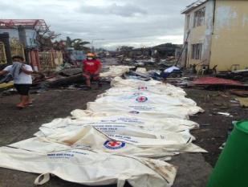
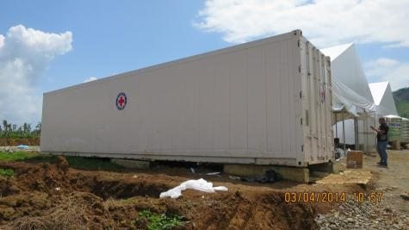
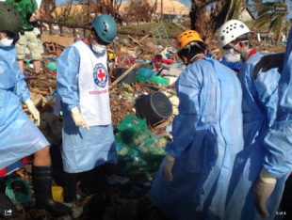
Management of Cadavers
Directly retrieved 2,668 dead bodies. Other services provided: provision of cadaver bags and deployment of Red Cross refrigerated vans.

Slide 15
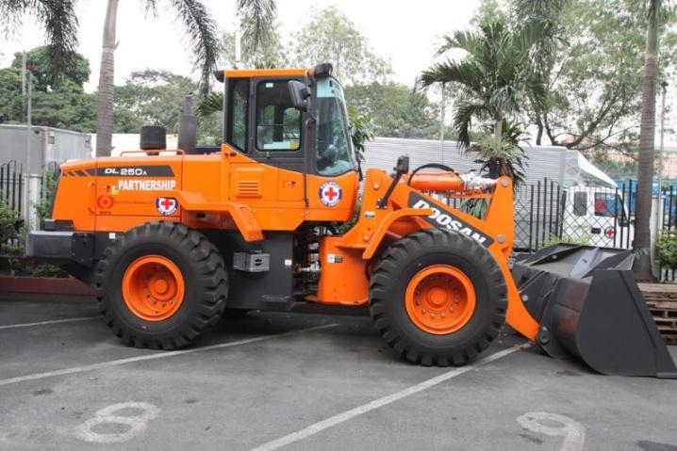
Debris Clearing
7 payloaders
22 communities were cleared; community people benefitted from the activity through cash for work and improved road access.
Notes:
As a result of clearing using the 7 PRC payloaders, more bodies were retrieved and more relief came in.

Slide 16
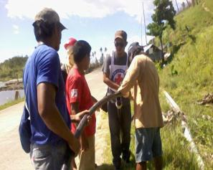
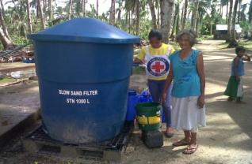
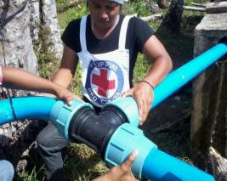
Water and Sanitation
18 million liters of water produced and distributed to the families affected by typhoon.
200,200: Individuals served with water supply activities.
16: Water Treatment Units installed producing water.
14: Water Tankers deployed supplying water in collecting points.
18.5 kilometers of water pipes installed in 13 communities
17 slow sand filters installed in 17 communities

Slide 17
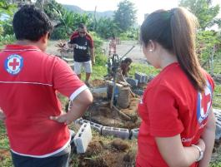
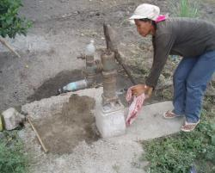
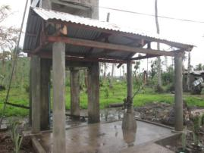
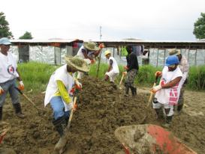
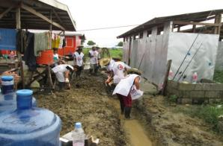
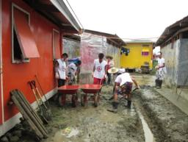
Water and Sanitation
88 hand pumps repaired/reconstructed
400 meters of drainage constructed

Slide 18
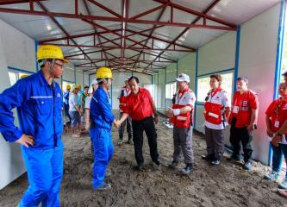
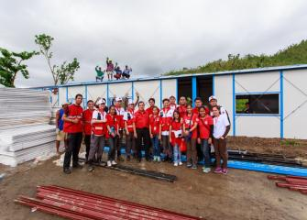
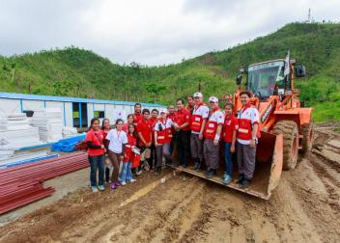
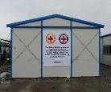
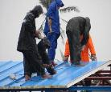
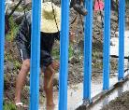
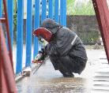
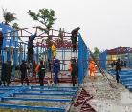
Emergency Classrooms
439 classrooms selected and 201 classrooms built

Slide 19
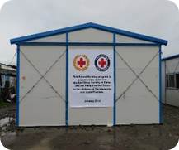
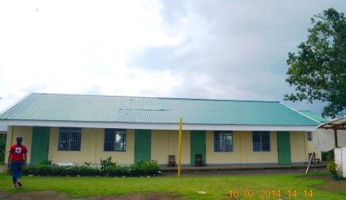
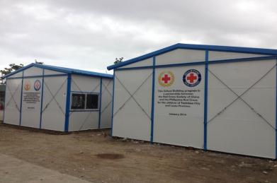
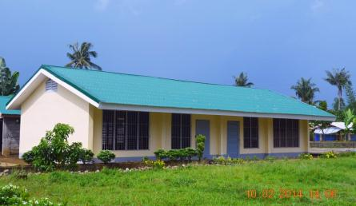
Transitional Classrooms

Slide 20
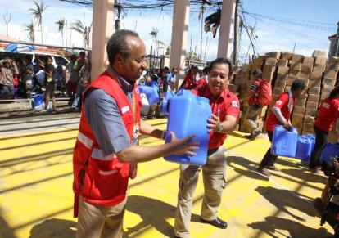
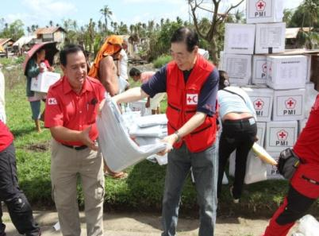
Staff and Volunteers
143 staff members involved in the operation
8,235 volunteers deployed
Notes:
Change photos

Slide 21
RECOVERY
ACCOMPLISHMENT
As of February 20, 2015

Slide 22
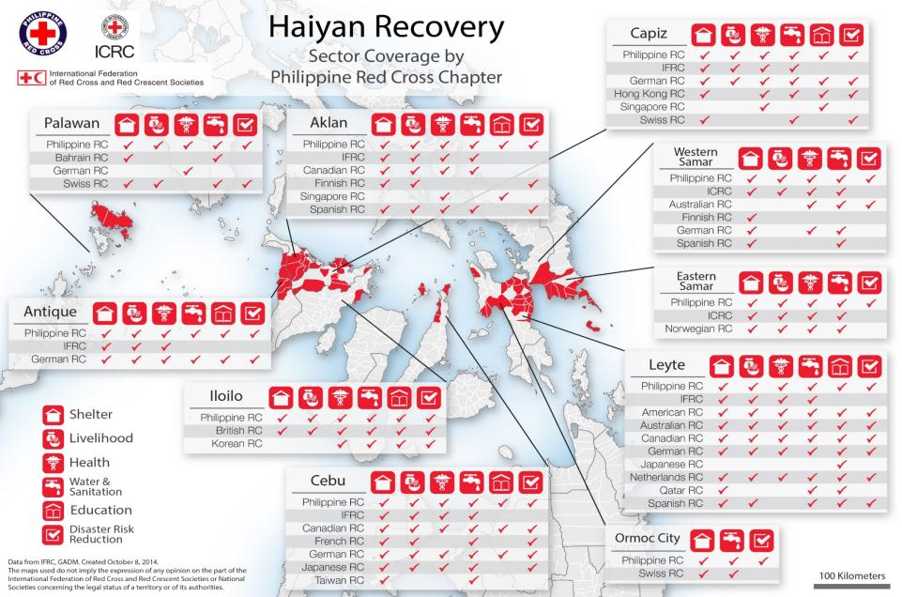

Slide 23
SUMMARY
ACTIVITY | PLANNED TARGET | COMMITMENT | ACCOMPLISHMENT | % of completion vs. Commitments
Shelter | 90,000 HH | 83,127 | 51,736 | 62%
Livelihood Support | 50,000 HH | 58,771 | 55,325 | 94%
Core Latrines | 40,000 HH | 33,252 | 2,536 | 7.6%
School Latrines | 80 units | 80 | 4 | 5%
Hygiene Promotion | 55,000 pax | 36,523 | 19,980 | 54.7%
Health Facilities | 50 units | 77 | 17 | 27%
Community Based Health and First Aid | 100 Communities | 101 | 96 | 95%%
Classrooms Built | 400 units | 439 | 204 | 46%
Students Kit | 60,000 pax | 2,500 | 2,965
Notes:
Target
Core Shelter – 33,124 households
Relocation – 128 households
33,252 households
Shelter Accomplishment
Core Shelter – 10,311 houses built
Shelter Repair Assistance – 39,900 households
Project Started
Shelter Repair Assistance – April 13, 2014
Core Shelter – May 10, 2014
Livelihood Support – April 24, 2014
Construction of classrooms
Chinese Red Cross (166 classrooms) - Emergency Phase: February 9, 2014
Spanish Red Cross ( 35 classrooms) – October 10, 2014
Construction of Health Facilities – October 31, 2014

Slide 24
SHELTER
As of February 20, 2015
A total of 51,736 houses repaired and constructed. This is 62% of our target which is 83,127.

Slide 25
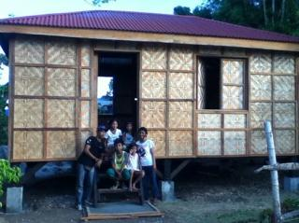
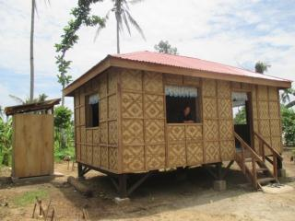
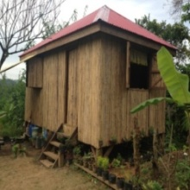
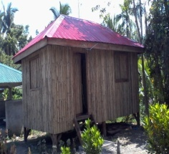
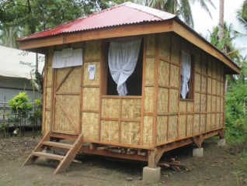
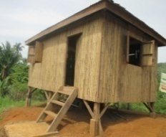
SHELTER
Wooden Core Shelter

Slide 26




SHELTER
Half Concrete Core Shelter

Slide 27




SHELTER
Shelter Repair Assistance

Slide 28
LIVELIHOOD
As of February 20, 2015
A total of 55,325 households supported with livelihood assistance. This is 94% of our target which is 58,771.

Slide 29
Coverage by Age
Mean Average Age: 55 y/o Youth (>30y/o): 17.86% Elderly (<60) 21%

Slide 30
Livelihood Group Category

Slide 31
SOCIAL VULNERABILITY CATEGORY

Slide 32
Proposal Type Category
Mean Average Proposal Amount: Php 11,343.40

Slide 33
Livestock Profile

Slide 34





LIVELIHOOD
Livelihood Support

Slide 35



LIVELIHOOD
Livelihood Support

Slide 36
WATER and SANITATION
HOUSEHOLD LATRINES
3,232 latrines linked to core shelter built. This is 10% of the target which is 31,222.
As of February 20, 2015

Slide 37
WATER and SANITATION
SCHOOL LATRINES
Completed the construction of WatSan facilities in 4 schools. This is 5% of the target which is 87.
As of February 20, 2015

Slide 38
WATER and SANITATION
HYGIENE PROMOTION
23,800 households participated in the hygiene promotion sessions. This is 89% of the target which is 24,927.
As of February 20, 2015
Notes:
Some area have over targeted because there are not direct beneficiaries participated in the Hygiene Promotion sessions.

Slide 39





WATER and SANITATION
Household Latrines Construction
School Latrines Construction
Installation of Hand-Pumps

Slide 40




WATER and SANITATION
Hygiene Promotion Sessions

Slide 41
HEALTH
HEALTH FACILITIES
Constructed 17 health facilities. This is 27% of the target which is 64 health facilities for repair/construction.
As of February 20, 2015

Slide 42
HEALTH
COMMUNITY BASED HEALTH and FIRST AID
Community Based Health and First Aid conducted and participated by 96 communities. This is 95% of the target which is 101.
As of February 20, 2015

Slide 43
HEALTH
COMMUNITY HEALTH VOLUNTEERS’ TRAINED
Trained 605 community health volunteers. This is 69% of the target which is 1,000.
As of February 20, 2015

Slide 44
HEALTH
PRC PROJECT ON HEALTH FACILITY EQUIPPING
Supported by IFRC and ADB
Province | Utrasound machine | Aneshesia machine | Ventilator (portable) | Respirator (portable) | ECG machine | Generator 6KVA | Std Eqpt for | OB/Del kits | First Aid kits
 |  |  |  |  |  |  | RHU
E.Samar | 1 | 1 | 2 | 2 | 1 | 6 | - | 507 | 304
Leyte | 6 | 4 | 4 | 4 | 4 | 17 | - | 556 | 418
Ormoc | - | - | - | - | - | 3 | - | 166 | 103
W.Samar | - | 1 | - | - | 1 | 5 | - | 203 | 204
Total Qty | 7 | 6 | 6 | 6 | 6 | 31 | - | 1432 | 1029
77 health facilities ( 60 RHU’s, 17 District Hospitals) identified to be provided with equipment
(16 in E. Samar, 46 in Leyte, 6 in Ormoc, 9 in W. Samar)
As of February 20, 2015

Slide 45





HEALTH
Brgy. Ginuban, Lawaan, Eastern Samar
Brgy. Abaca, Dagami, Leyte
Brgy. Catadman, Basey, Western Samar

Slide 46


HEALTH
Brgy. Tanza Sur, Panay, Capiz
Brgy. Timpas, Panitan, Capiz

Slide 47








HEALTH
Immunization
Medical Consultation
Nutritional assessment
Nutrition Month

Slide 48
EDUCATION
As of February 20, 2015
Built 204 classrooms with ongoing construction of 25 classrooms.
Distributed 2,965 students kit.
.

Slide 49







EDUCATION
Classrooms repaired/ constructed

Slide 50
Auxiliary Role

Slide 51

PRC’s Auxiliary Role
Republic Act 10072- Philippine Red Cross Act
“The Philippine Red Cross shall be recognized as the voluntary, independent and autonomous nongovernmental society auxiliary to the authorities of the Republic of the Philippines in the humanitarian field to assist said authorities in discharging the obligations set forth in the Geneva Conventions and the Statutes of the International Red Cross and Red Crescent Movement.”
Notes:
Red Cross as an auxiliary to the Government. We ar emandated

Slide 52
AUTHORITY AND LEGAL BASIS
RA 10072 – Philippine Red Cross Act of 2009
Section 4, Paragraph e:
“(e) To establish and maintain a system of national and
international relief in time of peace and in time of armed conflict and apply the same in meeting emergency needs caused by typhoons, floods, fires, earthquakes, and other natural or man-made disasters, and to devise and carry on measures for alleviating the suffering caused by such disasters”.
Notes:
The authority under which the Philippine Red Cross (PRC) assumes responsibility for the relief of disaster victims is reflected in Republic Act 10072, Section 4, Paragraph e:

Slide 53
RCRC Movement Coordination
in the Philippines

Slide 54
Movement Wide Operational Framework
Purpose
Key Elements
  Pillar One – Shared Operational Priorities
  Pillar Two – Working effectively together
  Pillar Three – Quality and Accountability
Consultation
Process for finalization
Notes:
Purpose
This Framework is a strategic guide for all of us.
based on spirit of the Joint Statement “Red Cross/Red Crescent Movement Response to Humanitarian Needs after Typhoon Haiyan (Yolanda)” signed by the Philippines Red Cross (PRC), the International Federation (IFRC) and the International Committee of Red Cross (ICRC) in November 2013, guided by each of the Movement components’ vision and strategy, the Framework will guide at the strategic level the development of the overall plan of action of the Typhoon Haiyan Operation.
Key Elements
Pillar One – Shared Operational Priorities – this guides what we do, where we do it, how we do it.
Pillar Two - Working effectively together – how we work together to maximise our impact, how we engage with external actors (government and other actors) – how we speak with one voice
Pillar Three - Quality and Accountability – common standards and guidelines – reflect the Philippines.
Consultation
We are finalizing the Framework based on the draft you have plus your thoughts, contributions and feedback from the next 2 days.
The final MWOF document will be agreed with PRC and ICRC and shared with all Movement partners by the end of February 2014.

Slide 55
Movement Wide Operational Framework
Movement-wide Operation Framework
(MWOF)
PRC Yolanda
Recovery Plan
Local Partners
IFRC
Strategic
Operation/
POA
ICRC
Bilateral partners

Slide 56
Movement Wide Operational Framework
Pillar 1 Shared Operational Priorities
The Five Recovery Elements
Pillar 2 Working Effectively Together
Effective Movement Coordination Mechanism
Pillar 3 Ensure Quality and Accountability
Quality Programming
Humanitarian Diplomacy Strategy
Integrated Delegate Model
Transparency
Accountability
Risk Management
5 F’s Recovery Principles
5 One’s
5 Ways to Enhancing PRC Capacity
5 Integrated Programmes
5 Strategic Documents

Slide 57

Pillar 1
Shared operational objectives, priorities and common approaches.
5 Recovery Elements
5 Strategic Documents
5 F’s Recovery Principles
5 One’s – Ways of Working Together
5 Ways to Enhancing PRC Capacity
5 Integrated Programmes
Notes:
The 5 F’s is an approach that is familiar to all of us in Philippine RC.
Global research is suggesting there are common features in successful recovery operations – we have combined these two – we want them to become familiar and to guide our recovery work. This how they fit together for us.
Focused
Successful recovery focuses on people’s own recovery and is complimented through community based support.
Successful recovery focuses on a common and comprehensive recovery picture.
Successful recovery focuses on integrated planning, partnership and effective two way communication at all levels.
Fast
Successful recovery provides assistance in a timely, fair and coordinated manner and ensures flexibility.
Friendly
Successful recovery responds to community needs and is conducted at the local level.
Successful recovery supports and recognises the wide range of needs and capacity of groups within a community.
Flexible
Successful recovery recognises the changing nature of disasters and communities and how their needs change over time.
Forward looking
Successful recovery is an opportunity to plan for the future and build back better.
Successful recovery capitalises and builds on the strength of volunteers.

Slide 58





Pillar 1 cont’d
5 Strategic Documents
Notes:
The 5 Strategic Documents that guide us are as follows.
The PRC Strategy highlights four main goals: significantly reduce the impact of disasters, climate change, public health emergencies and illnesses; improve health and well-being; reduce unnecessary suffering form armed conflict and other forms of violence; and, ensure that the PRC is a well-functioning National Society.
IFRC Strategy focuses on four core areas: promotion of the Movement’s Fundamental Principles and humanitarian values; disaster response; disaster preparedness; and health and care in the community.
The ICRC Strategy is ---
The Philippine Government’s existing DRRM and CCA frameworks guide us in our DRRM activities (i.e. preparedness, prevention, mitigation), as well as in mainstreaming climate change adaptation.
The Movement developed a draft Operational Framework for Typhoon Haiyan. This is built around focusing on operational priorities, working effectively together, and ensuring quality and accountability.

Slide 59






5 F’s Recovery Principles
● Focused ● Friendly ● Forward -
● Fast ● Flexible Looking
Notes:
PRC also developed what we call the 5Fs for the Recovery Principles.
Focused, Fast, Friendly, Flexible, and Forward Looking.
Focused – We must focus on empowering communities as they are at the center of everything we do. We must keep our focus as well on a common understanding of the recovery picture – we have a plan, we should stick to it.
Fast – We should provide assistance in a timely, effective, inclusive, fair, and coordinated matter.
Friendly – We should be one with the community. We respond to their needs, as well as include them in our activities. Support and recognize the wide range of needs and capacities of each sector within a community.
Flexible – Recognize the changing nature of disaster risks and how community needs change over time.
Forward Looking – Opportunity to plan for the future and build back better. Enhance capacities of the PRC to better anticipate, respond, and adapt to similar situations in the future.

Slide 60
Pillar 1 cont’d
5 One’s – Ways of Working Together
One Red Cross in Typhoon Yolanda Recovery means:
One Lead
One Plan
One Team
One Approach
One Report
Notes:
PRC shall be the lead in this Recovery. We will all follow one plan, developed by the Movement partners. With this, we will act as one team. In all our areas, we will have one approach, preventing comparisons. Last, we will follow one reporting mechanism, that will later on help us in monitoring and evaluating our programme.

Slide 61


Pillar 1 cont’d
5 Ways to Enhance PRC Capacity - Volunteers
Taking an innovative approach to supporting communities through the Red Cross 143 volunteer programme
Notes:
We will strengthen our Red Cross 143 programme in the different communities, schools, and workplace.
Red Cross 143 = minimum of 1 leader + 43 members
They will be first to prepare, first to know, first to report, first to respond, and first to provide relief, recovery and rehabilitation.

Slide 62

Pillar 1 cont’d
5 Ways to Enhance PRC Capacity – Facilities
PRC chapter ‘reengineering’ to enhance local level support to communities
Notes:
Our local chapters should be improved and updated in order to have a more effective and efficient service delivery. This can be in terms of improving the facility, providing equipment and training.

Slide 63

Pillar 1 cont’d
5 Ways to Enhance PRC Capacity - Learning
Establishment of PRC academy to strengthen expertise in disaster management
Notes:
We are also planning to establish an academy of the PRC, wherein we will conduct leadership, management and technical trainings in the different PRC services.

Slide 64



Pillar 1 cont’d
5 Ways to Enhance PRC Capacity - Modernization
Prepositioning of disaster management and logistical equipment that is critical for response in an island nation
Equipping with tools
Notes:
Prepositioning of relief stocks and equipment in strategic areas will contribute for timely and efficient response, especially as the Philippines is a disaster-prone area. With our experiences especially in for 2013, wherein we experienced typhoons, flooding, armed conflict, and earthquake, we depleted our stocks and this affected our response operation. That is why we are planning on building up more regional warehouses to preposition stocks, as well as replenish stocks in our central warehouse.
Likewise, as our chapters are the front-liners on the ground, they should be well-equipped.

Slide 65

Pillar 1 cont’d
5 Integrated
Recovery Programs
Shelter
Livelihood
Education
Health, Water and Sanitation
DRRM and PRC Capacity Enhancement
Notes:
Our programmes should include the integrated 5 major sectors. We are aiming for a holistic approach. Then, with Red Cross 143, we will be able to build safe and resilient communities.

Slide 66
Pillar 1 cont’d
To ensure community resilience, we must deliver integrated programs.
Shelter, livelihoods, health and risk reduction programming are intrinsically linked.
Poverty that existed before the typhoon is holding communities back from recovering.
More detailed assessments are required.
Consider environmentally sensitive solutions.

Slide 67
Pillar 1 cont’d
6. Scale up PRC chapter capacity and Red Cross 143 .
7. Geographic targeting
8. The greatest needs and the most actors are in Leyte but there will be gaps.
9. Engagement with external partners is vital.
10. Sustainable impact will come from investment in livelihoods and shelter provision, complimented by health and WatSan.

Slide 68
Pillar 2 – Working Together Effectively
Movement Platform Group
Strategy, External Relations, Leadership
Movement Coordination Meetings
Operations, planning, information sharing
Technical Working Groups
Implementation, Coordination, Integration of technical & thematic areas at headquarters and field level
Notes:
Movement Platform Group
Tasks:
Ensure planned activities are communicated to PRC and implemented with the consent of PRC.
Address key issues arising from the humanitarian response by individual and/or collective Movement components which may put the PRC operation at risk.
High level external representation of Movement components within the Philippines according to our respective mandates and ensures internal and external communication is consistent.
Ensure a unified approach to the humanitarian response.
Ensures the operation is implemented in accordance with the revised “Principles & Rules”.
Movement Coordination Meetings
Tasks:
Ensures awareness and conformity by Movement partners to Movement/Federation policies, principles and standards.
Shares needs analysis and assessments, PRC operational strategies - including Movement component engagement and integrated programming.
Works to ensure a Federation wide approach, in support of the PRC Plan of Action and the implementation of the Federation Wide Reporting System (FWRS).
Commissions and receives reports on Performance and Accountability as required.
Technical Working Groups:
Tasks:
Discuss and agree operational strategies (based on input from Field TWG’s) for proposal to and adoption by PRC leadership, IFRC, and ICRC, as relevant.
Promotes and ensures integrated approaches to programming and PRC support.
Ensures coordination between Movement components, according to their respective mandates with government departments, UN agencies, NGOs and other actors at Manila and field levels, and identifies key emerging issues which should be addressed at the MCM.
Monitors adherence to guidelines, procedures, and cooperation modalities for programme and project management and implementation.
Monitors progress, including identification of risks and challenges, coordination needs, and effective and efficient use of Movement resources for the duration of the operation and ensures communication flow with senior management of PRC, IFRC, and ICRC, as needed.

Slide 69

Pillar 3

Slide 70


What Went Well
Clear vision, strategy and priorities
Notes:
Our operations went well because we are guided by our Clear Vision and Strategy.
We are directed by our priorities.
Focused, fast, friendly, flexible, forward looking
Communicating our objectives
Example: the suitcase for disaster response
*

Slide 71

What went well
Wide network of active volunteers
Notes:
Volunteers in nearby chapters are organized and trained
Volunteers from other chapters were mobilized to assist in the operation
*

Slide 72

What Went Well
Overwhelming Support.
“RC/RC Partners in the region contributed in
reaching the disaster affected population.”
Notes:
*

Slide 73

What went well
Strategic and long-term partnership
Notes:
Long-term partnership established.
With existing partnership agreement with IFRC, ICRC and PNS
*

Slide 74

What went well
Capacity to mobilize our resources
Notes:
human, material, technical, financial resources at the local and regional
Acquired and mobilize new resources beyond the usual red cross response ( example: satphones, payloaders, water plants, etc despite logistics challenges
*

Slide 75




What did we learn
Notes:
We got to know our neighbours much better in terms of their skills, technical capacity and attitude and also how to work with them. We knew what they had and we understood how they operate.
discovered the great potential, opportunity and Capacity to mobilize resources within the region.
We got insight on how our partners work and what they can offer.
*

Slide 76


What did we learn
Notes:
clear objectives, if your objectives are not clearly communicated you will loose control and leadership, they will stream roll you and take over. You need to be firm, be flexible at a later stage, not at the onset. You know what you want, you know your context be firm and present your case.
We have a unique role, as a Movement, to become actively engage in advocacy in armed coflict situation (cease fire). If we don’t do it we may loose it. Let’s find out what we can do to become more relevant in this area.
*

Slide 77

What did we learn
Notes:
Alerted partners before the disaster happened. Invest time, effort in preparedness.
*

Slide 78



What needs to be improved
Mobilization of regional RC/RC disaster response tools
Notes:
Have frameworks in place (coop, operation, coordination) We did not know before that these things could be pre-cooked. Agree on how to work together before we need to work together inside the RC/RC and beyond.
* Coordination – with the number of global tools that was deployed coordination becomes a nightmare
- it affected the capacity of the PRC to coordinate
- it operates in silos with the rest of the tools thereby missing the chance of
integrated response support to beneficiaries
* NEEDS of the Operations vs push from external for some partners to be seen operationally
* Deployment of some tools did not consider what is the existing capacity within the PRC—what materials are available i.e WATSAN
* RDRT members of the PRC were not mobilized to have joint assessment with FACT
- RDRT is marginalized and underutilized
- RDRT was deployed too late . RDRT was not considered a priority tool in this operation
*Importance of the role of the IFRC supporting the NS in coordinating the response
* Deployment of global tools should be based on the needs of the beneficiaries and the gap in the capacity of the NS.
* Deployment of global tools should not be driven by external push from back donors to be seen operationally-it erodes not only the capacity of the NS but it also erodes accountability- silos and redundancy
* When ERU’s are deployed it should not necessarily connote the entire package- it could just mean personnel and not equipment i.e. WATSAN
* Global tools deployed should ensure that it brings on board the capacity of the NS- not just the capacity that they are bringing in but takes note of what is existing within the NS and integrate it into the tool itself
*

Slide 79


What needs to be improved
Notes:
Prepare for scenarios that you don’t even imagine
Admit we need help, understand that we can not do things alone, we need partners (including affected people) We need to improve the way we work externally (e.g. organizing the local volunteers)
*

Slide 80

What needs to be improved
Notes:
Better mapping of who is who and what can they do
Become better at understanding regional capacities an focus RC/Rc work on building local capacity for response and community level
Identify opportunities for strategic partnerships (association, churches, etc)
*

Slide 81

What needs to be improved
Coordinated and planned support
Notes:
-International assistance should be based on needs and agreed upon
Standard should also be disseminated to donors
*

Slide 82

Coordination and Partnership
NS Joint Statement
Notes:
2 days after Haiyan made a landfall, PRC, ICRC and IFRC signed the joint statement in order to ensure coordination of the movement in the response
*

Slide 83

Coordination and Partnership
NS Joint Statement
Notes:
2 days after Haiyan made a landfall, PRC, ICRC and IFRC signed the joint statement in order to ensure coordination of the movement in the response
*

Slide 84

Coordination and Partnership
Notes:
Haiyan Coordination Meetings are held everyweek during the height of the operation. It became a bi-monthly meeting the past months.
From Jan 2015, it is now scheduled on a monthly basis
*

Slide 85

Coordination and Partnership
Notes:
In order to ensure coordinated response, partners are assigned in a specific area implementing one plan in a standard set by the PRC.

Slide 86
Way Forward
-“We must not compete with one another. Let us work as one.
Remember: One team, One Plan, One Red Cross”
Notes:
By working together effectively, we can make this Society stronger as a result of this operation
Let us use this operation as an opportunity to make our NS stronger!
“The strength of our joint efforts must surpass the force of any disaster!
Our message is One Team, One Plan and One Action!

