Slide 1
Typhoon Haiyan
Comparative media and social media
monitoring report
From 5 to 12 November – Two years on

Slide 2
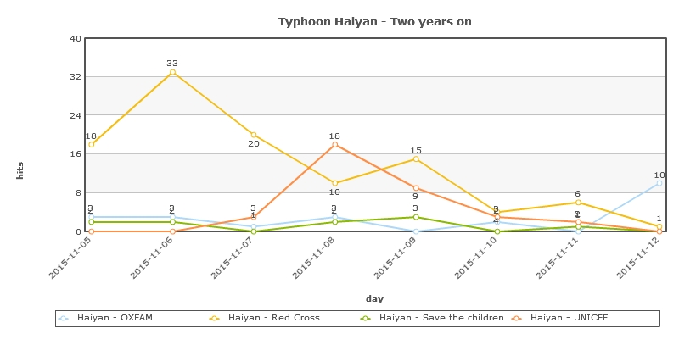
Media outreach – Key figures
KEY FIGURES
From 5 November to
12 November
Red Cross
107 hits vs 200 hits for the one year anniversary
UNICEF
35 hits vs 190 hits for the one year anniversary
OXFAM
22 hits vs 100 hits for the one year anniversary
Save the Children
10 hits vs 300 hits for the one year anniversary

Slide 3
Media outreach – Key messages- Red Cross
Two years after a super typhoon devastated the Philippines and sounded a global alarm on climate change, a massive rebuilding programme has had big successes but at least one million survivors are still without safe homes. The Red Cross, for example, said it had given cash assistance to more than 90,000 families and rebuilt or repaired 65,000 homes. (AFP) (Gulf Times) (Kuwait Times) (NDTV)
Amid Typhoon Haiyan recovery, some feel they are left behind. Mother-of-five Merove Angelino, meanwhile, bought two pigs with a 10,000 pesos cash grant from the Red Cross as the family found it hard to survive on her husband's 150 pesos a day from casual farm work and the small amount she got doing laundry. (Reuters)
Almost 80 percent of the projects/interventions undertaken by the Philippine Red Cross in Yolanda affected areas in Leyte was accomplished two years after the super typhoon struck the region. The accomplishments include humanitarian intervention through emergency assistance, shelter, livelihood, WASH, health and Education. PRC Chairman Richard Gordon reported that of the 66, 011 homes built for typhoon Yolanda victims amounting to Php2.2 billion, half of these equivalent to 30, 000 homes were completed in Leyte. (Philippine Information Agency)
The chairman of the Philippines Red Cross describes the struggle the country faces against an increasingly hostile climate. (BBC News)
"The success of our Haiyan operations would not have been possible without the support of our partners in the Red Cross Red Crescent (RCRC) Movement and private partners who have generously contributed to help alleviate the suffering of those whose lives have been affected by Typhoon Haiyan. Because of the massive destruction cause by Haiyan, there was also a massive outpouring of support that came to us that helped restore people’s lives and dignity,” said PRC chairman Richard Gordon. (inquirer.net)
Al Jazeera English [In her live report, Al Jazeera reporter Jamela Alindogan said she mentioned the Red Cross Movement operation on Haiyan, citing figures from the press release and additional info from Kate Marshall.
Keywords
Climate change
Cash assistance
Repaired homes
Shelter
Livelihood

Slide 4
Media outreach – Key messages
UNICEF – Save the Children - OXFAM
Key messages UNICEF:
On the second anniversary of Super Typhoon Haiyan, the United Nations Children's Fund (UNICEF) has commended the significant progress made in recovery and rehabilitation efforts in the Philippines, but remains concerned about the unmet needs of children and their families, some still living in temporary housing. "The two year anniversary of Super Typhoon Haiyan marks tremendous progress in recovery and rebuilding efforts," said Lotta Sylwander, UNICEF Representative in the Philippines. "UNICEF commends the great efforts invested by the government, civil society and communities to help children and families get back on their feet." In a ceremony held in Tacloban City with development and humanitarian partners, Ms. Sylwander recognized the community efforts that went into ensuring that children are healthy, safe and protected. (NNN-UNNS)
Key messages Save the Children:
Two years into the response, serious work has been done, and a lot has changed. Save the Children has reached close to 900,000 people, including half a million children with lifesaving aid and rehabilitation assistance. We have distributed families food and clean water; provided primary health care; repaired schools and health centers; and provided families and children with the much needed shelter and livelihood assistance. Behind the numbers, we see children whose lives have been changed. Save the Children will continue to support some of the most vulnerable children and their families as they get back on the feet. (Rappler)
Key messages Oxfam:
“While developed countries continue to hesitate in providing much needed support to enhance adaptation actions, particularly vulnerable and poorer developing countries like the Philippines continue to bear the brunt of the destructive effects of climate change,” says Shubert Ciencia of Oxfam in the Philippines, a senior member of the Philippine delegation to the UN climate talks. “Rich countries, who have historical responsibility in causing climate change, must help developing countries who are suffering the most from its adverse impacts to cope and enhance their resilience,” he added. (The Guardian)
Keywords UNICEF
Children
Temporary housing
Keywords
Save the Children
Live saving aid
Repaired schools
Clean water
Keywords OXFAM
Climate change
Developing countries

Slide 5
Media outreach – Comparative Analysis
Analysis:
The Red Cross has been the most visible on the media scene to mark the two years anniversary of typhoon Haiyan. The Red Cross focused mainly its messages on recovery programs and achievements such as providing cash grants to affected families so that they could rebuild their lives. Another key message delivered by the Red Cross and which has been shared widely by the media is the one on rebuilt/repaired houses. “The Red Cross has so far built and repaired more than 65,000 homes, reaching 80 per cent of the target of 80,000 houses”, this message has been relayed by many media outlets. The chairman of the Philippines Red Cross, Richard Gordon did also an interesting interview on BBC speaking about the struggle the country is facing against an increasingly hostile climate.
OXFAM, UNICEF and Save the Children have been much less visible on the media scene than the Red Cross.
OXFAM focused its main message on how the Philippines continue to bear the destructive effects of climate change. “While developed countries continue to hesitate in providing much needed support to enhance adaptation actions, particularly vulnerable and poorer developing countries like the Philippines continue to bear the brunt of the destructive effects of climate change,” says Shubert Ciencia of Oxfam in the Philippines, a senior member of the Philippine delegation to the UN climate talks. (The Guardian)
UNICEF maintained its line on children. Even if UNICEF recognised the significant progress made in recovery and rehabilitation efforts in the Philippines, UNICEF is still concerned about the needs of children and their families, some still living in temporary housing. That was its main message for the two year anniversary of Typhoon Haiyan.
Save The Children has reached close to 900,000 people, including half a million children with lifesaving aid and rehabilitation assistance. Save The Children main message relies on this main figure quoted by few media.

Slide 6
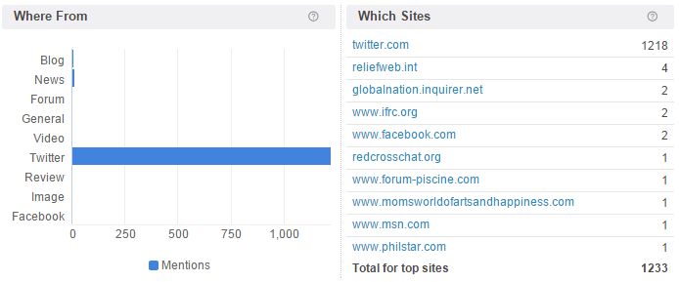
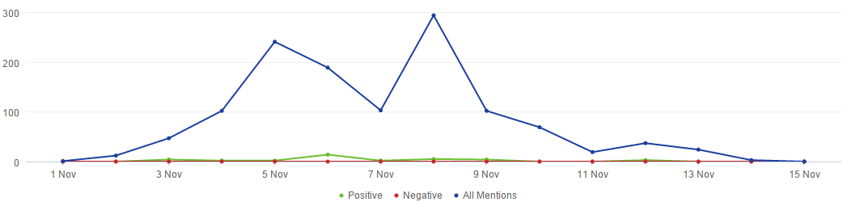
Social media analysis - traffic
A total of 1,243 online mentions of the Red Cross Red Crescent in association with Typhoon Haiyan were shared between 05 and 12 November. Most of these were on Twitter. These include the bespoke Red Cross Red Crescent hashtag #RisingFromHaiyan

Slide 7
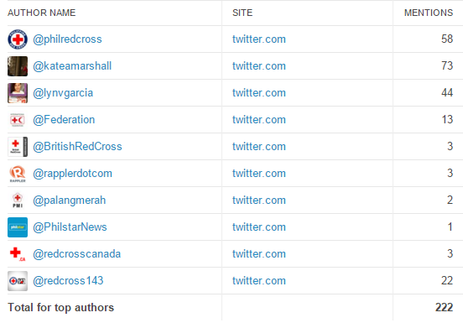
Social media analysis – top authors
Here is a list of the top Twitter accounts that have been active during the reporting period, ranked by level of influence. Philippine Red Cross appears to be by far the most influential user.
Among external users are Philippines-based online media outlets like Philstar News and Rappler.

Slide 8

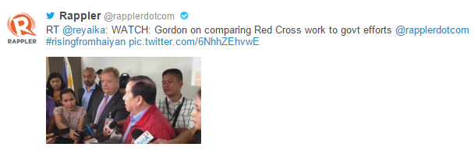


Social media analysis – top content
Here is some of the most popular content shared both by Movement and external users. Interesting to note the opinion piece shared by Philstar, in the context of widespread criticism of humanitarian orgs involved in the response, praises the work done by PRC.
Also worth noting that the first five most popular tweets sent by the Philippine Red Cross alone have generated almost 3 million impressions.

