Slide 1
Tips on Facilitating and Managing Training

Slide 2
Key objectives of this session
At the end of this activity, the participants are able to:
Explain the concepts of training and learning as these relate to their experiences
Explain the principles of adult education
Describe the different training methodologies and aids available to different training situations
Discuss the important considerations and processes involved in managing a training activity.

Slide 3
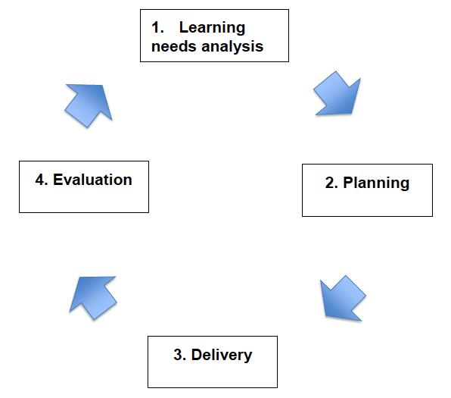
The Training Cycle

Slide 4
Training and Learning
Definition of Training:
It is the art of facilitating the transfer of knowledge, skill and/or attitude to people who will utilize what they learn to change/improve their behaviors/performance.
Definition of Learning:
It is the process of acquiring new ideas, knowledge, skills and attitude to effect changes in behavior/performance.

Slide 5
Four major components / elements of a learning / training situation
The Trainer / Facilitator
Participants or trainees
The subject matter
The learning / training method

Slide 6
Adult Learning Principles and conditions
When they enter the session room, they bring along:
A wealth of experience, knowledge and skills
Armed with their own beliefs, values and convictions
“Adult learners are motivated, not taught to seek newer knowledge, skills and behavior”
“Adult learner is the richest resource in the learning process”

Slide 7
Characteristics of Adult Learners
No one directly teaches adults anything
What is being taught should have a personal meaning for adults and should be relevant to their needs and problems
While adult learners want to be independent, they also enjoy functioning interdependently
Learning is a cooperative and collaborative process
Learners have feelings as well as thoughts
Learning is maximized where what learners SAY reflects what they THINK and FEEL
Notes:
CHARACTERISTICS OF ADULT LEARNERS
Pursue training with a sense of purpose
Have some relevant knowledge or skill
Are motivated by goals
Want training to relate to the real world
Need to have theory immediately applied to practice

Slide 8
Characteristics of Adult Learners
People learn best as a result of EXPERIENCE
Learning is a REVOLUTIONARY process
Learning is not imposed, it is a Developing and Evolving process

Slide 9
How do people learn?
Test have shown that:
People remember
20% of what they hear
40% of what they hear and see
80% of what they discover for themselves
“I hear and I forget, I see and I remember, I do and I understand” - Confucius

Slide 10
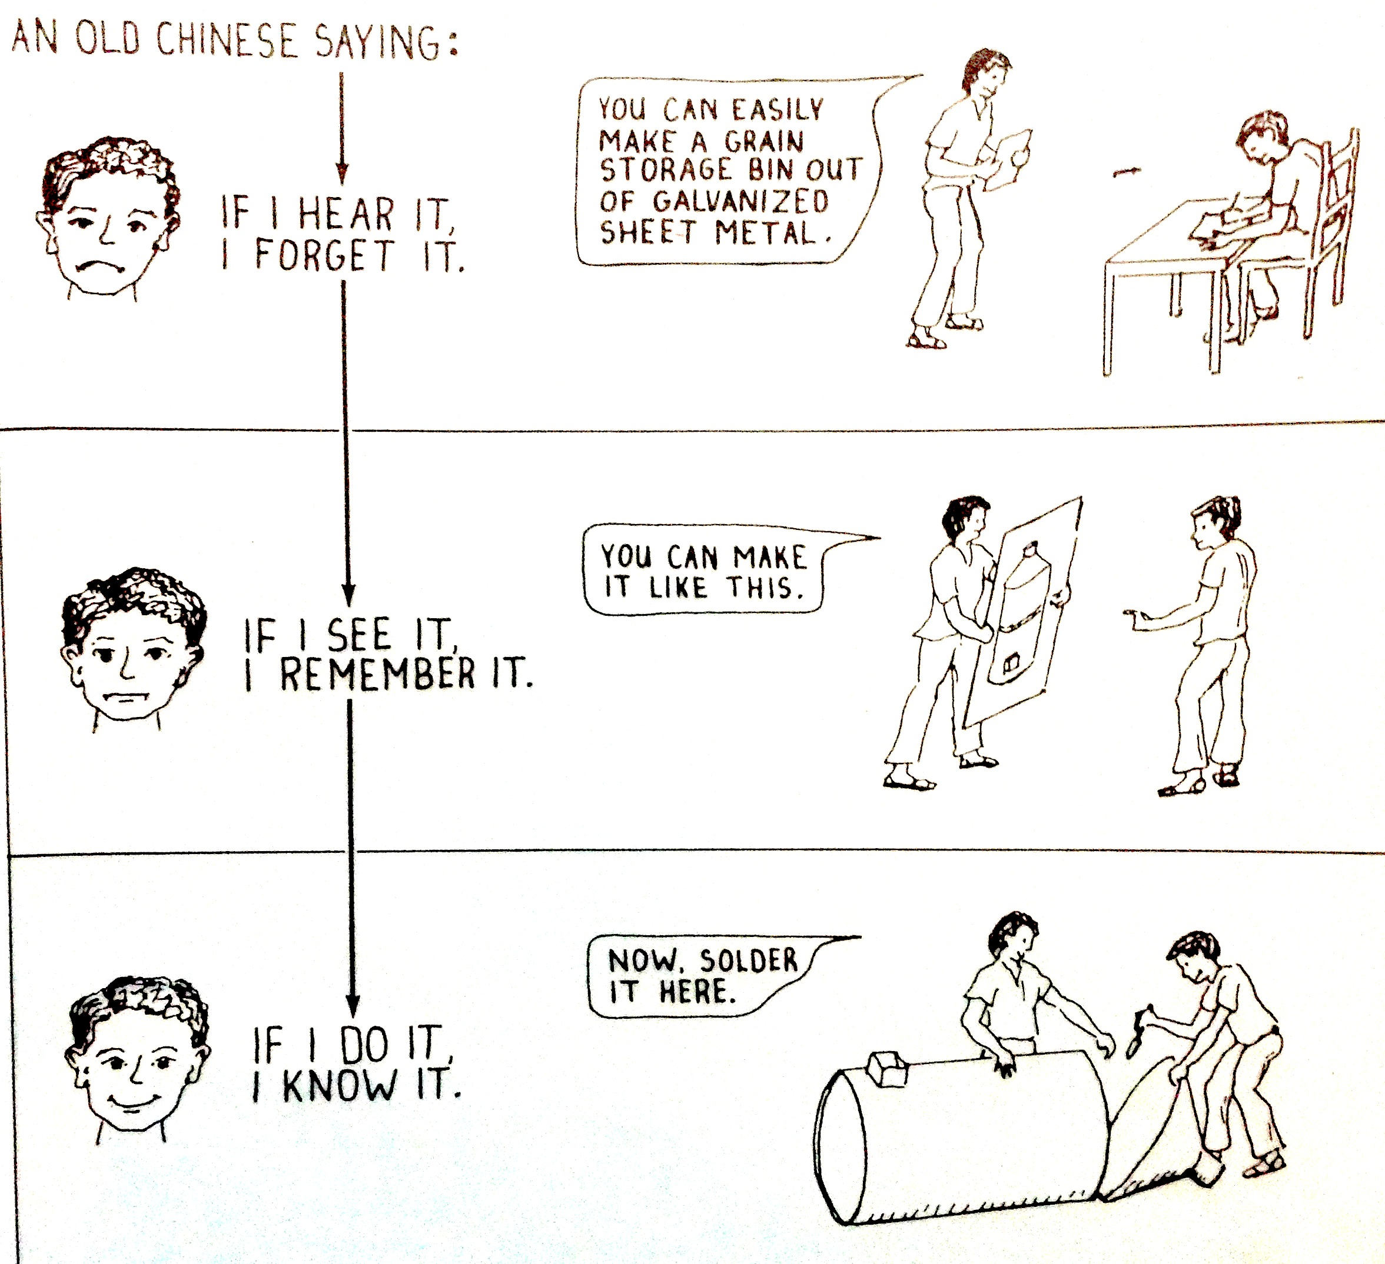

Slide 11
What prevents ADULTS from learning?
Being afraid of criticism
Span of time since last formal learning session
Negative memories of earlier training experiences
Difficulties in taking tests and/or receiving feedback
Balance between workload, personal priorities and training

Slide 12
What works best in Training?
True-to-life examples and data
Having individuals share with trainees
Real-world case studies

Slide 13
Two Schools of Thought in Learning

Slide 14
Teacher versus Trainer
TEACHER TRAINER
Presents information Guides discussion
Provides the right answers Provides the right questions
One-way communication Two-way communication
Gives assignments Coordinates learning activities
Dictates objectives Molds group’s goals
Teacher-centered Learner-centered
Gives examinations/grades Evaluates trainee reactions

Slide 15
Training Needs Assessment (TNA)
Definition:
Determination, by variety of methods, of the needed knowledge, skills, values and orientation, experiences, and perceptions of the target trainees in a given training. (Franco, 1991).
Ideal KSA – Actual KSA = Gaps (Ycasiano, 1991)

Slide 16
Objectives of doing TNA
Get to know the participants and the organization;
Participants:
Number
Age group
Sex
Educational background
Work experience
Status
Expectations from this training/after the training
Organizational culture
KSA level

Slide 17
Objectives of doing a TNA
Organization:
Needs & problems
Resources available
Vision, mission, goals
Programs & services
Structure
Plans after the training
Define focus/stress of training activity
Choose appropriate methodologies
Present other non-training options

Slide 18
TNA Methodologies
By ASKING > Questionnaires: checklists, rating scales
> Informal interviews w/ target pax
> Group consultations
By OBSERVING community/PO/agency members in social interaction > Personal
> Filmed
By STUDYING > PO/agency files, records, reports
> Organizational structure & policies
> Program plans
> Work samples
> Performance appraisals

Slide 19
Some observed TNA myths
TNA can only be done using the participant information form.
TNA is done only on the target participants.
It is only the trainer who knows what training will fit the needs of the requesting organization.
It is only the requesting organization who knows what training should be given by the training organization.
TNA is conducted only before an actual training.

Slide 20
The Training Design and Module?
TRAINING DESIGN:
It is a defined sketch or plan that starts with specifically formulated statements of training objectives and how such objectives might be satisfied within a given timeframe through a set or sets of interrelated activities that employ a number of instructional methods and techniques and other training aids.
TRAINING MODULE:
It represents a set or unit of interrelated activities in a training program which stands for a given terminal objective.

Slide 21
Setting Objectives
An objective is a statement that describes:
What the participants will be able to do as a result of the training
What the expected output shall be at the end of training
Importance of an objective:
To know where you are going. Provide structure for specific stages of a session
To know when you have arrived
To provide basis for evaluating the effectiveness of the training
To allow the trainer to select the most appropriate instructional methods, content and materials
What the expected output shall be at the end of training
Notes:
Training course aims are:
• Used to indicate the overall purpose of a course
• Usually long-term and expressed in rather general terms
• Do not say what participants will actually be learning and achieving at specific points
A common phrase used before listing course objectives: ‘By the end of the session, participants will have/ will be able to…’
The crucial point is that you identify exactly what the participants are to achieve by the end of the course/session. Once your aim and objectives are clear you can then move to more detailed planning, selecting content, identifying the best training methods, gathering resources needed and deciding what success looks like and how you will monitor this.

Slide 22
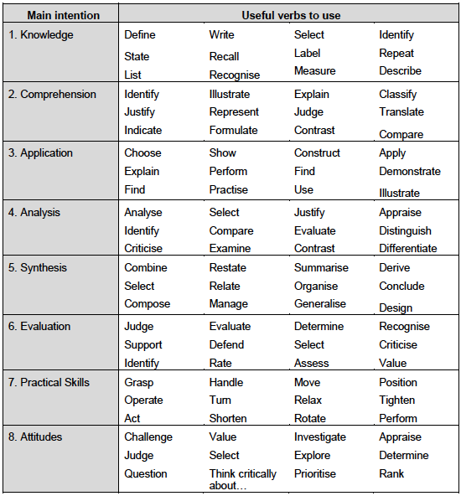
Commonly used words for objective setting?
Notes:
One way of setting objectives is through using the acronym ‘SMART’.
SPECIFIC They state exactly what you aim to achieve and to what extent
MEASURABLE So you will know whether you have been successful
AGREED So that your trainees have a stake in what they are learning
REALISTIC That is, they are capable of being achieved
TIME-BASED So that there are specific timeframes structuring the process

Slide 23
Training Methodology and Technique - definitions
METHODOLOGIES – refers to the main channel of communication & inter-action adapted in studying and learning.
TECHNIQUES – are the various devices that can facilitate the learning process.
TWO METHODS:
Non-group based – lecturing
Group-based – buzz groups, SLEs, etc.

Slide 24
Criteria for choosing training methods:
How comfortable the trainer feels with the method
Objectives of the lesson
Background & interest of the trainees
Time available to conduct the lesson
Physical set-up of the training
Number of trainees
Trainers’ relationship with the trainees
Trainers’ relationship with one another

Slide 25
Some of the most common training methods

Slide 26
Some principles governing application methods
Almost all training methods have comparative advantages and disadvantages.
There is no such thing as the training method.
Choice of method should rest on the good judgement of the trainer.
A combination of training methods in a training module would result in heightening the learning impact.
Training aids and media are not training methods.
Source: HRC, Dept. of Psychology, Ateneo de Manila University

Slide 27
Principles of visual aids
KISS & KILL
KISS = Keep It Short and Simple
KILL = Keep It Large and Legible

Slide 28
Types & description of training materials
FLAT Materials
Flip charts
Puzzles
Pictures
Flannel
Chalk board
Magnetic board
Plywood board
Charts & graphs
Posters
Discussion Materials
Lecture papers
Case studies
Mass Media Materials
Newspapers/magazines
Brochures
Leaflets
Illustrated story/comics
Audio-visual Materials
Sound slides
Films/documentaries
Folk-based Materials
Songs
Games
Creative literature
Puppet shows
Dramas/skits

Slide 29
Pre- , Actual and Post-Training checklist
After the training design / course content has been completed, the trainer is now ready for its implementation.
In order to get the most of the training / learning situation, the trainer may find the following checklist as important guide.

Slide 30
Pre-Training Checklist
What is the training for?
Determine the training needs in relation to the organization program needs and job needs of the person to be trained.
Consider timeliness of the training program.
State the specific objectives of the training. (The more specific statement of the objective, the greater is the clarity of the intended behavioural outcome.)
Consider the behavioural outcome (knowledge, attitudes or skills) expected of the trainees as results of the training.
Consider location or site of training.

Slide 31
Pre-Training Checklist
Who will be trained?
Know background information on the trainees (e.g./ age, sex, previous training or level of academic attainment, work experience, interests, special characteristics, etc.)
How many?
Have they been informed about the training?
Do the participants in the training program understand and accept the objectives of the training?
Do the trainees see how the training will benefit them in the successful performance of their job?
(Note: the training must meet the job needs of the trainees)

Slide 32
Pre-Training Checklist
What will be the content of the training program?
Select the training program content in relation to the training needs and objectives.
Arrange the training content in the order that will facilitate effective teaching-learning activities.

Slide 33
Pre-Training Checklist
What training methods will be used?
Choose the training methods that will make possible the attainment of the objectives of the training.
Keep in mind the behavioural outcomes identified for the training and determine the method or methods that can be effectively used to achieve these.
Whatever methods will be used must be considered in the light of practicability, economy, availability of resources, ability of the trainer to use the method effectively and other practical considerations.

Slide 34
Pre-Training Checklist
Who will do the training?
Selection of best trainers and resource persons.
Select trainers and resource persons who can do the best job of teaching.
Resource persons should be briefed in advance about the training, its oobjectives, participants, etc. So that they can plan and prepare appropriate teaching materials.
Resource persons should be made to see how their particular teaching activity fits into the total training program.
Assign a person or a training team who sees to it that the training program is being implemented as planned.
The central person takes charge of overseeing, coordinating training activities.
Assessing clear tasks and coordination with the team.

Slide 35
Pre-Training Checklist
Have detailed arrangements been made?
Decide when and where the training sessions will be held.
Prepare realistic and appropriate time schedules and follow them.
See to it that all resource persons and trainees know the schedule.
Having meeting places, instructional facilities and equipment ready.
Make sure meeting places are well arranged and comfortable as circumstances permit.
Arrange for appropriate record keeping, recognition of trainees (if these are expected of the training program arrangement); also “coffee breaks”
Arrange for field trips in advance; make contacts for visits to specific places, if needed.
Watch out for details that may have been overlooked in early stages of planning the training program and correct accordingly.

Slide 36
Pre-Training Checklist
What Materials to prepare?
Be certain that you secure the needed materials and equipments for effective conduct of training from the introduction down to the closing. Have materials assembled for distribution and enough copies are provided for everyone. A checklist of these items would be helpful and review it before each session.

Slide 37
Pre-Training Checklist
Have adequate funds for training been provided for?
Cost of course development
Training costs have to be computed taking into consideration such items such as: venue – food and accommodation, transportation/per diem of staff/trainers, allowance for training materials, honoraria/travel cost of resource persons, travel cost needed on training (i.e., field trips, exposure, etc.); administrative cost such as supplies, materials and equipments, miscellaneous and contingency.
Consider number of trainees
Consider number of trainers and resource persons cost
Consider length of time for training
Financial capacity if the office / program giving the training
Miscellaneous cost and contingencies.

Slide 38
Training Proper
Monitoring and Evaluation of activities
Monitoring program of activities and progress.
Find out the trainees’ reactions to the training sessions or activities. A post meeting reaction sheet may be prepared for this purpose.
Encourage suggestions or comments from the trainees and trainers.
Make adjustments or revisions, if necessary, in the training program.
Evaluate the training in terms of the specific
Conduct process evaluation, including course content, sessions, lectures, training methods, arrangements.
Preparing for day-to-day activitites
Liaising with resource persons and participants.
Controlling expenses and use of funds

Slide 39
Post-Training Checklist
Has a program of following up a trainees in their work situation (post training evaluation) been provided for?
Find out the applicability of what trainees have learned in the training to field conditions.
Obtain information on which the base decisions for improving future training programs.
Conduct terminal evaluation.
Making training completion report, including financial report.
Following up participants.
Conducting impact evaluation.

Slide 40
Key Messages
Adult learners attend training with various experience and expectations
it is best to learn the techniques of being a trainer than being a teacher
different training methodologies apply to different training situations
there is no such thing as “the training method”

