Slide 1
Youth Development in Southeast Asia
SEAYN /APYN, Action Plan
Youth Empowerment Project through YABC
Youth Engagement Strategy

Slide 2
Southeast Asia Youth Network
Evolved from Youth Directors & Youth Leaders Meetings for several years;
Sub regional Network to APYN with definition
(1) to advocate for SEA Youth as a whole,
(2) to ensure equal participation of both staff & volunteer &
(3) to encourage youth initiatives
in the OD & Youth Forum in Kuala Lumpur, Malaysia (2013).

Slide 3
Structure

Slide 4
Linkage to APYN
APYN
Steering Committee
EA (1 member)
SA(1 member)
Coordination Committee
EA(2 members)
SEA(1 member)
Pacific(1 member)
SEAYN Coordination Team (YL)
SA(2 members)
SEA (2 members)
Pacific(2 members)
SEAYN Coordination Team (2 YL)

Slide 5
Strategic Function
Opportunity
Explore opportunity & peer to peer support through resource mobilization
Project
Develop regional project
Platform
Promote sharing of information, knowledge & best practice
Dissemination
Provide update to NS & regional leaderships and youth trend (both zonal & regional) to youth community
Discussion
Jointly identify & discuss the youth related issue

Slide 6
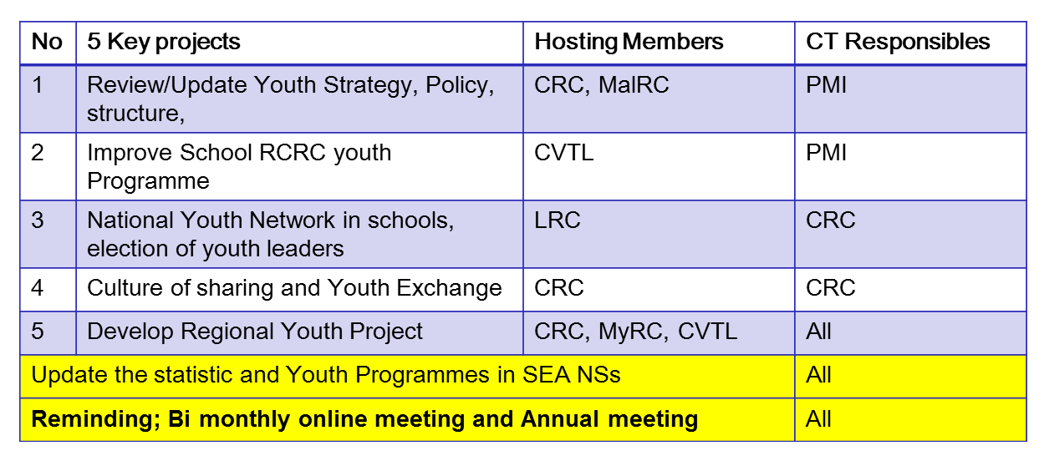
Key Action Plan 2013-2014

Slide 7
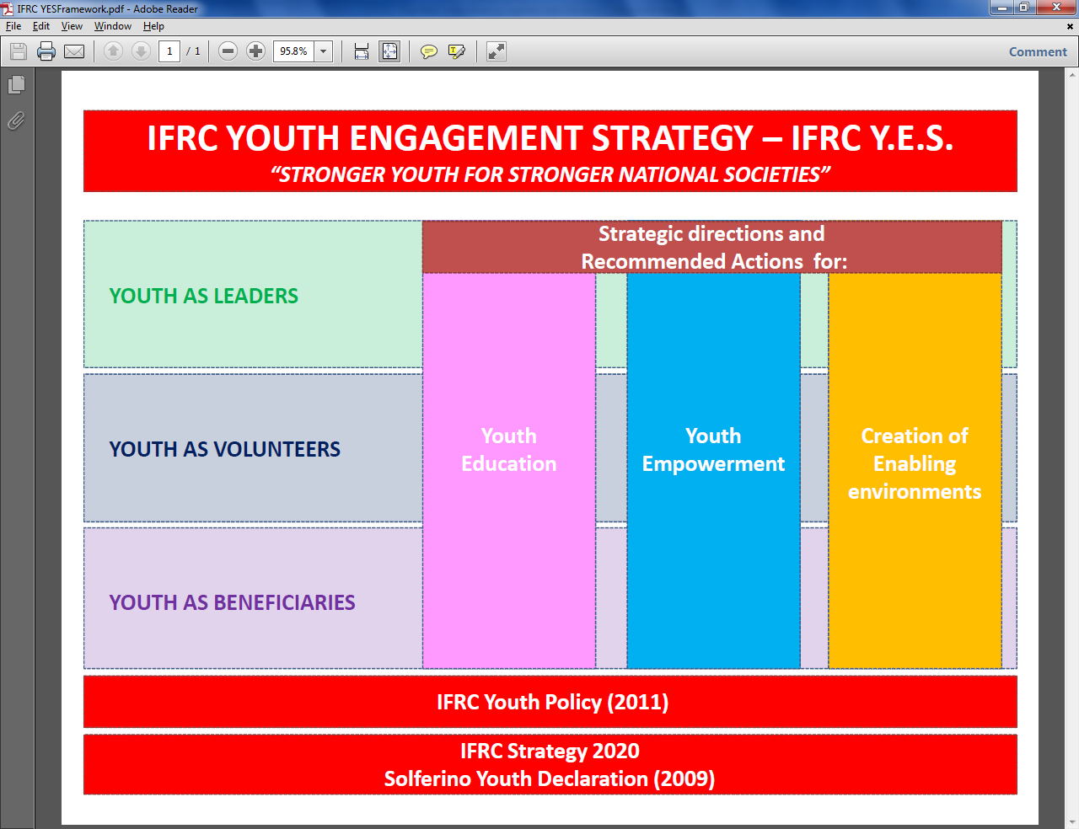
Youth Engagement Strategy

Slide 8
Ajloun commitment called upon all NS leadership to:
Endorse and further support the AP and MENA youth networks including regional network.
Integrate and support the implementation of effective youth programmes which use peer-to-peer and non- cognitive methodologies as reflected in YABC initiative.
Recognize the importance of the Ajloun Commitments, which are linked to Solferino Youth Declaration and provide the human and financial resources for their implementation.
Provide greater support and appropriate resources to enable quality use of and access to technology.

Slide 9



Youth As agent of Behavioral Change

Slide 10
THANK YOU

