Slide 1
Presentation on RDRT
At
RCSR Forum
Jakarta
in
4th August 2015

Slide 2
Key progress after last CSR Forum meeting
Technical meeting organized for effective RDRT in October; 2014.
Following scenarios were recommended for mobilization of RDRT:
    Scenario 1: RDRT should be deployed along with DREF operation . If IFRC launches the emergency appeal for affected NS, RDRT deployment provision must come automatically. DREF and emergency appeal need to cover the cost of RDRT/s.

Slide 3
Key progress after last CSR Forum meeting- Continued
    Scenario 2: If government announces a state of emergency following any given disaster/crisis, RDRT may also be deployed.
    Scenario 3: If the humanitarian community activates the cluster system (formally and informally), RDRT should be deployed.
    Scenario 4: RDRT should be deployed to participate in different exercises which are organized by different regional organizations like ASEAN, bilaterally/multilaterally by governments of this region etc during non

Slide 4
Key progress after last CSR Forum meeting- Continued
Following Criteria were outlined to update RDRT roster list:
    Members who have been working as volunteers and staff of NS;
    Members who can communicate in English. A regional language is always an asset;
    Members who can be available for deployment within 72 hours of request;
    Members having good mental and physical health;
    Members who have good facilitation skills; and
    Members who can be released by NS to facilitate the RDRT and NDRT training across the region
Roster update: First round of roster update. Around 100 RDRT members in list.

Slide 5
Key progress after last CSR Forum meeting- Continued
A letter from SEARO was shared with the name of RDRT as mentioned in updated roster list to NSs for validation during first week of April; 2015.
Ten RDRT members were mobilized to support Nepal EQ operation from this region which occurred just after the
An initial web story produced and available at: http://www.ifrc.org/en/what-we-do/disaster-management/responding/ongoing-operations/nepal-earthquake/personal-experiences-from-southeast-asias-regional-disaster-response-team-members-in-nepal/

Slide 6
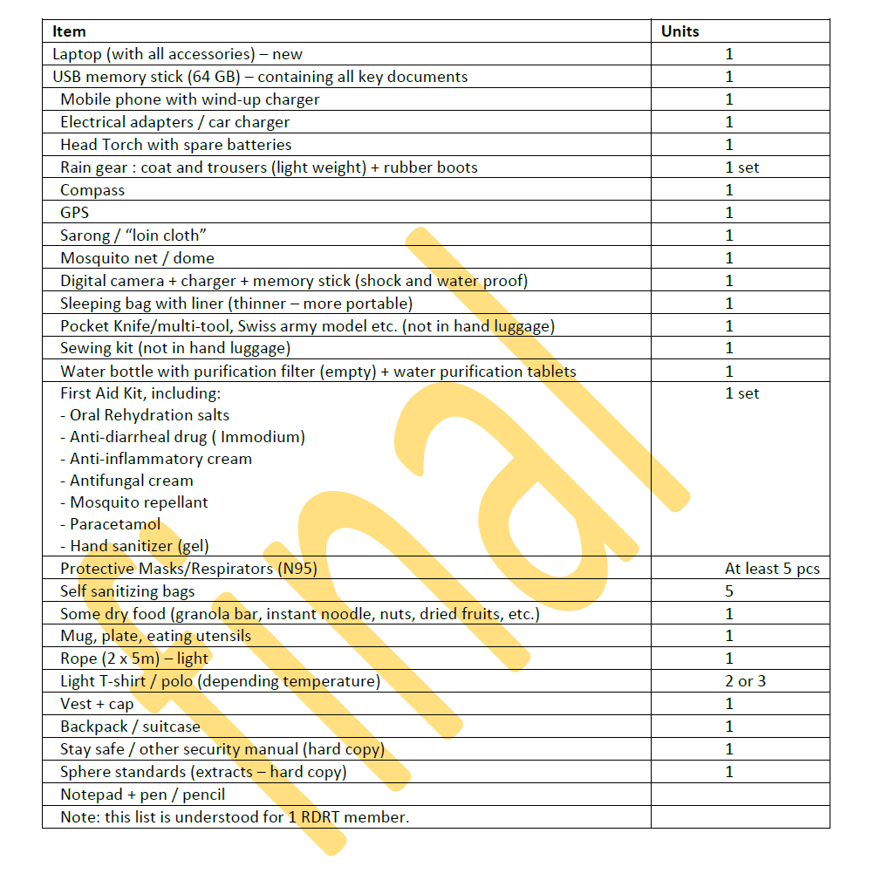
Procurement and used Equipment's for RDRT-4 sets available in SEARO

Slide 7
Some Reflections from RDRT members after deployment in Nepal EQ
It’s important to have a unified chain of command with clear roles and responsibilities – not to have ”too many cooks in the kitchen”. Yet also, it’s important to be flexible and to just get involved and do what’s needed, even if it’s not in your original terms of reference.

Slide 8
Some Reflections from RDRT members after deployment in Nepal EQ-continued
Personally, the first few days of staying in the area were the most difficult part, because that was when I had to adjust and cope with the situation. Being away from home. Extremes on weather. The tremors. Language barrier. Limited resources. Limited communication lines – just to name a few.
In terms of dealing and coping with these challenges, it helped to think about the people who are experiencing far more difficult situations because of the earthquake. I had a tent, some people were living just under scrap materials or tarpaulins. I had water to drink and food to eat, some people have to travel two or more hours to get water and wait for relief just to have a decent meal.

Slide 9
Some Reflections from RDRT members after deployment in Nepal EQ-continued
The difficult moments lie in how to deal with communities when they have so much hope in the Red Cross, that the we can provide them with the assistance they need. From my experiences in local and regional response, one of the things that I take care to remind myself – and the team – is that we must always be clear on our role and limitations before we go to meet the community. This is important because we don’t want them to have expectations we cannot meet.

Slide 10
More
We can heard more from our colleagues of CVTL- who were part of RDRT in Nepal EQ

Slide 11
RDRT related process and progress
Evaluations of RDRT deployment in Nepal EQ.
IFRC secretariat is working to develop RDRT manual at global level which includes RDRT training agenda; manual; ToR; deployment process; equipment etc. The draft will be shared when it is available.

Slide 12
Recommendations for this CSR forum
Development of precise actions in regional Road map to make RDRT more effective. We hope; we can find during these three days meeting.
Key recommendations to next SEA RCRC leadership meeting to make RDRT more effective for their approval.

Slide 13
THANK YOU

