Slide 1
National climate risk assessments & National adaptation plans (NAPs)

Slide 2
Key objectives of this session
At the end of this activity, the participants are able to:
Understand the usefulness of assessing the national climate risk information and have a good understanding about the needs and potential roles and benefits of engagement in the NAP process with relevant stakeholders.

Slide 3
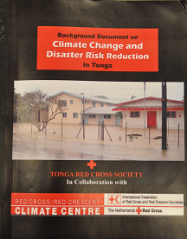
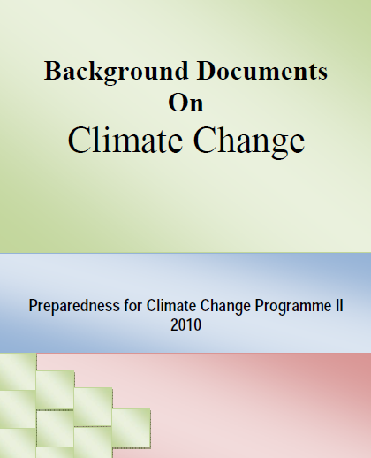
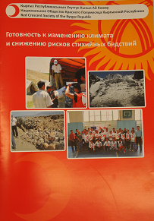
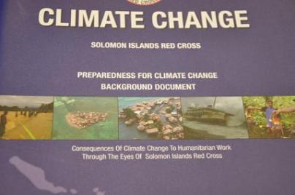
National climate risk assessments:
a key first step!
Over 60 Red Cross Red Crescent assessments have been written
Notes:
Many Red Cross Red Crescent National Societies have written a climate risk assessment. Examples are available from the Climate Centre.

Slide 4
Assess climate risks and impacts relevant to the NS context
Policy dialogue
Adjust NS work
Highlight humanitarian consequences of CC
Engage with relevant sectors
Ensuring the needs of the most vulnerable are addressed in national and sectoral climate change policies
How could changing risk patterns affect vulnerability
Assess how the NS should adjust existing programmes/projects
Draft an action plan
Assess funding opportunities /funding mechanisms
Photo: IFRC
Notes:
The national climate risk assessment is helpful to get a good understanding of the humanitarian consequences of climate change. The next step is to find out whether the existing national government policies address these concerns: are the needs of the most vulnerable being met in climate change policy? When this is not the case, the national risk assessment is a helpful tool to strengthen the policy dialogue between the National Society and relevant government institutions, for example in the context of the development of the national adaptation plan.
Titel der Präsentation
4

Slide 5
Main focus of national climate risk assessments
Describe current weather-related risks
Describe climate trends (past) and projections (future)
Impacts and vulnerability (also per relevant sectors)
Reflect how these impacts affect your work
Action Plan
Notes:
A national climate risk assessment could consist of:
Describe the current climate situation, as well as existing geography and vulnerabilities.
Gather available climate change information (projections).
How does this impact the lives of the most vulnerable?
Reflect on how these impacts will affect your work and mandate.
Include an action plan with next steps.
In the relevant reading section of this module, you will find more steps and guidance on how to write a national climate risk assessment.

Slide 6
Evidence of local impacts
Use available regional and country data
Involve communities – use VCA information
Involve other stakeholders, including your meteorological office
Notes:
Reducing risks experienced by the most vulnerable people is key for the Red Cross Red Crescent Movement. The work reflected in the climate risk assessment needs to address the most pressing issues for vulnerable people. It will also be key to assess not only the climate change projections for your country, but also to link these to current climate risks your country already experiences.
You can strengthen these findings by adding community perceptions of changing climate investigated using participatory tools such as in Vulnerability and Capacity Assessments. Are their perceptions documented/shared? (Remember that there are many causes of change in communities, such as environmental degradation, make sure to investigate some of the causes of change – you can check against measured trends in rainfall and temperature where they exist)
Invite stakeholders at local level to comment/ contribute to your assessment: local government representatives, community members, etc.
You can think of quoting them or having them answer the following questions:
• What are the regular climate risks that face the province/area/community: weather shocks such as floods, typhoons and slow-onset climate risks such as drought.
• Have the intensity or frequency of these been changing at all?
• Have temperatures, rainfall or seasons been changing? If so, what implications might this have into the future (could be positive or negative)?. Consider health, disasters, agriculture, water, ecosystems.

Slide 7
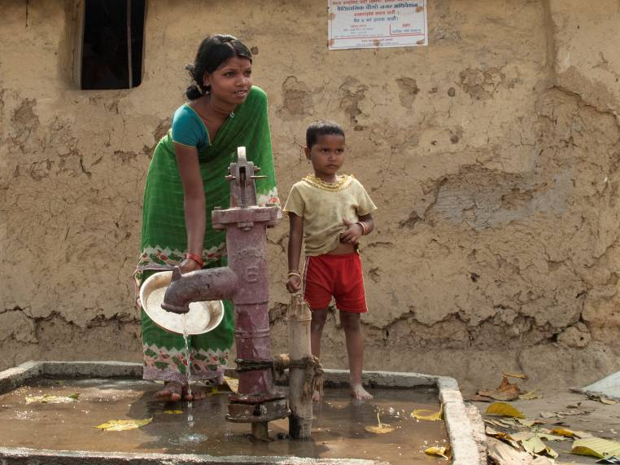
National climate risk assessment
Keep it real and relevant:
Don’t include things that you can’t explain
… and which are not relevant to the work of the RCRC
Keep it simple :
Don’t confuse yourself and readers with too much complex data
Notes:
This part will need to highlight the reason for writing the report. You are concerned about the impacts on the most vulnerable from a humanitarian perspective and therefore you need to frame the impacts in relation to your mandate: disasters, health, emergencies and vulnerability. You can have a look at the Red Cross Red Crescent Climate Guide to see how climate change impacts are framed in the context of the Movement.
Though climate change is now affecting the weather, including the risk of more extreme events, it is impossible to link any single weather event only to climate change. In a normal climate, there have always been extreme-weather events, and these will continue as well. This is the reason why we speak about addressing climate variability as well as climate change.

Slide 8
National climate risk assessment
Climate trend and projections information can be found at sources such as:
- Your ministry of environment, meteorological office, etc.
UNDP country profiles
IPCC regional summaries
WB country profiles
National adaptation strategies/NAPAs
UNFCCC communications
Notes:
There will be plenty of relevant data and it is good to decide which sources are credible enough. A number of international sources are worthwhile checking. We have listed some important ones on this slide.

Slide 9
PMI – National Climate Risk Assessment
Introduction to National Climate Risk Assessment

Slide 10
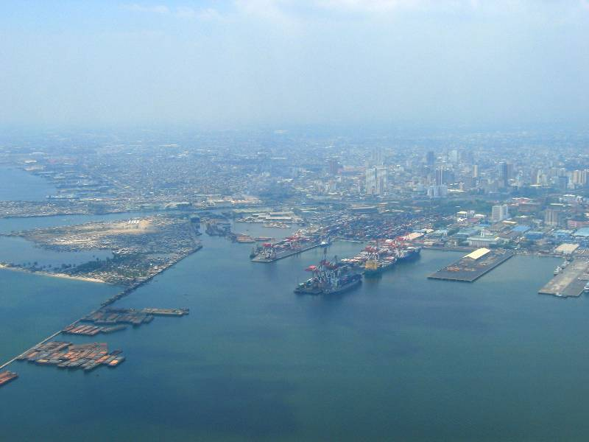
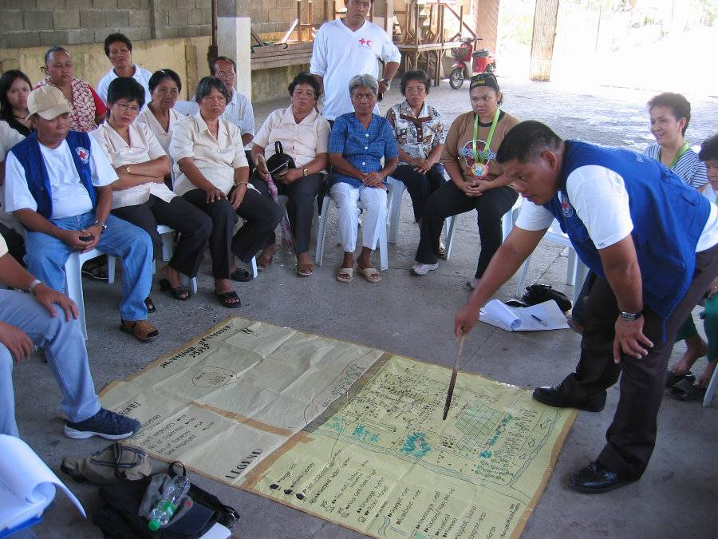
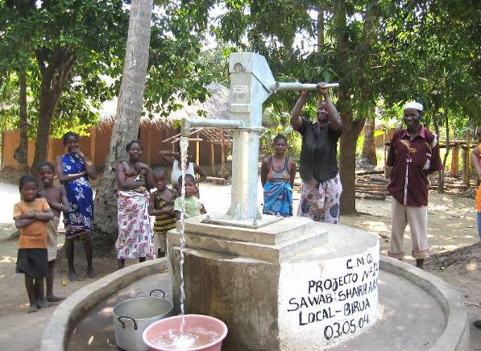
Influence policy and resource allocation
...otherwise risk funding may go to protect infrastructure and not reach vulnerable communities
Photos: Danish Red Cross
Notes:
10
Use Red Cross Red Crescent influence to advocate for adaptation funds, not only to cover the protection of infrastructure (too easy a default opportunity for political and administrative actors), but to make sure funding finds its way to vulnerable people and communities to help them adapt to new circumstances.
10

Slide 11
Nepal Red Cross Society – NAPA/LAPA
Introduction to NRCS engagement in National Adaptation Programme of Action (NAPA) process
Introduction to Local Adaptation Plan of Action (LAPA) in Nepal

Slide 12
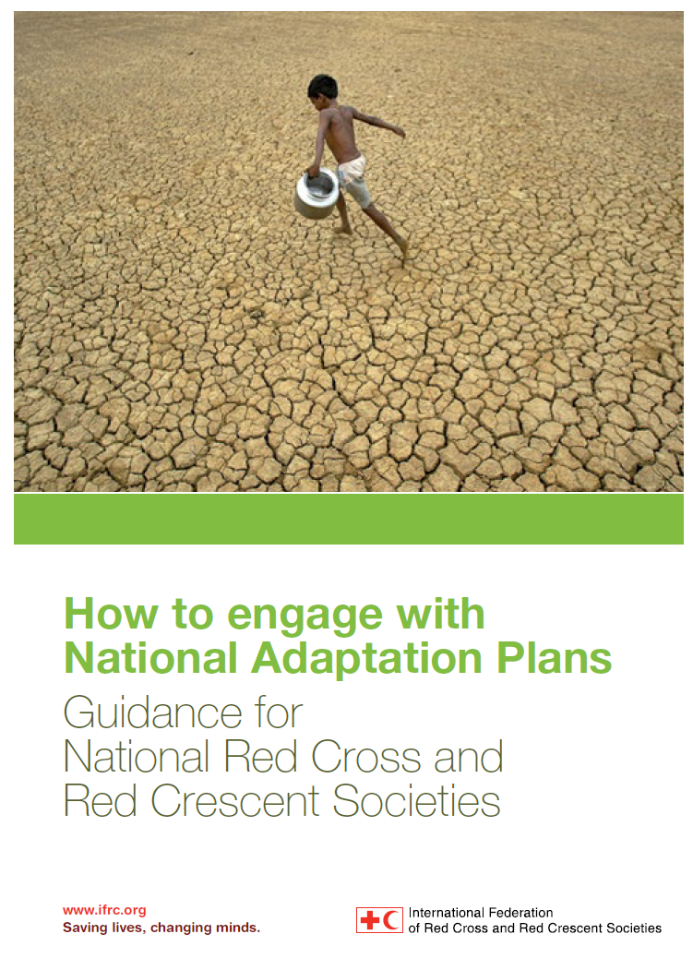
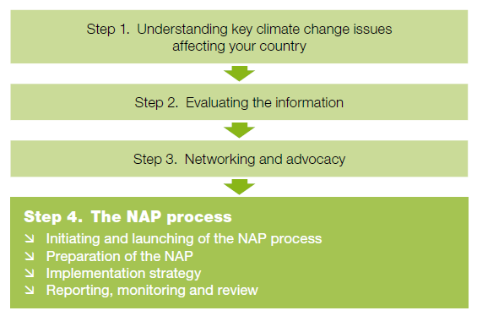
Engage in NAP
Notes:
12
Policy dialogue – advocacy or humanitarian diplomacy – is necessary as we believe many international commitments made by governments are not yet implemented nationally or locally, or in a way that builds the resilience of the most vulnerable people. Ultimately, the Red Cross Red Crescent assisting in the implementation of, and accessing funding from, upcoming adaptation funds through national policy dialogues could be an outcome of advocacy efforts. We will therefore explain what is happening globally and how adaptation funds are being made available to governments.

Slide 13
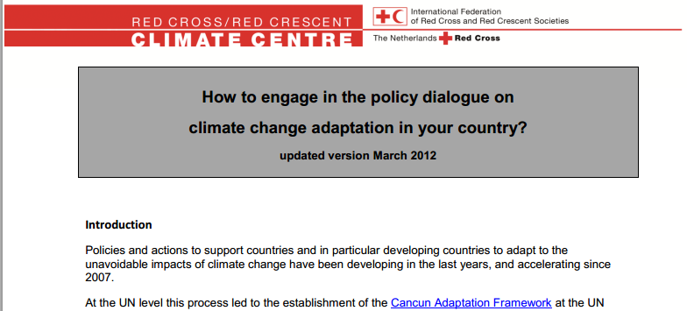
Summary document…
Notes:
13
13
This document spells these steps out in more detail:
www.climatecentre.org/downloads/File/advocacy/National%20CCA%20policy%20dialogue%20_version%20february%202011.pdf

Slide 14
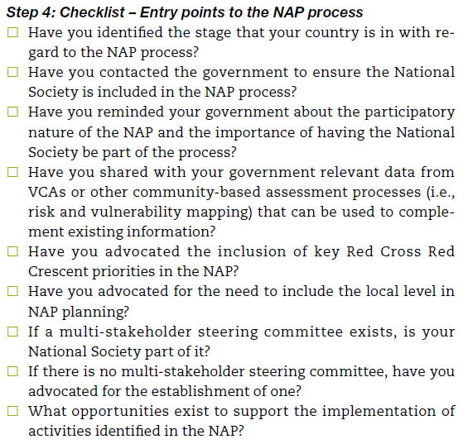
Notes:
14
Steps

Slide 15
Exercise… the situation
You have checked the draft national “climate change adaptation policy”, which you think does not adequately address humanitarian challenges of climate change
You are now working with your Secretary General and the heads of the disaster management and health departments to prepare for a meeting with the government officials responsible for adaptation policy and planning. Your interests of the meeting are:
How can humanitarian concerns be better included in a revised draft of the national climate change policy?
What role could your National Society could play in implementing a policy more focused on adaptation for vulnerable people?
Notes:
15
15
15
Find out what has been published in terms of strategies and policies by your government. Within the UNFCCC framework, most of the least developed countries have written a National Adaptation Programmes of Action (NAPA) a few years ago. This was the first generation of national adaptation plans. Since the COP decisions in December 2011, a second generation of plans will be developed and implemented by governments. Most countries submit National Communications on climate change to the UNFCCC. Even though the main parts of these reports are about greenhouse-gas emissions (of less relevance for the Red Cross Red Crescent), they also describe the vulnerability of your country to climate change impacts in the coming decades. See also:
http://maindb.unfccc.int/library/view_pdf.pl?url=http://unfccc.int/resource/docs/2011/sbi/eng/l16.pdf
On the UNFCCC website you can find the contact information for national focal points – the ministry where you can find out about the adaptation policy of your government.

Slide 16
Exercise… Role play:
Convince your government
Form teams approx. 60% will be NS reps approx. 40% will be government reps
RCRC teams:
List key questions you and your superiors would raise with the government officials
List five specific things your National Society could offer to help the government: practical ideas on climate change adaptation that would fit into a climate change adaptation policy
Government teams:
Prepare yourself to meet RCRC as officials from:
Ministry “responsible for DM”
Min of Environment (CC)
Min of planning
Min Health
Etc.
Notes:
16
16
Find out what has been published in terms of strategies and policies by your government. Within the UNFCCC framework, most of the least developed countries have written a National Adaptation Programmes of Action (NAPA) a few years ago. This was the first generation of national adaptation plans. Since the COP decisions in December 2011, a second generation of plans will be developed and implemented by governments. Most countries submit National Communications on climate change to the UNFCCC. Even though the main parts of these reports are about greenhouse-gas emissions (of less relevance for the Red Cross Red Crescent), they also describe the vulnerability of your country to climate change impacts in the coming decades. See also:
http://maindb.unfccc.int/library/view_pdf.pl?url=http://unfccc.int/resource/docs/2011/sbi/eng/l16.pdf
On the UNFCCC website you can find the contact information for national focal points – the ministry where you can find out about the adaptation policy of your government.

Slide 17
Wrap up and Key Messages
It is important for the RCRC to engage in the NAP process as it impacts on our work
Engaging in the NAP process provides opportunities (e.g. information sources, partnerships, knowing where other stakeholders are operating, etc.)
Opportunity to mobilize resource for the National Society and for communities we work with

