Slide 1
National Society Development: some updates

Slide 2
Strategy 2020
Vision 2020
Strategic Aim 1
Save lives, protect livelihoods, and strengthen recovery from disasters and crises
Strategic Aim 2
Enable healthy
and safe living
Strategic Aim 3
Promote social inclusion and a culture of non-violence and peace
Enabling Action 2
Pursue humanitarian diplomacy to prevent and reduce vulnerability in a globalized world
Enabling Action 3
Function effectively as the IFRC
Enabling Action 1
Build strong National Red Cross and Red Crescent Societies

Slide 3
National Society Development Framework
Approved during the General Assembly in Sydney (2013).
ICRC has also endorsed this.
Key Point:
National Society development is, in the first instance, the responsibility of each sovereign National Society.

Slide 4
National Society Development Framework
Aim of the National Society Development:
NSD is not a goal in and itself, the primary impact of the NS can be measured through the services that it offers. It does not have end point and is a moving goal.

Slide 5
A strong National Society is an organisation that consistently delivers, through volunteers and staff, relevant country wide services to vulnerable people sustained for as long as needed and that contributes to the strength of IFRC and the Movement.
National Society
Development Framework
Key messages from the Framework
An NS is primarily a domestic organization
Each NS is responsible for its own development
Within NS senior leadership is the responsibility for NSs health and future
Mobilization of support from all relevant partners
Core; services carried out at scale
Capacities
To exist | To organize | To relate and mobilize | To perform | To adapt and grow
Notes:
NS Development should ultimately lead to increased relevance, quality, reach and sustainability of NS core services
To support all those affected by conflict and OSV is part of those core services
Key messages of the framework
A NS is primarily a domestic organization which must build a case for its existence within its environment
Each NS is responsible for its own development
Within the NS, senior leadership (governance and management) is responsible for the NSs health and future
NS development is an inclusive process: it mobilizes support from all relevant partners
At the core of each NS’s identity are the services that it can carry out at scale: these will largely determine how it is organized and led
There are many aspects of a strong voluntary organization, of course, but only the most strategic will be mentioned here. A strong National Society:
Lives up to a clear, focused, important and well-known mission.
Runs at least one well-known, nation-wide service on a permanent basis.
Covers the country with local branches that are strong and local enough to ensure access at all times and self-sustainability..
Has credible national leadership, good internal communications, and a strong headquarters that with the regional branches as its representatives lead, guide, train and support the local work.
Eventually has national and/or regional capacities that can temporarily support local branches when overwhelmed by the scale or complexity of a situation.
Covers through a mix of planned incomes, the yearly costs for its whole organization and key services, and is thus self-sustainable.
Mobilizes good governors, leaders, members and volunteers, and attracts and keeps competent managers and staff.
Is accountable to its members, the communities it serve, and donors and partners.

Slide 6
National Society Development (NSD)
Aim of NS Development team :
Coherent and consistent approaches across zone, to support NSs to scale up leadership and institutional capacities that extend their reach and quality of services and become more relevant to meet humanitarian needs by increasing the magnitude, quality and impact of their work.
Coherent organizational development planning and quality standards at country, regions and zone.
Facilitation of an integrated approach to OD.
Notes:
standards

Slide 7
SELF ASSESSMENT
Capacity enhancement plan
Peer Review
Certification
WHO WE ARE?
WHAT WE DO
OCAC
Strategic Plan
Leadership
How well do we do?
FWRS and Databank
How can we do better?
National Society
Learning and Knowledge Sharing Network
+ external institutions
DATABANK
Who we are
How to get in touch with us
What we do
Who are our partners
How we can help others
Where others can help us
What are our financial resources
What are our key documents
How we learn and share knowledge
Bridging the digital divide
How can we reach further?
Identify minimum level of connectivity and online capacity required to participate fully in the Federation. Create mechanisms to enable National Societies to increase their capacity in information technology
Notes:
OCAC - NSs to analyse their own capacities and baselines through a multi-sectoral analysis…

Slide 8
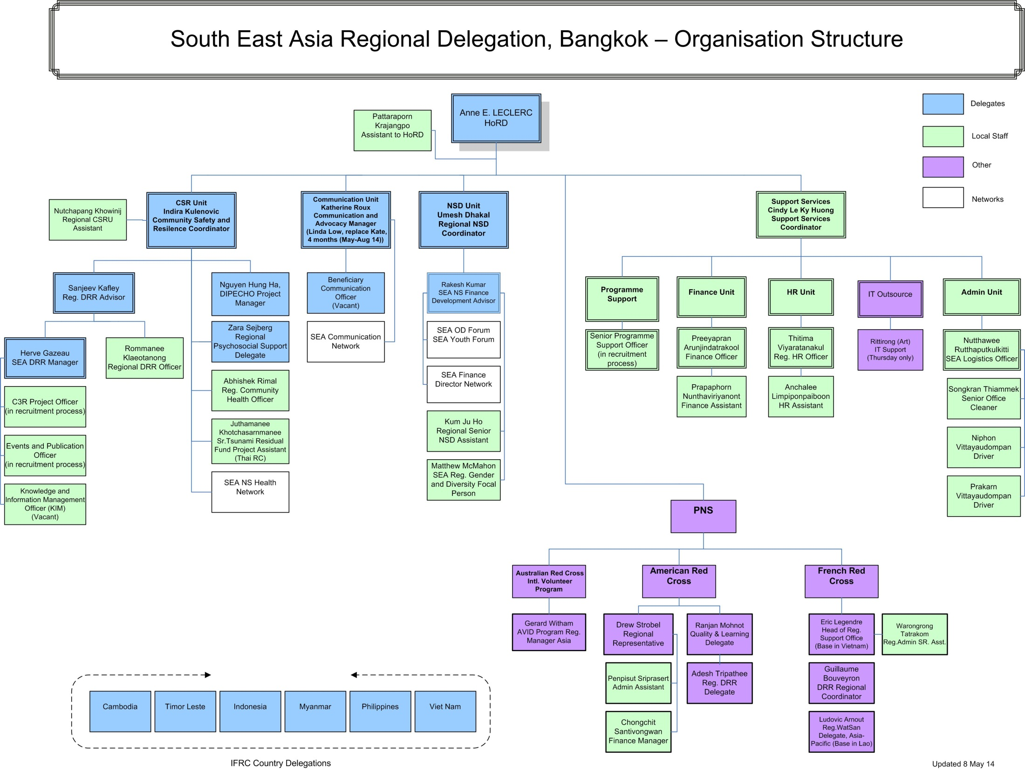

Slide 9
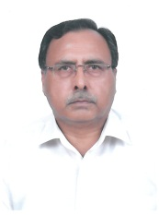
NSDU Structure
NSDU Coordinator
FD adviser
Youth focal
Gender focal

Slide 10
Organizational Development (OD)
Support in NS Strategic Positioning
Support in NS Change Management Process
Increasing access to different tools and policies
Coordination

Slide 11
Organizational Development (OD)
Support in NS Strategic Positioning
Support in NS Change Management Process
Increasing access to different tools and policies
Coordination

Slide 12
Capacity Building
Strengthening capacities in programming
Strengthening capacities in systems and procedures

Slide 13
Current NSDU Activities
NSD Framework implementation
NS Capacity Building including resource mobilization
Finance Development
Youth Development
Gender and Diversity

Slide 14
NSD Framework
1) OCAC
  Myanmar(2012), CVTL-VNRC(2014) , CRC (BOCA) ,PRC(tbc)
2) LPKS
  PRC (478), PMI(225), MalRC(94), SRC(79), TRC(65), Myanmar (58)
3) FDRS
  CRC-CVTL- PRC-TRC- Myanmar(100%), LRC-SRC-VNRC(86%), BRC-PMI-MalRC(29%)
4) DDI
  CRC- VNRC(done), CVTL(PoA), MalRC(tbc)
5) RMS
  MalRC-PRC-CVTL(in use), Myanmar(ongoing), CRC&VNRC(2014)

Slide 15
NS Capacity Building
LRC, VNRC Presidents and SGs visit to Regional office and GVA for their RC orientations in 2013.
Leaders from MRCS, CVTL, Lao are participating or will participate in NLO and MIC.
Support to LRC resource mobilization
Induction to the Executive Board of Brunei Darussalem Red Crescent.

Slide 16
Finance Development
Navision Software Completion in Myanmar RC
Independent audit of Myanmar RC financial statements has been completed in March 2013 followed by a formation of finance commission
Sun system software upgraded in VNRC
Independent audit of 2011 financial statements in VNRC
Planning of FD to CVTL in 2014 (possible to PMI?)

Slide 17
Youth Development
Establishment of SEA Youth network, implementation of key action plans, enhancement of members’ capacity through online meetings.
Leadership role by coordination team members (CRC, PMI, MaRC)
Development of Regional Youth Empowerment Project, Cambodia (2014)
Cross regional cooperation between SEA NSs and EA NSs (Thai – RoK RC)

Slide 18
Gender and Diversity
Mainstreaming Gender and Diversity into all SEARD programs, tools and strategies
Building the capacity of SEARD and interested National Societies to strengthen existing Gender and Diversity initiatives (Gender Audit has been completed in Cambodia, Lao, and Myanmar).
Increased integration of gender equality into national and regional DRR policies and programs
Forming a SEA Regional Forum on Gender and Diversity

Slide 19
Few NSD Interventions.
Country | OCAC | BOCA | Finance Development | Youth Development | Gender and Diversity | Strategic Planning
Brunei |  | n/a | Financial Management system development planned. | Youth Policy drafted, support plan being discussed. | Gender and Diversity audit and related interventions being discussed. | Draft available.
Cambodia |  | BOCA piloted in 2 Branches |  | CRC youth policy updated, YEP started with YABC training in September/ event in November | Audit planned in September | Strategy 2011-2020. A 4 year Development Plan (2011-2015) in place.
Indonesia |  |  |  | SEAYN Chair | Audit planned in October | Preparing draft SP (2014-2019). To be discussed in GA in December.
Laos |  |  |  | SEAYN deputy Chair | Audit planned in September | 2011-2015 SP in place.
Malaysia |  |  |  | OD and Youth steering committee Chair, SEAYN member |  | 2011-2015 Strategic Plan in place.
Myanmar |  |  | Navision refresher training planned in September |  | Gender and Diversity Sensitization and Strategic planning workshop scheduled for September | SP 2011-15 reviewed and revised in July 2013.
Philippines |  |  |  | SEAYN Officer, YABC involvement in Sept and Nov |  | SP approved and distributed to chapters and PNSs.

Slide 20
Few NSD Interventions (contd..)
Singapore |  |  |  | CLARE project planning in Dec YEP initiative in November, Youth symposium in Dec |  | 2010-2015 SP in place.
Thailand | Done self- assessment based on OCAC. |  |  | KRC visit, AMCDRR Participation | Initial Gender Scoping conducted with Director of Community Resilience and Health. | 2011-2015
Timor-Leste | OCAC completed in 2014. |  | Training for the branch coordinators in October (TBC) | School RC youth programme, YEP next year | Gender audit and support to review of strategic plan scheduled for November | Strategy 2010-2014 in place. Review planned in 2014.
Viet Nam | OCAC completed in 2014. |  |  |  | Audit and working group session with French Red Cross planned for October/November | NS Development Strategy 2020 . SP 2011-2015.

