Slide 1
IRI Partnership and Seasonal Forecasts
Notes:
Note: Climate Centre was established in 2002 and became and independent foundation in 2004. We are a reference centre for the whole Red Cross Red Crescent Movement.
This module is part of the Climate Centre’s Climate Training Kit, and is focused on how to make our community risk assessment work climate smart.
The aim of this presentation is to provide inspiration and the space for practitioners to consider climate change in their work with communities. This presentation assumes that the practitioner understands and utilizes the International Federation’s Vulnerability and Capacity Assessment (VCA) toolbox (www.ifrc.org/what/disasters/resources/publications.asp) or the Community Based Health and First Aid tool (http://www.ifrc.org/what/health/firstaid/tools.asp ).

Slide 2
RCRC and IRI
What is IRI?
International Research Institute for Climate and Society based at Columbia University in New York
Combines state-of-the-art climate information with knowledge on vulnerability and sector-specific impacts
For more than 20 years, the IRI has developed a variety of tools to better understand, anticipate and respond to climate and weather events and their socioeconomic impacts

Slide 3
RCRC and IRI
Why go into Partnership?
Improve its capabilities to both respond to and prepare for disasters
Incorporate climate information into DRR and decision-making is urgent, evidenced by the increasing frequency, intensity and humanitarian consequences of disasters around the world
Help decide when and where to send aid since both time and resources are limited -- can mean the difference between life and death
Also critical is predicting the hotspots or areas that are high-risk because of their location and the vulnerability of their populations.
The partnership is also well positioned to use improved models for climate anomalies and extreme weather forecasts.

Slide 4
RCRC and IRI
What do they develop together?
Tailored forecasting
Monitoring products
The IRI provides assistance to the interpretation of observed and projected weather conditions relevant to our work.
Contact IFRC/IRI Helpdesk at ifrc@iri.columbia.edu or visit the IFRC maproom

Slide 5
RCRC and IRI
6-day Forecasts → maps show where heavy rainfall is expected in the next 6 days and how much rainfall is expected
3-month → Maps show where large or small amounts of rainfall are expected in the next 3 months
Past Conditions → Maps show rainfall patterns that can be expected for El Nino, La Nina and average years
Recent Climate Trends →Maps show what the rainfall has been like for the last 100 years and what trends exist in your location
Vulnerability Indicators → Maps show population density and child mortality rates to indicate areas of the world that might be most vulnerable to high or low rainfall amounts

Slide 6
RCRC and IRI
This collaboration provides an enormous opportunity for improved early warning and early action at global and local levels
We are thrilled to be working with the IFRC to better anticipate and respond to extreme weather and climate events. As a global leader in disaster response, it is an ideal partner to connect new knowledge and information with best practices throughout the world
-- Steve Zebiak, IRI Director General

Slide 7
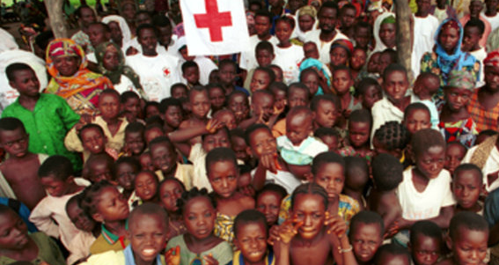

Seasonal Forecasts and their use
Early Warning, Early Action
Notes:
7
See vimeo.com/8122673.

Slide 8
Seasonal Forecasts
Big-picture, coarse resolution
It is NOT possible to make inferences about precisely where there are risks of increased or decreased rainfall
A forecast of increased risk of above-normal rainfall over West Africa, for example, should be taken as just that, and NOT as a forecast for above normal rainfall in specific countries or parts of West Africa

Slide 9
Seasonal Forecasts
Benefit: LONG LEAD TIME for early warning information
Early indication that a rainy season might be wetter or drier than normal can be a helpful guide to anticipate any potential impacts
Should be supplemented by forecasts on shorter timescales (10-day, weekly, daily) to get more certainty and detail

Slide 10
Seasonal Forecasts
Only give a general sense of the character of the season by providing a forecast of seasonal rainfall totals
Are PROBABILISTIC (and leave a large amount of uncertainty)
  Normal
  Above-normal
  Below-normal

Slide 11
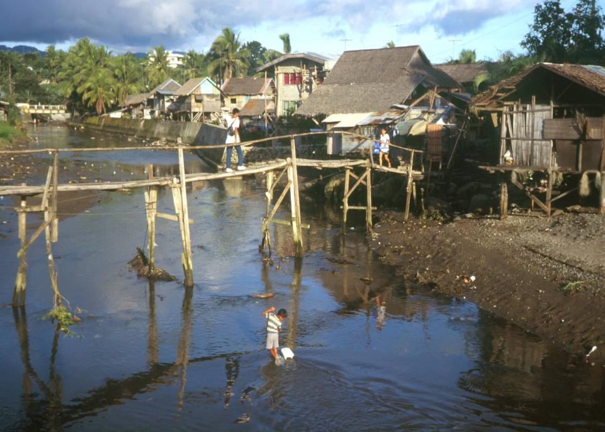
Remember
Communities face many challenges, and climate change needs to be considered alongside .
It is not possible to determine if any one weather-related disaster
is caused by climate change –
all risks need to be considered.
Photo: Danish Red Cross
Notes:
There are many risks that any given community may face and these risks may be different from one community to a next. They could be related to health related, land tenure, agriculture or livelihoods. In some cases, the concerns may be related to climate but not always; this is important to keep in mind.
This session aims to provide you with some further ideas for using the tools that you already do to consider how climate change may interact with a community. And where it is an issue that needs acting upon.

Slide 12
Climate information flow
Community information
e.g. group discussion, seasonal calendar, historical profile
Decision making
Outside information
e.g. Meteorological Office,
climate change focal point
Community risk reduction plan
Sharing information further – advocacy
e.g. local government, early warning policy-makers
Notes:
Community information about climate-related trends can be useful for programmatic decision-making as well as community-based projects. Information on community anecdotes and concerns about changes (such as increased frequency of droughts) can be fed into local and national policy dialogue with government so that national plans for climate change adaptation are locally appropriate. There have been examples of National Societies sharing information from their VCA/CBHFA in the creation of National Adaptation Programmes of Action.
Both information from the community and scientific data are valuable to put together a picture of changes that have occurred, and think about how risks might change in the future. It is important to remember that we may not experience climate change as a linear path towards the long term climate projections – greater climate variability and extremes are more immediately felt in most cases.
Explanations for any large discrepancies between community experience and scientific data should be sought to enhance understanding.

Slide 13
A matrix to help the analysis
Changes observed by the community | Are the changes good or bad? Why? | Possible reasons for changes
 |  | Evidence based on scientific information | Other factors that may explain changes observed by communities
Example 1. Sea eroding the coastline | Bad: affects infrastructure close to sea, inundates food gardens | Sea level rising 8mm per year in Solomon Islands | Some sand mining along coastline
Example 2. Getting hotter in the summer | Bad: old people can’t cope when its very hot Good: can grow more crops in summer | Temperature rising
Example 3. Flooding more often | Bad: River rises more quickly and more often these days | Meteorological office reports that no change in extreme rainfall events | Logging present upstream, probably affecting flow
Notes:
An example from the Solomon Islands.
13

Slide 14
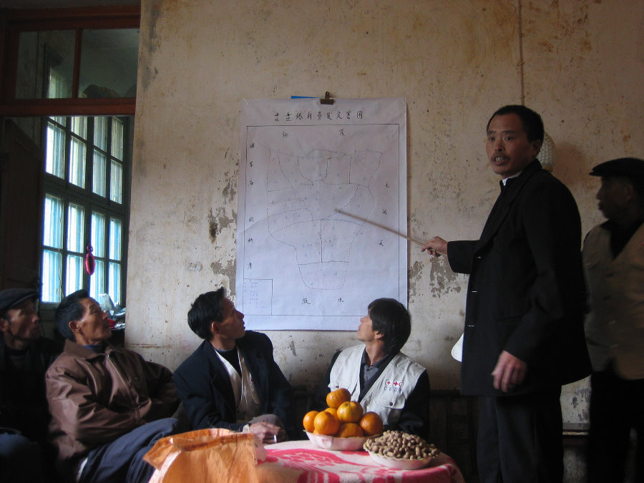
Developing community action plans
How might information collected before and during the VCA/ CBHFA be best considered in community risk-reduction plans?
What could the community itself address, and what would required external support and collaboration?
Do we invite government and civil society involvement if appropriate?
Photo: Danish Red Cross
Notes:
Once you have the big picture, it could also be used when the community start to develop solutions to the problems faced. How do they currently cope with the problems? If these problems worsen over time, how is this likely to affect the community? What could be done to stop the problem getting worse? The aim is for communities to understand that the risks are changing and that they can take action to reduce the risks they face.
The community risk-reduction plan (or equivalent) are the most important outcomes of the community-based process, and proper facilitation should ensure that the plans build not only upon past experiences and historical evidence of disasters, but also consider emerging or changing risks.

Slide 15
Notes:
2010 was a La Nina year. This forecast from October predicts that the blue areas are likely to have above-normal rainfall, and the brown/yellow areas are likely have below-normal rainfall over the November-January season.
Send to IFRC every month

Slide 17

What is El Nino?
Source: NASA
Notes:
Some parts of the world are regularly impacted by year to year variability in rainfall due to factors such as El Niño and La Niña (for example South east Asia, Africa, Americas & Pacific).
If you are interested in linking seasonal forecasts to the community level we suggest you get in touch with the Climate Centre so we can work with you and the IFRC to assist you in this. The process is likely to need to involve working with the Meteorological Office and whoever is responsible for early warning creation and dissemination in your country.
Regular La Niña and El Niño updates are available at the Climate Centre website and is also disseminated directly to disaster managers by email from the IFRC secretariat in Geneva.

Slide 18
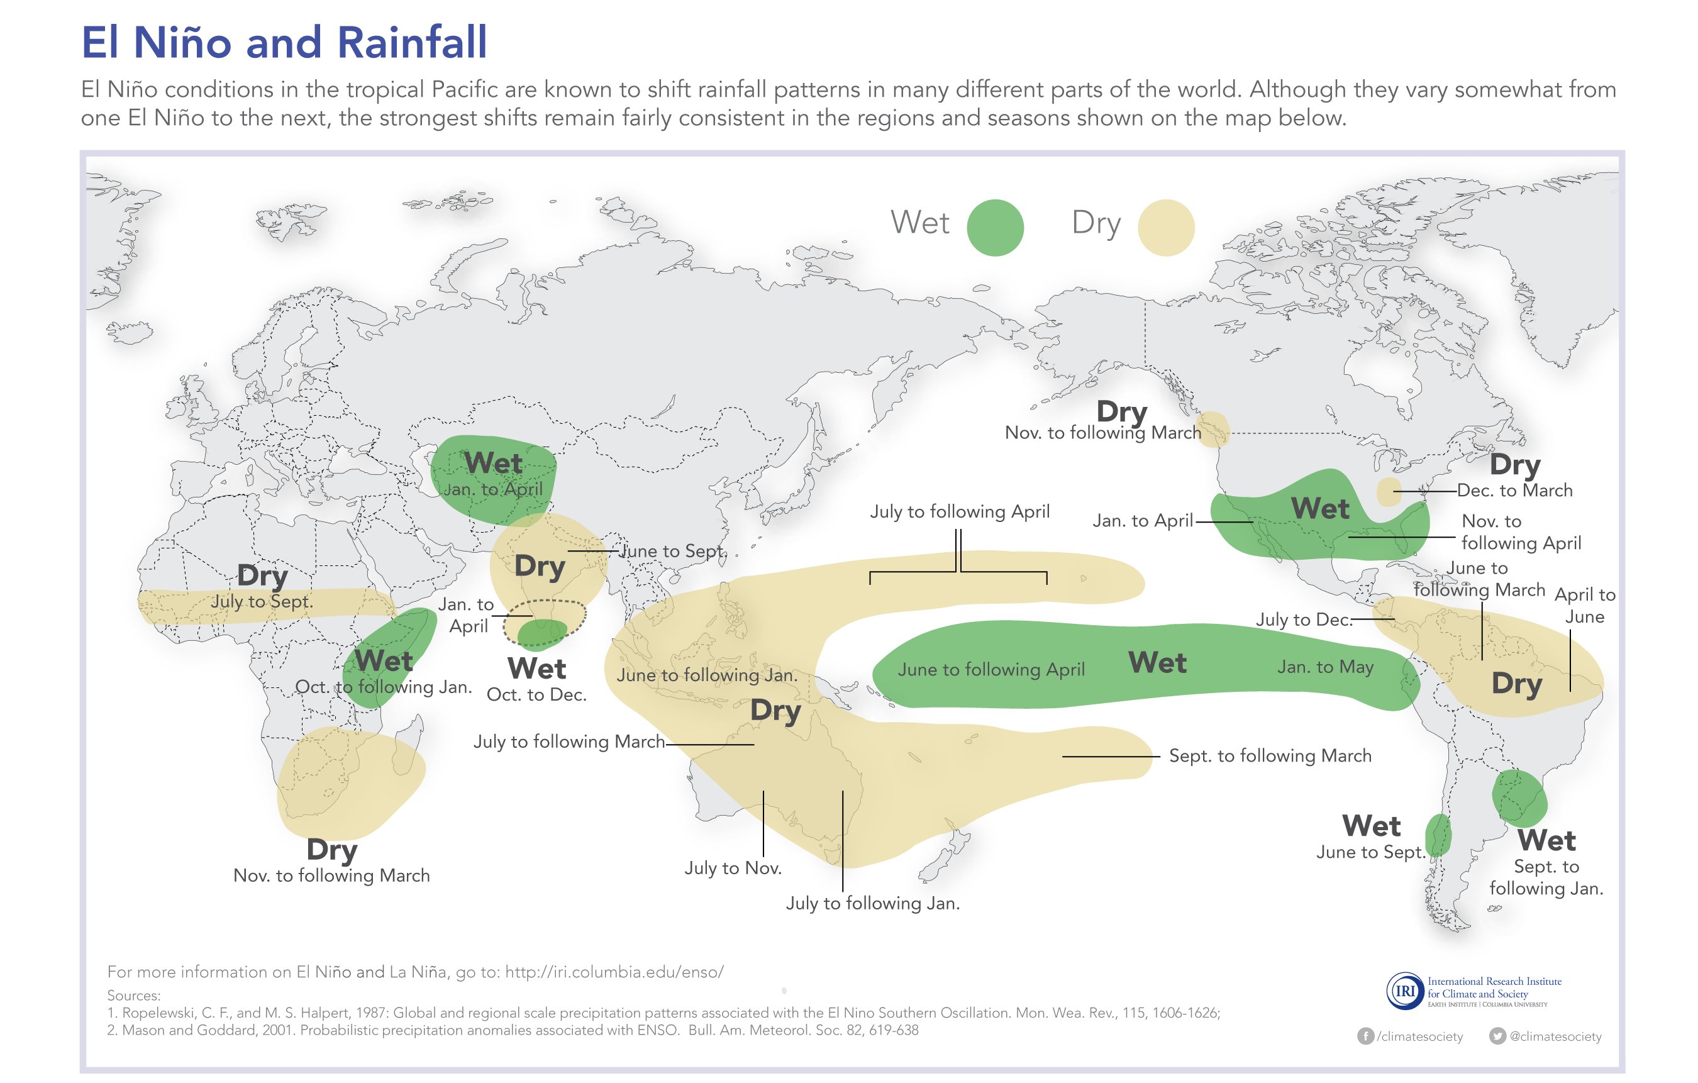
El Nino and Rainfall

Slide 19
El Nino
El Niño is a natural part of climate variability, and refers to a warmer than average period in the equatorial Pacific (the opposite of cold La Niña events).
In the last 20 years, we have experienced 5 moderate to strong El Niño events (1997-1998, 2002-2003, 2004-2005, 2006-2007, 2009-2010).
While El Niño can go unnoticed or even have beneficial impacts in many parts of the world, it can also be disruptive or cause extensive problems when some areas receive too much or too little rainfall.

Slide 20
El Nino
Every El Niño event is a little different, so it is a good idea to check the forecast every month
El Nino’s impact will also be different from one area to another

Slide 21
What is the Current Situation?
That the conditions have been borderline El Nino for some time now and there is a possibility that it will tip over to El Nino in the next month or so.
There is also the possibility that it won’t.
Regardless, we are seeing some quite strong signals in the seasonal forecasts, for high chance of below or above average rainfall.

Slide 22
Why does it matter to us?
Once developed, El Niño events typically persist for about a year (occasionally longer), peaking during the October - January period.
The strength of a El Niño event only provides a rough indication of how widespread and severe associated impacts are likely to be on a global scale.
The strength of a El Niño event does not provide certainty regarding the severity of impacts in specific locations.
The best way to anticipate if this El Niño event is likely to bring too much or too little rainfall to your area is to monitor seasonal forecasts, which take influential factors from this El Niño and other elements in the climate system into account.

Slide 23
Examples of No Regrets Actions
Continue monitoring and counterchecking seasonal and shorter term forecasts to ensure reliability
Conduct a research on past impacts and actions taken during El Nino in your areas
Meet with your DMU and local met offices
Identify which are the most vulnerable groups in your country/area
Review and update your contingency plans
Revisit your relief stocks
Information dissemination on El Nino and how it will affect the different sectors/groups

Slide 24
Remember!
Decisions based on forecasts reduce climate risk.
By considering forecasts across timescales,
the Red Cross Red Crescent can:
  Build community resilience
  Create action plans for predictable hazards
  Be more effective before, during and after emergencies.

