Slide 1
IFRC Disaster Management TOOLS
“National Conference on Challenges of Thai Medical
System for Disaster Management”
July 11 – 12, 2013, at Rajmontien Room, Montien Hotel, Bangkok
Notes:
My name

Slide 2
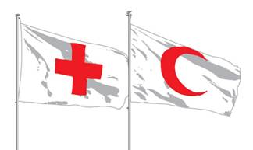
The International Federation of Red Cross and Red Crescent Societies (IFRC)
We are a secretariat that exists to provide support to and linkages between our 187 member National Societies
We provide international coordination services in response to large-scale disasters and health emergencies
We provide international representation, resource mobilization and advocacy
We support the capacity building of our National Societies
Notes:
Making a difference around the world
Through its 186 Red Cross and Red Crescent member National Societies, IFRC is a global humanitarian organization that acts before, during and after natural and manmade disasters at the community level in non-conflict situations.
IFRC’s relief operations are combined with development work, including disaster risk reduction programmes, health and care activities, and the promotion of humanitarian values. In particular, it supports programmes on prevention and fighting the spread of diseases, such as HIV, tuberculosis, avian influenza and malaria. IFRC also works to combat discrimination and violence, as well as assisting migrants irrespective of their legal status.
The IFRC has a secretariat in Geneva, a permanent observer delegation at the United Nations in New York, an office in Brussels and five zone offices in:
Europe and Central Asia: Budapest
Asia Pacific: Kuala Lumpur
Africa: Johannesburg
Middle East and North Africa: Amman
Americas: Panama
These zones place personnel and resources closer to the vulnerable communities served by the IFRC and its members.

Slide 3
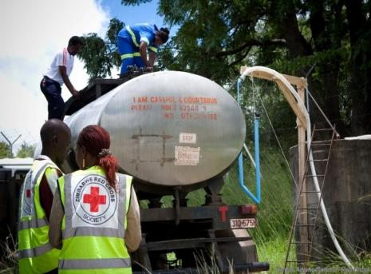
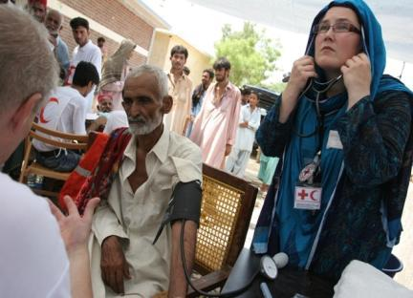
IFRC DM mechanism & tools
Notes:
Session1: Federation Disaster Response Mandate and tools, ERUs & SOP
Session objective: Understand the Federation’s disaster response mandate, tools and its system.
Facilitator: Mr. Heikki VAATAMOINEN, Federation
Pre-reading: Emergency Response Unit 2008, ERU standard operating procedure

Slide 4
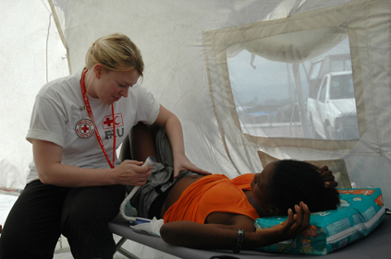
The key IFRC disaster management tools:
Information: Disaster Information Management System (DMIS), information bulletins
Funding : Disaster Relief Emergency Fund (DREF) & Emergency Appeals
Assessment & Coordination: FACT, RDRT
Professional response services: ERUs
Notes:
The IFRC has a number of tools at its disposal in order to work with disaster management. I would like to emphasize that even though I say IFRC tools it’s not entirely correct as this are tools that are at the disposal of the NS, as the IFRC will not launch a DREF or a FACT without the NS requesting it. So these are the tools we work with:
DMIS – a very important tool for regional, zone or donors as we often sit far from the field. Even though I’m new in this position I have already noticed that some NS uses DMIS more frequently than others. Information bulletin – allows the promotion of what a NS is doing. It reaches a global public as it is publiched on the IFRC web page.
Fundingt tools: DREF and Emergency Appeals. Which I will comeback to later.
FACT and RDTR, FERST (Federation Early Recovery Surge Team)
ERUSs, HEOps, SURGE

Slide 5
Professional response services
Funding tools
Assessment/ Coordination tools
Field Assessment and Coordination Team (FACT)
Regional Disaster Response Team (RDRT)
Emergency Response Units (ERU)
Basic Health Care (BHC)
Referral Hospital
Rapid Deployment Hospital
Water (M15, M40)
Mass Sanitation (MSM)
Relief
Logistics
IT/Telecom
Base Camp
Appeal
Disaster Response Emergency Fund (DREF)
Notes:
This slide show that the DM tools are suppose to work in an integrated way. To the lower left you also see the different ERU units.

Slide 6
Disaster Relief Emergency Fund (DREF)
Federation’s main tool for accessing immediate emergency funding
Non earmarked funds used for quick start up of response to disasters
Can also be used for replenishment of distributed items
Can be start up loan (larger disasters) or grant (smaller disasters)
Up to CHF 1,000,000 (approx. 30 mil THB) per operation
Notes:
Disaster Relief Emergency Fund (DREF) is a revolving fund to allow start up of emergency response to disasters quickly.
In operations, which are not supported by an appeal (minor), the DREF allocation is often the only external source of funding for the Operating National Society.
In appeal based operations (major), immediate release of DREF funds allows immediate response. When other funding comes available for the operation, DREF allocation can be replenished and the funds re-utilised for the next operation.
Allocations may be made as start-up loans in the case of large-scale disasters, grants to respond to small-scale disasters, or for making preparations in the case of imminent disaster.
All requests for DREF allocations are reviewed on a case-by-case basis. Money can be authorized and released within 24 hours.
Since the DREF is not dependent on donors in the same way as EA’s it is therefore useful for non-visible and forgotten disasters.
It’s important to bear in mind that costs should be generated by the emergency operation. Expenditures for recovery or rehabilitation are not eligible.
Time is a very important factor for DREF. Infact applications will be considered based on the speed of the request. So for instance for:
Rapid-onset - large-scale disasters (DREF loan of start-up funding): 24-48 hours
Rapid-onset - smaller disasters (DREF operation): 7-10 days
Rapid-onset - smaller disasters for which the DREF is requested for replenishment/reimbursement of National Society operation: 14 days from first response from NS
Slow onset disasters: Time in days since the trigger date e.g. an emergency has been declared or critical number of people have been affected: 14 days
The target level of DREF is 10 million Swiss francs. In 2002 the level of available funds have been 6-7 MCHF. During the year allocations totaling 4.2 MCHF for 42 emergency operations have been released and 1.6 MCHF of that recovered through operation appeals. Donors have also given 1.8 MCHF directly to build up DREF.

Slide 7
FACT (field assessment & coordination team)
Globally selected team
Deployed by upon request of or in consultation with a host Red Cross National Society (NS)
Primary output a Plan of Action (PoA) with the affected NS
Assesses needs
Coordination with NS and other actors
Deployed within 12-24 hours
In country for 1 month
Notes:
The FACT allows disaster response operations to begin while buying enough time to find longer term human resource solutions.
FACT are a group of experienced RCRC disaster managers from within the Federation and from the NS. The personnel come from 100 countries and with different expertise in relief, logistics, health, nutrition, public health, epidemiology, water and sanitation, finance, administration, psychosocial support, shelter and early recovery
One of the more important tasks of a FACT is to develop a PoA together with the affected NS. The PoA should take into account a number of things such as area and magnitude of the disaster and its anticipated evolution. It should of course also contain the needs, capacity of the NS, coordination with local governments, UN etc.
FACT teams can be deployed anywhere in the world for 2-4 weeks with only 12-24 hours notice.
A team can be available for up to one month and shall be self supporting for that time.

Slide 8
RDRT - Regional Disaster Response Teams
Regional RC/RC teams
Deployed regionally within 24-48 hours in smaller scale emergencies
Standardized training
Local language & culture
Assessment and hands-on
Managed by Regional Offices
Notes:
The Regional Disaster Response Team (RDRT) training started in 2000 and the curriculum for the training was standardised this year.
These teams are composed by members of National RCRC Societies within a defined geographical region that have trained together. These teams can be deployed within 24 or 48 hours to neighboring NS responding to a disaster.
Regional team concept is very similar to FACT, but RDRT is used also for smaller scale support. Where FACT concentrates more on coordination, the RDRT is stronger in helping in the implementation of activities. RDRT participates and supports the assessment and coordination done by the Operating National Society and the FACT.
The advantages of RDRT teams are many: RDRT members are disaster managers within their own National Societies and many of them have been working in international operations. Because of the regional approach, they often speak languages widely spoken in the region and are familiar with the local culture.
RDRT are managed and deployed by the regional offices of the IFRC. Deployments follows the same principles as in the FACT concept. RDRT training allows the members to link well with FACT and UNDAC teams as well as NS.
IMPORTANT: Always requested by or with the approval of the NS.

Slide 9
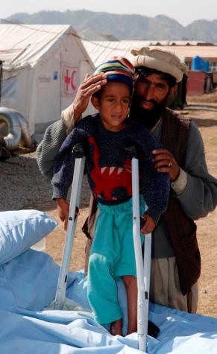
Emergency Response Units (ERU)
People & equipment package
Equipment standardised & modular
Standardised training
When local facilities are either destroyed, overwhelmed by needs or do not exist
Deployed within 24-72 hours for 4 months
Notes:
An ERU is a standardised package of trained personnel and modules of equipment ready to be deployed at short notice. They are designed to provide an essential, basic, and stardadised service platform for use in any part of the world. The units are fully self-sufficient for one month and can be deployed for up to four months.
ERUs are used whenever there is a situation that requires a quick response to which the NS or the delegation cannot respond alone. This is basically entails large emergency response operations.
The ERU provide specific support or direct service function when local facilities are either destroyed, overwhelmed by needs, or do not exist.
They are used in emergencies to cover gap only until function is no longer required, or until either the NS or the Federation country delegation can take over.

Slide 10
Emergency Response Units (ERU)
ERU can assist in the following areas:
Logistics
IT & Telecommunications
Basic health care
Referral and Rapid Deployment hospital
Water/Sanitation
Relief
Base camp
Notes:
The advantages for the NS with the ERU is:
Capacity building, as NS volunteers and staff work alongside the ERU, except for the hospital ERU which is part of health ERU.
Much of the equipment is handed over to the NS, like the Hospital ERU which traditionally handover to the Ministry of Health. But where the NS lacks capacity to take over handover will be done to the Federation.

Slide 11
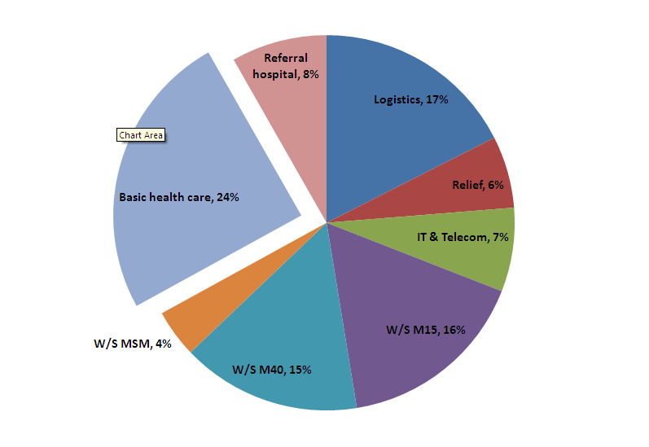
Emergency Response Unit statistics (since 1996)

Slide 12
Standard Operating Procedures
(SOPs)

Slide 13
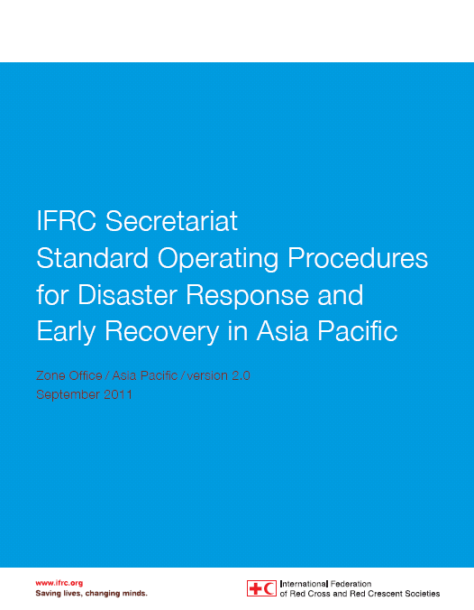
Guide IFRC action and reinforce
the internal procedures for IFRC Secretariat
the majority of responses to disasters are within the capabilities of National Societies
a single communication line between the Country Team and the Zone (global DM team)
Notes:
In summary the SoPs guide the IFRC Secretariat action.
It is important to note that while National Societies should be aware of the Secretariat procedures, the SoPs are an internal procedures for IFRC Secretariat and all Secretariat staff are required to follow them. They further set out how the IFRC Secretariat should interact with the operating NS, partners NS, and ICRC
The SoPS do not mean that the IFRC Secretariat will be come operational or impose onto the NS. The SoPs reinforce the FACT that the majority of responses to disasters are within the capabilities of National Societies. If a NS capacity is exceeded the SoPs guide the IFRC Secretariat how to mobilise complementary support.
That while the entire IFRC Secretariat (country, region, zone, Geneva) are there to support an operating NS. It is important that there be a single communication line between the Country Team and the AP Zone ( who represents global DM team). The AP Zone will work with the responsible IFRC Office to mobilise the different resources.

Slide 14
Key Concepts - Country Team
Comprises of a NS and IFRC representative
from a Host Red Cross National Society - this will be typically the Secretary General or Head of DM
from the IFRC this can vary:
the Country Representative or DM/Technical Delegate
a representative from the DMU, Regional Office, RDRT/FACT/ERU, PNS
DMU will initiate direct contact with the Country Team
Notes:
With in the SoPs there are a number of key concepts.
The first is the concept of a country team. This concept reinforces that it is not the NS or the IFRC Secretariat who make guide operational decision making in times of international supported disaster response, but it is a process of the NS and IFRC Secretariat working together in relation to the operation. Within this concept the NS leads implementation while the IFRC Secretariat supports the NS within the its mandated function.

Slide 15
Key Concepts - Operations Management & Coordination
Operations Management (National)
The NS is the operational lead and manages the implementation
The management of an operation is at the Country Level
If needed IFRC supports the NS through the Country Team
Operations Coordination (International)
The DMU is the international lead and coordinates the facilitation of international assistance
Facilitates management approval within Global team – Zone/Geneva
The Zone is the contact point for NS & International Organisations, outside of the country affected
Notes:
The second is to clarify that Operations Management is conducted at the country level. Decision making regarding the practical implementation of an operation will not take place outside of the affected country. If additional resources i.e. HR, finance, material etc. are required they will be provided to the country, not the region or zone offices.
The second is that operations coordination i.e. the decision on the type of tools and their facilitation. is undertaken at the zone office. The zone then connect in with the various offices who manage the mobilization of the tools.

Slide 16
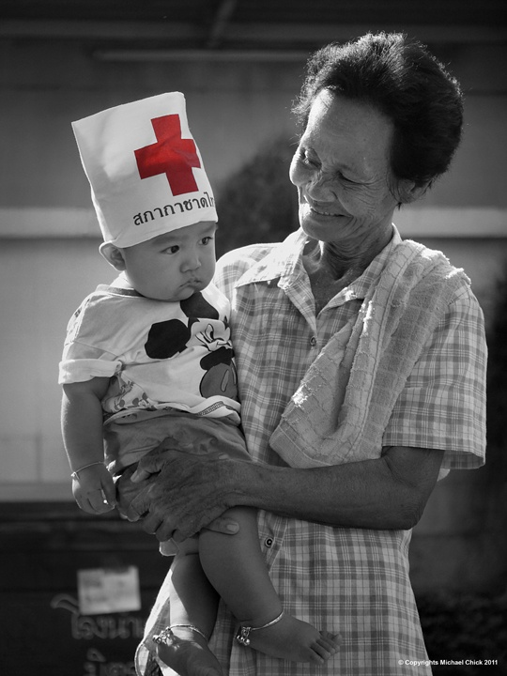
Thank You
Khob Khun Kha
Notes:
Making a difference around the world
Through its 186 Red Cross and Red Crescent member National Societies, IFRC is a global humanitarian organization that acts before, during and after natural and manmade disasters at the community level in non-conflict situations.
IFRC’s relief operations are combined with development work, including disaster risk reduction programmes, health and care activities, and the promotion of humanitarian values. In particular, it supports programmes on prevention and fighting the spread of diseases, such as HIV, tuberculosis, avian influenza and malaria. IFRC also works to combat discrimination and violence, as well as assisting migrants irrespective of their legal status.
The IFRC has a secretariat in Geneva, a permanent observer delegation at the United Nations in New York, an office in Brussels and five zone offices in:
Europe and Central Asia: Budapest
Asia Pacific: Kuala Lumpur
Africa: Johannesburg
Middle East and North Africa: Amman
Americas: Panama
These zones place personnel and resources closer to the vulnerable communities served by the IFRC and its members.

