Slide 1
Gender, Diversity and Climate Change
IFRC Southeast Asia Regional Delegation

Slide 2
Key objectives of this session
At the end of this activity, the participants are able to:
Increased knowledge regarding Gender, Diversity and how they impact on vulnerabilities

Slide 3
Background
What do we mean by Gender and Diversity?

Slide 4
Gender vs Sex
Sex: refers to the biological differences between men and women
Gender (as a concept): refers to the social differences between men and women and relate to the attitudes, behaviors, roles and expectations put on men and women as a result of being male or female
When we speak of ‘Gender’ we do not just mean women
Gender – provides us an analytical tool
Notes:
Gender as a concept refers to the social differences between men and women and relate to the attitudes, behaviors, roles and expectations placed on men and women as a result of being male or female
Gender provides us with an analytical framework to understand better the needs and capacities of all groups in a community and ensure these are addressed

Slide 5
How is gender influenced?
Gender is socially constructed, learned and has the ability to change over time and between situations
It is influenced by …
Tradition
Values and beliefs
Attitudes
Culture
Social influences
Behavior

Slide 6
Sexual and Gender-based Violence (S/GBV)
An umbrella term for any harmful act that results in, or is likely to result in, physical, sexual or psychological harm or suffering to a person on the basis of their gender.
A result of gender inequality and abuse of power.
Includes but not limited to sexual violence, domestic violence, trafficking, forced/early marriage, forced prostitution, sexual exploitation and abuse and denial of resources, opportunities and services.
Notes:
Sourced from IFRC Seven Moves Training

Slide 7
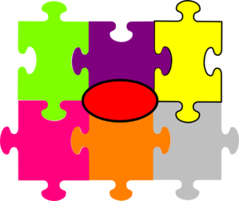
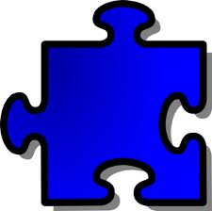
Diversity
Diversity refers to the acceptance and respect for the differences between people
Ethnic Origin
Health e.g.
Sexual Orientation
HIV Status
Diversity
Age
Religious affiliation
Socio-economic status
Nationality
Disability
Notes:
There are important interactions between a persons gender and aspects of diversity which can leave them increasingly vulnerable to disasters and to the impacts of climate change.

Slide 8
Vulnerability & Marginalized Groups
Due to aspects of a person’s diversity e.g. their age, their ethnic group, their migrant status etc. people can become marginalised.
Due to their group, or physical, social, economic, environmental and political factors that are influenced by a person’s gender or diversity, they can become more vulnerable/at risk to disasters, to the impacts of climate change, disease and health emergencies and to violence.

Slide 9
Vulnerabilities of gender and diversity in disasters
Women, girls and boys are 14 times more likely to die during a disaster than are men
Asia Tsunami, 2004 +70% fatalities women
Japan earthquake 65% of casualties were
/tsunami, 2011 60+
With climate change increasing the intensity and duration of disasters, these impacts will only increase
Notes:
Here are some examples of how gender or a group of people are vulnerable to a disaster…
Women, girls and boys 14 times more likely to die during a disaster than are men
More than 70% of those that died in the 2004 Asia Tsunami were women.
In three of the affected areas of the 2011 Japan earthquake/ tsunami, 65% of casualties were over the age of 60

Slide 10
IFRC Strategic Framework on Gender and Diversity issues
1
Gender and diversity integration in all programs, services and tools (planning, monitoring, evaluation and reporting).
2
Gender and diversity equality at all levels (governance, management, staff and volunteers).
3
Reduced gender- and diversity-based inequality, discrimination and violence through the active promotion of fundamental principles and humanitarian values.

Slide 11
Minimum Standard Commitments….
DAPS Framework:
Dignity
Access
Participation
Safety
Sectoral standards
Emergency Health
Food Security
WASH
Emergency Shelter Livelihoods
Non-food Items
Disaster Risk Reduction

Slide 12
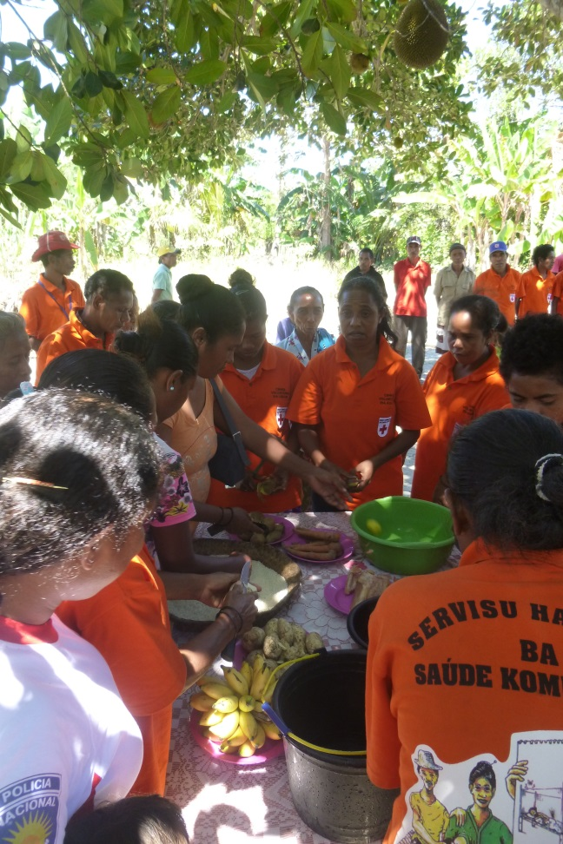
Gender equality
Gender Equality exists when males and females are able to equally share the distribution of power and have equal opportunities both in the home and in the community.
Gender Equality does not mean that males and females are the same – it means that their rights, responsibilities and opportunities do not depend on their sex.

Slide 13
What is Equity?
Equity Activity

Slide 14
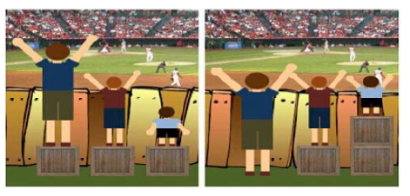
Gender and Diversity Equity
Equity happens when resources and services are divided so that people who need more, get more. The outcome is greater equality

Slide 15
Gender and Diversity Mainstreaming
Gender Mainstreaming is:
The process of ensuring we understand the implications of a particular programme or activity on men and women, and their different needs, capacities and priorities especially related to hazards and the impact of climate change
Designing and implementing our programmes in line with this understanding, so that gender and diversity approaches are integrated across all programs, tools, strategies and assessments

Slide 16
Gender and Diversity Mainstreaming
One key way to achieve this is to ensure sex and age disaggregated data is collected, analysed and used to inform all programmes and activities

Slide 17
Gender, Diversity and Climate Change
How can integrating Gender and Diversity Equality reduce the vulnerabilities associated with Climate Change?
Group exercises
Discussion

Slide 18
Gender and Diversity Equality reduces vulnerability
By increasing gender equality, a greater percentage of the population has access to the services and resources that increase their resilience to natural disasters and interpersonal violence.
But how is the related to climate change?
Different Needs – Different Abilities

Slide 19
Gender, Diversity and Climate Change
How can integrating Gender and Diversity Equality reduce the vulnerabilities associated with Climate Change?
Group Exercises
Discussion

Slide 20
Wrap up and Key Messages
Women, men, boys and girls and different social groups will experience disasters differently.
As such climate change will impact women, men, boys and girls in different ways
Everyone has different needs, priorities, capacities and vulnerabilities
These need to be understood and then incorporated into all programs, plans and activities

Slide 21
Wrap up and Key Messages
If we do this we will :
better prepare communities for impacts of climate change
achieve greater gender and diversity in reducing risks and
ensuring everyone in a community is resilient enough to build back after disasters

