Slide 1
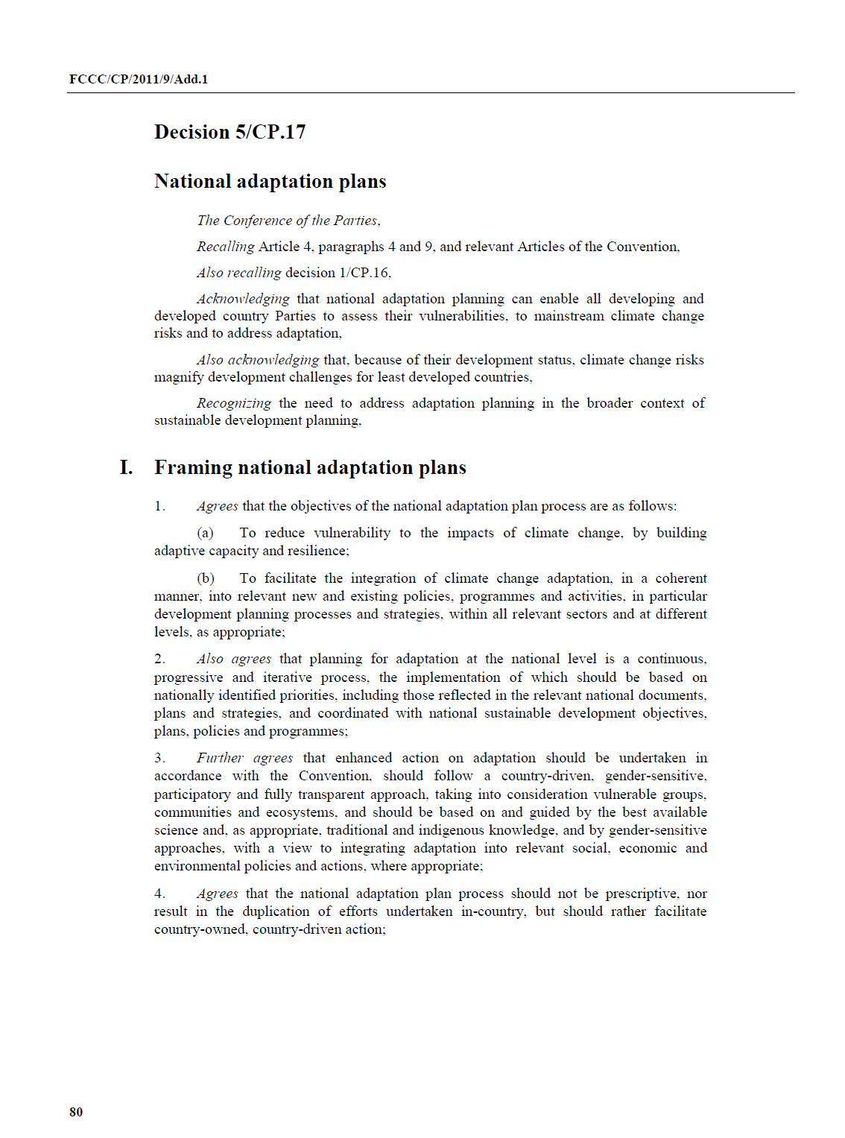
Institutional Mechanisms and Climate Change Finance From Global to National level Policies, Plans and Funding

Slide 2
Key objectives of this session
At the end of this activity, the participants are able to:
Describe the international climate policy context, especially climate finance as an enabler for developing countries to take strong climate action
Understand sources and channels of climate financing, (e.g. how these financial resources are being mobilized and what are some of the key issues with accessing climate finance)
Enumerate opportunities the NS can influence climate change related resource allocation at different levels

Slide 3
Content of the module
Climate policy context, plans and funding 30 min
Wrap-up Exercise on CCM-CCA-DRR 30 min
Local co-benefits
Partnerships
Synergies for funding
Key messages

Slide 4
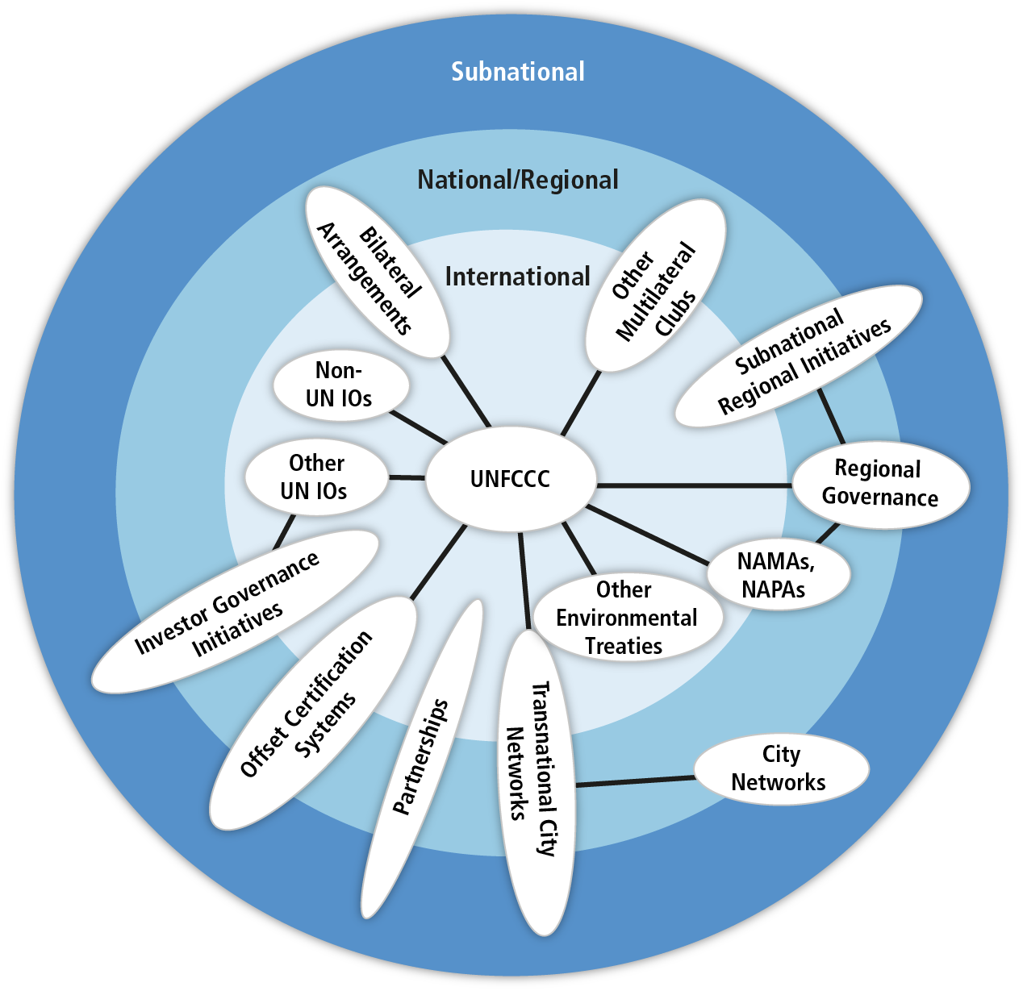
Climate change mitigation (and adaptation) is a global common problem that requires international cooperation across scales
RCRC
Based on Figure 13.1

Slide 5
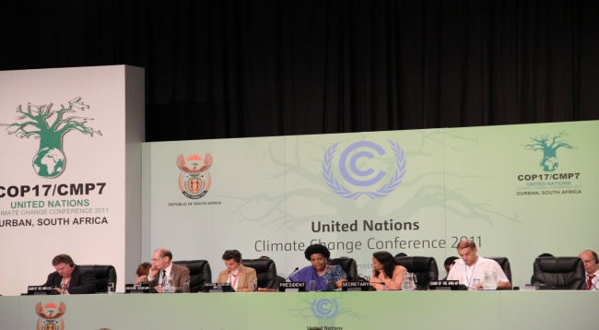
Background to the UNFCCC
opened for signature in 1992 to encourage countries to reduce GHGs emissions
recognized that there was a problem - IPCC´s First Assessment report released in 1990
The Parties have met annually from 1995 in Conferences of Parties (COPs) – initial focus was on mitigation
A strengthened response under UNFCCC since 2007 – Adaptation gains some attention
Notes:
Initially the main focus of the UNFCCC was to address the root cause of the problem: the greenhouse gas emissions.
The UNFCCC is a “Rio Convention”, one of three adopted at the “Rio Earth Summit” in 1992. Its sister Rio Conventions are the UN Convention on Biological Diversity and the Convention to Combat Desertification.
Recognized that there was a problem. This was remarkable for its time. Remember, in 1994, when the UNFCCC took effect, there was less scientific evidence than there is now.
1990 — IPCC’s first assessment report released. IPCC and second World Climate Conference call for a global treaty on climate change. United Nations General Assembly negotiations on a framework convention begin.
1988 — The Intergovernmental Panel on Climate Change is set up.
The ultimate objective of the Convention is to stabilize greenhouse gas concentrations "at a level that would prevent dangerous anthropogenic (human induced) interference with the climate system." It states that "such a level should be achieved within a time-frame sufficient to allow ecosystems to adapt naturally to climate change, to ensure that food production is not threatened, and to enable economic development to proceed in a sustainable manner.“
Source: http://unfccc.int/essential_background/convention/items/6036.php

Slide 6
UNFCCC focuses on
Mitigation
Adaptation
Climate Finance, including national level climate finance mechanisms, NAMAs, NAPA, NAPs, etc.
Technology
NAMA=nationally appropriate mitigation actions
(http://unfccc.int/focus/mitigation/items/7172.php);
NAPA=national adaptation programme of action
NAP=national adaptation plan
Notes:
Climate finance refers to local, national or transnational financing, which may be drawn from public, private and alternative sources of financing. Climate finance is critical to addressing climate change because large-scale investments are required to significantly reduce emissions, notably in sectors that emit large quantities of greenhouse gases. Climate finance is equally important for adaptation, for which significant financial resources will be similarly required to allow countries to adapt to the adverse effects and reduce the impacts of climate change.
In accordance with the principle of common but differentiated responsibility and respective capabilities set out in the Convention, developed country Parties (Annex II Parties) are to provide financial resources to assist developing country Parties in implementing the objectives of the UNFCCC. It is important for all governments and stakeholders to understand and assess the financial needs developing countries have so that such countries can undertake activities to address climate change. Governments and all other stakeholders also need to understand the sources of this financing, in other words, how these financial resources will be mobilized.
Equally significant is the way in which these resources are transferred to and accessed by developing countries. Developing countries need to know that financial resources are predictable, sustainable, and that the channels used allow them to utilize the resources directly without difficulty. For developed countries, it is important that developing countries are able to demonstrate their ability to effectively receive and utilize the resources. In addition, there needs to be full transparency in the way the resources are used for mitigation and adaptation activities. The effective measurement, reporting and verification of climate finance is key to building trust between Parties to the Convention, and also for external actors.

Slide 7
Climate Finance
All current annual financial flows of ´climate finance´ whose expected effect is to reduce net GHG emissions and / or to enhance resilience to climate change and climate variability show USD 343 to 385 billion per year globally (medium confidence). Most of this goes to mitigation. Out of this, total public climate finance that flowed to developing countries is estimated to be between USD 35 and 49 billion / yr in 2011 and 2012 (medium confidence). Estimates of international private climate finance flowing to developing countries range from USD 10 to 72 billion / yr including foreign direct investment as equity and loans in the range of USD 10 to 37 billion / yr over the period of 2008 – 2011 (medium confidence). (Source: AR5)
Notes:
Total climate finance includes all financial flows whose expected effect is to reduce net greenhouse
emissions and/or to enhance resilience to the impacts of climate variability and the projected
climate change. This covers private and public funds, domestic and international flows, expenditures
for mitigation and adaptation, and adaptation to current climate variability as well as future climate
change.

Slide 8
Shares of climate finance globally
Notes:
http://www.forestsclimatechange.org/forests-climate-change-finance/mitigation-adaptation-finance/
In order to assist countries in shifting towards low carbon and climate resilient development the international community provides substantial financial resources through a variety of mechanisms.
Most of the funding is spent on mitigation activities, which represent 77 percent of the total climate financingapproved since 2004.
Adaptation has been receiving 15 percent, slowly increasing compared to previous years thanks to public funding that play a major role in financing these interventions.
The remaining 8 percent of climate finance goes to multi-purpose projects, but the linkages between adaptation and mitigation are not necessarily explicit or synergetic.

Slide 9
What is funded in Asia Pacific?
58% to CCM since 2003

Slide 10
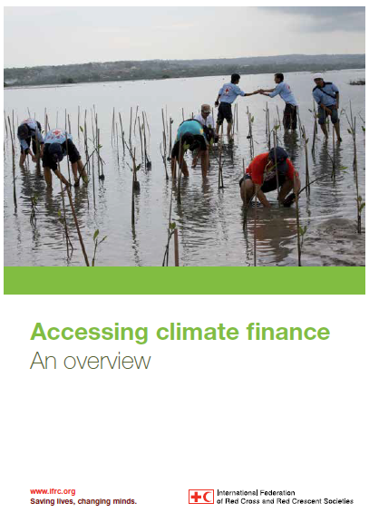
Climate finance landscape
Key messages from IFRC publication:
Need to strengthen collaboration with national governments
Develop innovative partnerships with private sector – funding, knowledge, technology
Seek synergies between adaptation and mitigation
Overview of the climate finance landscape;
Basic information on how to access climate funds;
Tips to bear in mind when writing a funding proposal;
Notes:
-Public sector funding is not distributed directly to end-users, but channelled through government agencies or development banks. Many international funds are only available through governments or UN development agencies.
-Most of funding goes through private sector, only limited sources of climate finance can be thought of traditional aid.
-Most funding is directed to mitigation. Mitigation-adaptation together is seen to support sustainable development

Slide 11
Funds become available through national policy dialogues and mechanisms
Influence what is funded through NAMAs, NAPAs, NAPs, etc. so that climate finance used in a way that supports the most vulnerable people to build their resilience.
Notes:
Ultimately, the Red Cross Red Crescent assisting in the implementation of, and accessing funding from, upcoming adaptation funds through national policy dialogues could be an outcome of advocacy efforts.
Therefore it is good to understand what is happening globally and how adaptation funds are being made available to governments.
Public sector voluntary interventions to contribute to low carbon development;
Compliant with national development plans, e.g. Cambodia climate change strategic plan in the case of Cambodia National Biodigester Programme;
Effect on emissions can be monitored;
Range from multi-sector interventions to specific policy instruments;
UNFCCC registry as a match-making tool

Slide 12
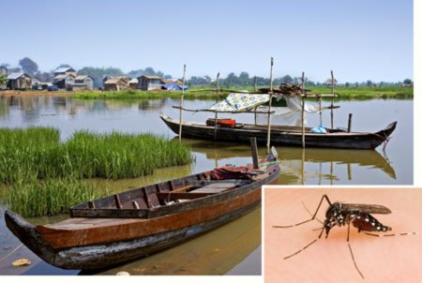
Climate finance in SEA: Cambodia Climate Change Alliance (CCCA) Trust Fund
Strengthened capacity for Climate Change Adaptation in Health: Integrated Response to Climate Sensitive Vector Borne Diseases in Cambodia
The project aims at strengthening capacity for dengue and other vector borne disease outbreak detection, prevention and response, including at the community level, to protect vulnerable populations in areas at risk of increased vector borne disease burden due to climate change.
For projects to be eligible for funding, they must respond to national priorities that are articulated in existing Government documents such as the NSDP-Update and NAPA
Notes:
E.g. CCCA Finance: Climate change adaptation projects can have a significant impact on the daily lives of affected communities. CCCA climate change projects are already a testament to what positive change small financial contributions can bring. As communities build their knowledge about the effects of climate change and identify possible responsive actions, they cannot be left alone to fend for themselves. Many CCCA project areas have already begun integrating climate change in their commune development and investment plans. Financing and resourcing these initiatives will be instrumental in fostering continued motivation, but more importantly in enabling communities to have a say in their own development for the future. The finances made available to communities through climate change interventions must be equitably, effectively, and accountably distributed. The international community plays an important role in ensuring adequate financing for Cambodia’s climate adaptation efforts. The government of Cambodia plays an equally important role in ensuring that the financing received is channeled through a transparent and accountable mechanism.

Slide 13
Group Work CCM – CCA – Risk Reduction
Notes:
This group work is based on all the sessions we learned under session 5 and session 6 (CCA,CCM, etc.)

Slide 14
Wrap-up Exercise on CCM-CCA-DRR
1. Discuss/work in groups to define which of the activities are CCM – CCA – Risk Reduction ? 10 min
2. De-brief in plenary 15 min
Local co-benefits?
Partnerships?
Synergies for funding?
3. Revisit the key messages 5 min
Notes:
CCM benefits? CCA benefits?
Run the traditional CCM-CCA-(traditional) DRR exercise, then discuss

Slide 15
Key Messages
Since climate funds become available through national policy dialogues and mechanisms, advocacy efforts with the national governments during planning processes (to influence government priorities) and for the local level implementation are key
Explore the potential for funding our core business (i.e. community resilience) through climate mitigation/selling climate mitigation co-benefits
Climate finance opportunities exist – Red Cross Red Crescent can access funding through improved reporting and profiling of activities
The RCRC needs to capitalize on what we already do (which is quite a bit!) in the area of climate change mitigation and community co-benefits.
Team up with relevant partners
www.ifrc.org
Saving lives, changing minds.

