Slide 1
Climate risk assessment – focus at community level
Notes:
How to improve VCA tools
How to improve analysis (table)
How to tweak the plans?

Slide 2
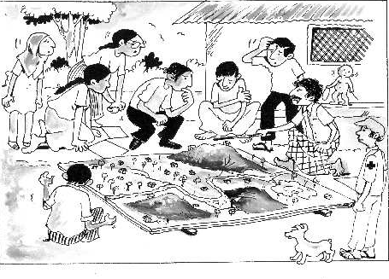
Key objectives of this session
Explore and share how to integrate information on the new/changing risks and vulnerabilities linked to climate change when carrying out a community assessment/VCA.
Notes:
Vulnerability and Capacity Assessment (VCA) is a participatory method that allows National Societies to work with communities to assess people’s vulnerabilities and build their capacities

Slide 3
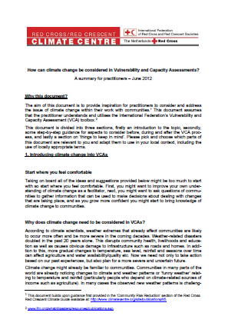
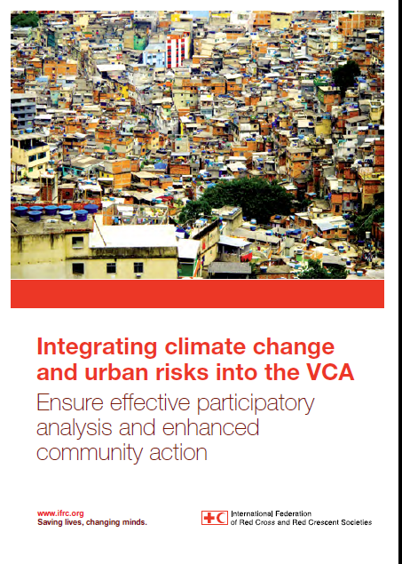
Which tools need changes?

Slide 4

Considering climate change in assessment tools
How to tweak the tools to assess also climate risks?

Slide 5
5 tools to consider…for now
Review of secondary sources;
Structured and semi-structured interviews;
Focus group discussion;
Direct observation;
Community maps: hazard/vulnerability map & capacity/resource map
Historical profile;
Seasonal calendar;
Risk matrix

Slide 6
Secondary information sources exercise
If you are planning a Community Assessment/VCA, what secondary information would you use to make sure that you guide the Community Assessment/VCA to become a ‘climate smart’ one?
How might you use the secondary information?
Notes:
We must base our efforts to incorporate climate change concerns into RC/RC work on knowledge and credible information, and prepare ourselves to set facts against myths and about climate change and its implications for the NS and vulnerable communities. So before trying to bring in the issue of climate change in the community process (VCA, etc.) we need to do some homework and seek credible sources of information about local weather variability and climate trends. Where do we seek relevant information for this purpose?
Consider investigations with:
Meteorological office (but don’t ask for raw data!)
The national climate change focal point – usually at the environment ministry
'Preparedness for Climate Change' (PfCC) background document (prepared if the NS was part of the PfCC process – see http://www.climatecentre.org/downloads/File/programs/PFCC/CC_PfCC_version web.pdf)
Research institutes
NGOs and UN agencies (e.g. UNDP)
Climate helpdesk: mailto:ifrc@iri.columbia.edu.
Note their replies on the whiteboard.
3. Coach for and add any answers that the participants don’t mention (you may like to prepare your own background list – adding to the list mentioned above – for the specific setting, e.g. country or region).
4. Ask how you might use the secondary information (e.g. in planning where and who to do the Community Assessment/VCA, knowing what trends to expect and ask communities about).
5. The facilitator can also point out that the NS can create longer-term alliances (formalized with MOUs) with meteorological offices and knowledge centres on climate change.

Slide 7
Scientific Information from secondary sources (examples)
Scientific Information | The observed climate variability and change in Myanmar over the last ~six decades includes the following: • a general increase in temperatures across the whole country (~0.08°C per decade); • a general increase in total rainfall over most regions; • a decrease in the duration of the south-west monsoon season as a result of a late onset and early departure times; and • increases in the occurrence and severity of extreme weather events, including; cyclones/ strong winds, flood/storm surges, intense rains, extreme high temperatures and drought.
 | Climate change projections for Myanmar predict: • a general increase in temperature across the whole country, particularly from Dec – May; • an increase in clear sky days exacerbating drought periods; • an increase in rainfall variability during the rainy season including an increase across the whole country from March – November, and decrease between December and February; • an increase in the risk of flooding resulting from a late onset and early withdrawal of monsoon events; • an increase in the occurrence and intensity of extreme weather events, incl. cyclones/ strong winds, flood/storm surge, intense rains, extreme high temperatures and drought.
Source: MoE and Dept of HydroMet. Myanmar’s NAPA to climate change 2012.

Slide 8
Climate projections out to 2100 show an increase in the severity of climate-related hazards (NECC, 2012; McKinley et al., 2015).
By the end of the century, climate projections show an increase in mean temperatures of 1–4°C, although outcomes will vary throughout the year and spatially across the country (RIMES, 2011; World Bank, 2012a). Rainfall variability is expected to increase in rainy seasons, potentially by ~10% over the coming decades (NECC, 2012; McKinley et al., 2015).
Combined with a continued shortening of the rainy season observed over the past 40 years, many climatologists expect greater concentration and variability in rainfall that will lead to increased frequency and intensity of flooding (NECC, 2012; McKinley et al., 2015).
Finally, extreme weather events like cyclones, strong winds, flood and storm surges, intense rains, extreme high temperatures and drought are all expected to increase in occurrence and intensity (NECC, 2012) (based on the PRECIS model).
Rising sea levels along the coasts are likely to compound these problems by aggravating saltwater intrusion and soil salinity in the coastal areas and river deltas (McKinley et al., 2015).

Slide 9
Hazard and vulnerability map
Objective: A visual experience that enables to see quickly and analyze the linkages, pattern and interrelationship between issues and risk they face, hazard location and resources
Guide Questions:
How much change has happened in community’s environment and land use?
What are the “old” and “new” areas affected by different hazards? Where there any changes in the exposure?
What were the hazards experienced by the community due to the external factors?
Notes:
Comparative mappings should identify community growth, areas impacted by different hazards, changes in water sources, etc. Also, external (“upstream”) factors beyond community should be discussed/noted

Slide 10
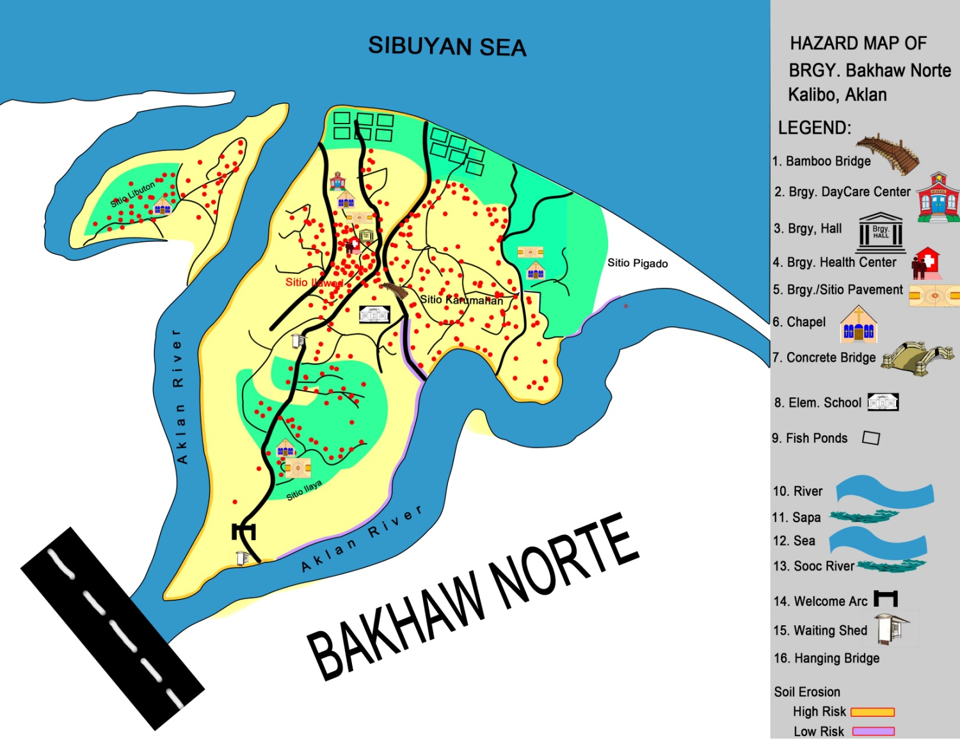
Hazard and vulnerability map
Notes:
Comparative mappings should identify community growth, areas impacted by different hazards, changes in water sources, etc. Also, external (“upstream”) factors beyond community should be discussed/noted

Slide 11
Seasonal calendar
Objective: A time-related data-gathering tool to explore the changes taking place in a community throughout a recurring time cycle over
Guide Questions:
What were the observed changes in the seasonal events such as weather, livelihood, health problems, etc?
If there were changes in the seasonal cycle, what actions the community has taken or is considering?
Notes:
Weather
shorter or longer dry or wet season?
increased rain or changes in temperature?
Livelihood
quality and quantity of livelihood products?
shift in planting/harvesting season?
introduction of new livelihood schemes?
Health
new diseases? Or its occurrence in unexpected location?
increased number of cases?

Slide 12
Seasonal calendar

Slide 13
Historical profile
Objective: To build a picture of past events that have an effect on a community and analyze the patterns that can help generate an awareness which may influence the decisions made by community members in the planning process
Guide Questions:
Are there changes in the frequency and intensity of hazardous events?
What events had contributed to the increased risk?
Notes:
Historical profiles identify changes in frequency and intensity of hazardous (and other) events

Slide 14
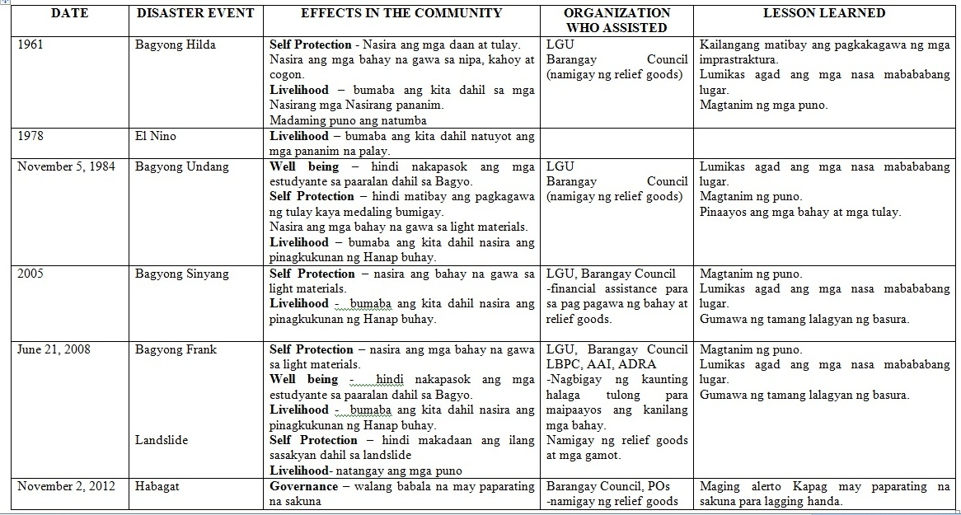
l

Slide 15
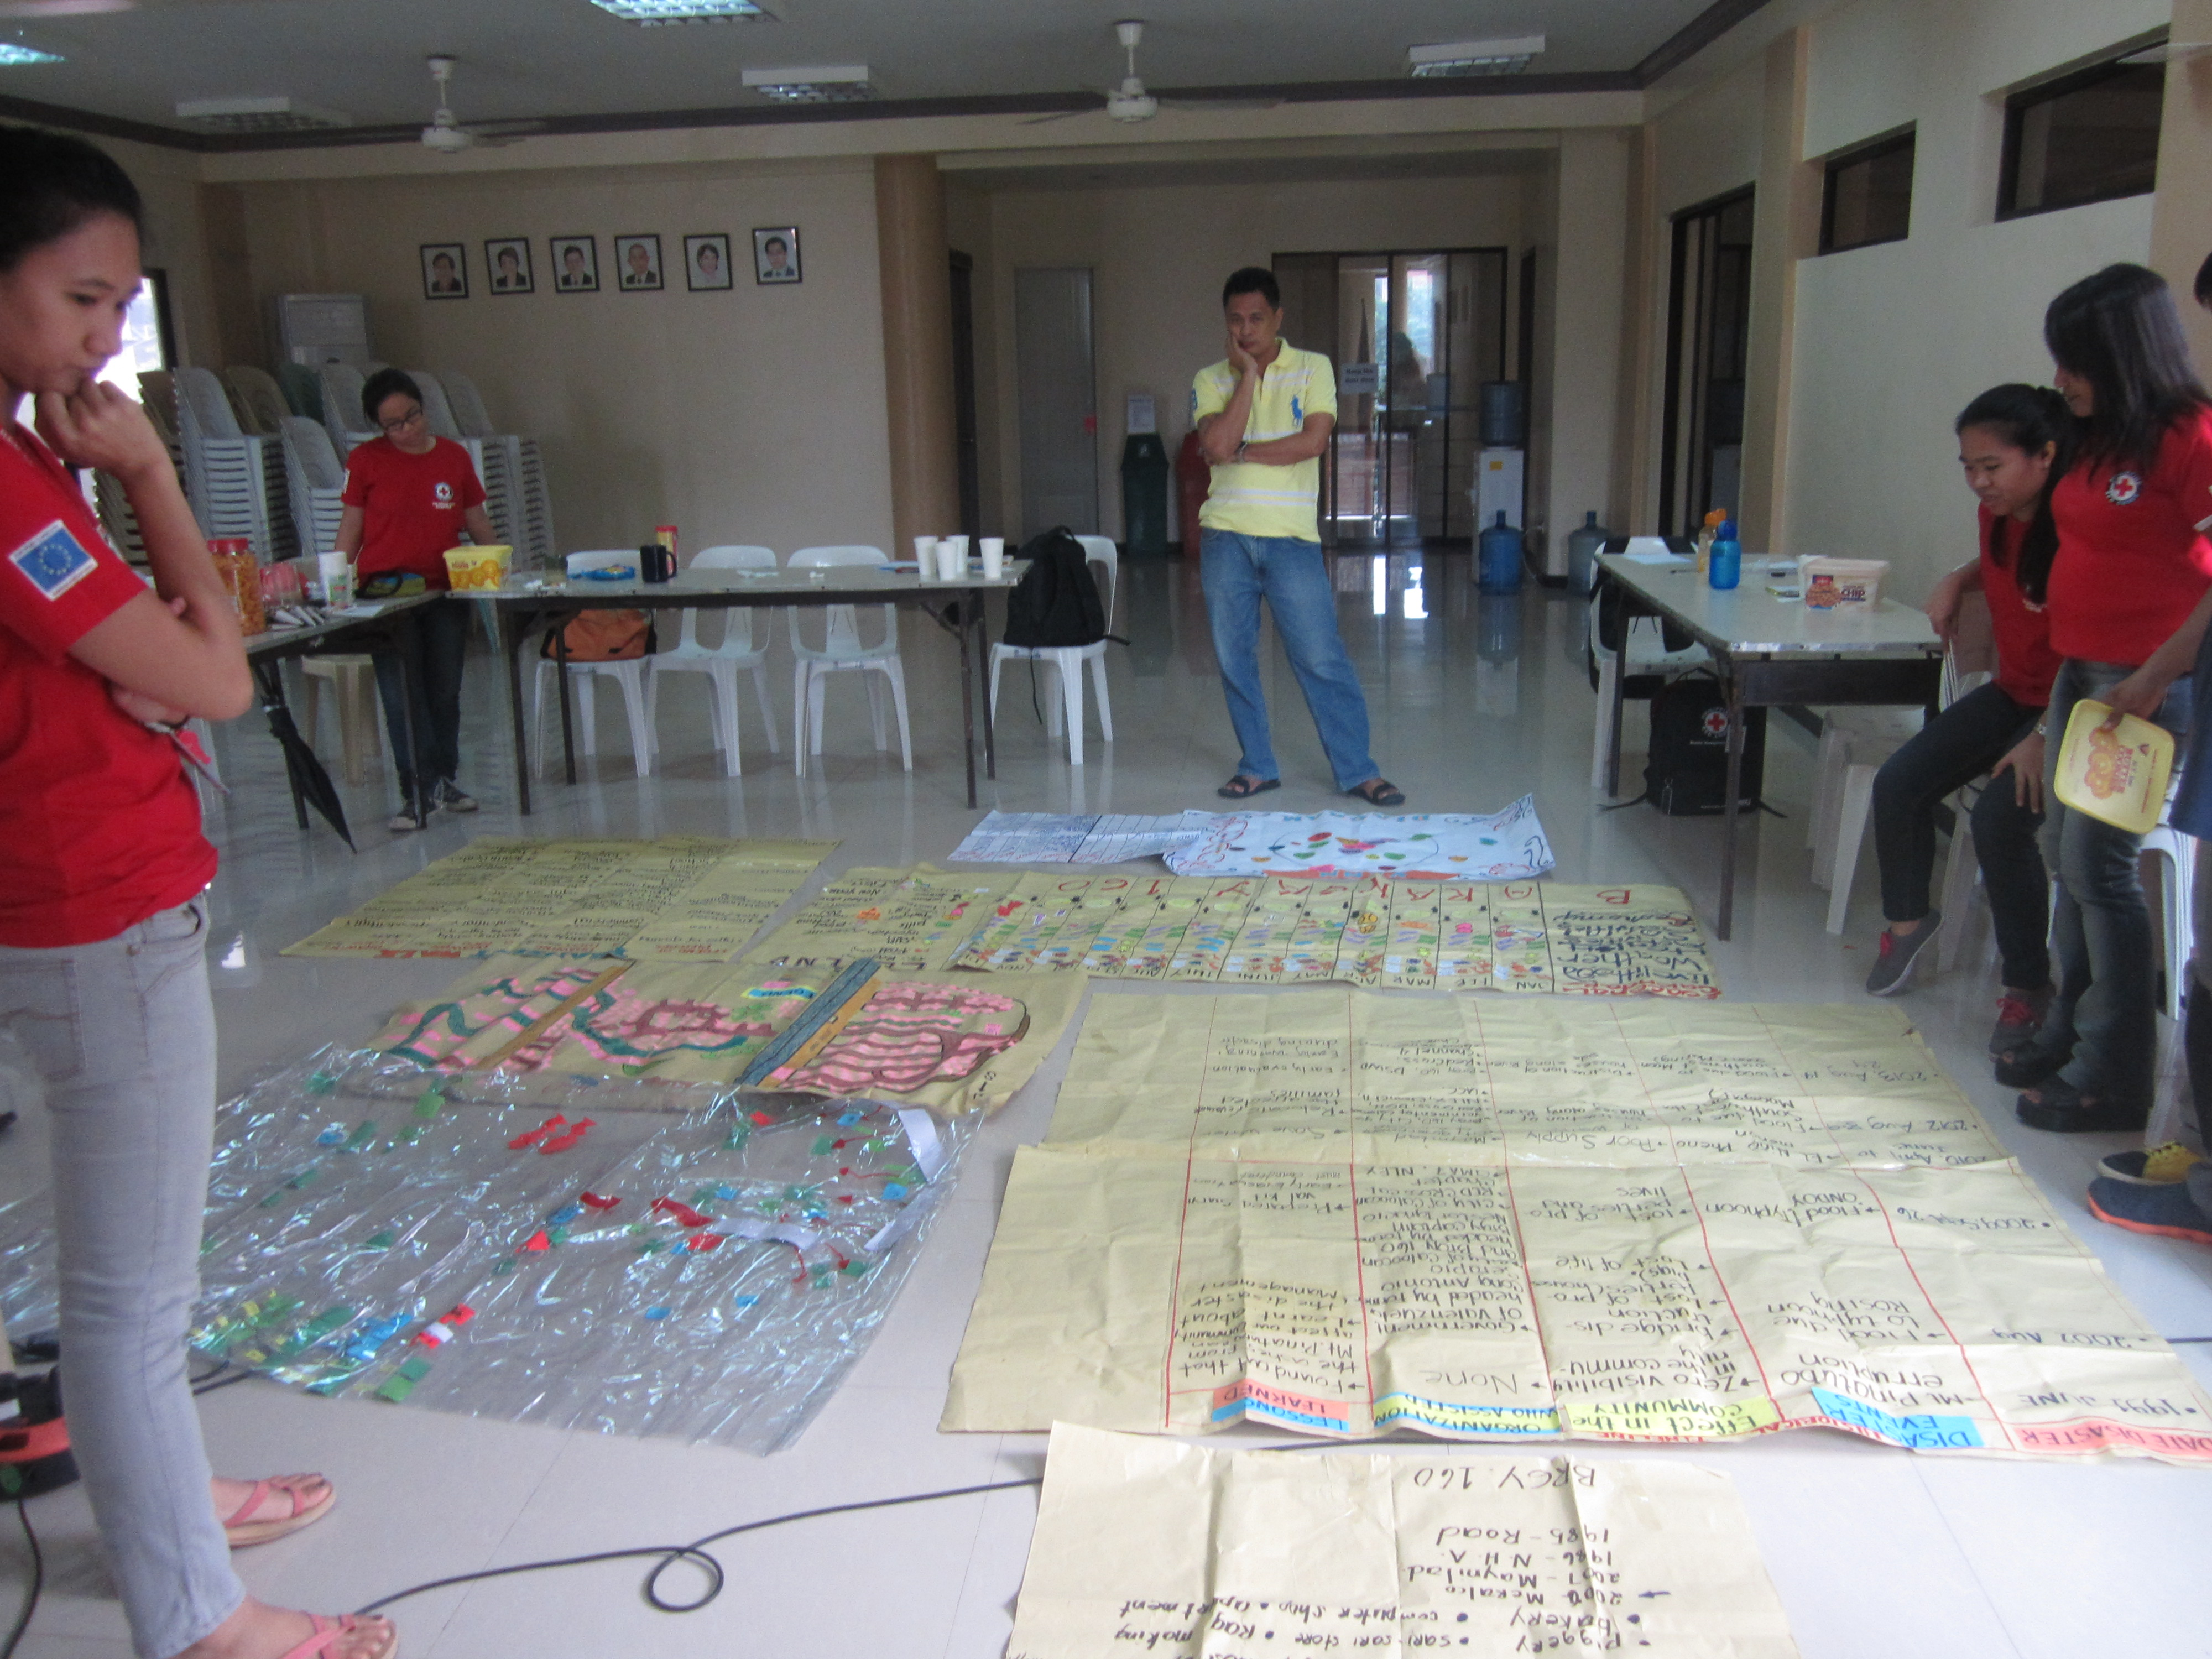
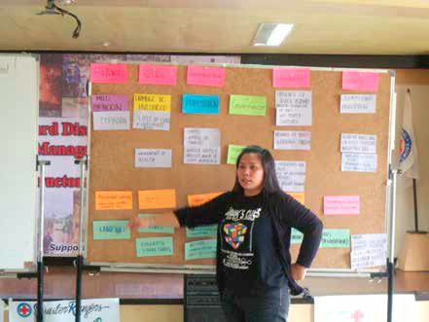
A matrix to help the risk analysis
Objective: To summarize all information collected across different VCA tools and enable to triangulate data with secondary information or further interviews
Notes:
Captures existing early warning methods, which elements are currently most at risk, and how hazards and disasters are normally dealth with (current practices are basis for improvements and scaling up)
15

Slide 16
A matrix to help the risk analysis
Hazard/threats | Impacts/Risks | Elements at risk | Vulnerability | Capacity
Risk Prioritization
Problem Identification
Problem Tree Analyses
Objective Tree Analysis
Community Action Plan
Notes:
An example from the Solomon Islands.
16

Slide 17
A matrix to help the climate risk analysis
Guiding questions for risk analysis: • Does the information people report match the scientific climate information? (If not, then the reported changes may have other reasons than climate change, and then the future climate projections are less helpfull in the planning) • How is climate change affecting existing risk patterns? • If the trends observed by communities and science continue, how may risks shift in the future? Questions to guide planning • How do people normally deal with the challenges? Can exisiting practices be adjusted and scaled up to handle more frequent and more severe events?
Changes observed by the community | Possible reasons for changes
 | Evidence based on scientific information | Other factors that may explain changes observed by communities
Example 1. Sea eroding the coastline | Sea level rising 8 mm per year in XX | Some sand mining along coastline
Example 2. Getting hotter in the summer | Temperature rising
Example 3. Flooding more often | Meteorological office reports that no change in extreme rainfall events | Logging present upstream, probably affecting flow
Notes:
17

Slide 18
Key Messages
Consider both local, traditional knowledge and scientific information
Conduct multi-sector assessments and analyses (and NOT a separate analysis for climate)
Look at changes versus existing climate conditions
Engage in capacity building
When doing a VCA, do it with a climate lens on (advice: don’t do the work twice – simply integrate climate into existing assessment work)
Use VCA process for climate change awareness raising and advocacy purposes and the 4 A's (Assessment, Awareness, Advocacy and Action)
www.ifrc.org
Saving lives, changing minds.

