Slide 1
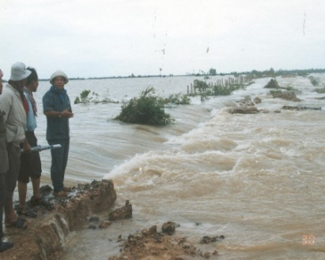
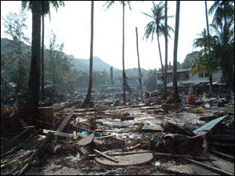
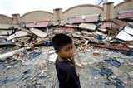
ASEAN COOPERATION
ON DISASTER MANAGEMENT
Disaster Management & Humanitarian Assistance Division,
ASEAN Secretariat

Slide 2
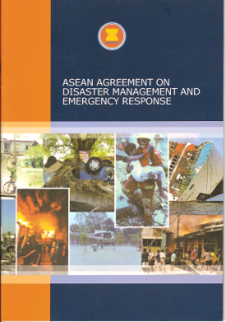
AADMER aims For a more united and coordinated asean’s RESPONSE toward disasters within the region
Initiated by ACDM since early 2004, supported by ASEAN Leaders in the Special ASEAN Summit in January 2005 after the Indian Ocean Tsunami
Negotiated within 4 months, signed by ASEAN Foreign Ministers in July 2005, ratified by all ten countries in ASEAN, entered into force on 24 December 2009
Aims to: (i) reduce disaster losses in ASEAN region, and (ii) jointly respond to disaster emergencies
Serves as a legal framework for all ASEAN Member States and a common platform in responding to disasters within ASEAN & helping one another
One ASEAN, One Response
Notes:
Recognising that the region is at high risk to natural and human-induced disasters, ASEAN has laid down a policy framework that mandates the programmatic pursuance of disaster management and risk reduction initiatives at regional and national levels. The ASEAN Agreement on Disaster Management and Emergency Response or AADMER was ratified by all ten Member States and entered into force on 24 December 2009. It has two objectives: (a) reduction of disaster losses, and (b) enhanced regional cooperation in responding to disasters. AADMER is a legally-binding instrument, binding all the ten countries, serving as a common platform in responding to disasters within ASEAN.

Slide 3
ASEAN COMMITTEE ON DISASTER MANAGEMENT (ACDM)
The ACDM is the main sectoral body under AADMER. The ACDM Focal Points are also AADMER National Focal Points. They are Heads of National Disaster Management Organisations/Agencies in ASEAN Member States
The ACDM reports to the AADMER Conference of the Parties (COP) and the ASEAN Ministerial Meeting on Disaster Management (AMMDM), who meets once in every year
The ACDM is the founding fathers of AHA Centre and serves as its Governing Board
The ACDM meets at least once in a year, but normally twice in a year. ACDM’s chairmanship rotates every year
The ACDM is the main driver in maintaining ASEAN’s Centrality and ensuring synergy in HADR efforts in the region

Slide 4
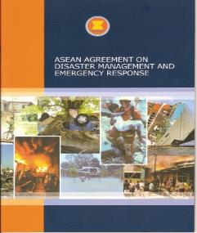
Aadmer is comprehensive as it covers the whole spectrum of disaster management
Disaster Risk Identification, Assessment & Monitoring
Disaster Prevention and Mitigation
Disaster Preparedness
Emergency Response
Rehabilitation
Technical Cooperation & Scientific Research
AHA Centre - TOR
Notes:
AADMER is a comprehensive Agreement as it covers the whole spectrum of disaster management, from risk identification, assessment and monitoring, prevention and mitigation, preparedness and response to recovery. AADMER also promotes technical cooperation and scientific research.

Slide 5
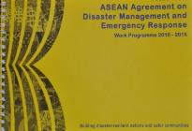
Disaster Preparedness & Response, or also known as HADR, is an element of AADMER and its Work Programme
Introduction and Guiding Principle
Risk Assessment,
Monitoring and
Early Warning
Prevention
and Mitigation
STRATEGIC
COMPONENTS
Preparedness and
Response
Recovery
AADMER Work Programme (2010-2015) translates legal framework into actions
ASEAN Committee on Disaster Management (ACDM) assigns lead shepherds for each component
ACDM Working Group on Preparedness & Response, co-chaired by Malaysia & Singapore, takes the lead in Preparedness & Response under AADMER WP
Institutionalisation of AADMER
Partnership
BUILDING BLOCKS
Resource Mobilisation
Information Management and Comm. Tech.
Outreach and Mainstreaming
Training and Knowledge Management
Monitoring and Evaluation
Building disaster resilience in asean
Notes:
To translate the visions of the AADMER into actions, the ASEAN Committee on Disaster Management (ACDM) has developed the AADMER Work Programme (2010-2015). The Work Programme is the successor of the previous work programme, i.e. the ASEAN Regional Programme on Disaster Management (ARPDM), 2004-2010.
The AADMER Work Programme (2010-2015) was adopted by the 15th Meeting of the ACDM in March 2010 in Singapore as a rolling plan. Phase 1 (2010-2012) includes ongoing activities initiated in the previous cycle as well as those that are already in the pipeline. Following the adoption in March 2010, the Work Programme was introduced to the partners in May 2010 in Makati, Philippines.
The AADMER Work Programme (2010-2015) covers all aspects of disaster management and outlines a detailed road map for four (4) strategic components: (1) Risk Assessment, Early Warning and Monitoring; (2) Prevention and Mitigation; (3) Preparedness and Response; and (4) Recovery.
Furthermore, as a holistic Work Programme, there are six (6) building blocks and drivers of implementation to provide a firm foundation for the four (4) components and to create a synergy among the various parts of the Work Programme. These building blocks are: (1) Institutionalisation of AADMER; (2) Partnership Strategies; (3) Resource Mobilisation; (4) Outreach and Mainstreaming; (5) Training and Knowledge Management System; and (6) Information Management and Communication Technology.

Slide 6
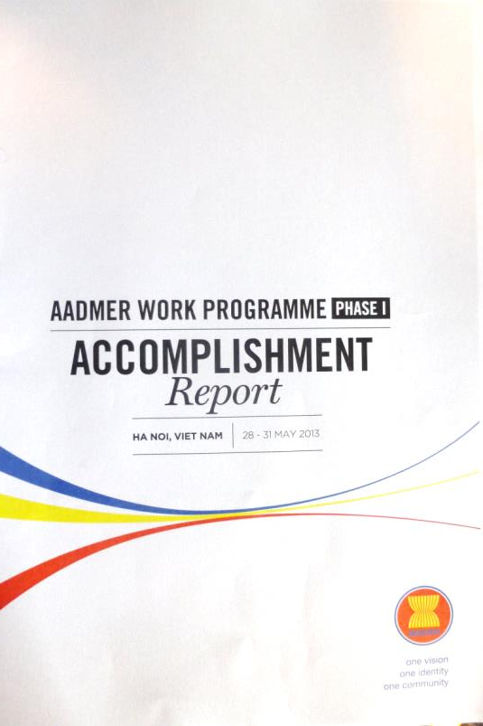
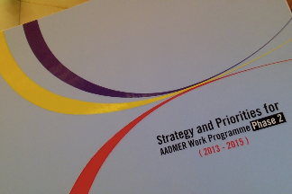
AADMER Work Programme is a 5-year rolling plan In 2013, ACDM produced an Accomplishment Report to capture the outputs under Phase 1 (2010-2013) ACDM also came up with the Phase 2 Strategies and Priorities under AADMER (2013) – 2015) to highlight its 21 priorities for the next few years
- Adoption of AADMER WP, March 2010, Singapore
- Prioritisation Exercise, April 2010, Manila
- AADMER Partnership Conference, May 2010, Makati
Mid-Term Review
July 2012 – May 2013
ASEAN vision of a more disaster-resilient and safer community by December 2015
2012-2013
2010
2015

Slide 7
21 Concept Notes as Priorities and Flagship Projects under Phase 2

Slide 8
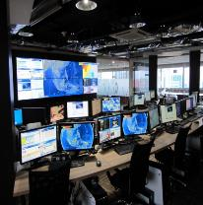
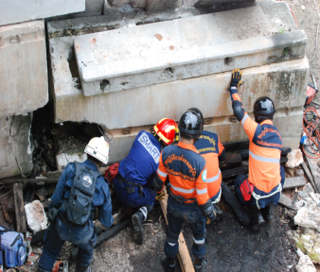
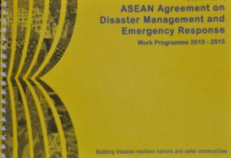
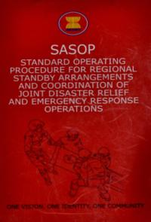
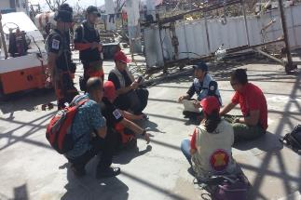
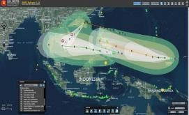
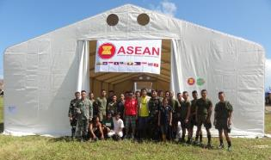
AADMER has gone from policy discussions to actions on the ground
AHA
Centre
ARDEX
ADMER F u n d
ERAT
DELSA
DMRS
Notes:
Snapshots of regional mechanisms:
AADMER Work Programme
SASOP
ARDEX (ASEAN Regional Disaster Exercises), this year hosted by Vietnam in October 2013.
ASEAN ERAT (Emergency Rapid Assessment Team)

Slide 9
Development of the post-2015 AADMER work programme
ASEAN Declarations and Statements on disaster management
Elements of the Post-2015 AADMER Work Programme
Contextual Analysis
Characteristics and Strategies
Action Plans
Implementation Mechanisms
Resources
Communication
Monitoring and Evaluation
ASEAN Community Vision 2025
Successor AADMER Work Programme
M&E of the AADMER Work Programme 2010-2015
Assessment of the 21 Concept Notes
Strategic “think-pieces”

Slide 10
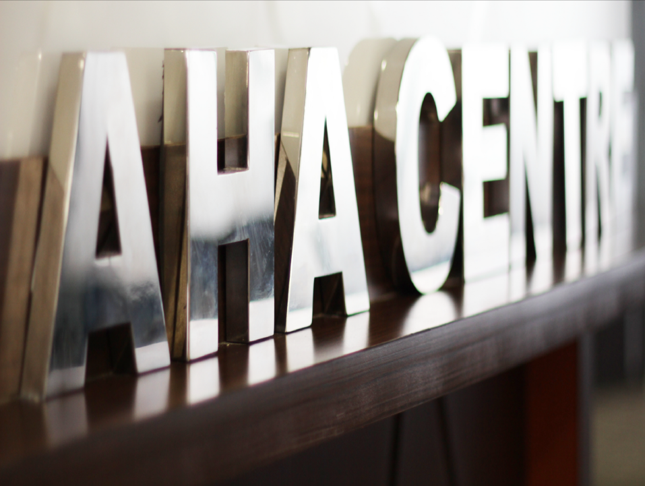

Slide 11
A lot of efforts have been made by ASEAN in establishing the ASEAN Coordinating Centre for Humanitarian Assistance on disaster management (AHA CENTRE) as the operational engine of AADMER
The AHA Centre shall be established for the purpose of facilitating co-operation and co-ordination among the Parties, and with relevant United Nations and international organisations, in promoting regional collaboration
(AADMER Article 20.1)
The AHA Centre shall work on the basis that the Party will act first to manage and respond to disasters. In the event that the Party requires assistance to cope with such situation, in addition to direct request to any Assisting Entity, it may seek assistance from the AHA Centre to facilitate such a request (AADMER Article 20.2)
One ASEAN, One Response

Slide 12
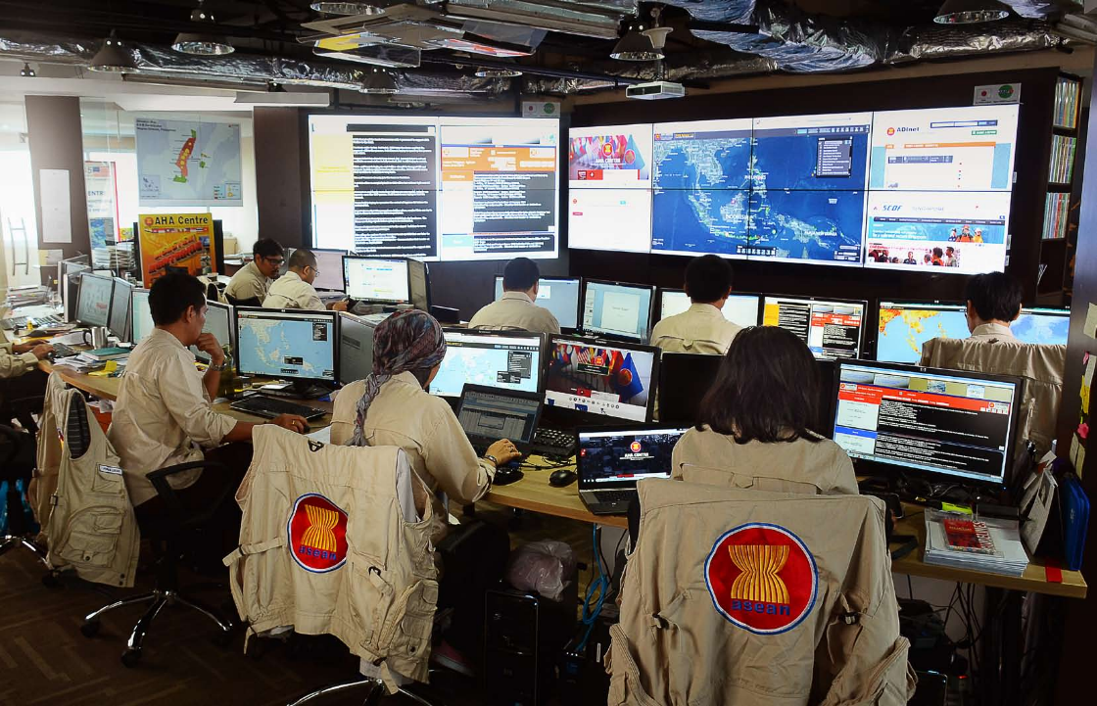
AHA CENTRE

Slide 13
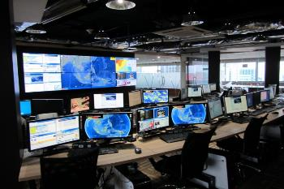
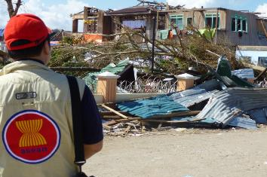
Currently AHA Centre is focusing on two main areas:
Focus areas
Activities
Disaster Monitoring and Response System
ASEAN Disaster Information Network
Flash Updates
Daily situation updates during emergencies
Weekly regional disaster updates
Monthly regional disaster updates
Information dissemination through social media
1
Disaster Monitoring
ASEAN Emergency Response and Assessment Team (ASEAN-ERAT)
Disaster Emergency Logistic System of ASEAN
Standby Arrangements
Web-based crisis information management
ASEAN Regional Disaster Emergency Exercises
Emergency response operations
AHA Centre Executive (ACE) Programme
2
Preparedness & Response
One ASEAN, One Response

Slide 14
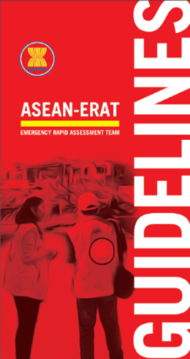
ASEAN-Emergency Response and Assessment Team (ERAT)
To support the National Focal Points in the initial phases of the disaster, to:
Conduct rapid assessments
Coordinate with the AHA Centre for the mobilisation, response and deployment of regional disaster management assets
Facilitate incoming relief assistance from ASEAN Member States
One ASEAN, One Response

Slide 15
ASEAN-ERAT
90
members
10
4
ASEAN
training courses
trained from
countries
conducted
ERAT Member by Duty Station
ERAT Member Composition by Institution
Number of ERAT Member Trained by Year
ASEC
CSO
Military
AHA Centre
NDMO
2010
Singapore
2011
Singapore
2013
Singapore
2014
Jakarta
One ASEAN, One Response

Slide 16
ONE ASEAN
ONE RESPONSE
ASEAN RESPONDING AS ONE IN THE REGION AND OUTSIDE THE REGION
VISIONING FOR 2015-2020 AND BEYOND

Slide 17
One ASEAN One Response is a vision of embracing various stakeholders in ASEAN to jointly respond to disaster together as One
stakeholders
approach
Mission
One framework: AADMER
One Standard Operating Procedure: SASOP
One Regional Coordinating Agency: AHA Centre
One Single Point of Contact: National Disaster Management Office
One Field Coordination Centre : Joint Operation and Coordination Centre of ASEAN
ONE ASEAN ONE RESPONSE
Civil, Military, CSOs, Private Sectors and other identified and willing partners
Disaster in affected country
FASTER Response
Bigger Resources
BETTER Coordination
ONE ASEAN ONE RESPONSE

Slide 18
One Asean one response
ASEAN
X.0
Responding beyond the region
ASEAN
3.0
ASEAN responding outside the region as one
ASEAN
2.0
Coordination beyond AMS
Establish and operationalize coordination mechanism with relevant mechanism in ASEAN such as EAS to respond to disasters in the ASEAN region
ASEAN
1.0
ASEAN responding as one
Establish and operationalize coordination mechanism with military, CSO, Private Sector, Red Cross, to facilitate and coordinate the overall ASEAN response
Operationalisation
1.0
Set up and operationalize AHA Centre
2011-2014
2015-2020 and beyond
ONE ASEAN ONE RESPONSE

