Slide 1
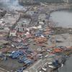
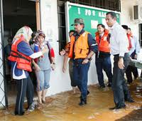
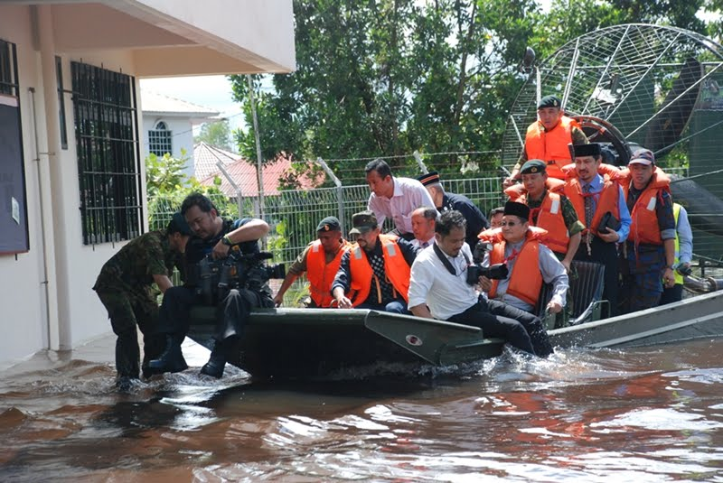
REGIONAL DISASTER MANAGEMENT COMMITTEE MEETING,SINGAPORE
6-8 JUNE 2012

Slide 2
SCOPE
BRIEF BACKGROUND OF BDRCS
STRUCTURE OF BDRC AND DISASTER
MANAGEMENT DIVISION
FUTURE PLANS OF DMD
CHALLENGES OF DMD

Slide 3
BRIEF BACKGROUND
Brunei Darussalam Red Cross Society was established in 1948 as a Branch of the British Red Cross
Gazetted in the Brunei Constitution in 1959
Following full Independence in 1984,the Brunei Red Cross was renamed as Brunei Darussalam Red Crescent Society (BDRCS)
BDRCS became the 130th member of the IFRC 1999

Slide 4
STRUCTURE OF BDRCS
PRESIDENT
VICE PRESIDENT
SECRETARY GENERAL
UNIFORM/YOUTH
VAD
DISASTER MGT AND PREPAREDNESS
INT RELATION & LEGISLATION
MEDICAL & HEALTH SERVICES
TRAINING RESOURCE & DEVELOPMENT
SOCIAL & WELFARE DEVELOPMENT

Slide 5
STRUCTURE OF DISASTER MANAGEMENT DIVISION
NATIONAL DIRECTOR
ASST DIRECTOR
DISTRICT CHAIRMAN
BRUNEI/MUARA
TUTONG
KUALA BELAIT
TEMBURONG

Slide 6
PAST DISASTERS SINCE 1960S
1962 – Major flood
1980s – Fires in Water Village
1987 – Rasau Gas blow-out in Belait District
1991 –Poor Air quality resulting from Mount Pinatubo eruption in the Philippines
1998 – Regional haze
1999 – Flash Flood during La Nina
2008 – Temburong Flash Flood
2009 – Extensive Flash Flood in Brunei Muara/ Tutong and Belait District
2010 – Influenza A (H1N1)

Slide 7
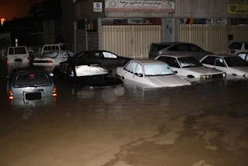
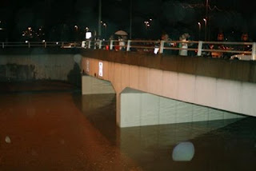
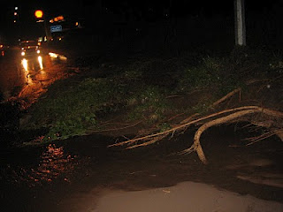
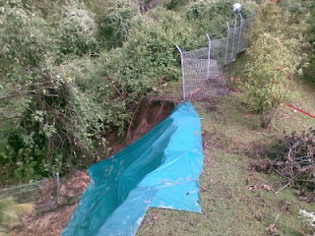
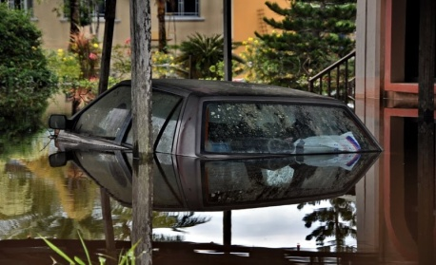
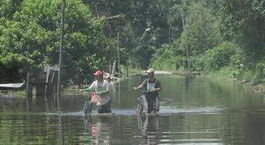
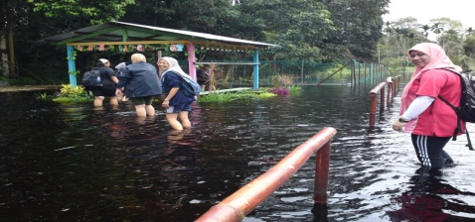
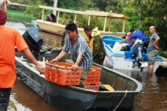
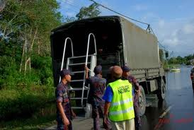
Photos gallary Disaster in Brunei
Notes:
BRIEF BACKGROUND BRDCS

Slide 8
NATIONAL DISASTER EXECUTIVE COMMITEE
Provide Policy and Strategy
STRATEGIC LEVEL
NATIONAL DISASTER MANAGEMENT UNIT
OPERATIONAL LEVEL
Planning, Implementation, Organize, Manage & Supervise Policy
MULTI AGENCIES
NDMC
VOLUNTEERS
NGO’S
PRIVATE SECTORS
GOVERNMENT AGENCIES
TACTICAL LEVEL
Disaster Operation

Slide 9
FUTURE PLANS OF DMD
(Strategic Plan 2012 – 2016)
Goals and Strategic Directions
Goals : Enhancing the capacity of BDRC in preparing for and responding to Disaster Management
Strategic Directions
Strengthen the Capacity –Manpower,management,Infra-structure,equipment,budget and approach in preparing for and responding to disaster and crises
Effective prepardness capacities for appropriate response to disaster and crises
To develop well prepared and effective means to help and meet the different needs of the most vulnerable people
Work with communities to improve their health and livehood and assisting them to prepare and respond to disaster and crises or “Community empowerment approaches” (CBDRM)

Slide 10
Strategic Directions
To work closely in partnership and colloboration with National Disaster Management Centre (NDMC)
Enhancing internal communications and coordination within BDRC Branches and NDMC
Strengthen recruitment and rentention of volunteers of BDRC
BDRC as part of Regional Disaster Management Team
Exposure of volunteers to the work in disaster prepardness and respone

Slide 11
CHALLENGES OF DMD
Reviewing the present BDRC Constitution to refelext the existing and emerging humanitarian values,quality of life the general public and the needy particularly the vulnerables.
Paradigm shift…Changing the mindset of the
BDRCS members including volunteers from the
routine tasks of domestic disaster relief
assistance to more challenging and demanding
International Humanitarian Disaster and relief
Establishing a National Disaster Prepardness and Response Mechanism ( BDRC Capacity
in Disaster Prepardness and Response)
Professional Disaster Management and
Response Personnel and DRT avaliable to be
deployed regionally and internationally
Rules ,procedures,regulations,SOP,manuals to
be developed hence imperative.

Slide 12
THANK YOU FOR YOUR
ATTENTION
Saving lives,Changing minds

Slide 15
NATIONAL DIRECTOR
ASST DIRECTOR
DISTRICT CHAIRMAN
BRUNEI/MUARA
TUTONG
KUALA BELAIT
TEMBURONG

