Slide 1
Introduction to IFRC Framework for Community Resilience… (2014)
Semarang, 25 May 2016
Herve Gazeau
DRR Manager, IFRC

Slide 2
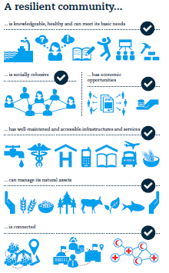
…what is a resilient community?

Slide 3
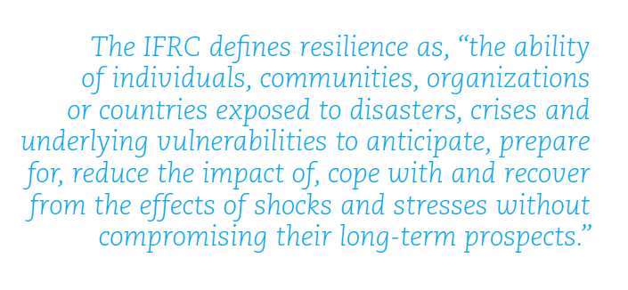

Slide 4
A resilient community
Notes:
Make red circles around the words ´knowledgeable´, ´healthy and ´basic needs´

Slide 5
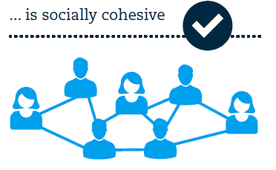
A resilient community

Slide 6
A resilient community

Slide 7
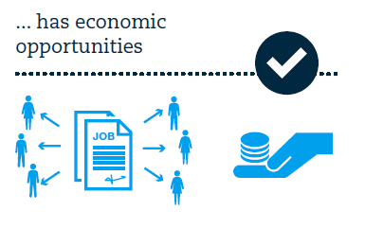
A resilient community

Slide 8
A resilience community

Slide 9
A resilient community

Slide 10
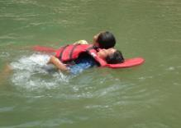
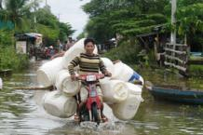
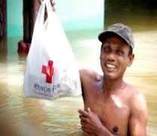
Key Principles:
People first
Local ownership
Comprehensive approach
Acknowledging interdependencies
Long term perspective
Working in partnerships
Know the limits

