Slide 1
Accountability to beneficiaries and beneficiary communications
Gender and Diversity Training Workshop
Notes:
Introductions

Slide 2
Defining the issue
What do ‘Accountability to beneficiaries’ (AtB) and ‘beneficiary communications’ (BC) mean?
Notes:
Before we start, some definitions….

Slide 3
What do we mean by Accountability to Beneficiaries?
The means by which power is used responsibly (HAP)
It is about making a deliberate effort to involve, communicate with, listen to and respond to communities’ concerns.
It is all about the relationship between the organisation and the community.
Simply put - it is good quality programming.
Notes:
MRCS

Slide 4

The four components of programme accountability
Mechanisms through which beneficiaries can make complaints and through which these are reviewed and acted on
Clear and relevant information is presented appropriately to the community
Transparency
Feedback,
complaints
and
response
Participation
Project
M&E
Enabling beneficiaries to play an active role in the decision making processes and activities that affect them
Monitor and review progress against goals and targets with the input from beneficiaries, as well as to integrate learning from this into future decision making
Notes:
1
From BRC accountability framework
Plus organizational commitments

Slide 5
Why is accountability important?
People have a right to know about & have a voice in actions that affect them
We all benefit: we provide a better service to communities and our programs are more successful
You deliver what people really need if they are involved, reducing mistakes & wastage and increasing acceptance, security and sustainability
It is our duty to be accountable to communities that we are working with
Accountability increases program quality and impact
Notes:
2

Slide 6
Why is accountability important?
Red Cross Code of Conduct: “We hold ourselves accountable to both those we seek to assist and those from whom we accept resources.”
MRCS Strategy 2015 recognises accountability to beneficiaries as a cross cutting issue and enabling action for all programmes: “To introduce methods for ensuring a more beneficiary-oriented approach and more accountability towards beneficiaries to be able to measure the impact and effectiveness in all MRCS programmes.”
Notes:
2

Slide 7
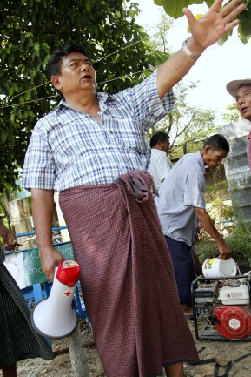
What are the links between AtB and Ben Comms?
Beneficiary communication is the HOW or the METHOD of most accountability initiatives.
You have to communicate to:
Be transparent
Be participatory
Have dialogue with beneficiaries
Involve beneficiaries in M&E
Notes:
2
Make the links to the AtB standards.
Won’t go in to detail of the different comms channels that can be used, this will be done more on Friday

Slide 8
What is beneficiary communication?
Not new – BC is about better dissemination of information & improved 2-way communication with people
Being accountable to our beneficiaries
Gives all affected people a voice & decision making power
More effective and efficient programmes
It saves lives
1. We provide useful information
2. Getting people’s feedback
3. We use their feedback to make programme decisions
4. We tell people how we used their feedback
Notes:
What is beneficiary communications within the Haiti context:
Providing people with useful, practical information they can use & keeping them up to date on Red Cross activities.
Which gives them the chance to be part of decisions and play an active role in the recovery process. If they don’t know what we’re doing – how can they play a role.
We then use their information to make the right programme decisions
Finally we feed back to them on how we used their information and how it helped us make decisions based on their needs
Why?
All humanitarian agencies should be accountable to their beneficiaries – this means being open, honest, allowing people to get involved and having a clear complaints and response mechanism. Helping communities to recover from a disaster will only ever be successful if the population are engaged and willing to take part in the process. And to engage people we must communicate and have solid beneficiary accountability – beneficiary communications is a tool to achieve this.
Bad news is better than no news: If you are waiting for a train it is better to be told it is late than to be waiting on the platform with no information at all.
If we deprive people affected by a disaster of information, they can lose perspective, lose hope, become frustrated and even angry. This can lead to unrest and even demonstrations, which complicates and slows recovery efforts even further.
By involving people in the recovery process and asking their opinion, we are more likely to arrive at the right solutions. Otherwise we’re just blindly walking around thinking we know what people want and need.
Beneficiary communication saves lives – from telling people how to spot the signs of cholera to staying away from rivers after heavy rainfall.

Slide 9
Beneficiary communication aims
To provide timely, relevant and accurate information to effectively communicate with targeted communities.
To listen to affected communities and use dialogue to improve programme delivery
To raise awareness, imparting knowledge and skills
To enable communities to understand their risks and have knowledge to protect themselves
To increase understanding about the Red Cross, humanitarian values, Fundamental Principals etc.
Notes:
1

Slide 10
Beneficiary Communication in MRCS policy
MRCS communications policy states the importance of beneficiary communications across the programme cycle, both in emergency and non-emergency situations
MRCS has committed to integrate the following activities across all programmes:
  Include beneficiary communications in contingency planning
  Develop a system to ensure that communities voices on Red Cross services and programmes are heard
  Mainstream communities needs and suggestions in Red Cross programmes
  Monitoring and Evaluating the impact of beneficiary communications

Slide 11
What are the links between gender and diversity and BC&A?
Our role as the Red Cross Movement is to support the most vulnerable to improve their lives, save their lives and build their resilience regardless of age, race, gender, etc.
BC&A can support us to make sure that we are reaching and listening to everybody, that we are fostering participation of everyone, that we are providing information transparently to everyone and that everyone has the opportunity to give us feedback.
Gender and diversity-sensitive programming is a fundamental part of being accountable to beneficiaries. Therefore how we use beneficiary communications approaches to deliver accountability should be gender and diversity sensitive.

Slide 12
Why should beneficiary communications be gender and diversity sensitive?
Different groups of people have different preferences & needs:
  The aid or support they need
  Information and communications needs
  Which information sources are most trusted
  How and when they want to engage with MRCS and participate in community based programmes

Slide 13
Operationalising gender and diversity sensitive BCA
The needs of women, men, children, the elderly and all other groups of vulnerable people must be considered at every stage of the programme cycle, from assessment through to M&E.
Notes:
Let’s look at the different phases: I will focus on the beneficiary communications side of things, rather than every detail of programming that should include a gender and diversity perspective.

Slide 14
Programme assessment and design
When planning BC activities and doing assessments, preferences and needs of all groups of people must be considered.
This will allow for inclusive programme design.
To communicate with our beneficiaries we have to choose channels and tools that will reach everyone.
How do we do this?
  Include questions in an assessment about how different groups of people communicate, where they get their information from, most trusted sources etc. to inform ways of working and communicating with all groups of people
  Collect all data in a disaggregated way
Notes:
e.g. If we hold community meetings, we must make sure that they are at a time that both men and women can attend. Or we must make sure that disabled people are able to come along. If we disseminate messages about early warning for a cyclone on the radio, we must think about what times of the day both men and women listen to the radio, and target both.

Slide 15
Questions to consider in assessments
What communications channels are appropriate for each group (women, men, children, more vulnerable groups etc)?
What are preferred and most trusted channels of communication for each group?
What community-based activities do women/men prefer?
Can the program use the same media and community activities for women/men?
What are the existing community structures and power dynamics, and how well do leaders represent all the community?
Notes:
This example is for men/women but can equally apply to all groups of people.

Slide 16
Tips for making assessments and programme design gender & diversity sensitive
Speak to all types of community members, including men, women, young, elderly, disabled, ethnic minorities and more vulnerable groups.
Consult with men & women or specific groups separately
Report assessment findings and recommendations by sex, age-group, & vulnerable groups – disaggregated
Try to ensure where possible that Red Cross teams (staff and volunteers) and committees reflect gender balance and diversity of the community.

Slide 17
Programme delivery
Information on gender dynamics & communications preferences gathered in assessment should inform implementation of activities
Use multiple communication channels based on the assessment (written/oral). E.g. community meetings, posters/leaflets, noticeboards, SMS messages, radio etc.
Set up feedback mechanism(s) that allow all beneficiary groups to speak to MRCS – ideally more than one channel.

Slide 18
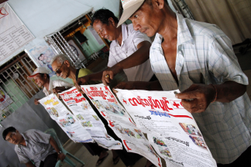
Message development and delivery
Message development should consider the different needs of different groups of people
Pre-test and re-test messages, concepts, and formats with women, men & other groups separately to see what works well each
Emergencies and disaster preparedness: Different groups of people have different needs therefore messages should reflect this.
Behaviour change: different messages will motivate different groups of people to change their behaviours.
Notes:
Message delivery is key to any programme
e.g. Bangladesh cyclone preparedness and messages for women to wear salwar kameze instead of sari, or tie their hair back.
e.g. if we are trying to get people to change their behaviours on health, women and men may have different motivations to change their behaviours. They also might have different social networks and forums that are important to deliver them to make an impact.

Slide 19
Questions to consider for gender sensitive message design and delivery
How will women/men perceive messages?
Are messages appropriate for the needs and circumstances of women/men?
What gender roles do the messages convey?
Do messages and materials include positive female and male role models?
What are the barriers for women/men to accessing messages, activities or services?
Do messages, concepts, activities, and products consider workload, access to information and services, and mobility of women/men?
How do women/men interpret each message and material?

Slide 20
Implementation and M&E
If we have considered the communications preferences and needs of all groups of people in the programme assessment and design phases, then we can use the most useful beneficiary communications techniques and tools to both implement and monitor our programme to see if it is reaching and having an impact on men, women and different groups.
Involve all groups in reviewing programme progress and quality: e.g. how is the new hardware working? Is the health of communities better? How can we tell?
Notes:
e.g. of when this doesn’t happen: Programme design that doesn’t talk to both men and women when making an assessment or doing monitoring may lead to inappropriate solutions. E.g. in Haiti where women IDPs were not using the toilet facilities after sundown and before sunrise. In the end it turned out that this was because there was no lighting in that area and it was not safe, there were attacks of sexual violence. So we installed solar lights and then women felt safe to use the toilet facilities even at night. It was through monitoring not only of the use of the facilities but the monitoring of beneficiary satisfaction that we were able to discover this problem and fix it.

Slide 21
And finally….
Accountable programming that considers needs and preferences of ALL groups of people will automatically be gender and diversity sensitive
Gender and diversity-sensitive ben comms strengthens accountability to beneficiaries and therefore the quality of programming, saving more lives & building more resilient communities
Beneficiary communications allows us to better understand the needs of affected people and address their vulnerabilities and gives affected communities a voice and decision making power
It does not have to be difficult or expensive
IFRC beneficiary communications and accountability technical support/training is available

Slide 22
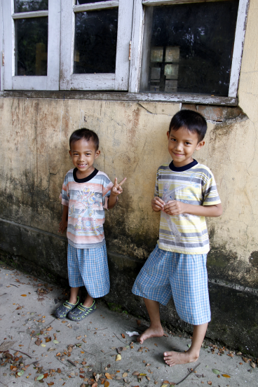
Questions?
For further information:
Mandy George, IFRC beneficiary Communications Adviser
amanda.george@ifrc.org
THANK YOU!

