Slide 1
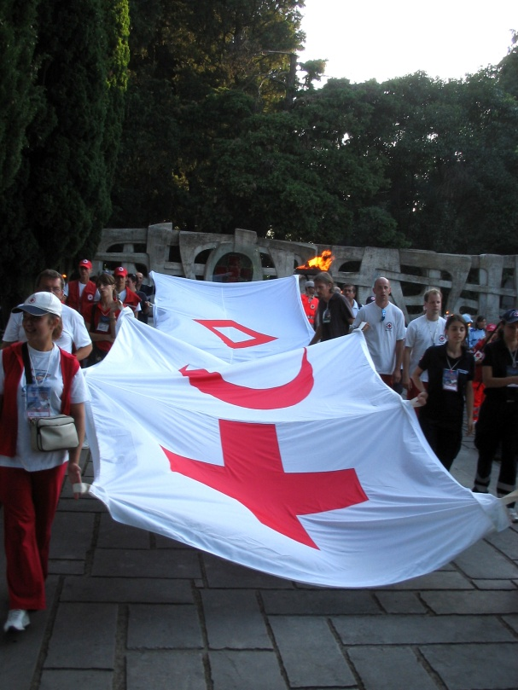
Migration Policies and strategies

Slide 2
Framework for Action: our pillars
2007
Together for Humanity Resolution
2009
Policy on Migration
2009
Policy on Displacement
2011
Resolution on Migration
Notes:
Working with vulnerable migrants is rooted in our mission, fundamental principles and universal character as well as in our volunteer and community base:
Auxiliary status with States
Focus on vulnerabilities and needs of migrants
Irrespective of their legal status
Work along the migratory trails: country of origin, transit and destination
In its ‘Together for Humanity’ document, the 30th International Conference (2007) provided a framework for our work on migration. In particular, concern was expressed that migrants, irrespective of their status, often live outside conventional health, social and legal systems and do not have access to processes which guarantee respect for their fundamental rights. At the 31st International Conference (2011) Resolution 3 on Migration^{[i]} endorsed this further and requires States and components of the Movement, including the secretariat and National Societies, to strengthen our cooperation in addressing the needs of vulnerable migrants.

Slide 3
Background
30th IC Resolution Together for Humanity 2007: migration is one of the great challenges faced by the world today and recognized that migration can generate positive effects while also causing vulnerability and suffering.
IFRC Policy on Migration 2009: acceptance of the role of RCRC National Societies in addressing the vulnerabilities and meeting the needs of persons negatively impacted by migration, irrespective of their legal status.
31st IC Resolution Migration: Ensuring Access, Dignity, Respect for Diversity and Social Inclusion, 2011

Slide 4
31st International Conference Resolution
Requested States to provide:
effective and safe access to all migrants without discrimination and irrespective of their legal status,
appropriate international protection and access to relevant services,
promote respect for diversity and social inclusion of migrants, enhance cultural and legal awareness between migrant and local communities,
promote humanitarian values and collaboration and partnerships between States and RCRC Movement, and international, regional and local partner organisations.

Slide 5
GENERAL PRINCIPLES FOR ACTION
Focus on the needs and vulnerabilities of LABOUR migrants
Include LABOUR migrants in humanitarian programming
Support the aspirations of LABOUR migrants
Recognize the rights of LABOUR migrants
Link assistance, protection and humanitarian advocacy for LABOUR migrants
Build partnerships for LABOUR migrants
Work WITH LABOUR MIGRANTS along the migratory trails (ORIGIN, TRANSIT AND DESTINATION)
Assist LABOUR migrants in return
Respond to the displacement of populations INCL LABOUR MIGRANTS
Alleviate migratory pressures on LABOUR MIGRANTS AND THEIR communities of origin

Slide 6
Linkages with Strategy 2020
The aims of Strategy 2020 are key to the success of our migration strategic plan
Strategic aim 1: Save lives, protect livelihoods, and strengthen recovery from disasters and crises
provision of assistance and protection to vulnerable migrants
strengthening migrants’ and host community resilience

Slide 7
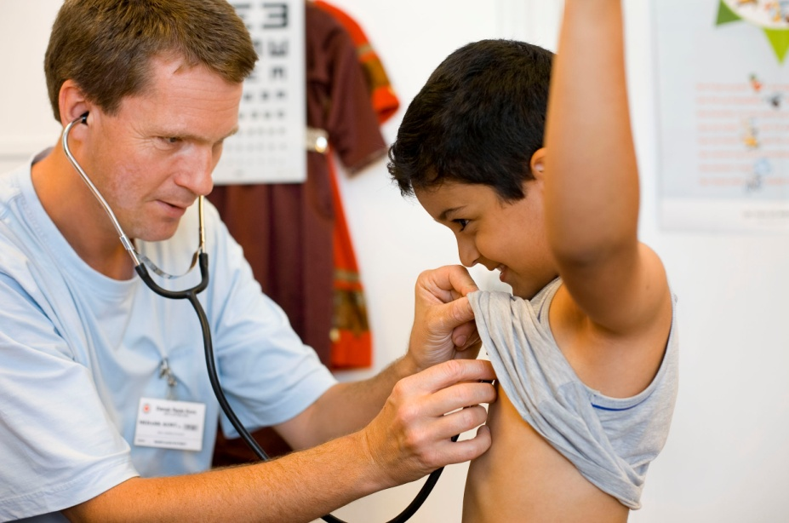
Linkages with Strategy 2020…
Strategic aim 2:
Enable healthy and safe living
improving equitable access to health care, psychosocial and social services

Slide 8
Linkages with Strategy 2020…
Strategic aim 3: Promote social inclusion, and a culture of non violence and peace
changing the dialogue on migration, promoting social inclusion and addressing xenophobia, stigmatisation, discrimination and violence (gender based violence, human trafficking, and smuggling) towards migrants.

Slide 9
IFRC Migration Strategy

Slide 10
Migration Strategic Action Plan
Aims to connect our work across the organization through closely linking with Strategy 2020 and to engage in strengthening National Societies’ capacities to respond to the increasing global challenges of migration, by focusing on awareness and advocacy, capacity building and partnerships.

Slide 11
Objectives
Provide effective support and strategic guidance to National Societies in achieving Strategy 2020, to ‘do more, do better, reach further’ in our engagement on behalf of vulnerable migrants.
Raise awareness about and promote implementation of the IFRC Policy on Migration and 31st International Conference Resolution and identify best practice.
Strengthen engagement, through advocacy and action, by working closely with Humanitarian Diplomacy and Communications Units and through partnerships with relevant actors, particularly UN agencies and INGOs.
Strengthen Migration networks to ‘work together’ though our Zones and National Societies and ensuring our work is relevant.

Slide 12
Global Estimates and Trends 232 million: Estimated number of international migrants worldwide (2013)
In other words, one of out of every 33 persons in the world today is a migrant.
Countries with a high percentage of migrants include Qatar (87 per cent), United Arab Emirates (70 per cent), Jordan (46 per cent), Singapore (41 per cent), and Saudi Arabia (28 per cent).⁶

Slide 13
What is required to support OUR operational programming, policies and advocacy ON BEHALF OF LABOUR MIGRANTS ?
cg

Slide 14
Thank You

