Slide 1
Gender, Diversity and Gender-Based Violence in Context of Disaster Law
Disaster Law Forum
10-12 June 2015
Notes:
Welcome to the Disaster Law Forum 2015.

Slide 2
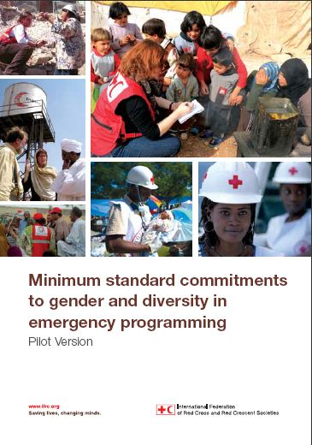
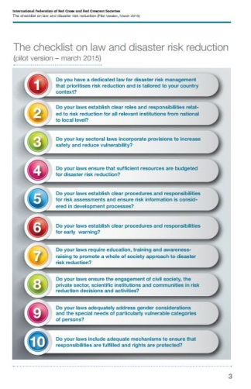
Session objectives
To provide information about the IFRC approach to Gender and Diversity Sensitivity as an analytical framework for Disaster Law
To define Gender Based Violence in the context of Disaster Law, demonstrating the linkage of Disaster Law development to national laws and policies on reducing Gender Based Violence
To provide information about recent mapping and research into Gender Based Violence in disasters in the context of Disaster Law and Gender Based Violence at the International Conference 2015
Notes:
This slide outlines the Session objectives.
This presentation will make important linkages to the DL Checklist.
Gender and diversity considerations in relation to the DL are important, as they help us to ensure that DLs are:
Effective
Reaching all people
Meaningful for the ‘most vulnerable’ in our societies

Slide 3
Sex and Gender
Sex: refers to the biological differences between men and women
Gender: refers to the social differences between men and women
“all those who are vulnerable to inequality, harm and loss of basic rights” because of their gender.
Notes:
Where as a person’s sex refers to the biological differences between men and women gender…..
Gender: refers to the social differences between men and women and relates to the attitudes, behaviors, roles and expectations placed on men and women as a result of being male or female. These differences are heavily influenced by culture and religion but are also changeable over time
Gender is often incorrectly used to refer to issues exclusively related to women. However, men also suffer from gender discrimination. Therefore the IFRC takes an inclusive approach and takes into account “all those who are vulnerable to inequality, harm and loss of basic rights” because of their gender.

Slide 4
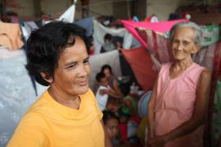
Diversity
Diversity: refers to the acceptance and respect of differences between people.
Physical or Social: sexual orientation, age, disability, HIV status, socio-economic status, religion, nationality and ethnic origin
Notes:
Diversity: refers to the acceptance and respect of differences between all people. These differences can be physical or social and can include: sexual orientation, age, disability, HIV status, socio-economic status, religion, nationality and ethnic origin
The are many interactions between gender and different aspects of diversity and these can further exacerbate a person’s vulnerabilities depending on the specific culture or the situation. An example being - a women living in a male dominated society - who is also HIV positive and from an ethnic minority group.

Slide 5
IFRC Strategic Framework on Gender and Diversity issues
1
Systematic incorporation of gender and diversity in programs, services and tools
2
Improved gender and diversity composition
3
Active promotion of fundamental principles to ensure reduced gender and diversity-based inequality
Notes:
The IFRC is guided by its Strategic Framework on Gender and Diversity issues (2013-2020). This provides strategic direction to the IFRC and its member National Societies by encouraging and promoting gender equality and respect for diversity.
The Strategy is in line with Strategy 2020 and the IFRC’s principles and values.
There are three key outcomes outlined in this strategy:
Outcome 1: Systematic incorporation of gender and diversity in all programmes, services and tools throughout the whole project management cycle - from assessment to planning, monitoring, evaluation and reporting.
Outcome 2: Improved gender and diversity composition at all levels e.g. governance, management, staff and volunteers.
Outcome 3: Reduced gender- and diversity-based inequality, discrimination and violence through the active promotion of fundamental principles and humanitarian values.

Slide 6
Vulnerabilities of gender and diversity in disasters
Women, girls and boys are 14 times more likely to die during a disaster than are men
Asia Tsunami, 2004 +70% fatalities women
Japan earthquake 65% of casualties were
/tsunami, 2011 60+
Notes:
From previous experience we know that women, girls and boys are disproportionately impacted by disasters. Statistics show that women, girls and boys are 14 times more likely to die during a disaster than are men
Some specific examples of this include:
More than 70% of those that died in the 2004 Asia Tsunami were women.
In three of the affected areas of the 2011 Japan earthquake/ tsunami, 65% of casualties were over the age of 60

Slide 7
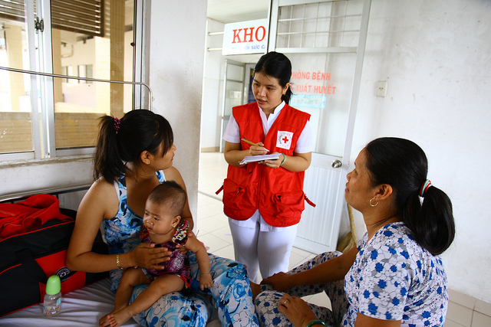
Gender and diversity considerations
Importation of necessary and appropriate relief items
Use of adequately trained
personnel
Ensure full and equal consultation with beneficiaries
Ensure early warning systems are gender and diversity sensitive
Notes:
This disparity occurs when preparedness and response plans do not take a gender or diversity inclusive approach
Considerations in DM and the main areas this relates with Disaster-law include:
Importation of necessary and appropriate relief items: The distribution of relief aid must ensure that the goods being distributed are gender sensitive but also that the process of distribution does not inadvertently place certain groups in more vulnerable positions making the impact of the disaster even greater. An example of this is through beneficiary registration for relief distribution – there are cases whereby beneficiaries are registered by the male HH or by home owners. However this can exclude groups such as FHH, widows and people who do not own property such as nomadic groups or migrants.
2) Use of adequately trained personnel: Where personnel are conducting assessments or providing services we must ensure that not only are these people trained but that there is a gender balance in the staffing and a balance of staff that represent the population they are supporting e.g. ethnic minorities, to ensure more effective and appropriate response that understands the populations needs.
3) Ensuring full and equal consultation with and participation of beneficiaries: Consulting beneficiaries is widely acknowledged as being essential to be able to create effective preparedness plans, reduce risk and provide adequate response to emergencies. We must harness the capacities of men and women and social groups such as people with disabilities, the elderly, people with health problems, within a population and ensure their equal and full participation at all stages of the DM - DRR, relief and recovery and in all stages of the programme cycle from planning, implementation, monitoring, evaluation and reporting. We must ensure that it is not seen as an ‘add-on’.
4) Ensure early warning systems are gender and diversity sensitive: From a gendered perspective this relates to women and girls systematically having less opportunity for or access to education. Therefore many more women are illiterate and this put them in a vulnerable position with regards to accessing information regarding disaster preparedness systems or early warning. Also EWS are less likely to be designed to target women and ways in which women can best receive information. People with disabilities or impairments will have a different perception on the environment around them and may have to access information differently e.g. hearing, sight or mental or physical impairments. This should be recognized and taken into consideration.
*Link with the next section of the presentation*
Women and girls are also disproportionately affected by gender-based violence which is known to increase in the aftermath of a disaster……

Slide 8
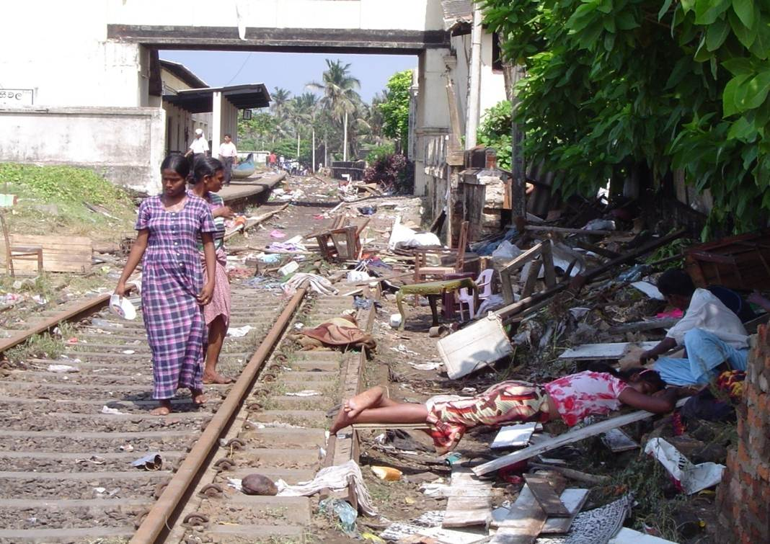
Sexual and Gender Based Violence as a priority in Disaster Response and Law
Notes:
This part of the presentation will focus on one aspect in particular related to gender and diversity, which is the matter of sexual and gender based violence in both health and natural hazard related disasters.
The information in this section can be distressing.
The issue of sexual and gender based violence is not new, rather, what is developing is a greater understanding of how SGBV is related to and can undermine existing government strategies to build community resilience.

Slide 9
Defining Sexual and Gender Based Violence
(Sexual and) Gender-based violence (SGBV) is an umbrella term for any harmful act that results in, or is likely to result in, physical, sexual or psychological harm or suffering to a woman, man, girl or boy on the basis of their gender. Sexual and GBV is a result of gender inequality and abuse of power.
Includes and is not limited to:
sexual violence
domestic violence,
trafficking for sexual exploitation or domestic slavery,
harmful traditional practices;
forced or early marriage,
forced prostitution;
sexual harassment
gender-based discrimination (e.g. denial of service access)
Notes:
Turn to look at a very concrete and discrete area of gender and diversity.
This is the issue of Sexual and Gender Based Violence and its relationship with emergencies. Today I am talking specifically about Disasters and health emergencies. This is an emerging area of law, and of practice.
It is important to note that there is some debate about what terms to use. The UN is moving towards the term violence against women (VAW), and Gender Based Violence is also commonly understood. As a mixed Movement, we increasingly use the term Sexual and Gender Based Violence to recognise the specific mandate for sexual violence in conflict of ICRC.
Definitions for terms are outlined in international agreements, some treaty law, some policies etc that have been developed since the 1970s.
The understanding of SGBV that I will be using today is on the slide.
Something that I want you to consider is that where international conflict occurs we have a number of international tools and local legal instruments. In disasters, response to acts of violence is largely defined in national codes, and accountability for international actors is often dependent only on codes of conduct, policies and practice.

Slide 10
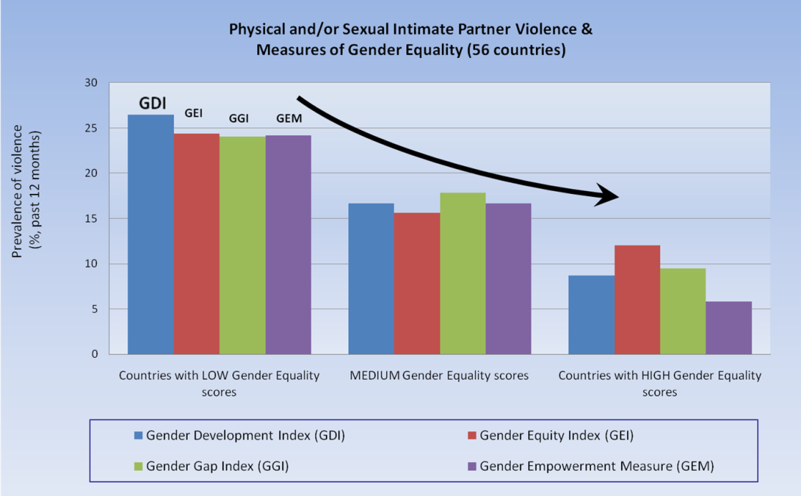
What we already know about SGBV
Exists in all societies in which we work
Crosses class and educational divides
Is often already a Government policy priority prior to disasters
Crosses ministerial, departmental and policy areas
Correlation to gender inequality
This bar chart shows the correlation between government initiatives to address gender equality, and levels of GBV.
Notes:
Even though there is a need for more research on exactly what works and doesn’t work when it comes to SGBV in emergency contexts, there are some things that are already well established:
It already exists in all of countries, and is an underlying issue in every disaster zone
Gender-based violence is a global problem - it cuts across all classes. It exists in all societies.
It constitutes a serious human rights, public health, international development and humanitarian concern.
The failure of international legal instruments, of national policies, of entire communities to grapple with the effects of gender based violence, and the tacit acceptance of it in many places means that it is a silent disaster.
Root causes of gender based violence have been acknowledged in cross cultural studies the world over, and a direct correlation in gendered acts of violence and gender equality indicators have been mapped here.
The black arrow is rates of acts of gendered violence – that is violence against women, men who are considered not to meet masculine norms.
IT IS ALREADY A PRIORITY OF YOUR GOVERNMENTS (some examples here from South East Asia) of national action plans, etc

Slide 11
International and Regional commitments
ASEAN Declaration on Elimination of Violence Against Women
ASEAN ASCC on issues of social inclusion and protection
Sendai Framework for Disaster risk reduction 2015 – 2030
Reducing Vulnerability and Social Inclusion
Notes:
Along with international legal commitments, we have a serious of regional agreements that relate Gender Based Violence in peacetime and also in the context of disasters.
ASEAN:
ASEAN Declaration Against Trafficking in Persons Particularly Women and Children 29 November 2004
Bali Ministerial Process
ASEAN Declaration on the Elimination of Violence Against Women
Next steps for AADMER Work Programme
Sendai Framework

Slide 12
Some examples
Country | Policy | Ministry/Supporting committee
Cambodia | 2nd National Action Plan on Prevention of violence against women 204-2018 (NAPVAW) Law on Suppression of Human Trafficking and Sexual Exploitation 2007 | Ministry for Women's Affairs Ministry of Health Government Technical Working Group on Gender and Gender Based Violence
Philippines | Republic Act No. 9262 (Anti-Violence Against Women and Their Children Act of 2004) | Inter-Agency Council on Violence Against Women and Their Children Department of Social Welfare and Development Department of the Interior and Local Government
Thailand | Protection of Victims of Domestic Violence Act, 2007; Anti-trafficking in Persons Act 2008 | Numerous jurisdictions Health Ministry - One Stop Crisis Centre
Timor-Leste | Law 7/2010 on Domestic Violence | With support Judicial System Monitoring Program
Viet Nam | Law on Domestic violence prevention and control 2007; and Law of Marriage and the Family 2000 | Committee on Ethnic Minority Affairs (Vietnam) Ministry of Health (Vietnam) National Committee for the Advancement of Women in Vietnam
Indonesia | Law on Elimination of Domestic Violence (2004); Plan of action for research into all forms of GBV in Indonesia | Ministry of Women's Empowerment - Strategic Plan to eliminate GBV
Notes:
South East Asia, in many ways, is leading on legal frameworks for addressing many issues of Sexual and gender based violence – especially related to rights of migrant workers, and in relation to anti-trafficking.
But perhaps more importantly, these issues are existing issues that your governments are grappling with and which have carefully contracted mechanisms in place. The risk, then, is that these are undone in times of emergency.
For example: here are some government policies from South East Asian Countries, that have been developed to start to address issues of Gender Based Violence in Emergencies.
Others note mentioned on the slide:
Brunei Darussalam - Married Women Act, 1999 [Sections 25-29]
Lao PDR - 2004 Law on the Development and Protection of Women
Malaysia – Domestic Violence Act 1994
Myanmar - Myanmar Penal Code provisions for sexual violence; AntiTrafficking in Persons Law

Slide 13
Exacerbating factors in emergencies
Increased number of actors
Increased ‘chaos’ and opportunities for GBV
Increased levels of separation
‘Hyper gender roles – the division of labour is often intensified (women care for children, take care of reproductive roles)
Increased use of negative coping strategies on behalf of men, women, boys and girls
(Sometimes) decreased family cohesion
Interrupted social protection mechanisms
(Total) breakdown in health, justice and regular social services
Access to justice, to remedy and to safety decreases
Inappropriate assistance (not based on consultation with community)
Notes:
If we look at the data it is startling – gender based violence truly does constitute a public health and social equality disaster. Gender based violence has been called the problem of pandemic proportions by women's groups and now officially by UN women.
Up to 70 per cent of women experienced physical or sexual violence remain in their lifetime.
Of women aged between 15 and 44 violence causes more deaths and disability than cancer malaria traffic accidents and war combined. (UN women, 2000 and a lesson, facts and figures on violence against women).
Such levels of inequality pre-exist in all contexts in which we work but especially underlined the context in which we manage disasters.
Emergencies – encompassing natural disasters and health disasters –are mostly characterised by a lack of stability even in places of respite. The slide shows some of the factors that exacerbate Sexual and Gender Based Violence in Emergencies.

Slide 14
Examples from recent emergencies
New Zealand Earthquake – Domestic violence referrals increase by 400%
2004 Tsunami – recue workers prosecuted for rape in Sri Lanka
2005 floods in Pakistan – early and forced marriage increases in face of increased poverty and desperation
2010 Haiti earthquake – sexual exploitation and abuse of children on mass scale
2013 Typhoon Yolanda – Prevention of violence activities to safeguard gains in the field of GBV prevention and response
Notes:
However, unlike research and attention given to sexual violence and other gendered violence in conflict settings, research on gender based violence in emergencies has been ad-hoc….. (2007) IFRC World Disaster’s Report said ‘even though it is possible to draw parrallels between discrimination and against women in national disasters, armed conflict and displacement, they are not the same. In comparison, there gendered consequences of natural disasters have received much less attention, action lags on the world being done in conflict settings’
In the past decade there has been some increase in literature (since 2004 tsunami):
Endemic rape and sexual abuse: In the 2004 tsunami, stories emerged in Sri Lanka of women being raped by their rescuers. Reports of rape, gang rape and sexual abuse in internally displaced persons’ (IDP) camps in Indonesia, India, Sri Lanka, Thailand and Myanmar also rose. Women in Sri Lanka reported being raped while traveling to damaged homes or going out to conduct everyday activities.
Intimate partner violence: Following the bushfires in southern Australia in 2009, and the subsequent to the Christchurch Earthquake in New Zealand, local domestic violence centres in both countries measures a 400% increase in referrals for new domestic violence, with those people citing that the violence was new, and had never occurred before. A deeper study has shown that in both cases, it was the lack of equal information provision to men and women that had resulted in miscommunication in times of the emergency, resulting in conflict over resources, over help seeking and ultimately leading to severe instances of marriage breakdown, including domestic violence. Additionally, following the 2004 tsunami, women in Sri Lanka experienced a rise in domestic/intimate partner violence, attributed to men’s increased consumption of alcohol and drugs after the tsunami, arguments about financial matters, or because husbands blamed women for being unable to save children during the tsunami.
Sexual exploitation: often increases after disasters, meaning some men, women, and children are forced to engage in transactional or “survival” sex. For example, following the 2010 earthquake in Haiti, some aid givers were prosecuted because their staff had abused beneficiaries, by engaging in transactional sex such as sex in return for food or food stamps (the transactions were often made by aid distribution committee members).Women who engaged in transactional or survival sex were more at risk of unwanted pregnancy, STDs and other health problems, escalation of GBV and social and community isolation, leading to ongoing social issues that local government units were to respond to through social care projects.
Early and forced marriage of women and girls: In the 2004 tsunami, the Indonesia Government noted with concern that many girls were forcibly married due to economic burden, demands for dowries and from a belief amongst families that girls would be protected from sexual violence or poverty. Many of these early and forced marriages were labelled “tsunami marriages”, whereby women and girls were encouraged or forced to marry in order to receive state support and compensation. In many cases, these compensation schemes were paid to men, locking women into violent and dependent relationships. Early and forced marriage in order to receive state subsidies also occurred following the 2005 earthquake in Pakistan.
Human trafficking: it is commonly recognised that natural disasters can lead to slavery and trafficking through increased opportunities for traffickers to prey on vulnerable populations however there is little systematic evidence of how this occurs in different geographical contexts.
References for this information:
Felten-Biermann 2006; Fisher 2012
APWLD 2005; Fisher 2012
(Fisher 2012).
(Fisher 2012; Oxfam 2005).
Davoren 2012; Horton 2012; MADRE 2010; UNHCR 2011
(MADRE 2012).
ActionAid 2007; APWLD 2005; Felten-Biermann 2006; Fisher 2012; Oxfam 2005; PDHRE & ActionAid 2006)
(Fisher 2012).
(Sayeed 2009).
(Nellemann et al. 2011; WHO 2005),

Slide 15
Movement wide mapping and research
2014-2015 Mapping exercise: 54 National Societies and ICRC have responded. 14 NSs in Asia Pacific identify GBV programming as priority.
Research in 10 countries on SGBV in Disasters:
Samoa | Australia
Bangladesh | Myanmar
Bosnia and Herzegovina | Malawi
Namibia | El Salvador
Haiti | Europe TBC
Notes:
After the Council of Delegates 4 years ago a global SGBV Coordination Group was established. It has commissioned mapping on GBV in emergencies.
It’s key findings:
Awareness raising, prevention and psychosocial support are the most common types of activities
GBV prevention and response is commonly integrated into other programming including violence prevention and health interventions
Training identified as considerable gap
Need for greater coordination and cooperation within the Movement and Governments
Need to work toward expanding quality and quantity of interventions, particularly in emergency response
The IFRC has also commissioned a 10 country research study on SGBV in disasters, which looks at data, prevalence, policy and responses. Findings will be presented to Council of Delegates and the International Conference, seeking only a mandate to support further work on SGBV in emergencies.

Slide 16
Next steps
Research partnership, and continued programming
International conference
Strengthened action

Slide 17
Disaster Law and Policy Considerations
For Governments
Apply a Gender Lens in any review of Disaster Laws
Identify existing SGBV policies at national and regional level, ensuring they are implemented in emergencies
Monitor and address SGBV as a disaster response priority
Strengthen evidence through research and advocacy on how to effectively mitigate SGBV in disasters
Endorsement of the International Conference Resolution on SGBV in Disasters
Notes:
Some key actions that Governments can take:
Apply a Gender Lens in any review of Disaster Laws including on importation of goods, beneficiary consultation and in EWS
Identify existing policies addressing SGBV at national and regional level, and identify process for their continued application during Disasters
Plan for ‘whole of society’ approach in DL, ensuring that levels of SGBV are adequately recorded and monitored as a key resilience indicator for communities
Strengthen knowledge and evidence through research partnerships on how to effectively mitigate SGBV in disasters through legal/policy level interventions
Consider International Conference Resolution on SGBV in Disasters

Slide 18
ASEAN
ASEAN Committees to work together to ensure that gender and diversity commitments are upheld in times of disaster and integrated as a strategic priority across committees and frameworks
National Societies
Disseminate research findings and mapping findings
Continue gender and diversity sensitive DRR programming
Act on the basis that SGBV exists and requires a response in emergencies (“Area of responsibility”)
Provide technical support on gender and diversity sensitive disaster management

