Slide 1
Supporting Migrant in the Philippines

Slide 2
Situationer
The Philippine has been considered to be one of the top 10 sending countries of migrant workers in the world.
Labor migration from the Philippines has constantly grown in the past 40 years and has more than doubled in the past 10 years .
The number of Filipino seafarers has also increased 75% in the past 10 years.
Migrants usually originate mostly from Metro Manila and surrounding provinces, who are mostly female domestic workers going to Malaysia and the gulf countries.
Over 70% of OFWs are between the age of 25-44 year of age.

Slide 3
PRC Migration Support Programmes
PRC Strategic Framework aims to give the most vulnerable-–which includes migrants– access to to PRC services.
RC Programs supporting OFW;
Assistance in providing ambulance services
Home/school visits,
Provision of Psychosocial Support
Restoring Family Links
Tracing
Health and Welfare Check
Communication and Inquiry
Referral to government agencies for medical repatriation,

Slide 4
Manila Declaration on Labour Migration
In May 2015, members of the RCRC Movement, along with other partner agencies, gathered in Manila to discuss common efforts to address the concerns of labor migrants.
The event was attended by national societies from Asia Pacifc and the Middle East North Africa
The PRC & other NS present, adopted a common position, to take collaborative action to protect the rights of labor migrants, with priority focus on Women Household
Declared and agreed thru acclamation, was a collective statement to protect the rights of labor migrants, and engage in continuing dialogue and collaboration for protection.
2

Slide 5
Objective of the Manila Dialogue
Strengthen collaboration and partnership for the protection of labor migrants, with a specific focus on female migrant workers, by bringing together experts across Asia Pacific and the Middle East North Africa.
Identify current challenges faced by female migrant workers, and best practices to reduce their vulnerability, with the aim of strengthening humanitarian services for labor migrants.
Advocate more strongly for the protection of migrants rights and access for humanitarian support in both sending and receiving country.

Slide 6
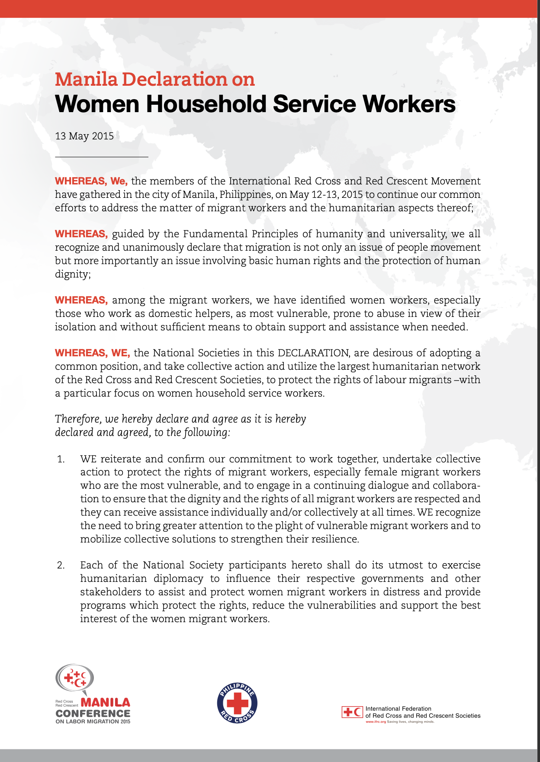
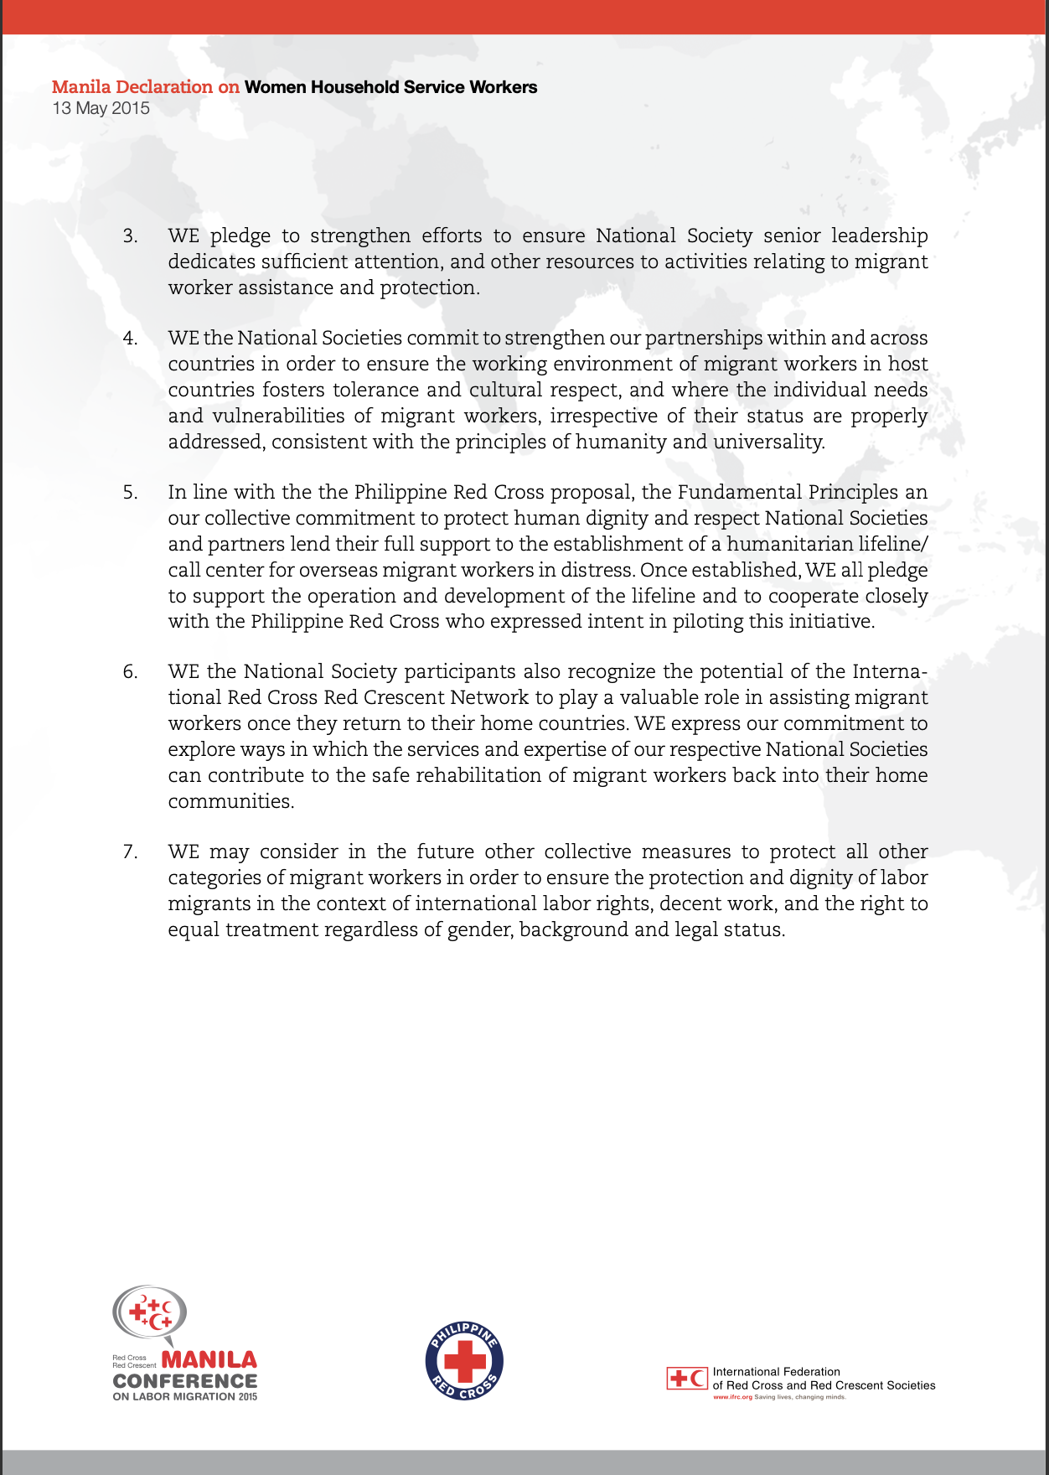

Slide 7
PRC Affiliations
Since 2015 PRC has been actively engaged with regional and global migration groups:
Co-Chair of the Asia Pacific Migration Network (pending confirmation)
Member of the Red Cross and Red Crescent Migration Task Force.

Slide 8
What is the focus of the APMN
The APMN was created to explore critical issues, develop actions, and contribute to a growing body of knowledge for the benefit of migrants based on the Movement’s Fundamental Principles and humanitarian approach. The APMN is committed to sensitisation on migration issues and vulnerabilities, and is focused on progressing practical action and cooperation to better support migrants and people made vulnerable through migration. Activities such as peer to peer learning, regular skype meetings, membership updates, research and mapping, engaging in policy discussions, hosting events and developing regional and thematic working groups have all contributed to an increase in collaboration and coordination on migration across Asia Pacific National Societies. Maldivian Red Crescent, Australian Red Cross are the current co-chairs, with two new co-chairs to commence in the coming months. Over the last four years the APMN has increased the profile of migration in the region, and as of October 2019 has engaged 35 National Societies in the Asia Pacific. ICRC and IFRC are ex officio members.

Slide 9
Virtual Volunteer.Org
The Virtual Volunteer Web App is an application that provides practical information for migrants to be safe to access services in local and overseas
Launched last November 27, 2019, the launch was first outside Europe
Place your screenshot here
9

Slide 10
www.virtualvolunteer.org
The platform can be access in any internet capable devices.
Since its launch last November 27, 2017-October 17, 2019.
A total of 8,750 users
12,223 sessions
63,439 views
Majority of the users are ages 25-34
Most of the views are coming from Quezon City, Batangas, Rizal Province, Makati, Cebu and Davao.
There are also recorded views coming from the Middle East, Malaysia, Dubai, South Korea, China, USA and other neighboring countries.
Marketing are being done, by partnering with airports, seaports, DFA passport processing center and during PRC events.
Place your screenshot here
10

Slide 11
8

Slide 12
Training on Health in Migration and Displacement
To facilitate continues learning and interest of PRC staff and volunteers in working with migrants, PRC collaborated with IFRC to develop and roll-out the Health in Migration and Displacement Training, which is the first in the world.

Slide 13
Training on Health in Migration and Displacement
The IFRC also supported the roll out of the said training at selected communities in Zamboanga, Sulu, Basilan and Tawi-Tawi.
A total of 35 NHQ individuals and 162 people from the partner communities and agencies (LGU, CSO’s, and other agencies) were trained.

Slide 14
Training on Health in Migration and Displacement
The topic focused on the approach of the Movement toward migration, PGI, health issues in origin, transit, and destination.
The training developed in Manila served as a role model and basis for the training on migration in Myanmar, Cambodia, Lao, and Thailand.

Slide 15
Community Roll-Out

Slide 16
Ways Forward
For the year 2019-2020, PRC in collaboration with IFRC will support selected PRC chapters in conducting community orientations on Safe Migration Messaging and dissemination of IEC materials.
Integration of the virtual assistant in the Virtual Volunteer to provide a more engaging experience to users. The assistant will be able to answer queries and questions 24/7.
16

