Slide 1
Virtual volunteer
www.virtualvolunteer.org

Slide 2
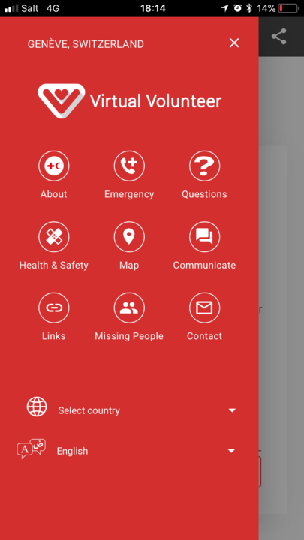
Virtual Volunteer
www.virtualvolunteer.org
The Virtual Volunteer.org is a web-application that provides practical information for migrants.

Slide 3
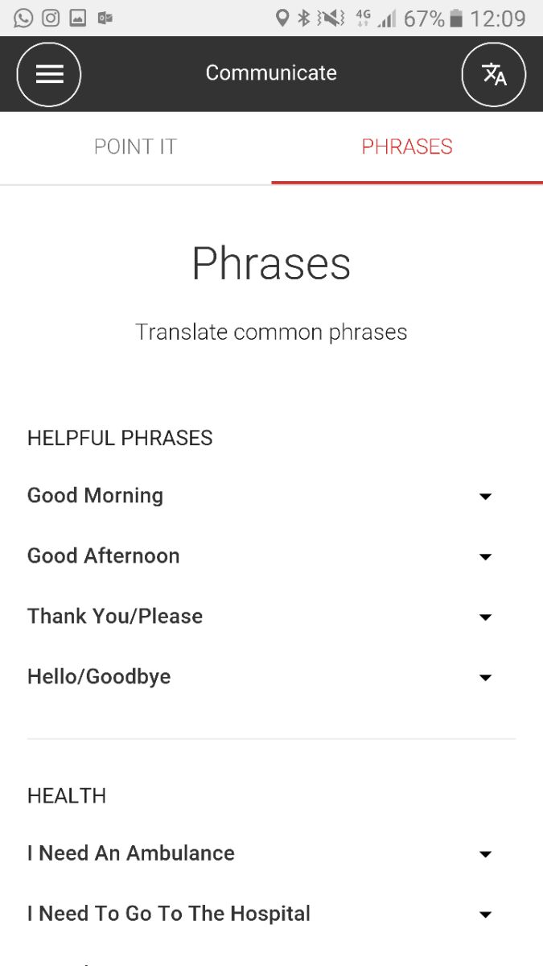
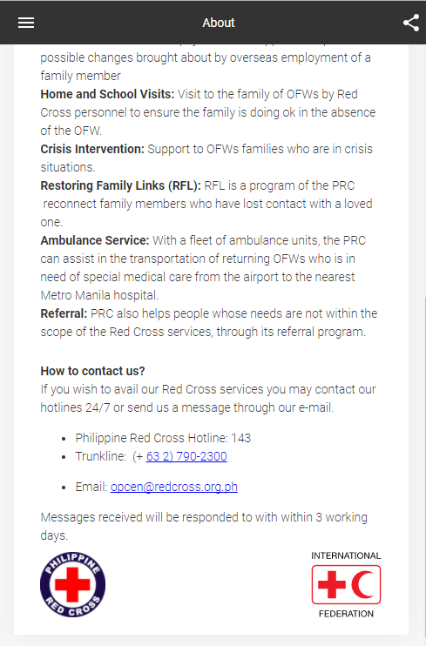
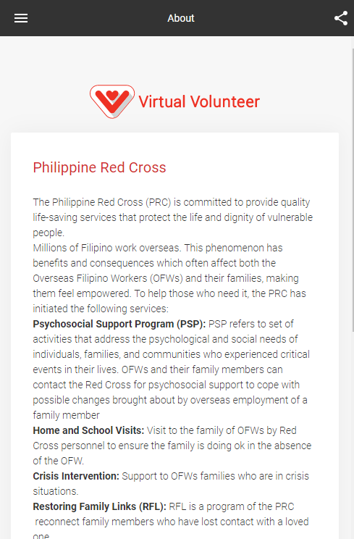
Provides an overview of Philippine Red Cross services for OFWs
And how to contact the Red Cross

Slide 4
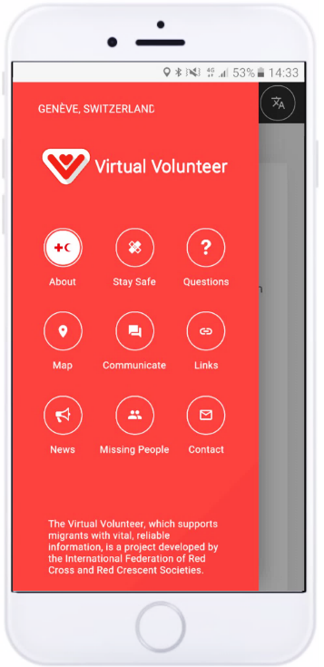
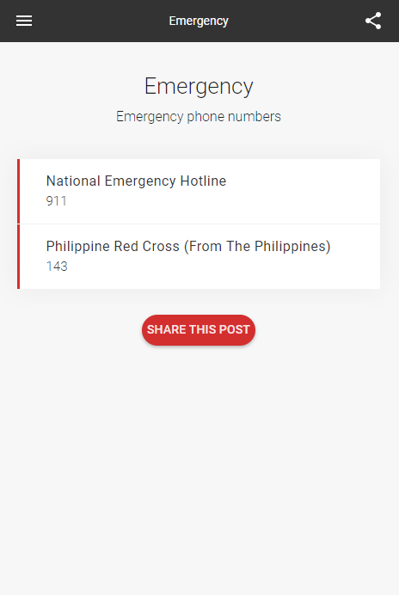
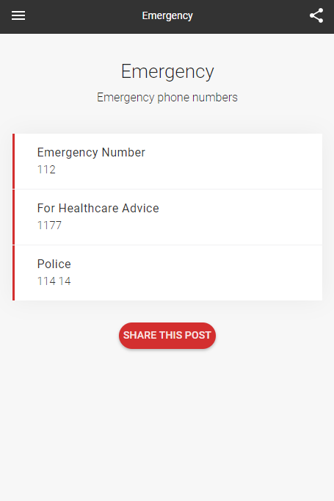
Provides Emergency number in the Philippines and country of destination

Slide 5
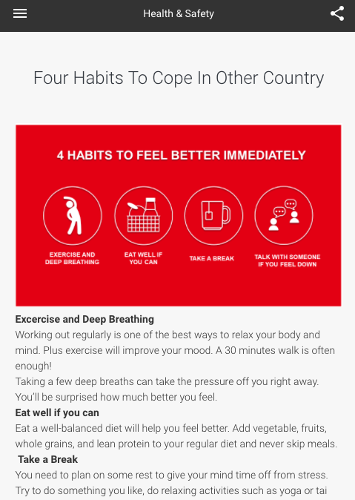
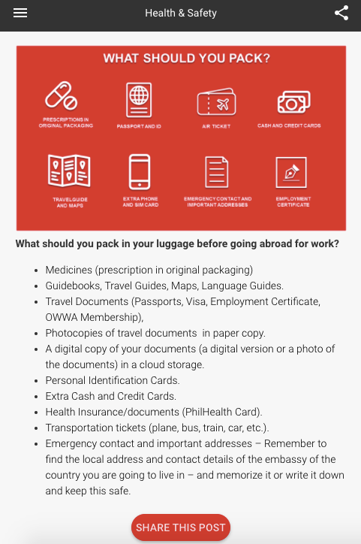
Provides tips on how to stay safe when abroad, the essentials to pack and how to cope with being far from your family.

Slide 6
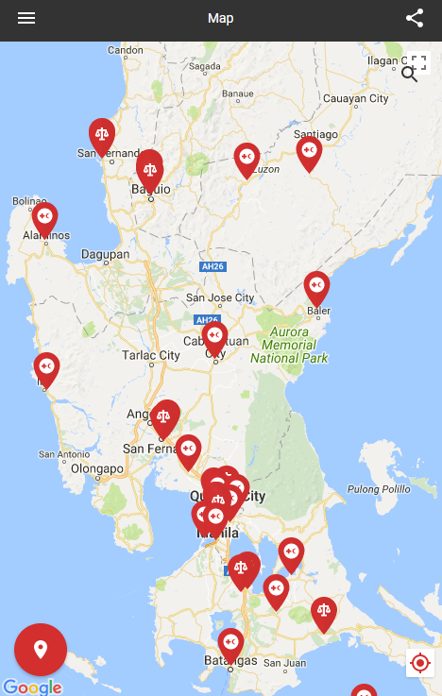
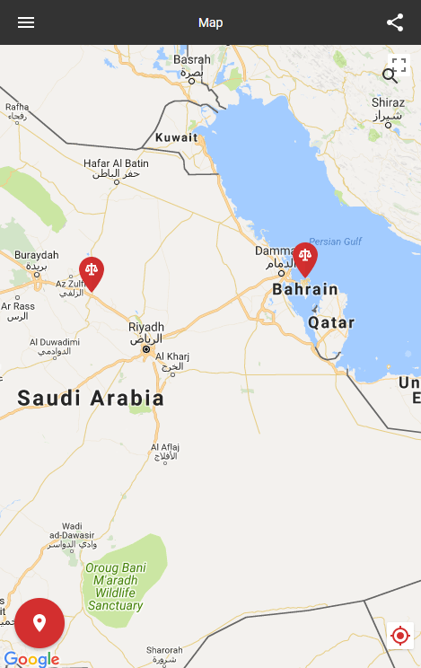
Helps you locate offices and services for OFWs in Manila
And will also display important locations in main destination countries

Slide 7
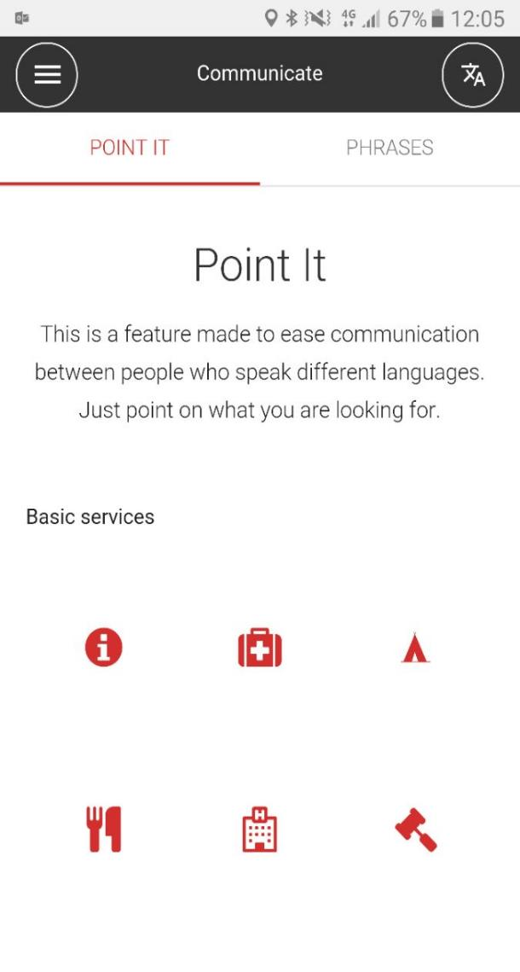
Helps people communicate in a foreign language

Slide 8
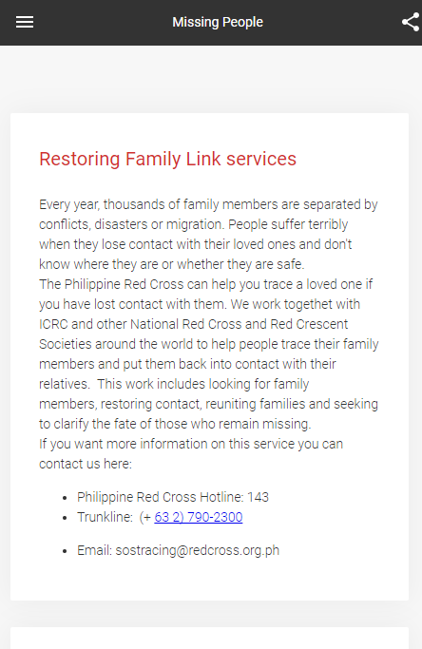
Helps people find family members they may have lost touch with

Slide 10
Virtual Volunteer Highlights
VV was launched here in the Philippines in 2017: this is the first outside Europe.
To date a total of 8,750 users, 12,223 sessions, 63,439 views were recorded.
Majority of the users are ages 25-34.
Most of the views are coming from Quezon City, Batangas, Rizal Province, Cebu, and Davao.
There are also recorded views coming from the Middle East, Malaysia, Dubai, and other neighboring Asian countries.
PRC VV team continuously promotes the app through partnering with airports, seaports, government institutions, and through various organizational events.

Slide 11
Virtual volunteer
www.virtualvolunteer.org

