Slide 1
RRI Baseline and Endline
16 May 2018

Slide 2
Objective and Approach
Reconstruct and validate baseline data for outcome indicators.
Collect end-line data using the same methodologies as the baseline.
Gather qualitative information on progress towards outcomes through a collection of change stories.

Slide 3
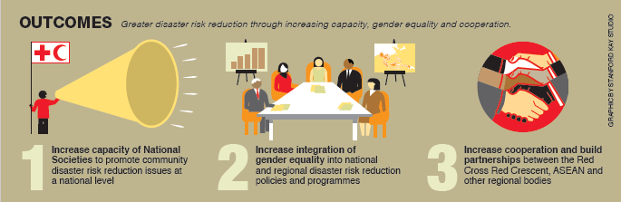
Outcomes

Slide 4
Method
Extensive desk review
Four online surveys – NS, IFRC, NDMO and external partners (36/42)
56 key informant interviews
Field trips to Myanmar and the Lao PDR
Case study methodology (16 cases developed)
Replication and validation of baseline
Endline creation
Higher weighting/effort afforded to Gender & Diversity and collaboration with ASEAN achievements.

Slide 5
Method
Two key workshops:
Gender and Diversity Technical Review Workshop (21-22 November 2017) to highlight G&D outcomes and contributions secured through the RRI.
Lessons Learned Workshop (21-23 February 2018) - key lessons related to the most significant RRI outcomes for use in future contexts; and identifying how RRI contributions could be broadened/up-scaled to the wider humanitarian system.

Slide 6
Main Findings per Outcome

Slide 7
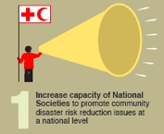
  Outcome: Increased capacity of SEA Red Cross National Societies
RRI’s regional-wide peer-to-peer support cooperation and subsequent sharing of knowledge, learning and technical support resulted in four key regional networks:
Annual Southeast Asia Leadership meeting
Community Safety and Resilience Forum
Southeast Asia Youth Network
RCRC Gender and Diversity Network

Slide 8
  Outcome: Increased capacity of SEA Red Cross National Societies
An important facet of the cross learning and knowledge sharing has been:
the production of the many RRI change stories and case studies.
the public awareness and public education materials.
shared ‘community voices’.

Slide 9
  Outcome: Increased capacity of SEA Red Cross National Societies
The RRI trained some 1181 individuals (52% female) in important resilience building skills:
612 people in G&D related topics.
146 on climate change.
57 as part of the ASEAN Coordinating Centre for Humanitarian Assistance on Disaster Management programme.
366 people in communications and advocacy themes.

Slide 10
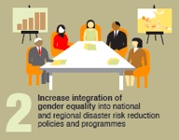
  Outcome: Increased integration of gender equality
Direct RRI G&D Technical Assistance resulted in a total of 66 significant G&D interventions, including:
32 trainings.
26 technical support events to NS.
8 technical support functions to IFRC’s external partners.

Slide 11
  Outcome: Increased integration of gender equality
Gender and Diversity capacity building support contributed to:
6 NS completing G&D institutional policies and/or strategies.
7 NS contextualizing G&D tools based on the IFRC’s inclusive VCAs and Minimum Standard Commitments tools.
3 NS conducting institutional G&D self-assessments.

Slide 12
  Outcome: Increased integration of gender equality
The RRI’s G&D work had previously been identified as “stand out” during the 2016 M&E consultancy . . .
and this continued to be the case when the endline report concluded.

Slide 13
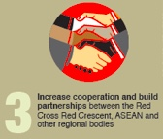
Outcome: Partnership building
The most notable has been the partnership with ASEAN, specifically the ASEAN Secretariat and the AHA Centre.
The RRI undertook 13 initiatives with the ASEAN Secretariat:
10 on disaster management and 3 on health.
Plus an additional 10 initiatives with the AHA Centre and 6 ACDM initiatives.

Slide 14
Outcome: Partnership building
RRI’s partnership with key organisations progressively grew, notably with the ASEAN School Safety Initiative (ASSI) and the following
UN agencies:
UN Women
UNISDR
UNFPA
UNOCHA
UNDP – significantly in the progression of SEA Disaster Law initiatives

Slide 15
  Outcome: Increased DRR cooperation between partners
Indicator 2: Enhanced regional RCRC partnerships with DRR organisations
29% overall improvement rating between 2014 and 2017

Slide 16
Outcome: Partnership building
The RRI contributed enormously to the establishment and strengthening of new disaster law legislative instruments.
Significantly, in 2017 the Initiative led the first mapping of disaster law and the institutionalization of the ASEAN Agreement on Disaster Management & Emergency Response (AADMER) into national laws with endorsement of the ACDM and partnership with ASEAN Secretariat.

Slide 17
  Overall Conclusion
  The RRI encouraged governments and other stakeholders to increase their engagement with ‘at-risk’ communities, local leaders and civil society in efforts to reduce risks and strengthen resilience.
  The status and role of National Societies as auxiliaries to government in humanitarian crises and development has been reinforced by the RRI’s direct interventions.
  The RRI made a significant contribution to strengthening disaster risk reduction resiliency in Southeast Asia and contributed to the overall ASEAN goal of reducing the impact of natural disasters on vulnerable communities.

Slide 18
  Recommendations
  1. Future Programme Implementation Plans (PIP) should be more accessible to National Societies and other partners.
  2. Develop a robust monitoring framework that accounts for issues of (i) ‘RRI’s attribution’, and (ii) National Society contribution to outcomes.
  3. Better plan and illustrate the Initiative’s link with communities (and subsequently the direct contribution made to increased resilience of vulnerable communities).

