Slide 1
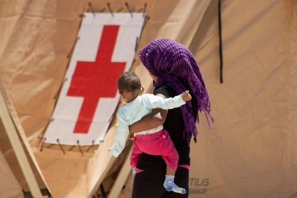
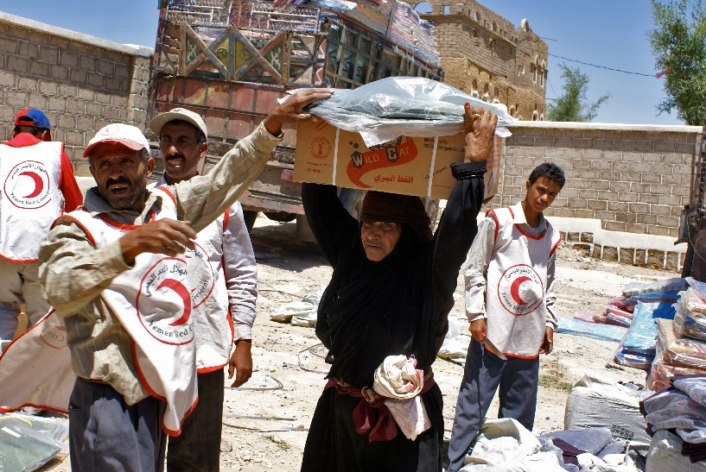
Emblems of humanity
Notes:
The red cross and red crescent emblems are a universal sign of hope for people in humanitarian crises. For communities enduring the trauma of armed conflict and other situations of violence or the hardships of natural disaster, the emblems signal that help is on its way.
Whether displayed on the badge of a doctor working in a field hospital, the side of a vehicle transporting wounded people in war, or a plane delivering relief supplies, these emblems symbolize impartial, neutral and independent humanitarian action to people around the world.
But they are also about much more. In times of armed conflict, the red cross and the red crescent are internationally recognized symbols of the protection that is due to the armed forces medical personnel, facilities and vehicles and to authorized civilian medical services. This includes the medical services of National Red Cross and Red Crescent Societies (National Societies) when acting as auxiliaries to armed forces medical services or when duly authorized by the authorities in accordance with the Geneva Conventions.

Slide 2
What are emblems?
The emblems are signs of protection displayed in armed conflict, informing those fighting that the people, vehicles or facilities displaying these emblems must at all times be protected and may never be targeted or attacked.
The emblems also indicate the affiliation of a person, vehicle or facility with the International Red Cross and Red Crescent Movement and its organizations.
Notes:
It is important to ensure a clear distinction between the emblems displayed for protective purposes and emblems used for indicative purposes (the emblems used in a logo for example) so that the protective function of the emblems is not undermined.
Protective use: In armed conflicts, the emblems are the visible sign of the protection conferred by the Geneva Conventions and their Additional Protocols. When displayed as a protective device, the emblems must be displayed on a white background, without wording or additional graphics, designs or inscriptions.
Indicative use: The emblems show the link that a person, object or building has with the Movement and its components. In such cases, the emblem displayed as part of the logo of a Movement component must be accompanied by additional information (e.g. the name or initials of the National Society). The emblems must be of small dimensions and may not be placed on armlets or on roofs, so as to avoid any confusion with the emblems used as a protective device.
For more information on the emblems please go to http://www.icrc.org/eng/war-and-law/emblem/index.jsp.

Slide 3
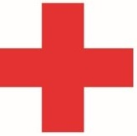

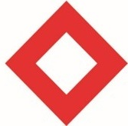
What are the emblems?
Three emblems are in use today
  the red cross
  red crescent
  red crystal
They are free of any religious, political or cultural association
Notes:
In 2005, the third Protocol additional to the Geneva Conventions was adopted, recognizing an additional emblem: the red crystal. For more information about the red crystal go to https://www.icrc.org/eng/resources/documents/misc/emblem-keyfacts-140107.htm
An emblem not in use today: The red lion and sun was recognized as the third distinctive emblem at the 1929 Diplomatic Conference. It was used by Persia until 1980, when the Islamic Republic of Iran declared that it would use the red crescent as its distinctive symbol instead. However, the Islamic Republic of Iran reserved the right to return to the red lion and sun should new emblems be recognized.

Slide 4

Why were the emblems created?
Swiss businessman Henry Dunant published A Memory of Solferino, in which he put forward two proposals for improving assistance for war victims:
to set up in peacetime, in every country, relief societies composed of volunteers ready to take care of wounded soldiers in wartime
to encourage countries to agree to the idea of an international legal protection for the wounded and sick on the battlefield and those caring for them
Learn more in the film Story of an Idea
Notes:
In 1859, Henry Dunant, a Swiss businessman travelling through northern Italy, witnessed the grim aftermath of a battle in and around the city of Solferino. Deeply moved by the suffering of thousands of wounded and dying soldiers left without any medical care, he published A Memory of Solferino, in which he put forward two proposals for improving assistance for war victims:
• to set up in peacetime, in every country, relief societies composed of volunteers ready to take care of wounded soldiers in wartime;
• to encourage countries to agree to the idea of an international legal protection for the wounded and sick on the battlefield and those caring for them
The first proposal led to the establishment of a National Red Cross or Red Crescent Society in almost every country around the world.
The second proposal set the stage for the adoption of the first Geneva Convention for the protection of the wounded and sick in armed forces in the field. The four Geneva Conventions of 1949 (https://www.icrc.org/en/war-and-law/treaties-customary-law/geneva-conventions) are today accepted by, and binding upon, all States. That proposal also led to the adoption of a single distinctive sign that would help to protect military medical services, volunteer aid workers and wounded people during armed conflict. The sign – or emblem as it was eventually called – had to be simple, identifiable from a distance, known to everyone and always identical.

Slide 5
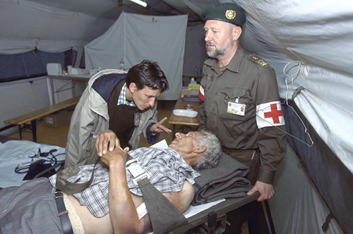
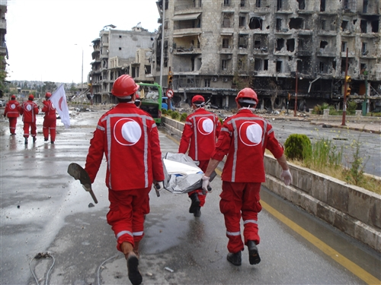
How can the emblems be used?
In times of armed conflict, they are displayed for protective purposes to ensure the safety of:
medical services and religious staff of the armed forces
National Society medical staff, facilities and vehicles, when placed at the disposal of the medical services of the armed forces
civilian hospitals, medical units and vehicles, and their staff and medical personnel assigned to the treatment and transport of the wounded and sick in times of armed conflict, subject to government authorization and control
Notes:
All three emblems have equal status and may be used individually as a protective device. The emblem in its protective function must be displayed on a white background, without wording or additional graphics, designs or inscriptions, and are displayed in large size.

Slide 6

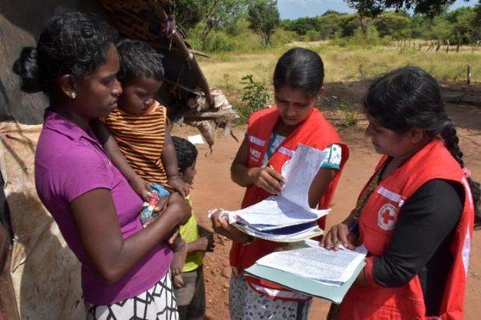
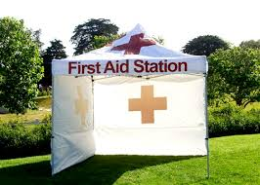
How can the emblems be used?
The emblems can also be displayed for indicative use by:
1) volunteers, staff or property affiliated with the Movement—the National Societies, the ICRC or the International Federation
2) ambulances and first-aid stations assigned to provide free treatment to the wounded and sick during peacetime in line with domestic legislation and with the authorization of the National Society
Notes:
The emblem for indicative use must be in small size.

Slide 7
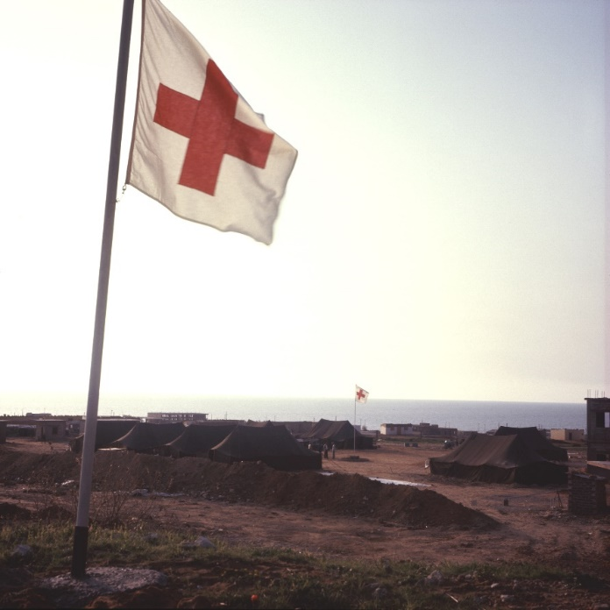
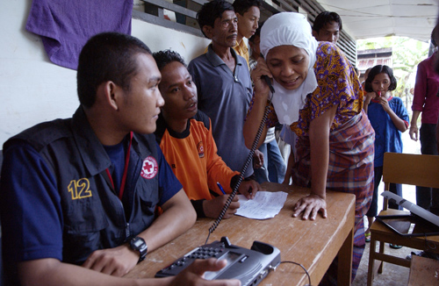
What is the difference between the emblem and a logo?
A red cross, red crescent or red crystal symbol without any accompanying description is know as the emblem and is displayed in large size for protective purposes.
A logo is the red cross or red crescent emblem displayed in small size together with the name or acronym of a component of the International Red Cross or Red Crescent Movement; this is indicative use.
It is important to note that the Movement does not “own” the emblems. The States grant Movement components the right to display the emblems.
Notes:
The emblem in its protective function is displayed in large size and with no wording, and on a white background.
A logo is displayed in a small size with the words of the name of the Movement component; the emblems in the logo must also be on a white background.

Slide 8

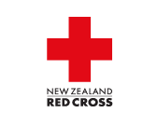






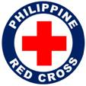

What are some other examples of our logos?
Notes:
Logos have two elements: an emblem and a Movement component name (i.e. ICRC, New Zealand Red Cross, Pakistan Red Crescent, etc as displayed above)

Slide 9
What is the Movement logo and when can we use it?
One logo to visually represent Movement components
Enables us to “speak with one voice” and promote our work for contexts, events, themes and campaigns of global concern and interest
Movement logo can be used for:
Representation
Communication
Movement promotion & fundraising for a major emergency
Movement promotion & fundraising for a general theme or campaign
Complements the logos of individual Movement components
Its use is exceptional and only upon approval
Movement logo may not be displayed or used for operational purposes
Notes:
For more information – see the key messages and frequently asked questions on the Movement logo on FedNet (https://fednet.ifrc.org/movementlogo).
What is the Movement logo and what is its purpose?
The Movement logo was adopted by Movement components at the Council of Delegates in December 2015.
The logo is only available in the six official languages of the International Red Cross and Red Crescent Conference (Arabic, Chinese, English, French, Russian, Spanish).
Visually represents Movement components using one logo
Enhances our collective “Red Cross Red Crescent” brand
Enables us to “speak with one voice” and promote our work for contexts, events, themes and campaigns of global concern and interest
Enhances our positioning as a relevant and essential humanitarian network present and active around the world
Meets expectations and opportunities to participate in Movement-wide global fundraising initiatives
What are the four situations it can be used?
Exceptional use only and upon approval for:
Representation
materials of the Movement’s Statutory meetings
in global events in which Movement components are participating
Communication
RC/RC magazine
Movement-wide campaign materials, joint statements, digital platforms and other materials on contexts and themes of global concern (e.g. World Red Cross Red Crescent Day)
Movement promotion and fundraising for a humanitarian emergency
for Movement-wide promotion and fundraising, including with an external partner, linked to a humanitarian emergency of global interest, where many Movement components are involved in the humanitarian response (major disaster such as Haiti EQ, Philippines Haiyan, or in the situation where a digital partner proposes to fundraise for the RCRC for a major disaster)
Movement promotion and fundraising for a general theme or campaign
for Movement-wide promotion and fundraising initiatives for an event, theme or campaign, which may also include sponsorship from, or partnership with, an external partner (e.g. Health Care in Danger, food security, migration?)
Related question from the Movement Logo FAQs:
Can I display my National Society logo together with the Movement logo?
Once the Movement logo is approved for use for a specific purpose, your National Society may choose to display the Movement logo alongside your logo, such as for a Movement-wide event that your National Society is hosting, or in a press release for your domestic market on a humanitarian emergency of global concern. In these examples, your National Society can position itself as part of the global Movement using the Movement logo.
Why does the use of the Movement logo need to be approved?
In the consultations between the ICRC, the IFRC and National Societies on the Movement logo and its conditions and rules, all components of the Movement recognized the need for and importance of:
protecting the brands and logos of individual Movement components; and
ensuring that the use of the Movement logo would not undermine the respect that is due to the emblems.
As a result, it was agreed that the Movement logo would be for exceptional use only and that its use would be subject to a strict approval process.
How is a request to use the Movement logo reviewed and approved?
First, the ICRC's director-general and the IFRC's secretary-general review any proposed use of the Movement logo for an event, theme, campaign or humanitarian emergency and grant an in‑principle approval – if they agree the situation is of Movement-wide interest or concern. Then, if the in-principle approval has been granted, the Movement Logo Approval Committee – composed of representatives from both the ICRC and the IFRC and, as appropriate, National Societies – reviews all specific requests and decides whether or not the logo may be used. Decisions are made in a timely manner taking into consideration the urgency of the request.
How can I make a request to use the Movement logo?
If you identify an opportunity to use the Movement logo that falls within the scenarios described above, you can complete the Movement logo request form and submit it to MovementLogo@ifrc.org. The request form ensures that you provide all the information that the Movement Logo Approval Committee will need to make its decision in an informed and timely manner.
What have been the approved uses of the logo to date?
As of March 2017, the logo has been approved and used for the eight initiatives below for representation and communication; the Movement logo has not yet been used for fundraising.
World Red Cross Red Crescent Day (8 May): https://fednet.ifrc.org/8maycommunication and http://ifrc-media.org/interactive/everywhere-for-everyone-8-may-2016/
RCRC Magazine: http://www.rcrcmagazine.org/
Movement institutional websites: (for example on http://www.ifrc.org/en/who-we-are/the-movement/ and https://www.icrc.org/en/document/logo-international-red-cross-and-red-crescent-movement)
World Humantarian Summit 2016
Habitat III 2016
2017 Council of Delegates
Global Communication Forum
RC2 Forum (during 2017 Statutory Meetings)

Slide 10
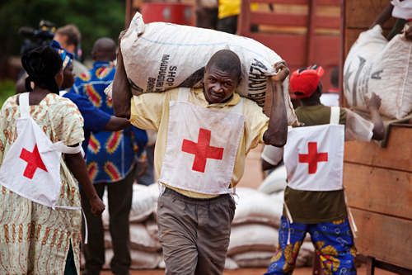
How was the protective symbol developed?
A single distinctive sign was proposed to help protect military medical services, volunteer aid workers and wounded people in armed conflict.
It had to be simple, identifiable from a distance and uniform, thus known to everyone.
It needed to be neutral, without any religious, political or cultural affiliation.

Slide 11
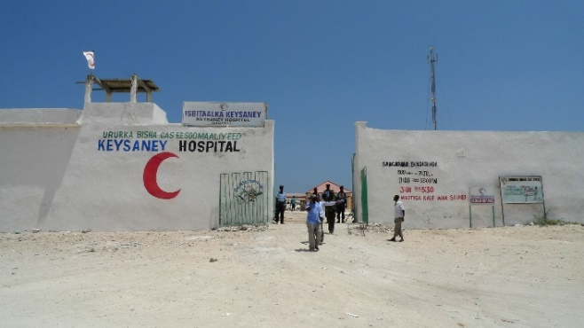
What laws and rules govern the display of the emblems?
The use of the emblems is regulated by the 1949 Geneva Conventions and their Additional Protocols and in many countries by domestic law
1991 Regulations of the Use of the Emblem of the Red Cross or the Red Crescent by the National Societies

Slide 12
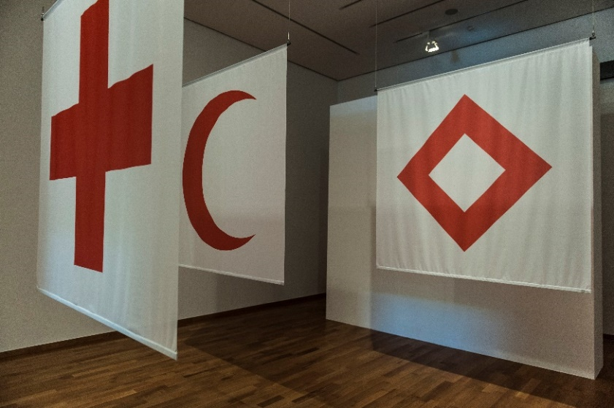
How were the emblems adopted?
A diplomatic conference in Geneva in August 1864 adopted a red cross on a white background, the colours of the Swiss flag in reverse.
During the 1876-1878 war between Russia and Turkey, the Ottoman Empire used as its emblem a red crescent, which was formally recognized in 1929 in an amendment to the first Geneva Convention.
In 2005, States adopted an additional emblem: the red crystal. The red crystal enjoys the same legal status as the red cross and red crescent and may be used in the same way and under the same conditions.
Notes:
For further information, please go to https://www.icrc.org/eng/war-and-law/emblem/overview-emblem.htm

Slide 13

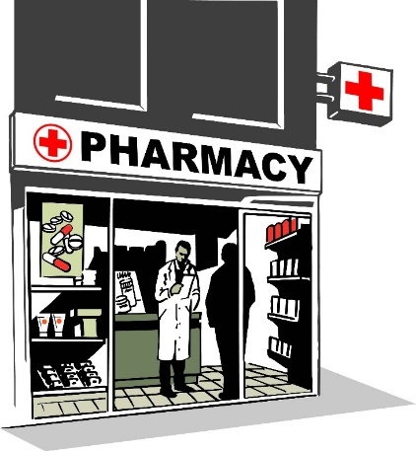
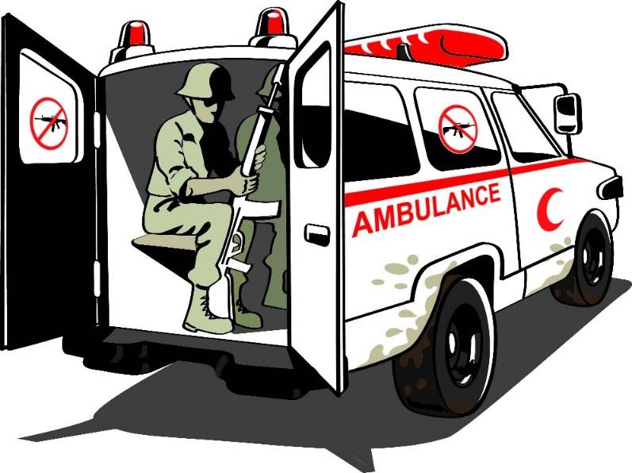
Misuse of the emblems
Here are some of the ways in which the emblems must not be used:
IMITATION
IMPROPER USE
PERFIDY
Notes:
The use of a sign which, owing to its shape and colour, may be confused with one of the emblems.
Any use of an emblem inconsistent with international humanitarian law. The use of an emblem by unauthorized people or entities (commercial enterprises, pharmacists, private doctors, non-governmental organizations, individuals, etc.) or for purposes that are inconsistent with the Movement’s Fundamental Principles or mission.
In order to ensure universal respect for and protection of the emblems, each State party to the 1949 Geneva Conventions has an obligation to enact national legislation with the aim of regulating the use of the emblems and of preventing and punishing their improper use both in times of war and peace.
National authorities must also take steps to inform the public, businesses and the medical community of the proper use of the emblems.
National Societies also cooperate with the authorities to ensure proper use of the emblems.

Slide 14
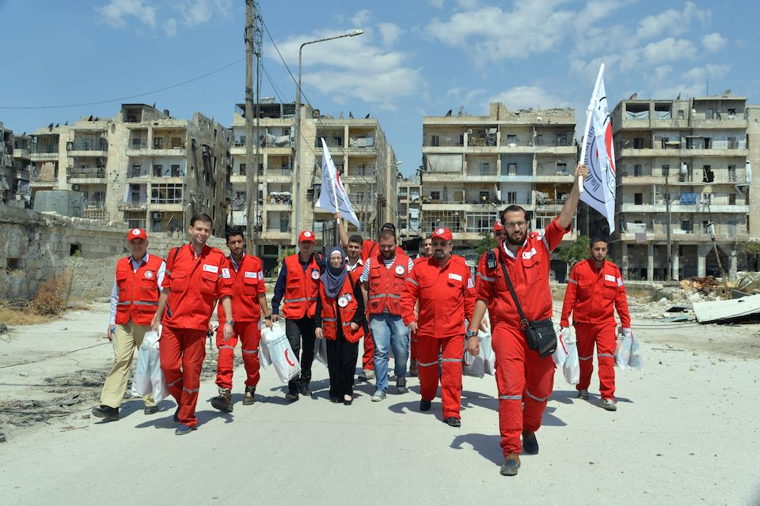
Why is it important that the emblems are displayed correctly?
Misuse of the emblems could jeopardize their protective function during armed conflict because the warring parties and weapon bearers may lose trust in what the emblems stand for.
Misuse may also hamper or jeopardize the safe access of Red Cross or Red Crescent staff and volunteers to people and communities in need during humanitarian crises.
© SARC
Notes:
Even in countries that are not experiencing any such crisis, it is important to ensure that the emblems are used correctly so that people and communities understand their purpose.

Slide 15
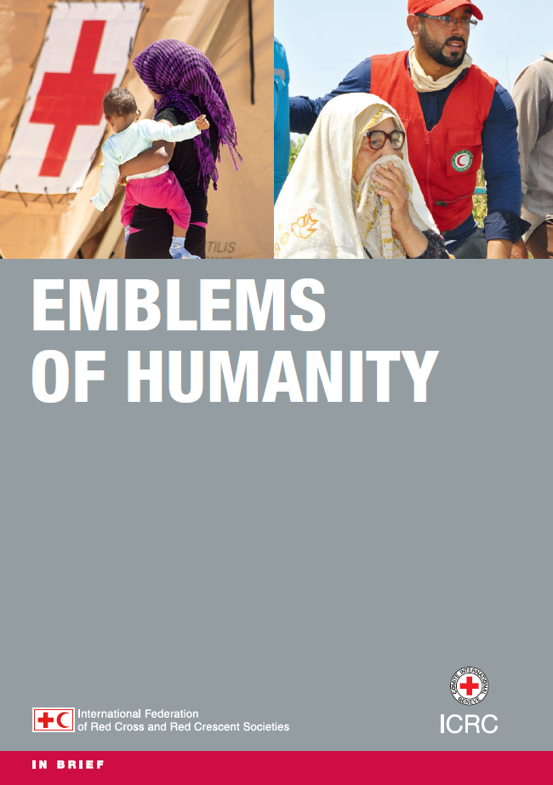
What tools about the emblems are available?
  Emblem toolkit – photos, Q&A, key messages, presentation, brochures (emblems of humanity and preventing misuse), survey for a perception study on the emblem, video animation, digital TV spot
  Emblems and logos in communication, marketing and fundraising (within Branding Toolkit)
Notes:
The tool Emblems and logos in communication, marketing and fundraising (within Branding Toolkit) is available in EN, FR, SP and AR for ICRC, IFRC and NS staff; it can be found at https://fednet.ifrc.org/brandingtoolkit.
This Branding Toolkit was created to help National Societies strengthen their brands and manage their reputation successfully in order to position themselves as leading humanitarian actors and remain relevant and competitive in today’s changing environment. The toolkit is the result of the International Branding Initiative. Communication, marketing and fundraising representatives from around 30 National Societies, the ICRC, and the International Federation have been involved in its realisation.
This toolkit, especially the “Do’s and Don’ts” section which visually displays correct and incorrect uses of the emblem, is an extremely valuable resource for National Societies to help them leverage their own brands, not just to contribute to a Movement brand positioning. The toolkit is intended to be a living document. We encourage all National Societies to submit good practice examples of their work on brand, visual examples for the dos and don’ts section in the guidance document on the use of the red cross and red crescent emblems and logos, experiences, market research results, case studies and successes.

Slide 16
THANK YOU!

