Slide 1
Day 3: Welcome back
Presentation for the IFRC Sexual and Gender-based Violence course

Slide 2
Session 7: Internal protection systems
Presentation for the IFRC Sexual and Gender-based Violence course

Slide 3
Monitoring and Evaluation of Policy/Safeguard
Code of Conduct
Child Protection Policy
Prevention of Sexual Exploitation and Abuse:

Slide 4
Voice of Survivors – Video / Gallery
To Serve with Pride
Survivor story and introduction to PSEA
Video from: 5.57 - 7.50.
Notes:
Video and discussion UNFPA Madagascar. Online at:
(IPV, physical violence,
economic violence, to initiate discussion on what kind of support a survivor should be
provided, family expectations, increased risk of GBV connected to migration and the lack of
social networks/support systems)

Slide 5
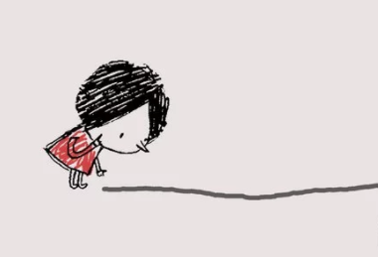
Activity
Walk the line

Slide 6
Preliminary list of considerations
IFRC

Slide 7
Preliminary list of considerations

Slide 8
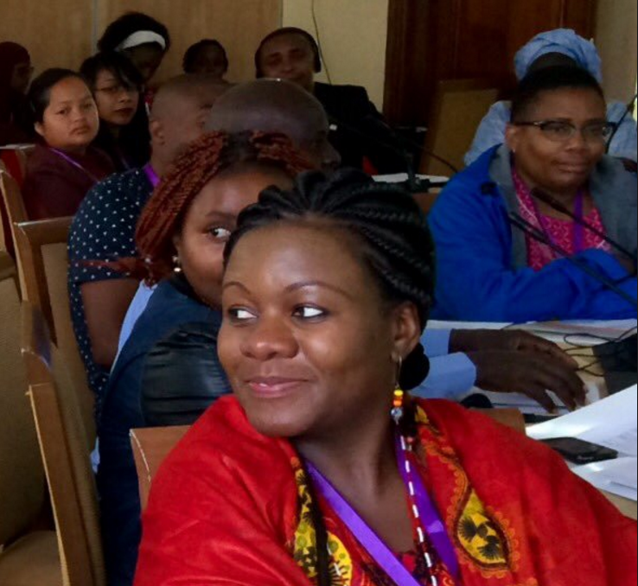
Preliminary list of considerations

Slide 9
Preliminary list of considerations

Slide 10
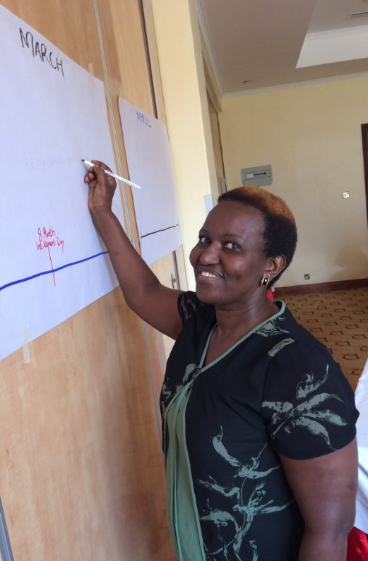
Preliminary list of considerations

Slide 11
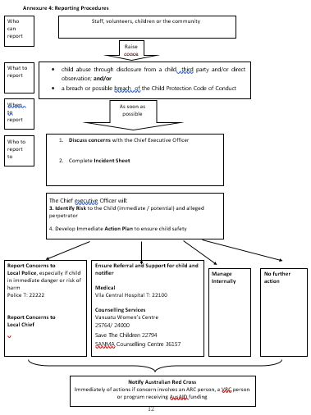
To the left, a reporting protocol
Handout, sample monitoring tool for Child Protection Policy

Slide 12
Child Protection Policy

Slide 13
Group discussion
Group 1: Child protection policies
Group 2: Code of conducts
Group 3: PSEA
Discuss:
Do you have this policy in your National Society?
How effective is it being implemented?
How could it be strengthened?

Slide 14
Coffee break

Slide 15
Session 8: Basic Staff Care
Presentation for the IFRC Sexual and Gender-based Violence course

Slide 16
Objectives of Staff and Volunteer Care session
Build an understanding of the various types of traumatic stress and how they impact you.
Gain awareness of the signs of burnout and vicarious trauma (called “Secondary traumatization”)
Basic Understanding of the processes you need to put in place and methods for staff care and managing stress.

Slide 17
Key messages on staff care for GBV prevention and response
Consider this definition of a crisis event:
“A crisis event is a major event outside the range of normal everyday experience that is extremely threatening to those involved, usually accompanied by feelings of powerlessness, horror or terror. When an individual is involved with, witnesses or is repeatedly confronted with crisis events that pose actual or threatened death or injury to self and others, they can be left feeling overwhelmed by fear, helplessness and a loss of security.”
- IFRC PSS Centre Staff Care Manual (draft)

Slide 18
Stress
As humanitarian workers, we are often in high-pressure environments. We may also feel a high level of commitment to our work.
To be effective in our work to support others, we need to first take care of our own well-being.
This requires being aware of the stressors in our lives and how they affect us, and methods to prevent and respond to their negative impacts

Slide 19
Stress
Cumulative Stress
Result of prolonged, accumulated, unrelieved exposure to stressors
Critical Incident Stress
Caused by extraordinary events which provoke high level of stress in almost everyone involved
Vicarious Trauma/Secondary Traumatisation
Result of witnessing or learning about others’ traumatic experiences that causes a reaction that mirrors that of the survivor
Notes:
What is “secondary traumatization”?
How can staff needs be addressed as they work with survivors of SGBV?
How can volunteer needs be addressed?
As a rule of thumb, volunteers should only refer. For specific cases where volunteer driven activities or services are the only points of support for survivors around, careful consideration should be taken if the NS/branch wants to offer some SGBV survivor services with plans on how to ensure minimum standard requirements for the sector. Can it be assumed that all emergency health facilities have the capacity to provide SGBV clinical health support (as per the MSC for emergency health)?

Slide 20
Exposure to continuous negative events
Result of prolonged, accumulated, unrelieved exposure to a variety of stressors
Most common form of stress experienced by humanitarian workers
When not recognized and managed, leads to burnout

Slide 21
Ways we are affected by GBV Work
Cognitive
Physical
Emotional
Behavioral
Spiritual/ Beliefs/ Values
There are many different signs of stress, and they manifest in many different ways depending on the characteristic of the person and the stressor.
May be physical, cognitive, emotional, behavioral, or spiritual/philosophical.
May be immediate, or may be delayed.

Slide 22
Important skills for Staff and Volunteer Care
Responding to disclosure
Containing disclosure
Confidentiality
Supportive environment

Slide 23
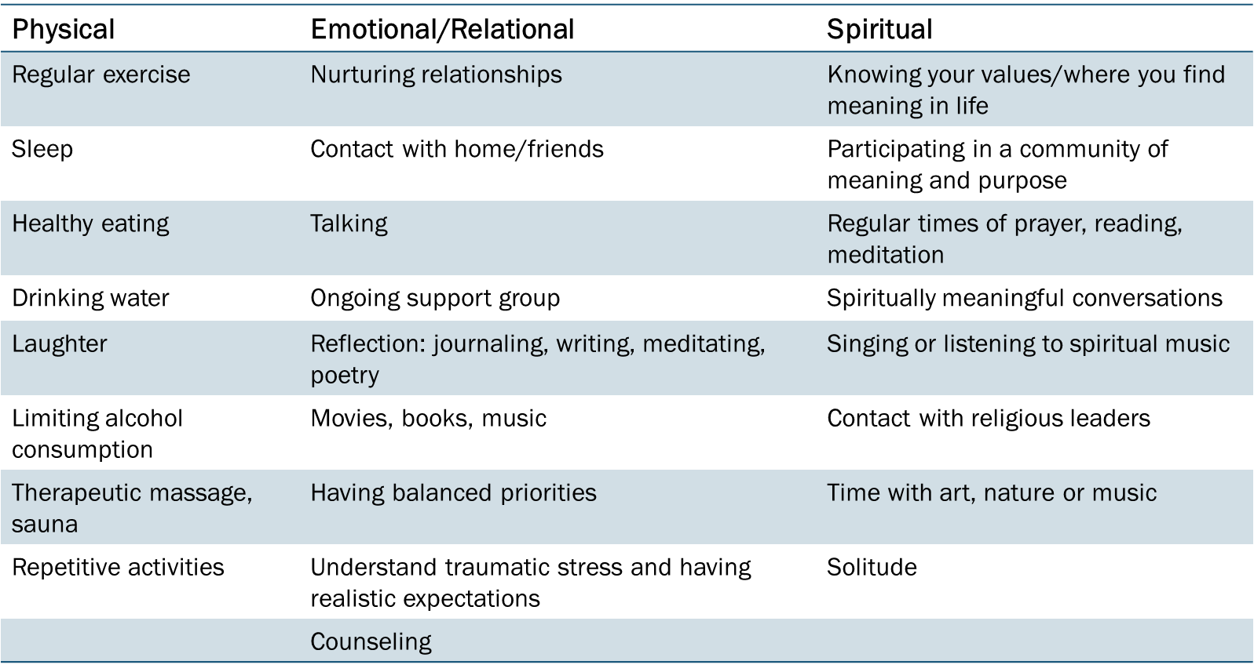
Techniques and Strategies

Slide 24
Ideas for volunteers
Regular recreational/team support activities structured into work-plans
Rotating responsibility for planning activities.
Well-being buddies

Slide 25
Thank you
© International Federation of Red Cross and Red Crescent Societies, Geneva, 2014.
Add any information to copyrighted materials here.
Any part of this presentation may be cited, copied, translated into other languages or adapted to meet local needs without prior permission from the International Federation of Red Cross and Red Crescent Societies, provided that the source is clearly stated. Requests for commercial reproduction should be directed to the IFRC Secretariat at secretariat@ifrc.org
All photos used in this presentation are copyright of the IFRC unless otherwise indicated.
This presentation and relevant resources are available on FedNet at fednet.ifrc.org

