Slide 1
Day 2: Welcome back
Presentation for the IFRC Sexual and Gender-based Violence course

Slide 2
Session 4: Review and Discussion
Presentation for the IFRC Sexual and Gender-based Violence course

Slide 3
Review and discussion
Review from yesterday:
Reflection from Day 1
Mapping the field feedback
Today:
  Morning: focus is on applying the Minimum Standard Commitments to the two scenarios
  Afternoon: Action planning

Slide 4
Session 5: Mitigation and Response to
Sexual and Gender-based Violence
Presentation for the IFRC Sexual and Gender-based Violence course

Slide 5
Voice of Survivors – Video / Gallery
Pascaline's story:
https://avarchives.icrc.org/Film/18645

Slide 6
Minimum requirements for National Societies
  Knowledge and application of the Minimum Standard Commitments
    Sector specific knowledge and implementation
    Confidential multi-sectorial referral of survivors
    Internal codes of conducts and structures for cases of concern
  How to achieve this:
    Seven Moves training of managers, staff and volunteers
    Coordination, available information and training of referral pathways and contact information, and confidential referral of survivors
    Routines and training to set up systems, information dissemination internally and externally

Slide 7
Taking it up a step, mainstreaming SGBV

Slide 8
Response: Added requirements
Build capacity of existing services to support SGBV survivors
  Clinical health: MISP for SRHR, clinical management of rape
  Psychosocial support: PSS centre training
  Communication with and treatment of children
  Contact cluster coordinator to see if training in SGBV data collection and storage, or information management systems is possible/realistic
Starting new activities to provide services to survivors should be carefully considered (existing or new knowledge and expertise, organisational commitment, sustained funding, training opportunities…)
  International humanitarian minimum standards must be followed

Slide 9
Response: Added requirements
Build capacity of existing services to support SGBV survivors
  Clinical health: MISP for SRHR, clinical management of rape
  Psychosocial support: PSS centre training
  Communication with and treatment of children
  Contact cluster coordinator to see if training in SGBV data collection and storage, or information management systems is possible/realistic
Starting new activities to provide services to survivors should be carefully considered (existing or new knowledge and expertise, organisational commitment, sustained funding, training opportunities…)
  International humanitarian minimum standards must be followed

Slide 12
Making referrals
Keep in mind that the person affected can choose not to be referred if they are adult
When the affected person is a child all personnel are obliged to ensure that IFRC policy and local laws are followed
If the affected person agrees to the referral, obtain consent before sharing information
Notes:
Making referrals: IFRC Draft Protection Field Guidelines

Slide 13
Making referrals
Make the referral according to established procedures and accompany the person if needed and possible
Follow-up with the affected person and the receiving agency to ensure the referral was successful
Document the case and the referral in writing, and share this with your line manager
Notes:
Making referrals: IFRC Draft Protection Field Guidelines
Inter-Agency Standing Committee (IASC) Reference Group for Mental Health and Psychosocial Support in Emergency Settings: Inter-Agency Referral Form and Guidance Note
https://interagencystandingcommittee.org/system/files/1866_psc_iasc_ref_guidance_t2_digital.pdf

Slide 14
Data collection and storage
Incident data should only be collected by organisations that provide direct services to survivors
Always start with explaining why data is collected, for what purpose, and that they can choose to stop at any time
Standard intake forms (health, PSS) include options for SGBV
Forms should comply with national categories, if sufficient (age disaggregated, both male and female survivors…)
Data routines as for other health related data
  Anonymised, identification separate
  Strict confidentiality and access to files
  Locks, codes

Slide 15
Data sharing with other institutions
Survivors should not need to tell the same story several times - retraumatisation
Consent form from survivor
If sharing data with other organisations for follow-up of survivors, ensure that data sharing agreements are in place and routines agreed on to avoid breach of confidentiality and incompatibility/overlap of data

Slide 16
Coordination in Practice
Where there is a Protection Cluster, UNFPA as the global GBV AoR lead, is responsible for supporting and/or establishing an inter‐agency GBV coordination body.
As a first action, determining the capacity of funding a mid‐ to senior‐level staff person to the role of GBV Coordinator.
Where there is no Protection Cluster but GBV has been identified as a priority area of concern to the Humanitarian Country Team and the cluster system is in place, UNFPA coordinates with other relevant entities and NGOs to support and/or establish an inter‐agency GBV coordination body,
Notes:
GBV AoR: GUIDANCE NOTE Field‐Level Coordination of a GBV Area of Responsibility Working Group

Slide 17
Coordination in Practice
Where an inter‐agency group already exists to coordinate GBV prevention and response activities, this body should always be considered first as a potential forum for coordinating GBV in a cluster context.
  Do not establish parallel structures unless absolutely necessary; make what exists stronger and sustainable.
Notes:
GBV AoR: GUIDANCE NOTE Field‐Level Coordination of a GBV Area of Responsibility Working Group

Slide 18
Minimum Actions to be Undertaken by an Inter-agency GBV Coordination Body
Mapping all relevant actors (e.g. identifying who is doing what and where) and existing relevant coordination bodies or working groups
Allocating a full‐time staff to the role of GBV Coordinator
Mobilizing participation by UN, NGO, Red Cross/Red Crescent, and (as appropriate) donors and Government actors in the GBV AoR working group.
Drafting an AoR ToR and work plan
Developing Standard Operating Procedures (SOP) using the IASC GBV SOP template.
Notes:
GBV AoR: GUIDANCE NOTE Field‐Level Coordination of a GBV Area of Responsibility Working Group

Slide 19
Minimum Actions to be Undertaken by an Inter-agency GBV Coordination Body
Disseminating and ensuring comprehension and use of the IASC Guidelines for Gender‐ Based Violence Interventions in Humanitarian Settings
Ensuring inclusion of GBV in all relevant humanitarian funding processes and humanitarian action plans.
Representing the GBV AoR working group in the Protection Cluster
Ensuring cross‐cluster coordination by interacting with other relevant cluster leads (e.g.Health, Water and Sanitation, Nutrition, Education etc.)
Where relevant, catalyzing and supporting sub‐national structures for GBV coordination
Notes:
GBV AoR: GUIDANCE NOTE Field‐Level Coordination of a GBV Area of Responsibility Working Group

Slide 20

Mitigation and Response
Small Group Work Using The Scenarios
  Applying The Minimum Standard Commitments
  Defining and strengthening the role of the NS in the operation
Groups split by sector (30 mins)
Whole Group together on coordination (20 minutes)
Whole group together on strengthening NS (20 minutes)
Plenary (20 minutes)

Slide 21
Mitigating and responding to SGBV in your sector: 30 minutes
Identify the sectors that need to address SGBV in the scenario, and assign one or two people in the group to each sector.
a. What are some practical, immediate interventions you can integrate into your sector to address the vulnerabilities of groups in this community to SGBV?
b. What are other sectors in this scenario with whom you will need to coordinate?
c. Who are other actors in this scenario with whom you will need to coordinate?

Slide 22
Mitigating and responding to SGBV in your sector: 20 minutes
Coming back together as a group, discuss which actions you agreed on for each sector. As a group, discuss:
How will you refer survivors to essential response services (medical, psychological/psychosocial, legal and protection)?
How will your group's sectors coordinate together to minimize re-traumatization of the survivor and protect her/his privacy and confidentiality?

Slide 23
National Society actions: 20 minutes
What role can the National Society play in the humanitarian operation?
Can the NS provide services to SGBV survivors?
What are the resource and knowledge gaps on SGBV which the NS need to fill to work responsibly in the operation?

Slide 24
Session 6: Monitoring and Evaluation
Presentation for the IFRC Sexual and Gender-based Violence course

Slide 25
Speed debating
It doesn’t matter if we count an adolescent girl as a adult, she just is another person
If the number of cases of GBV reported to us increases, it means the number of cases of GBV are increasing

Slide 26
A short film on Gender and Age Markers
https://www.youtube.com/watch?v=_LYX_v-B51Q (3min 52secs)

Slide 27
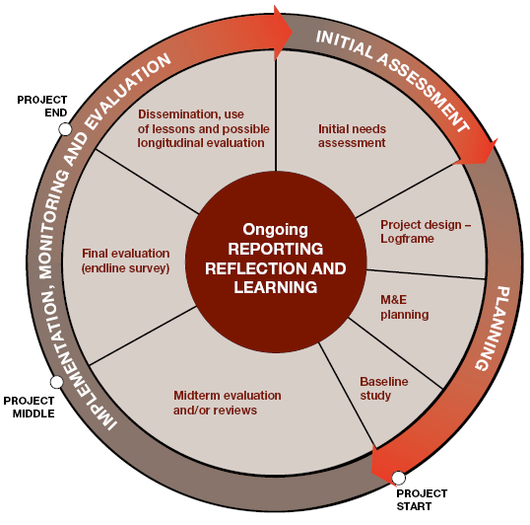
PMER and the project cycle - obligations to ensure we provide quality
Notes:
This provides, in a way, an overview of the project cycle with M&E activities. These phases are not static and necessarily follow one after another. For example community engagement and communication will be done throughout the cycle, e.g. based on input from stakeholders you adjust planning, implementation etc.
There are multiple tools/resources for M&E, this list is not exhaustive and other tools might also be used depending on your specific context (an example is using a theory of change instead of a logframe). You will get a chance to talk more and apply the different tools during the rest of this training. For example tomorrow you will have a chance to look at the assessment, logframe etc. more in depth.
The resources mentioned here are key tools that establish the foundation of project/program PMER and ones that are often used by the Movement.
After having looked at this the rest of the focus in this presentation and throughout this training will be on Gender and Diversity and how these aspects can be included in PMER in different stages of the project cycle. As part of that we will also look at the G&D tool that has been developed and used by NorCross based on the G&A marker from ECHO and that can be used as a concrete tool to assess your projects on G&D issues.

Slide 28
Gender and Age is about clearly showing that we are meeting the needs of the most vulnerble
Imagine a proposal for an Appeal reads like this:
Health problems were identified and will be addressed throughout the project
Gender has been mainstreamed throughout the project
What do you think?

Slide 29
The statements are completely meaningless
They do not tell us:
  Who is vulnerable to the health needs
  What they will expect and receive from IFRC or the NS
  Why we will target those people (and not others)
  How we will ensure that the targeted has an impact on the problem statement

Slide 30
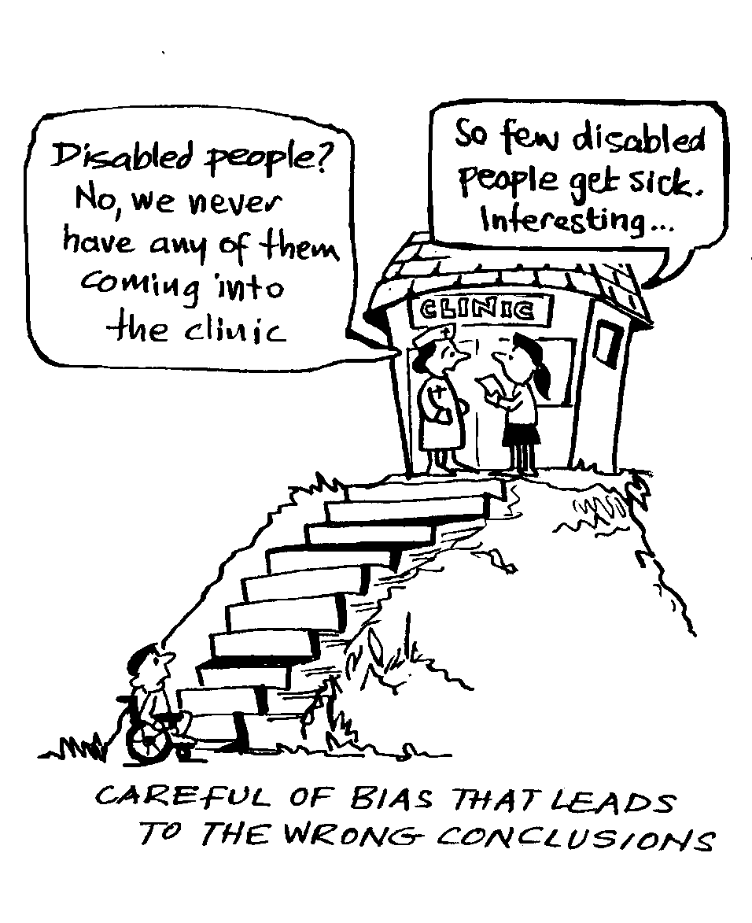
They are sometimes more than meaningless, they are dangerous
We have commitments to Do No Harm
We are a leading agency, we cannot miss the analysis on who we reach, how and why
We have our minimum standard commitment to promote Dignity, Access, Participation and Safety, so let’s do it, measure it and show it off!

Slide 31
When assessing an Appeal or Project
Avoid generic phrases: “The needs of the most vulnerable are mainstreamed” / “Gender was mainstreamed throughout the document”
Be needs based: “The assessment showed that elderly could not access health services due to physical and logistical barriers of getting to the clinic/ girls were not allowed to participate in activities outside the home after sunset. The project has therefore bought a minibus shuttle service to ensure the safe transport of these groups to the afterhours clinic.»

Slide 32
Phase 1, Initial Assessment
Phase 2, Planning and Design
Phase 3, Implement, Monitor, Adjust
Phase 4, Evaluate and Learn
Analysis/ assessment include vulnerable groups, look at needs and capacities – ensure disaggregated data
Ensure that your actions take G&D considerations into account when designing your interventions and check your assumptions (e.g. through baseline)
Integrate G&D considerations in the implementation of the project, e.g. through specific actions. Based on your findings from monitoring adjust where needed
Evaluate your actions, looking at how your actions have impacted differently on each group/individuals. Learn and try to use lessons learned for future actions

Slide 33
Gender and Age Marker Tool
The Gender and Age Marker tool is a tool to help mainstream and assess gender and diversity in projects/programmes including Appeals, and will help us implement the Minimum Standard Commitments to Gender and Diversity in Emergency Programming
… to improve quality

Slide 34
What does it do?
It considers gender and age issues and also explicitly takes diversity into account
It assesses proposals and project implementation including Appeals (and can be used for all other programmes or services)
It focuses on quality criteria
It is a collaborative learning tool, engaging both partners and staff in a constructive dialogue
It is used by some NSs and is based on evidence from donors on what works, helping us to monitor integration of G&D considerations in projects/programmes and adjust support (and importantly to measure our indicators in the Plan and Budget)

Slide 35
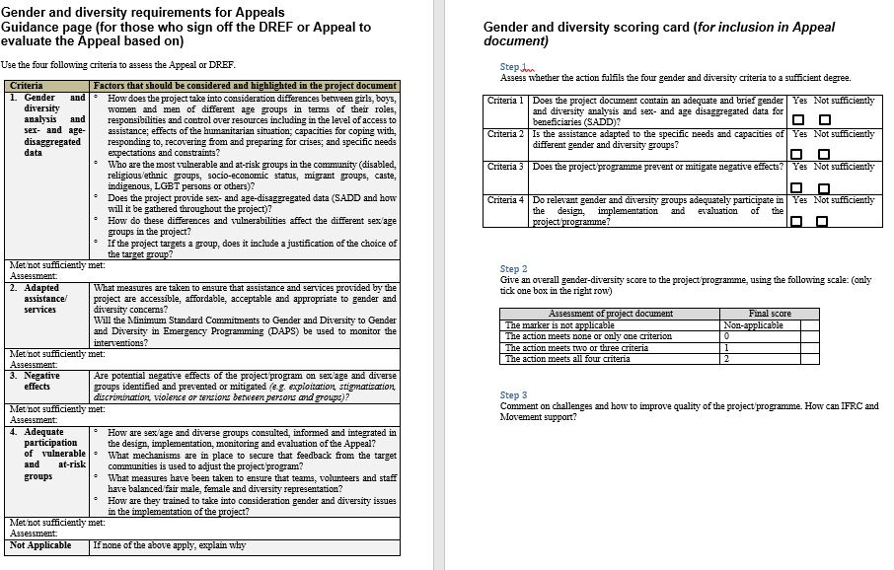

Slide 36
Apply the Gender and Diversity tool ….
Assess whether the project meets the four criteria
1. Gender & Diversity Analysis / SADD | Yes | Not Sufficiently
2. Adapted Assistance / Services | Yes | Not Sufficiently
3. Prevent / mitigate Negative Effects | Yes | Not Sufficiently
4. Adequate Participation | Yes | Not Sufficiently

Slide 37
Criteria 1. G&D Analysis and SADD
Does the project contain an adequate and brief gender and diversity analysis (planning) or does the project provide sex- and age-disaggregated data (SADD) (MER) ?
  Roles and control over resources
  Discrimination, lack of access
  Effects of the situation on different groups
  Capacities of affected people
  Specific needs of the most vulnerable and at-risk groups
  If targeted: justification of target group

Slide 38
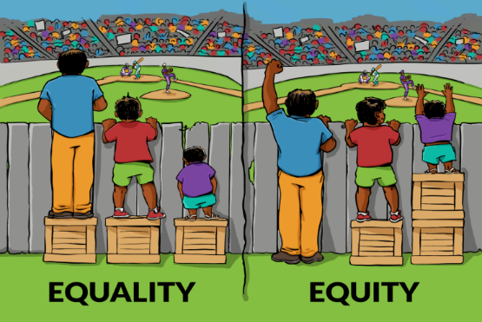
Criteria 2. Adapted assistance / services
Are the interventions/services adapted to the specific needs and capacities of different groups?
  Systematic adaptation of interventions
  Equitable access to services
Notes:
What measures are taken to ensure that the services provided by the project/program are accesible, affordable, acceptable and appropriate to gender and diversity concerns. Equity and equality are two strategies we can use in an effort to produce fairness.. Equality means that everyone should have equal rights and promotes fairness but Equity is giving everyone what they need to be successful. Not everyone starts from the same point so you might need to design specific interventions.

Slide 39
Criteria 3. Negative effects
Does the action prevent or mitigate negative effects?
Potential negative effects are prevented
Gender – or diversity - related risks created by the context are mitigated
Notes:
Concrete examples of how assistance is adapted to the specific needs and capacities of different gender and age or other specific groups and how the action ensures that all relevant groups enjoy equitable access to the assistance. An example of a negative effect could be for example that you provide services to one group – e.g. migrants – forgetting about the population living in a certain area that might create tensions. You can look at well as if there are any measures proposed to mitigate or prevent such effects from happening. Can someone maybe provide an example of a project where the project had another effect than expected (negative?) or where you where able to prevent that?

Slide 40
Criteria 4. Adequate Participation
How do sex/age and diverse groups participate in the different stages of the project / programme – in the design, implementation & monitoring and evaluation of the action?
Participatory approach
Adequate team composition (staff, volunteers, community members) – gender, age, other characteristics
Notes:
It is important to include several people in the different stages of the project. This can be done through participatory approaches such as VCA, PHAST, stakeholder analysis, CBHFA but also through monitoring committees, participatory monitoring and evaluation approaches. Assess your project to see what has been proposed and if there are examples also from other projects that you can use. Assess also what the composition of your teams of volunteers, staff, community committees look like. Do they represent the different groups (age, gender, minorities, handicapped)? If not what measures can be taken? Good examples are programmes involving for example handicapped in the design of the programme. They will look at different things. Including people in all stages also increases their commitment and can also benefit to prevent any negative effects.

Slide 41
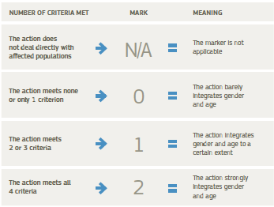
How to ‘score’ the four criteria
Determine the mark, depending on how many criteria are met:

Slide 42
Sex, age and disability disaggregated data
Use sex- and age- disaggregated data as mandatory to inform your assessments, analysis and programme planning.
Where possible and necessary in a target area use disability disaggregated data as well as filtering by other components of diversity
Allows us to understand the differences in level of participation, the benefits women and men receive from the programme and any gaps
Example (note age brackets to be determined in counting people reached)
Age | 0-5 |  | 6-17 |  | 18-59 |  | 60+
Indicator / Sex | F | M | F | M | F | M | F | M
# of participants (m/f) attending Community Disaster Preparedness simulation activity | 2 | 4 | 6 | 3 | 25 | 44 | 2 | 4
# of boys and girls involved in preparation of child friendly spaces | 5 | 6 | 14 | 19 | 0 | 0 | 0 | 0

Slide 43
SGBV indicators, group work (45 minutes)
Sit with your scenario group
15 minutes: Work individually or in pairs as per the sectors you worked earlier
  Look at the indicators for sector implementation from the IASC GBV guidelines
  Choose 2 indicators relevant for your scenario based on the work from Mitigation and Response session
30 minutes: In the group, agree on what challenges, activities and requirements you need to plan in the operation/project to use and measure the chosen indicators for the sectors in the scenario

Slide 44
That’s it for today folks!
Start tomorrow at 09:00

Slide 45
Thank you
© International Federation of Red Cross and Red Crescent Societies, Geneva, 2014.
Add any information to copyrighted materials here.
Any part of this presentation may be cited, copied, translated into other languages or adapted to meet local needs without prior permission from the International Federation of Red Cross and Red Crescent Societies, provided that the source is clearly stated. Requests for commercial reproduction should be directed to the IFRC Secretariat at secretariat@ifrc.org
All photos used in this presentation are copyright of the IFRC unless otherwise indicated.
This presentation and relevant resources are available on FedNet at fednet.ifrc.org

