Slide 1
Day 1: Welcome and Introductions
Presentation for the IFRC Sexual and Gender-based Violence course

Slide 2
Welcome
Thank you to the Philippines Red Cross and IFRC Philippines!
Introductions
  Name
  Professional background
  # years working in programmes related to gender/SGBV

Slide 3
Getting to know each other
In pairs, complete the Introduction ‘pre-test’
The correct answers will be given at the end of the week after the post test

Slide 4
Objectives of this training of trainers
Master the core concepts of Sexual and Gender-based violence, the importance of doing no harm, including in the process of data-gathering; the survivor-centred approach; the need for self-care for staff and volunteers; and recommended interventions to prevent and mitigate risk of SGBV within the participant's sector
Understand the opportunities and limitations for RCRC actors to contribute to safe communities through attention to sexual and gender-based violence
Be equipped with some skills & practical tools on how to integrate SGBV awareness, mitigation, or referral in emergency programmes and projects
Develop knowledge of multi-sectoral coordination and basic monitoring and evaluation (M&E), taking a "do no harm" approach to SGBV, and making links to child protection, community engagement, and accountability measures
Have developed a set of next steps to act on SGBV appropriate to your work context

Slide 5
Overview of Agenda
Monday | Tuesday | Wednesday | Thursday | Friday
Survivor-centred approach | Summary* (Group 1) | Summary* (Group 2) | Summary* (Group 3) | South East Asia Gender and Diversity Network Meeting
Key concepts – Sexual and Gender-based violence | GBV Mitigation and Response | Movement approaches Internal Protection Systems | Action Planning SGBV training and group presentations
Situation analysis
Mapping the field | Monitoring & Evaluation | Basic staff care | Evaluation and next steps
 |  | Action planning / organisational experiences | End

Slide 6
Pre-survey and Expectations
Pre-survey results
Expectations
Challenges and limitations

Slide 7
Pre-survey and Expectations
Increased knowledge of and understanding of basic concepts of gender-based violence
How to prevent, mitigate and respond to GBV
How to advocate in the NS for GBV
How to address GBV in DM programming – especially contingency and response planning
Apply / implement (some) GBV in the NS programmes and within communities
To have a good experience and learn from other National Societies in the training
Familiarity with the tools and practical way of implementing the tools & approaches to Minimum Standards on GBV
Best Practices
To be able to share on GBViE with NS volunteers to heighten their awareness, for them to not be part of the problem, even if they can’t be part of the solution.
Notes:
Trainer to fill in pre-survey results and group expectations on the slides ahead of the training.

Slide 8
What will not be covered:
Primary prevention of Gender-based Violence, this training is more focused on mitigation and response in emergency situations
How to conduct a gender analysis
How to evaluate DM interventions in relation to GBV, identifying indicators and measuring long term impact of programmes
Detailed standalone programmatic approaches
The steps that humanitarian responders can take to reduce any potential aggravations/aggression

Slide 9
Confidentiality Agreement
“We, the undersigned participants in this Sexual and Gender-based Violence in Emergencies training, agree to keep confidential information disclosed in this meeting anonymous and private”
(We agree to have photos and videos taken unless otherwise noted. Photos and videos will be used in training reports, and other IFRC and National Society materials for the purposes of reporting about the training, promoting the training and demonstrating the positive impact of the training, photos will not be used to share any case studies or private information about participants)
Notes:
Print out

Slide 10
Session 1: Voices of Survivors
Presentation for the IFRC Sexual and Gender-based Violence course

Slide 11
Content Warning
Staying safe during this training – content can be heavy and saddening
May elicit memories or past experiences
Sessions on staff care but….
Take breaks when you need to
You can refer to the facilitators in the break for support

Slide 12
Voice of Survivors – Video / Gallery
https://www.youtube.com/watch?v=gJ0SaCiAOrk

Slide 13
Discussion
What is the form of SGBV in this story?
What are the impacts for the survivors’ daily life?
What impacts for their family?
How do persons around the survivor react?
What supports do the survivors need?
What supports do they receive?

Slide 14
Session 2: Key Concepts and the Role of the Red Cross Red Crescent Movement
Presentation for the IFRC Sexual and Gender-based Violence course

Slide 15
Key concepts QUIZ
A quiz on key concepts
This quiz will take 15 minutes
We will discuss the answers together

Slide 16
The answers
What does SGBV stand for?
  Sexual and Gender-based Violence
  Sexual and Gross Bodily Violence
  Sexual or Gendered Bullying and Violence
What is SGBV?
  Physical, sexual, psychological or economic violence against a person because of their gender
  Violence during wars and conflict
  Physical violence against women only

Slide 17
Violence studies from 86 countries across Africa, the Americas, Eastern Mediterranean, Europe, South-East Asia and the Western Pacific, show that up to _____% of women have experienced physical and/or sexual violence in their lifetime from an intimate partner (a husband, a boyfriend, or spouse)
28%
68%
88%
Globally, 1 out of every _____women will become a victim of rape or attempted rape over the course of her lifetime (Heise, Ellsberg, and Gottemoeller 1999)
3
5
10

Slide 18
What % of women have reported experiencing physical violence by either an intimate and/or non intimate partner in their lifetime, in a) Cambodia ____% and b) Vietnam _____%
5%
13%
22%
35%
50%

Slide 19
What % of women have reported experiencing physical violence by either an intimate and/or non intimate partner in their lifetime, in a) Cambodia ____% and b) Vietnam _____%
22%
35%

Slide 20
Gender-based Violence is known to increase after disasters?
  True
  False
  Not enough evidence

Slide 21
In the Philippines (in Compostela Valley), from January 2012 to December 2012 (12 month period) there were 40 reported GBV cases. This was before Typhoon Pablo. After the typhoon, between December 2012 to April 2013 (4 month period), how many reported GBV cases were there?
    50
    90
    100
    110

Slide 22
In the Philippines (in Compostela Valley), from January 2012 to December 2012 (12 month period) there were 40 reported GBV cases. This was before Typhoon Pablo. After the typhoon, between December 2012 to April 2013 (4 month period), how many reported GBV cases were there?
    110

Slide 23
Male survivors of Gender-based Violence may be less likely to report violence because of:
  Individual factors – shame, fear for safety, health fears
  Societal factors – loss of income
  Community factors – stigma, isolation
  All of the above

Slide 24
The following characteristics underpin a Survivor Centred Approach:
  Safety, Dignity, Confidentiality, Non-Discrimination
  Safety, Security, Standard Response, Dignity
  Case management, Psychosocial Care, Healthcare
Trafficking, for sexual exploitation, is a form of gender-based violence
    True
    False

Slide 25
The following characteristics underpin a Survivor Centred Approach:
  Safety, Dignity, Confidentiality, Non-Discrimination
  Safety, Security, Standard Response, Dignity
  Case management, Psychosocial Care, Healthcare
Trafficking, for sexual exploitation, is a form of gender-based violence
    True

Slide 26
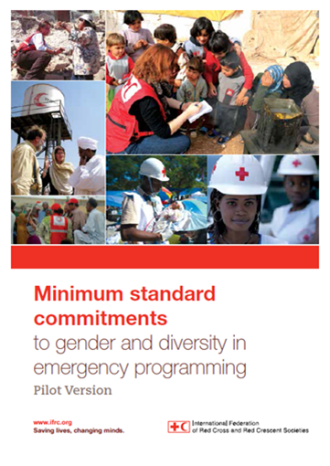
Objectives for this session
Review what you learned in the Seven Moves training / online “different needs, equal opportunities” course
Master the key concepts of an evidence-based approach to program design and evaluation; the importance of doing no harm; the survivor-centered approach; the need for self-care during the training;
Review and explore your own experiences

Slide 27
Key concepts PART I
Resolution on SGBV
Why focus on prevention?
The survivor-centered response
“Do no harm”
Self-care for staff and volunteers

Slide 28
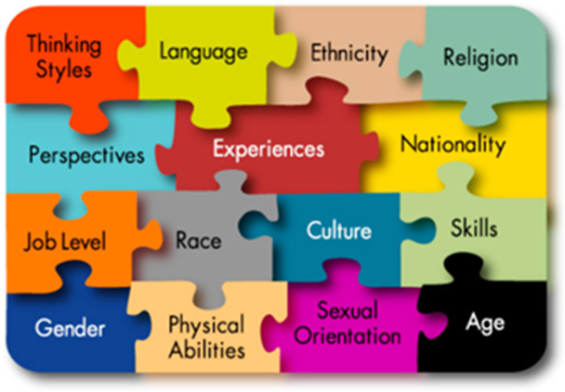
Core Concepts PART I
Sex | Gender
Biological differences | Social differences
Male, female, intersex* | Masculine, feminine, or other
Born male or female; difficult to change | We become masculine or feminine (or other). Changes across the life-cycle, within and between cultures.
Binary opposites | Degrees of masculinity and femininity – society sets the bar.
Notes:
Male and female – binary opposites
Masculine and feminine – degrees of masculinity and femininity set against a bar set by society.
Feminine – girly-girl, princess, tomboy, butch, androgynous, bitch, whore, madonna
Masculine – hyper masculine, ‘a bit of a woman’, ‘a girl’s blouse’, ‘feminine’

Slide 29

Sexual and Gender-based Violence (S/GBV)
An umbrella term for any harmful act that results in, or is likely to result in, physical, sexual or psychological harm or suffering to a person on the basis of their gender.
A result of gender inequality and abuse of power.
Includes but not limited to: sexual violence, domestic violence, trafficking, forced/early marriage, forced prostitution, sexual exploitation and abuse, and denial of resources, opportunities and services.
Another confusing and contested term: sexual violence, sexual and gender-based violence, violence against women and girls
Notes:
Gender-based violence (GBV) is a term used to describe any harmful act that is perpetrated against a person’s will, and that is based on socially ascribed differences between males and females. While men and boys can be victims/survivors of some types of GBV (particularly sexual violence) around the world, GBV has a greater impact on women and girls. Examples of GBV throughout the lifecycle include (but are not limited to): sex-selective abortion, differential access to food and services, sexual exploitation and abuse, including trafficking, child marriage, female genital mutilation/cutting, sexual harassment, dowry/bride price abuse, honour killing, domestic or intimate partner violence, deprivation of inheritance or property, and elder abuse.
Gender-based violence is pervasive in times of peace. In times of crisis, GBV may become more extreme. In armed conflict, one form of GBV, sexual violence, can become so widespread and systematic that it is considered a method of war and can escalate into a crime against humanity, a war crime or an act of genocide

Slide 30
Example: Types of sexual and gender-based violence
Verbal abuse
Physical abuse
Isolation
Intimate partner violence (eg. domestic violence, marital rape)
Female genital mutilation
Rape
Gang rape
Sexual slavery
Indecent assault
Sexual exploitation
Forced nudity
Forced sterilization or forced abortion
Forced pregnancy
Forced marriage, levirate mariage, early mariage
Trafficking

Slide 31
To implement the RCRC Movement approach
What you need to know:
Who you can refer survivors to for medical care, psychological/psychosocial support, legal aid, protection
How you can minimize risk of exposing survivor to violations of confidentiality, and avoid having survivor tell traumatic story repeatedly to different actors
We will discuss this further in the session on situation analysis

Slide 32

“Do no harm”
Discuss: What does “do no harm” mean in the context of programming on sexual and gender-based violence?

Slide 33
Survivor-centered response empowers survivors
Survivor-centered response places survivor needs, informed consent at the center of programming
Diverse actors work together to ensure survivors access to:
  Medical services
  Psychological and psychosocial support
  Legal assistance
  Protection services
Confidentiality, informed consent respected by all
One actor cannot do it all
  Multisectoral coordination, referral pathways must be planned in advance
  Avoid having survivor tell traumatic story repeatedly

Slide 34
Group Activity
Alana’s Story

Slide 35
A survivor of SGBV loses her/his power repeatedly
Violence
Police
Health care providers
Family, friends
Injury, trauma, threats of retaliation
May not take attack seriously, “blame the victim”
May stigmatise survivor, refuse to provide care
May violate confidentiality, discriminate, exclude, or cause additional violence

Slide 36
Survivor-centered response
Health
Protection
Security
Survivors
Legal
Psycho-social
Source : Protocole international relatif aux enquêtes sur les violences sexuelles dans les situations de conflit

Slide 37
Resolution on sexual and gender-based violence: Joint action on prevention and response (2015)
  32nd International Conference of the Red Cross and Red Crescent
  Asks States to make every effort to prevent SGBV
  Calls on States, National Societies to ensure survivor access to:
    health care services
    psychological and psychosocial support
    legal assistance and
    socio-economic support.
  Commits to capacity-building, and ensuring “disaster and emergency management plans and activities address SGBV”

Slide 38
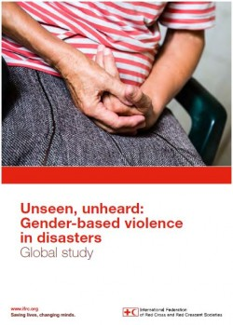
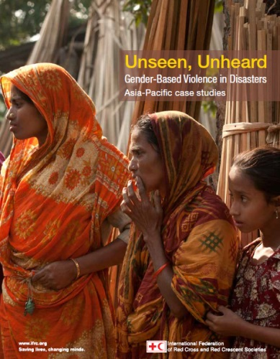
IFRC Resources
2015: IC SGBV Joint Action for Prevention and Response Resolution
2015: Unseen Unheard country-specific case studies: Myanmar, Bangladesh & Samoa
2016: Country studies in Nepal, also in Indonesia, Philippines and Laos
Also – Violence Prevention modules (Bangladesh, Mongolia, Vanuatu)

Slide 39
“Violence is not random. It is predictable. If it can be predicted, it can be prevented.”
- World Health Organization

Slide 40
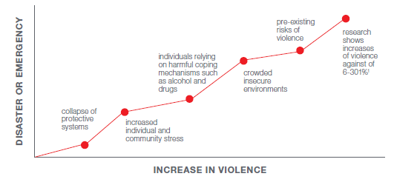
VIOLENCE INCREASES IN DISASTERS & EMERGENCIES

Slide 41
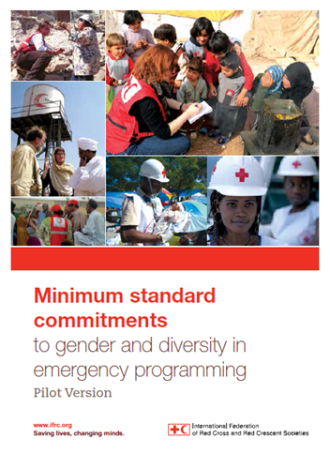
Red Cross Red Crescent: Focus on prevention/mitigation
Seven sectors – health, food security, WASH, emergency shelter, livelihoods, non-food items, disaster risk reduction
Four Commitments (with corresponding standards)
D – Dignity
A – Access
P – Participation
S – Safety
Gender-based violence prevention and safeguarding in each Sector specific guideline

Slide 42
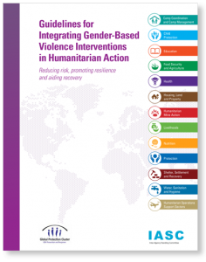
Red Cross Red Crescent: Focus on prevention/mitigation
Focus on: Prevention, mitigation and safeguarding the National Society
  Sector-specific safety issues
  Increasing accountability
  Economic empowerment
  Addressing social norms
  Child protection
  Prevention of sexual exploitation and abuse
Notes:
The focus on Day 1 is that there is already a mandate and role for the National society (it is safeguarding, etc) and that there are also ways that a National Society can plan to enhance its response

Slide 43
Signing Code of Conduct
Understanding of services on offer
Dissemination to staff and volunteers
Referral systems in place and monitoring that they function
Staff care and follow up
*Sector specific follow up

Slide 44
In this course, we will address…
What is “do no harm” in the context of SGBV?
What kinds of health, psychosocial, legal and socio-economic services should States and National Societies ensure survivors can access?
How can disaster and emergency management plans and activities address SGBV?

Slide 45
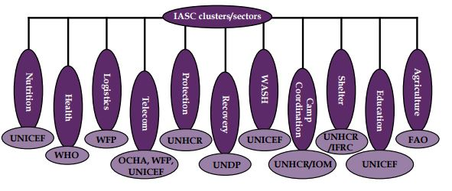
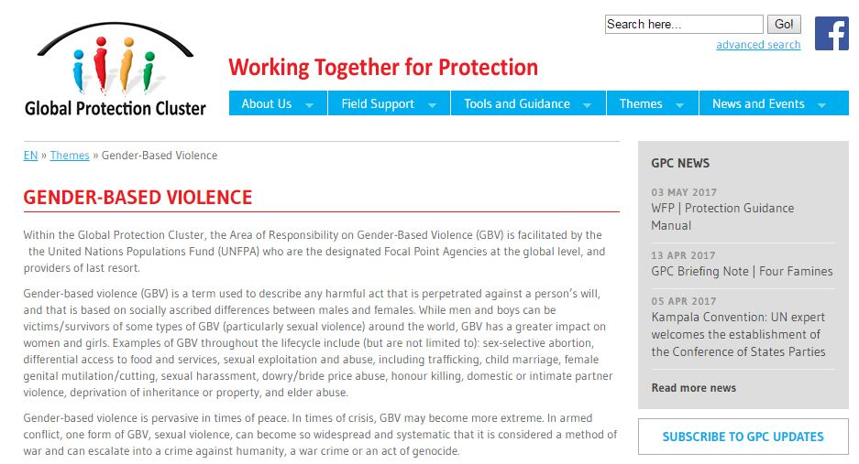
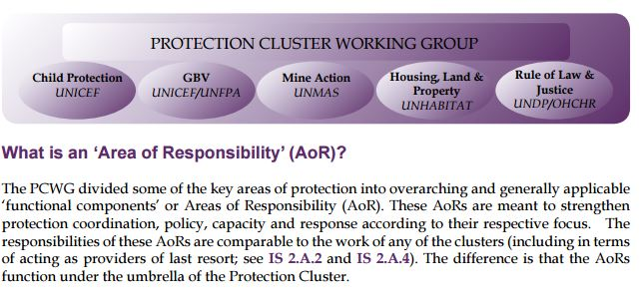
The International Humanitarian System wide GBV Response
UN Action
Peacekeepers
Community Based Organisations
Women’s Groups
Traditional Structures
* Government and LGUs

Slide 46
What is the ‘cluster approach’?
The ‘cluster approach’ was adopted on 12 September 2005 by the IASC as the standard for organizing international humanitarian response to any major emergency.
The cluster approach organizes the many actors addressing a specific need in an emergency (such as shelter, water and sanitation, health, etc.) by coordinating them under a lead agency (IFRC in shelter)
Although initiated by the UN, the cluster approach aims to close gaps, increase predictability and strengthen the capacity of all humanitarian actors—not just those working under the UN flag.

Slide 47
What is the ‘cluster approach’?
Why is the cluster approach important?
  International humanitarian response to major emergencies typically includes multiple autonomous organizations, and it has, in the past, lacked strategic leadership. This fragmented response has led to gaps in services, duplication of efforts, insufficient engagement with government and national actors and a lack of accountability for overall performance.

Slide 48
The decision of the IASC to implement a cluster approach is significant because:
It is the first time the major groups of international actors that typically respond to humanitarian emergencies (UN agencies, the Red Cross Movement and NGOs) have agreed on a predictable, standing arrangement for organising their assistance most effectively..
The approach builds on lessons learned from prior emergencies and systematises coordination practices that have worked
Effective Outcomes

Slide 49
What exactly is a ‘cluster’?
A coordination group focused on a key area of humanitarian response.

Slide 50
What is an ‘Area of Responsibility’ (AoR)?
The GBV Area of Responsibility (AoR) is one of four functional components of the Global Protection Cluster, and was founded in 2008. The Protection Cluster is one of 11 humanitarian clusters established by the Inter-Agency Standing Committee (IASC).
The GBV AoR is led by UNFPA and facilitated by a Geneva-based coordination team. The membership carries out the work of the AoR through participation in Task Teams that work on various aspects of the AoR’s work plan. The Regional Emergency Gender-based Violence Advisors (REGA) based in regional hubs are responsible for building sustainable GBV coordination capacity at regional and field levels with governments, UN agencies and NGOs.

Slide 51
The International Humanitarian System wide GBV Response
More on Cluster System and Coordinated Response tomorrow!

Slide 52
Staff and volunteer care
Throughout this training we will ensure we promote self-care
Consent / Content Warning – these are examples of staff care
Taking breaks – also example of staff care
Building in fun activities – for relief from the content is important
Avenues to discuss the content of the training in a private and confidential way ie through parking lot or facilitators
More on self care on day 3

Slide 53
Session 3a: Conducting A Situation Analysis
Presentation for the IFRC Sexual and Gender-based Violence course

Slide 54
Conducting a situation analysis
This next session will cover:
What do you need to know before addressing SGBV?
Where can you find the information and contacts you need?
Ethical challenges and how to address them: “Do no harm” in data-gathering
Preparing a situation analysis based on this information

Slide 55
What you need to know
What is the magnitude of the (SGBV) problem?
  What are the ethical issues to consider in gathering information on this issue, and how should they be managed?
  What are diverse vulnerabilities to SGBV that exist and how to consider needs of who is at risk?
What laws and policies apply in the context?
What are the local social and cultural norms?
What are the existing services?
Knowing this will allow you to understand the situation and see where the gaps in information are

Slide 56
Firstly, find out:
What are the prevalent types of SGBV in your community
Use secondary data and primary data
Ensure that you refer to diverse vulnerabilities: females, males, persons with disabilities, ethnic minorities, particular groups such as Lesbian women, Gay men, Transgender persons

Slide 57
Example: Types of sexual and gender-based violence
Verbal abuse
Physical abuse (non-sexual, hitting, choking, cutting, burning…)
Intimate partner violence (eg. domestic violence, marital rape)
Female genital mutilation
Rape
Gang rape
Sexual slavery
Indecent assault
Sexual exploitation
Forced nudity
Forced sterilization or forced abortion
Forced pregnancy
Forced marriage, child mariage
Trafficking

Slide 58
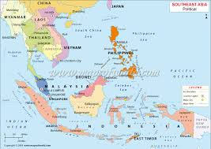
Southeast Asia examples
Laos (non-disaster, Study on Violence against Women in Lao PDR, 2014):
2,997 women were interviewed. 11.6% reported experiencing physical violence, 7.2% sexual violence and 26.2% said they experienced emotional violence. 30.3% reported at least one of the three types of violence.
Indonesia:
After the 2004 tsunami, early marriage increased in Indonesia as families in refugee camps saw it as the only protection for their daughters from rape” In many cases girls were pressed into marriages with “tsunami-widowers’ were planned to access state subsidies for starting a family. (Singh, 2012 –PLAN UK)

Slide 59
Root cause of GBV is gender inequality and abuse of power….
The Gender Inequality Index rank’s a country’s out of 152
1 being the least unequal and 152 being the most unequal
Countries in Southeast Asia (with data available) rank between 105 to 15
No country has 0 gender inequality
http://hdr.undp.org/en/content/table-4-gender-inequality-index
Notes:
Country
Ranking
Cambodia
105
Indonesia
103
Myanmar
83
Philippines
78
Thailand
70
Viet Nam
58
Malaysia
39
Singapore
15
Timor-Leste
N/A
Laos PDR
N/A
Brunei Darussalam
N/A

Slide 60
Some populations are especially at risk of SGBV
Research has shown that some populations are especially at risk of experiencing SGBV, including:
  Persons with disabilities
  Lesbian, gay, bisexual and transgender persons
  Ethnic, linguistic or other national minorities
  Sex workers
  Children
Sexual violence: Women, men, boys and girls can all be vulnerable, but men and boys are even less likely to disclose
Consider the reasons why some groups may be vulnerable/at-risk to violence, and in reporting violence?

Slide 61
What data to gather?
Secondary data and primary data
  Secondary data – Data collected by someone other than the user, including statistics (social / housing records), government reports, NGO reports, UN reports, literature reviews, case studies, diaries, police reports etc
  Primary data – Data collected by the user, such as community consultations and qualitative data/discussions held with affected community members

Slide 62
Assume that the issues are occurring, and that survivor stories are true
ICRC policy is “Reverse burden of evidence” – why?
  Challenges the unseen, invisible nature of GBV
  No longer waits for evidence before preparing a response
  Assumes that sexual violence in conflict is happening even without specific allegations
We know GBV occurs in every context. Increases in disasters and conflict. This approach makes us:
  More proactive
  More effective in preparing, mitigating and responding to sexual violence and GBV

Slide 63
Assume that the issues are occurring, and that survivor stories are true
IFRC signed ‘Call to Action’ - act to prevent and respond before waiting for evidence of specific instances to emerge
IFRC commitments to Call to Action:
To encourage National Society members to work with their national governments to discuss the creation of safer and more inclusive environments for women and girls during and after disasters
Enhance attention to the prevention of and response to VAWG in all relevant skills training and capacity building

Slide 64
Ethical issues and risks in data-gathering
Gather ONLY data you need and nothing else
Do not gather primary data unless basic response services are in place to which you can refer survivors:
  Including medical care, psychological care, legal aid and protection
Monitor staff involved in data collection for signs of stress or secondary traumatization
Notes:
What is “secondary traumatization”?
How can staff needs be addressed as they work with survivors of SGBV?
How can volunteer needs be addressed?
As a rule of thumb, volunteers should only refer. For specific cases where volunteer driven activities or services are the only points of support for survivors around, careful consideration should be taken if the NS/branch wants to offer some SGBV survivor services with plans on how to ensure minimum standard requirements for the sector. Can it be assumed that all emergency health facilities have the capacity to provide SGBV clinical health support (as per the MSC for emergency health)?

Slide 65
Making sure there is informed consent
In a survivor-centered approach, informed consent is essential
Survivors about whom you are collecting data must:
  Understand who you are and the research purpose
  Understand any possible risks of participation
  Demonstrate their comprehension to you
  Agree, in writing or verbally
  Do not ask questions that may cause the person to be re-traumatized (such as telling their story repeatedly)
  This is true even when data is anonymized (identifying characteristics are removed) because there may still be risks
Notes:
Data collection should ensure the least risk to the respondent

Slide 66
What laws and policies apply in the context?
Laws that may apply include:
  Laws that define rape or SGBV (do they include male victims? Do they protect wives from marital rape?)
  Laws on age of consent for sexual activity, or for medical care
  Laws restricting women’s access to medical care
  Laws on reproductive rights, including laws on abortion
  Laws on homosexuality
  Criminal laws and standards of evidence in court
  Policies on HIV or STI treatment and management
  And others…
Where can you find information about these laws?
Who can advise on how they are applied in practice?

Slide 67
The obligation to address SGBV
There are many laws relevant to SGBV in the national context (as well as in international law), it is helpful to map the laws in your country:
Criminal laws which address murder, assault, incest, sexual offences, etc.
Civil laws which address assault or sexual harassment at work
Rules of procedure and evidence, which facilitate
the application of the law.
Policies that provide a framework for implementing laws and providing reparations and redress to survivors.

Slide 68
Such as…
Children’s Rights Act
Human Rights Code or Commission
Family Violence Act
Education Act
Marriage Act
Elimination on Violence Against Women Act or equivalent

Slide 69
Examples of Laws in
Cambodia
Law on Suppression of Human Trafficking and Sexual Exploitation (2007)
Law of Marriage and the Family (1989)
Prohibits Child Marriage
Law on the Prevention of Domestic Violence and the Protection of Victims
      Prohibits marital rape
Notes:
Cambodia: Second, there is existing legal protection against marital rape, which occurs frequently in Cambodia. A survey from 2005 indicates that 14% of respondents know a woman whose husband has forced her to have sex against her will.[22] There is a misconception in Cambodia that rape within a marriage is not a crime. According to the 2005 survey, 45% of Cambodians[23] believe it is the right of the husband to force his wife to have sex with him. Although the Law on the Prevention of Domestic Violence and the Protection of Victims only speaks in general of sexual aggression and does not explicitly mention (marital) rape, it should be considered applicable to marital rape.[24] http://cambodialpj.org/article/legal-and-gender-issues-of-marriage-and-divorce-in-cambodia/

Slide 70
Why we map existing services
It allows us to prepare:
Confidential referral of survivors as minimum requirement for National Societies.
What is required for us to achieve this (ie. non judgemental, confidential refferals)?
Information on what other agencies or organisations are already managing programmes that address SGBV?

Slide 71
Confidential referral by the National Society
Referral pathway with contact information to other services established
Internal standard operating procedures for the NS established
Staff and volunteers have the contact information to other services & are trained in non-judgmental, non-discriminatory and confidential referral
Staff and volunteers have signed codes of conduct
Managers know how to support staff and volunteers, and know how to receive and document information about referral of survivors

Slide 72
Mapping existing services
In your context, which organisations provide:
Clinical health services
Case management
Psychosocial care and support
Mental health services
Protection
Legal services/counselling
Law enforcement
Identify the organisations and conduct outreach to them, asking whether they will take new referrals and who in the community they provide services to

Slide 73
Mapping existing services
Minimum standards exist for various services
Not the National Society’s responsibility to check the quality of other institutions’ services

Slide 74
No cluster approved referral pathways exist
Be pro-active, engage in partnership meetings, pick up the phone
Check if cluster system/working group will be established in the operation
Use known and trusted services existing prior to the emergency (if still operational)
If still no sufficient services seem to exist, be careful to refer. Do not attempt to provide services yourself without having expertise, systems and routines in place.
Notes:
New IFRC Protection Field Guidelines are being drafted, available in July 2017.

Slide 75

Coffee break

Slide 76
What are local social and cultural norms?
Who can provide information and advice about the following?
Gender roles and responsibilities in the local context
Marriage practices and customs, including dowry
Decision-making within the family
Norms of communication and decision-making
How property is inherited or managed
Community leadership
Places and times where specific groups gather – e.g., where women may gather to talk without men present, or where men gather to talk without women
Examples from National Societies

Slide 77
Summary of Situational Analysis Messages
Where possible, use secondary data to assess magnitude of SGBV
  Do not gather data about incidence unless response services are in place to refer survivors
  Do not gather data you do not need
  Begin thinking about diverse vulnerabilities/risks in situation analysis
  Gather information on social and cultural norms and how they may affect SGBV survivors
Gather information on laws, policies and how they are applied
Map SGBV services and ensure you/your team know how and where to refer survivors/how to promote the pathways of referral in community even when no cases reported

Slide 78
Session 3b : Completing A Situational Analysis in Practice: Mapping the field
Presentation for the IFRC Sexual and Gender-based Violence course

Slide 79
Mapping the field activity (60 minutes)
Handouts/scenarios – to be used throughout training
Scenario 1: A cyclone hits a coastal city
Scenario 2: A tsunami in a country affected by an ongoing conflict
Drawn from National Society staff experiences; real life contexts
Instructions for the activity:
One person in your group read the scenario aloud
Discuss together
Identify the information needed for a (basic) situation analysis
Identify areas where the information is not available from the case study and brainstorm ideas of where you will get this information from
Use Annex 6 to support your discussion and feedback.
5 mins feedback from each scenario!

Slide 80
That’s it for today folks!
Start tomorrow at 09:00

Slide 81
Thank you
© International Federation of Red Cross and Red Crescent Societies, Geneva, 2017
Add any information to copyrighted materials here.
Any part of this presentation may be cited, copied, translated into other languages or adapted to meet local needs without prior permission from the International Federation of Red Cross and Red Crescent Societies, provided that the source is clearly stated. Requests for commercial reproduction should be directed to the IFRC Secretariat at secretariat@ifrc.org
All photos used in this presentation are copyright of the IFRC unless otherwise indicated.
This presentation and relevant resources are available on FedNet at fednet.ifrc.org

