Slide 1
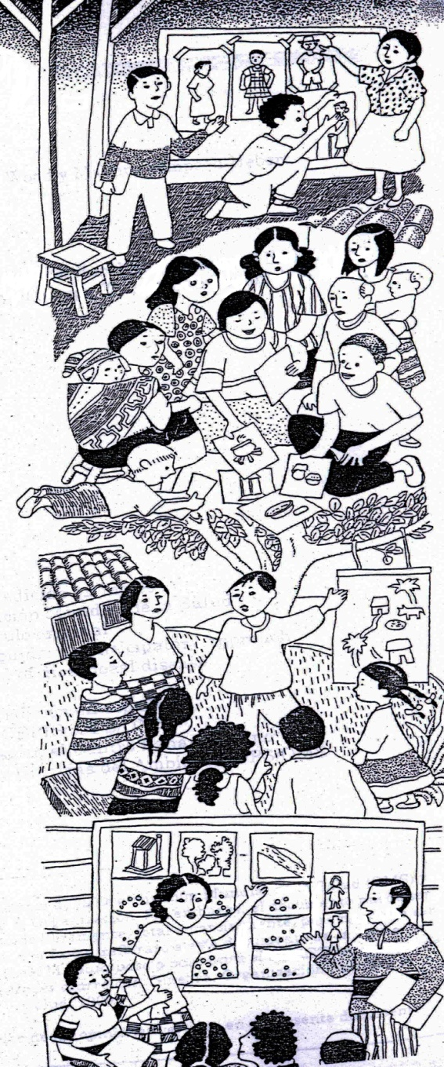
PHAST Process II

Slide 2
Seven steps to community planning for the prevention of diarrhoeal disease
Step 2
Step 3
Planning for solutions
Problem analysis
Step 4
Step 5
Step 6
Step 7
Step 1
Problem identification
Selecting options
Planning for new facilities and behaviour change
Planning for monitoring and evaluation
Paticipatory evaluation

Slide 3
STEP 4: SELECTING OPTIONS
Step 4. Selecting Options
Step 4
Selecting options
Activity
1. Choosing sanitation improvements
2. Choosing improved hygiene behaviors
3. Taking time for questions
Tool
1. Sanitation options
2. Three-pile sorting
3. Question box
Activity 1 and 2: Choosing Water and Sanitation Improvement and Choosing Hygiene Behaviors Improvement
Both activities assist the communities to assess their sanitation and hygiene situation and decide on what changes they want to make.
Water and sanitation ladder tools

Slide 4
ACTIVITY 2: CHOOSING IMPROVED HYGIENE BEHAVIORS
Step 4. Selecting Options
This helps the group to decide which hygiene behaviors it wants to work on with the community using 3 pile sorting tool.
The purpose of the tool is to assist the group identify hygiene behaviors they want to change, encourage and maybe introduce in the community.
3 PILE SORTING TOOL

Slide 5
Why to work together?
Hardware
Software
Notes:
Hardware sanitation facilities , Water supply systems, soap , jerricans , toilets, pipes , taps
Software : Hygiene and sanitation promotion, social mobilization , organization , monitoring and evaluation
The most importantly software is about human behavior and interaction and is therefore highly culturally and socially sensitive
Without the right software, no behaviour change
Without water access, nobody will wash their hands
Factors: social (class, position, age, gender), cultural (sex, gender), ethical & spiritual (rituals, religion, believes), legal (observance of laws), political (limit access to information), resources (financial and material, knowledge and skills, items for exchange)

Slide 6
ACTIVITY 3: TAKING TIME FOR QUESTIONS
Step 4. Selecting Options
This gives the participants a chance to ask questions and obtain feedback from fellow participants, thus increasing the confidence and self-reliance of the group.
QUESTION BOX TOOL

Slide 7
Seven steps to community planning for the prevention of diarrheal disease
Step 2
Step 3
Planning for solutions
Problem analysis
Step 4
Step 5
Step 6
Step 7
Step 1
Problem identification
Selecting options
Planning for new facilities and behavior change
Planning for monitoring and evaluation
Participatory evaluation

Slide 8
STEP 5: PLANNING FOR NEW FACILITIES AND BEHAVIOUR CHANGE
Step 5. Planning for new facilities and behavior change
Step 5
Planning for new facilities and behavior change
Activity
1. Planning for change
2. Planning who does what
3. Identifying what might go wrong
Tool
1. Planning posters
2. Planning posters
3. Problem box
Activity 1 Planning for change
This helps the group plan the action steps for implementing solutions it has decided on. This is by developing a plan to implement changes in sanitation, water and hygiene behaviors
. PLANNING POSTERS TOOL

Slide 9
Activity 2 Planning Who does what
Step 5. Planning for new facilities and behavior change
The purpose is to identify who takes responsibility for carrying out the steps in the plan and setting a time frame for the activity.
Planning posters tool

Slide 10
Activity 3. IDENTIFYING WHAT MIGHT GO WRONG
Step 5. Planning for new facilities and behavior change
The question box is used
to:
Identify what possible problems may arise during the implementation of the action plan.
Assist the communities and agency to think ahead of how to solve such possible problems.
PROBLEM BOX TOOL

Slide 11
STEP 6: PLANNING FOR MONITORING AND EVALUATION
Step 6. Planning for monitoring and evaluatio
Step 6
Planning for monitoring and evaluation
Activity
1. Preparing to check our progress
Tool
1. Monitoring (checking) chart
How to measure the progress being made
How often progress should be measured
Who should be responsible for measuring progress
How to involve other members of the community in checking progress and the achievement of project goals

Slide 12
STEP 6: PLANNING FOR MONITORING AND EVALUATION
Step 6. Planning for monitoring and evaluation
This step has only one activity. In this activity the group fills in a chart for checking (monitoring) its progress towards achieving its goals means are identified for measuring progress, how often this needs to be done and who will be responsible for doing it.
Monitoring chart tool
GOAL (What do you want to achieve ) | Number or Amount | How to measure | How often | By whom

Slide 13
Step 7: PARTICIPATORY EVALUATION
Step 7. Participatory evaluation
Step 7
Participatory evaluation
Activity
1. Checking our progress
Tool
1. Various tool options
This step is carried out after the community has implemented its plan, perhaps months or one year after.
It is normally carried out jointly with the community members and other stakeholders based on the indicators that had been agreed upon during the action plan.
How much has been done in the community
How much of the plan still needs to be done
Any problems or difficulties encountered
Any corrective actions that is needed

Slide 14
1. Checking our progress
Step 7. Participatory evaluation
Various tool options
Monitoring checking chart
Purpose :To see if goals have been met
Community Map
Purpose :To see if the community has undergone any physical changes
Planning posters and who does what
Purpose :To see if goals have been met
Pocket chart
Purpose :To see if hygiene behaviors have changed
Whether this result is an improvement
How this result compares with the group’s plan
The reasons why people voted as they did

