Slide 1
INTRODUCTION TO HIV IN EMERGENCIES
Lasha Goguadze
ART, Jakarta

Slide 2
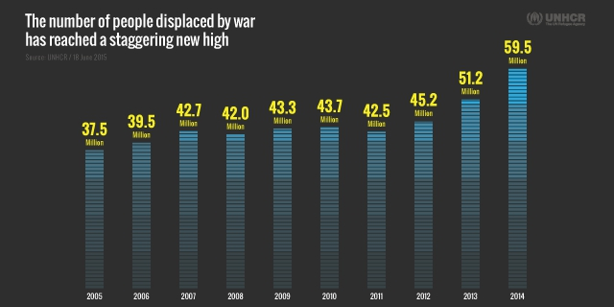
Evolving frequency of natural and man-made disasters
107,000,000 people affected by manmade disasters
59 million people affected by conflicts

Slide 3
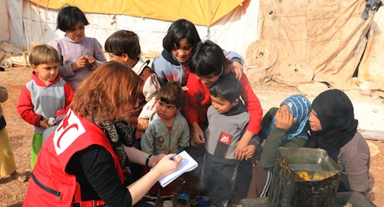
People with HIV caught up in emergencies
1 in 19 people living with HIV/AIDS are caught up in natural and man-made disasters
These people are especially vulnerable but are often neglected
Many lack access to essential HIV treatment

Slide 4
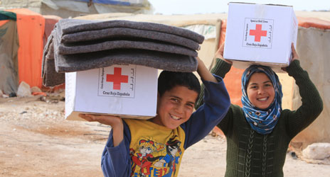
Red Cross and Red Crescent Societies are always present
RCRC have a unique role to play in emergency situations and are often the first to respond
More than 13 million volunteers have assisted the RCRC societies to perform critical tasks during emergencies

Slide 5
IFRC AND ICMHD WORKING TOGETHER
Guidelines
Training
Assessment tools

Slide 6
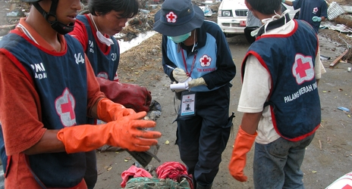
GUIDELINES ON HIV IN EMERGENCIES FOR RCRC STAFF AND VOLUNTEERS
Overview of HIV in emergencies
What RCRC staff can do, how they can do it and how they can relate to other humanitarian organisations

Slide 7
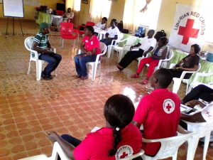
TRAINING ON HIV IN EMERGENCIES FOR RCRC STAFF AND VOLUNTEERS
 | Module
Day 1 | 1. Understanding emergencies
 | 2. Understanding HIV/AIDS
 | 3. Psychosocial effects of disasters
Day 2 | 4. Complicating factors
 | 5. Preventing HIV infection
 | 6. Responding to disruption in HIV services
Day 3 | 7. Advocacy for HIV services
 | 8. Performing an HIV assessment
 | 9. Summary

Slide 8
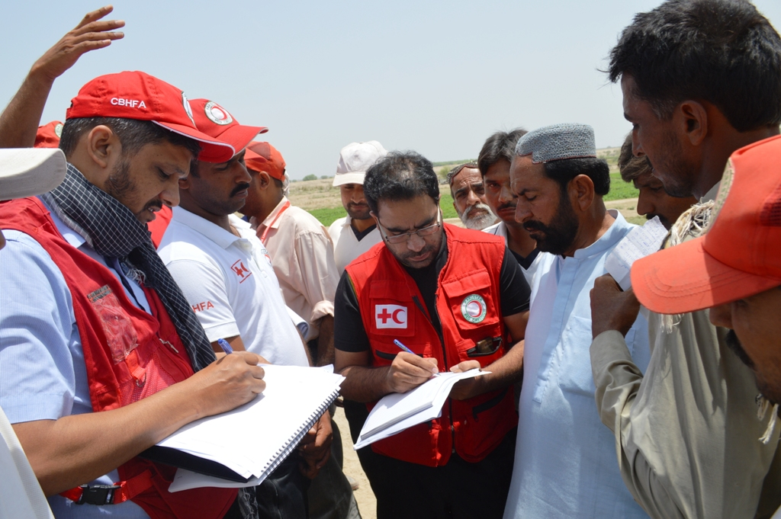
HIV IN EMERGENCIES RCRC FIELD ASSESSMENT TOOL
The assessment should cover:
the number of people living with HIV,
population groups most at risk of HIV, where they are and what services are available to them.
RCRC staff/volunteer’s knowledge of HIV
the capacity of the healthcare system to provide HIV treatment and care.

Slide 9
THANK YOU FOR YOUR TIME

