Slide 1
The story of the new
Bangkok, 29 November 2016
Notes:
Presentation for the South East Asia NS workshop

Slide 2
Milestones
1983 Creation of the SFD
2001 SFD becomes an independent Swiss foundation
2013 SGS NGO Benchmarking certification
2014 General Evaluation of the SFD
2016 New 5 years strategy

Slide 3
Our mission
Strengthen national capacities in less-resourced countries to remove barriers faced by persons with physical disabilities, by fostering sustainable, accessible and quality physical rehabilitation services and promoting inclusion.
Notes:
Since 2021 – mission statement
We keep our core activity – Physical rehabilitation

Slide 4
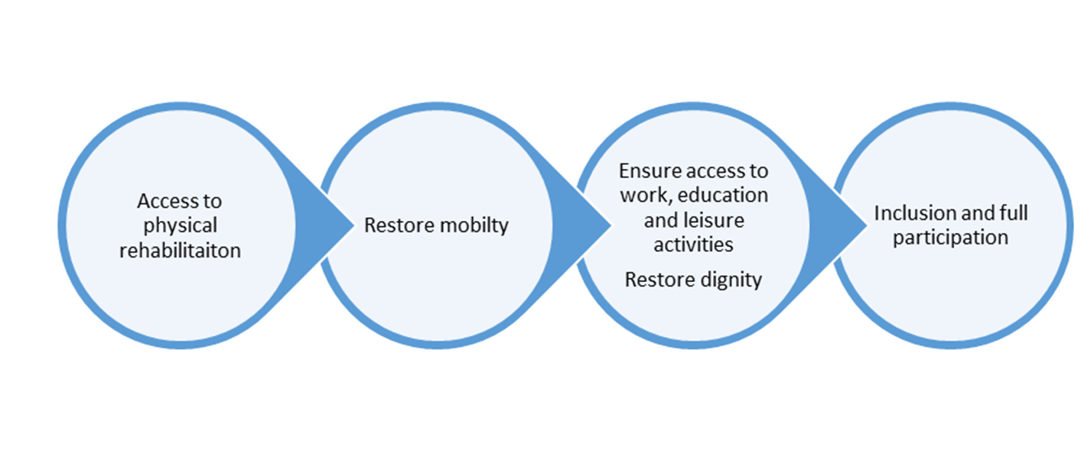
Disability, Rehabilitation, Inclusion
Notes:
The contribution of the SFD to full participation and social inclusion
Rehabilitation → restoration/improvement of mobility → Social and economical inclusion
Physical rehabilitation is essential for full inclusion

Slide 5
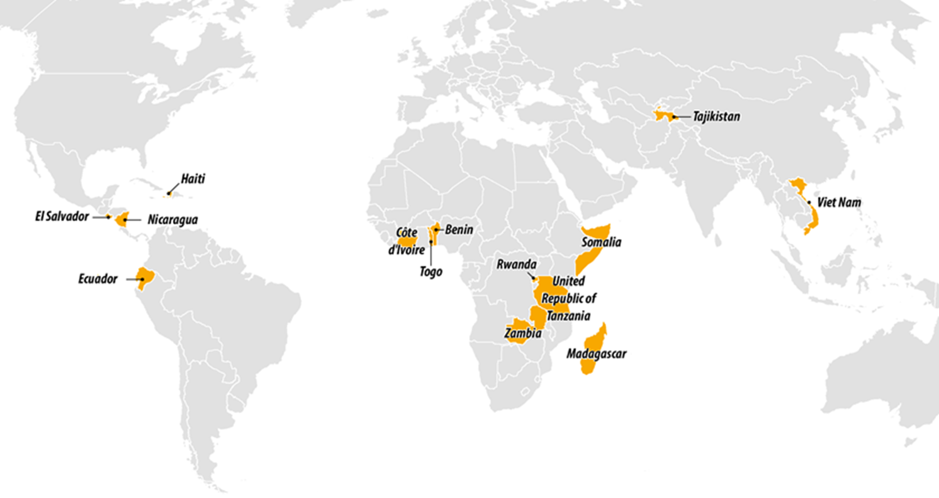
Countries supported in 2016

Slide 6
Stakeholders’ mapping

Slide 7
Strategy 2017-2021
Hosted by the ICRC
Governed by strategic partners
Reference center for the Movement
Complementary to the ICRC and the NS
Focusing on its core activity, physical rehabilitation, but open to a wider response to disability

Slide 8
Our branding explains who we are,
what we do, and who we do it for/with

Slide 9
The 5 General Objectives
Notes:
Priority 1 – sustainability of the sector → work with national authorities – structure
Focus on quality and education
Lack of financial resources → vulnerable PwD access + social inclusio
Develop centres management capacities

Slide 10
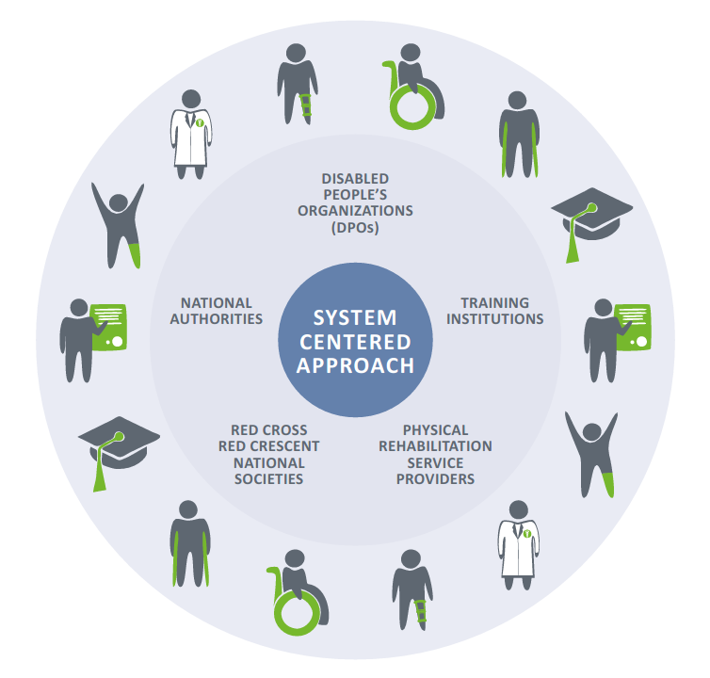
Our partners & beneficiaries

Slide 11
Cooperation with National Societies
Further develop and scale up best practices in:
Identification of Persons with Disabilities
Referral to physical rehabilitation centres
Mapping of and access to Social Inclusion activities
Social services
Sport
Micro Economic Initiatives
Including NS in the national platform and action plan

Slide 12
Movement Strategic Framework on disability inclusion
Support National Societies in the enabling actions
Disability Awareness
1.1 – Understand the number and situation of PwD
1.4 - Develop partnerships with DPOs
3.1 – Influence to address discrimination and foster full inclusion
3.2 - Increase knowledge of disability
3.3 – Advocate full inclusion through Humanitarian Diplomacy

Slide 13
Movement Strategic Framework on disability inclusion
Access to Services
2.2 – provide disability specific services
Assistive devices
Social and economical inclusion

Slide 14
The ambition is also to create
A reference centre for the Movement
Data collection & Reporting
Guidelines and methodologies
New technology
Disaster preparedness
Physical access

