Slide 1
Convention on the Rights of Persons with Disabilities (CRPD): implementation update
By Monthian Buntan
Member of the UN Committee on the Rights of Persons with Disabilities and
Member of the National Legislative Assembly, Royal Thai Parliament
28 November 2016,
Red Cross and Red Crescent Movement Workshop on Disability Inclusion and Victim Assistance in Southeast Asia

Slide 2
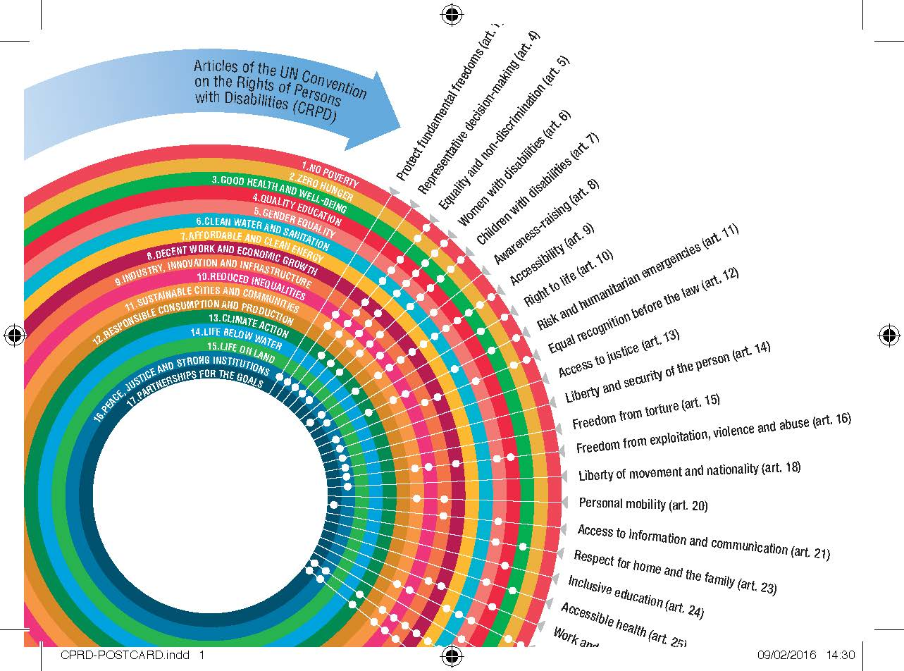
CRPD & SDGs by CBM
http://www.cbm.org/New-resources-on-Agenda-2030-and-the-CRPD-501728.php
Notes:
The link between the Sustainable Development Goals and the CRPD
Goal 1: NO POVERTY: End poverty in all its forms everywhere: this goal is underpinned by the right to life (CRPD article 10), control over one’s own resources by guaranteeing equal recognition before the law (CRPD article 12) and an adequate standard of living and social protection (article 28), as well as articles 5, 6, 7, 9, 11, 31 and 32.
Goal 2: ZERO HUNGER: End hunger, achieve food security and improved nutrition and promote sustainable agriculture: The right to adequate food, including food security, safeguards, and an adequate standard of living (CRPD article 28), control over land, property and inheritance can be guaranteed by equal recognition before the law (CRPD article 12), as well as articles 5, 6, 7, 9, 31 and 32.
Goal 3: GOOD HEALTH AND WELL-BEING: Ensure healthy lives and promote well-being for all at all ages: This is underpinned by the right to life (CRPD article 10); access to sexual and reproductive health services is recognized by the right to enjoyment of the highest attainable standard of health without discrimination on the basis of disability (CRPD article 25), family planning, information and education is ensured by respect for home and the family (CRPD article 23), as well as articles 6, 7, 9, 11, 31 and 32.
Goal 4: QUALITY EDUCATION: Ensure inclusive and equitable quality education and promote life-long learning opportunities for all: Article 24 of the CRPD promotes an inclusive education system at all levels on the basis of equal opportunity and freedom from exclusion; persons with disabilities must have effective access to general technical and vocational guidance programmes, placement services and vocational and continuing training as outlined in article 27 of the CRPD; safe, non-violent learning environments can be enabled by protection from exploitation, violence and abuse outside the home in article 16 of the CRPD, in addition articles 5, 6, 7, 9, 31 and 32 apply.
Goal 5: GENDER EQUALITY: Achieve gender equality and empower all women and girls: Article 6 of the CRPD recognizes that women and girls with disabilities are subjected to multiple discrimination; the elimination of harmful practices requires effective women- and child-focused legislation and policies as outlined in article 16 of the CRPD; the provision of social protection policies is covered by article 28 of the CRPD; the right to participation in political and public life relates to article 29 of the CRPD; the right to the same range and quality and standard of free or affordable sexual and reproductive health is recognized in article 25 of the CRPD; the right to reproductive and family planning is ensured through respect for home and family (CRPD article 23); women’s right to ownership over land, property and inheritance is acknowledged in CRPD article 12’s right to equal recognition before the law; and the right to accessible information and communications for women and girls is outlined in article 21 of the CRPD; the promotion of gender equality for women and girls with disabilities is recognised in article 8 of the CRPD on awareness-raising, in addition articles 5, 7, 9 and 31 are applicable.
Goal 6: CLEAN WATER AND SANITATION: Ensure availability and sustainable management of water and sanitation for all: Article 28 of the CRPD recognises the right to the continuous improvement of living conditions, access to clean water and the promotion of the right to an adequate standard of living for persons with disabilities; articles 5, 6, 7, 9, 11, 31 and 32 also apply.
Goal 7: AFFORDABLE CLEAN ENERGY: Ensure access to affordable, reliable, sustainable and modern energy for all: Universal access, especially in developing countries and the requirement to measure progress on this goal in relation to persons with disabilities are covered by articles 9, 31 and 32.
Goal 8: DECENT WORK AND ECONOMIC GROWTH: Promote sustained, inclusive and sustainable economic growth, full and productive employment and decent work for all: The recognition of the right of persons with disabilities to work on an equal basis with others and to gain a living by work freely chosen, and to receive equal remuneration for work of equal value and to have safe working conditions is covered by article 27 of the CRPD; equal access to banking, insurance and financial services can be enabled by upholding the right to equal recognition before the law (CRPD article 12); freedom from exploitation, violence and abuse such as forced labour, modern slavery and human trafficking are rights upheld by article 16 of the CRPD. Articles 5, 6, 9 and 31 also apply.
Goal 9: INDUSTRY, INNOVATION AND INFRASTRUCTURE: Build resilient infrastructure, promote inclusive and sustainable industrialisation: Access to financial services including affordable credit is ensured by equal recognition before the law (CRPD article 12); ensuring personal mobility with the greatest possible independence for persons with disabilities can be guaranteed by implementing article 20 of the CRPD; freedom to access information on an equal basis with others and through all forms of communication is part of article 21 of the CRPD; promoting opportunities for self-employment, entrepreneurship, the development of cooperatives and starting one’s own business are recognised rights under article 27 pf the CR{D; articles 5, 6, 7, 9, 31 and 32 are also applicable.
Goal 10: REDUCED INEQUALITIES: Reduce inequality within and among countries: Ensuring enhanced representation and voice of persons with disabilities in decision-making is covered by article 4 of the CRPD; promoting the positive perceptions and greater social awareness towards persons with disabilities to foster inclusion is part of article 8 of the CRPD; facilitating safe migration and mobility can protect persons with disabilities from exploitation (CRPD article 16); ensuring access to social protection and poverty reduction programmes is contained in article 28 of the CRPD; in addition, articles 5, 6, 7, 9, 11, 31 and 32 are applicable.
Goal 11: SUSTAINABLE CITIES AND COMMUNITIES: Make cities and human settlements inclusive, safe, resilient and sustainable: the right of persons to an adequate standard of living for themselves and their family, including adequate housing must be realised (CRPD article 28); persons with disabilities must be afforded personal mobility in the manner and at the time of their choice and at affordable cost (CRPD article 20); safe cities and settlements must ensure protection from violence (CRPD article 16); the environment and public transport must be accessible on an equal basis with others in urban and rural areas (CRPD article 9); participatory planning and management must be respected (CRPD article 4); Articles 5, 6, 7, 11, 31 and 32 also apply.
Goal 13: CLIMATE ACTION: Take urgent action to combat climate change and its impacts: persons with disabilities who are subject to the occurrence of natural disasters and other situations of risk must be included in all protection and safety mechanisms (CRPD article 11); climate-related planning and management must be inclusive of and accessible to persons with disabilities (CRPD article 32); articles 5, 6, 7, 9 and 31 also apply.
Goal 16: PEACE, JUSTICE AND STRONG INSTITUTIONS: Promote peaceful and inclusive societies for sustainable development, provide access to justice for all and build effective, accountable and inclusive institutions at all levels: death rates must be reduced by effective enjoyment of the right to life (CRPD article 10); freedom from violence, exploitation and abuse must be upheld (CRPD article 16); as must freedom from torture cruel, inhuman or degrading treatment or punishment (CRPD article 15); access to justice on an equal basis with others, including through the provision of procedural and age-appropriate accommodations must be in place (CRPD article 13); inclusive decision-making that closely consults with and actively involves persons with disabilities through their representative organisations (CRPD article 4); supported decision-making regimes should be available (CRPD article 12); the right to a legal identity is covered by CRPD article 18; persons with disabilities must enjoy all human rights and fundamental freedoms (CRPD article 1) and are not deprived of their liberty unlawfully (CRPD article 14); in addition, the following articles also apply: 5, 6, 7, 9, 31 and 32.
Goal 17: PARTNERSHIPS FOR THE GOALS: Strengthen the means of implementation and revitalize the global partnership for sustainable development: enhancing the use of enabling technology, in particular information and communication technology can be achieved for persons with disabilities by implementing article 21 of the CRPD to ensure accessibility; collection of high quality, timely and reliable data disaggregated by disability relates directly to article 31 of the CRPD on statistics and data collection; articles 9 and 32 of the CRPD especially in regard to partnerships with organisations of persons with disabilities and facilitating access to technology transfer, are also applicable.

Slide 3
Ratification of CRPD: 168 Countries Optional Protocol: 92 Countries
Notes:
https://www.un.org/development/desa/disabilities/convention-on-the-rights-of-persons-with-disabilities.html
- จำนวนรัฐภาคีในอนุสัญญา 168 ล่าสุด คือ Central African Republic เมื่อวันที่ 11 October 2016
- จำนวนรัฐภาคีในพิธีสารเลือกรับ 92 ล่าสุด คือ Central African Republic เมื่อวันที่ 11 October 2016

Slide 4
Amount of State Parties Reports that are considered by the Committee
Notes:
http://tbinternet.ohchr.org/_layouts/TreatyBodyExternal/MasterCalendar.aspx?Type=Session&Lang=En
- จำนวนรายงานประเทศที่รัฐภาคีเสนอต่อคณะกรรมการ 95 ประเทศ
- จำนวนรายงานประเทศที่ผ่านการพิจารณาจากคณะกรรมการ 47 ประเทศ (2016 = 14, 2015 = 14, 2014 = 9, 2013 = 4, 2012
= 4 , 2011 = 2)
- จำนวนรายงานประเทศที่รอการพิจารณาจากคณะกรรมการ (Backlog) 48 ประเทศ

Slide 5
Communications
and 1 Inquiry
Notes:
https://extranet.ohchr.org/sites/petitions/crpd/16session/Pages/default.aspx
- จำนวนเรื่องร้องทุกข์ที่เสนอต่อคณะกรรมการ 37
(the Committee has therefore received a total of 304 communications related to States parties to the OP-CRPD, out of which 37 have been registered)
- จำนวนเรื่องร้องทุกข์ที่ผ่านการพิจารณาจากคณะกรรมการ 13
(The Committee has so far registered 37 cases. In 13 cases, the Committee has taken final decisions (8 Views with violation; 2 Views without violation, 3 inadmissibility decisions). Of the 24 pending cases, one is on the agenda of the 16th session (communications No. 7/2012). Of the others, nine are ready for examination on admissibility and merits (communications No. 14/2013, 15/2013, 16/2013, 19/2014, 25/2014, 26/2014, 29/2015, 30/2015, 32/2015), and two for examination on admissibility (communications No. 27/2014, 31/2015). In all the other cases, comments and observations remain pending.)
จำนวนเรื่องร้องทุกข์ที่รอการพิจารณา (pending cases) 24
จำนวนประเทศที่คณะกรรมการได้เข้าไปไต่สวนและรายงานการไต่สวน 1 (UK)

Slide 6
General Comments: 4+1
Notes:
http://www.ohchr.org/EN/HRBodies/CRPD/Pages/GC.aspx
- จำนวนความเห็นทั่วไป 4 ฉบับ (Article 12,9,6,24) + 1 Draft Article 19

Slide 7
6 Statements by the Committee
1. Statement by the Committee on the Rights of Persons with Disabilities-FOR A BETTER URBAN FUTURE-Securing inclusion of persons with disabilities in the New Urban Agenda-Habitat III-Third United Nations conference on Housing and Sustainable Urban Development
2. Statement of the Committee on the Rights of Persons with Disabilities on disability inclusion for the World Humanitarian Summit
3. Joint Statement by Special Rapporteur on the rights of persons with disabilities, Committee on the Rights of Persons with Disabilities and Special Envoy of the Secretary-General on Disability and Accessibility
4. Statement on Disability inclusion in the Third World Conference on Disaster Risk Reduction and beyond
5. Statement on Sustainable Development Goals
6. Opinion of the Committee on the Revision of the Standard Rules for the Treatment of Prisoners
Notes:
http://www.ohchr.org/EN/HRBodies/CRPD/Pages/CRPDStatements.aspx
- จำนวนเอกสารที่เป็นข้อเสนอแนะหรือแสดงจุดยืนในเรื่องต่างๆ (CRPD Statements) 6 ฉบับ เรื่อง
1. Statement by the Committee on the Rights of Persons with Disabilities-FOR A BETTER URBAN FUTURE-Securing
inclusion of persons with disabilities in the New Urban Agenda-Habitat III-Third United Nations conference on Housing
and Sustainable Urban Development
2. Statement of the Committee on the Rights of Persons with Disabilities on disability inclusion for the World
Humanitarian Summit
3. Joint Statement by Special Rapporteur on the rights of persons with disabilities, Committee on the Rights of Persons
with Disabilities and Special Envoy of the Secretary-General on Disability and Accessibility
4. Statement on Disability inclusion in the Third World Conference on Disaster Risk Reduction and beyond
5. Statement on Sustainable Development Goals
6. Opinion of the Committee on the Revision of the Standard Rules for the Treatment of Prisoners

