Slide 1

Disability is in society, not me
Movement –wide
Strategic Framework on Disability Inclusion

Slide 2
Looking back …
Nov 2013
Apr 2014
Dec 2014
Apr 2015
Resolution
Geneva meeting
First draft
Second draft (including external org)
Dec 2015
Strategic Framework adopted
Notes:
let us quickly recap what’s been happening over the last two years:
In November 2013, the Council of Delegates passed inSydney resolution 9 ‘ Promoting Disability Inclusion within the Red Cross red Crescent Movement’. This resolution requested increased action in this area and specifically, asked for the development of a strategy on disability inclusion.
In April 2014 , a group of National Societies together with the IFRC and the ICRC met in Geneva and drafted the skeleton of the framework – as well as decided to allocate some specific resources to develop this piece of work.
From then on and until December 2014, a small working group – ICRC, IFRC, Australian Red Cross and Norwegian Red Cross- worked in partnership to further develop that initial skeleton into the first draft of the strategic framework
From Jan – April 2015, the framework went through a round of internal and external consultation. Other NS as well as external organisations – ILO, EDF, CBM, etc- provided very valuable feedback that informed the development of the second draft. Which is the one current out on the international conference website.

Slide 3
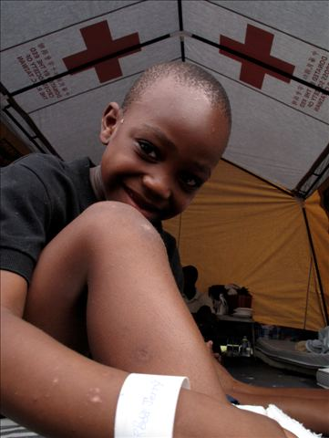
Strategy Framework on Disability Inclusion
Purpose
Non-discriminatory and inclusive
Increase participation
Promote disability inclusive practices
Notes:
What are we trying to achieve? We want to:
- ensure that all our actions, policies and internal practices are non-discriminatory towards and inclusive of persons with disabilities, we want to
- increase participation of persons with disabilities across the Movement, and
- promote disability inclusive practices throughout its work.

Slide 4
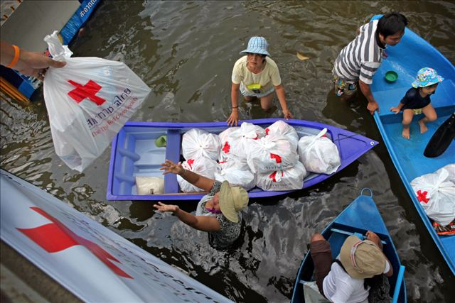
Strategic framework on disability inclusion
    Introduction
    Definition
    Barriers
    Facts and figures
Notes:
The introduction of the strategic framework provides key contextual information – setting scene- that is very relevant to the implementation of the framework.
Firstly, it borrows the definition of persons with disabilities from the UN Convention on the Right of Persons with Disabilities. those who have physical, mental, intellectual or sensory impairments, which, in interaction with various barriers, may hinder their full and effective participation in society on an equal basis with others”.
Therefore, this framework uses the equation of barrier + impairment = disability throughout. This Convention the human-right perspective
Secondly it mentions the main types of barriers experience by people with disabilities: (ask audience) barriers of information, environmental, institutional and attitudinal – very often they are all linked. I would also add such barriers as legal status ( irregular migrants often times don’t ask for help simply because of the fear of being arrested/detained/deported) + language barrier ( I know this is trivial but can be a huge challenge)+ social ( migrants and ethnic minorities live in their small communities isolated from the main stream society due to xenophobia and negative attitudes)
Finally within the facts and figures section, provides an insight into the close relationship, often reciprocal between, disability and poverty, gender, conflicts and disasters and violence.

Slide 5
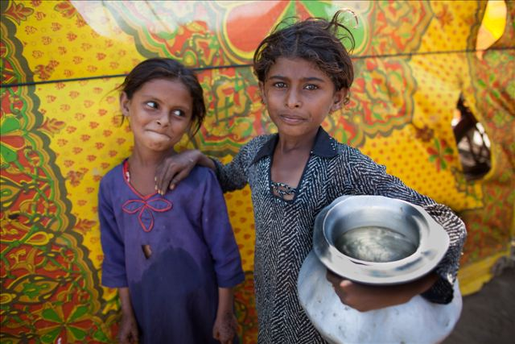
Strategic Framework on disability inclusion
Rationale for Action
Fundamental Principles
  Humanity
  Impartiality
  Unity
Notes:
Why is disability important? We thought it was is important to take some space around the
Articles 11 and 32 of CRPD are of special interest to the Movement as they refer to situations of risk and humanitarian emergencies, and to international cooperation, respectively.
The implementation of this strategic framework provides an example of the application of the Fundamental Principles in action. The Fundamental Principle of Humanity is of particular relevance, since its main components- alleviate and prevent suffering, protect life and health, and assure respect for and protection of the individual – underpin all three strategic objectives, together with the human rights based approach enshired in the CRPD.
In addition, the Fundamental Principles of Impartiality – providing assistance on the basis of need and without discrimination – directly requires the Movement to reduce barriers so that persons with disabilities are not excluded from the humanitarian response and other services provided. Finally, it may also be argued that the Fundamental Principles of Independence and Unity are upheld when persons with disabilities can fully participate in society and have the individual autonomy to make their own choices.
Please note that an analysis of the strong correlation between the Movement’s Fundamental Principles and Humanitarian Values and the Convention on the Rights of Persons with Disabilities’ general principles appears as an annex to the strategic framework.

Slide 6
The structure of the strategic framework
Goal of the framework:
All components of the Movement aim to :
be inclusive organisations,
build their own capacities,
mobilise resources,
involve and support persons with disabilities and their caregivers;
in order to address barriers hampering their full enjoyment of rights and freedoms.
Vision & Goal
SO 1: All components of the Movement adopt a disability inclusive approach.
SO 2: PwD have equal access to the services and programs we provide.
SO 3: change mindsets and behaviours to promote respect for diversity.
Nothing about us without us
Notes:
The vision: an inclusive society for all; in which persons with .disabilities can participate fully and achieve their full potential.
Goal: All components of the Movement aim to be inclusive organisations, to build their own capacities, to mobilise resources and to involve and support persons with disabilities and their caregivers in order to address barriers hampering their full enjoyment of rights and freedoms.
To implement the vision and goals we have three building blocks, the strategic objectives and as guiding principle that sustains all the above activities we have, the Fundamental Principles and Humanitarian values and the Convention on the Rights of persons with disabilities.
Underneath each enabling action, the framework suggests a series of activities. In truth carrying out these activities can often contribute to more than one strategic objective, given they are all very closely linked.

Slide 7
Strategic framework on disability inclusion
inclusive approach
Ensuring the Movement's internal organisational systems, processes and policies are disability inclusive
Notes:
Strategic Objective 1: All components of the Movement adopt a disability inclusive approach.
This objective focuses on ensuring the Movement's internal organisational systems, processes and policies are disability inclusive, including corporate and human resources, marketing, communications and infrastructure.
To help make this objective happen, we have the following 4 enabling actions:
- 1.1 All components of the Movement better understand the number and situation of persons with disabilities within their respective areas.
1.2 All components of the Movement identify and address physical, communication and institutional barriers which may prevent the access, meaningful participation and/or employment of persons with disabilities.
1.3 All components of the Movement have Human Resources policies, systems and practices that actively encourage and support the integration of persons with disabilities as staff, volunteers and members.
1.4 All components of the Movement actively build partnerships with appropriate People with Disabilities Organisations (PDOs) and other relevant civil society organisations.

Slide 8
Strategic framework on disability inclusion
inclusive approach
Number and situation of persons with disabilities
Physical, communication and institutional barriers
Human Resources policies, systems and practices
Partnerships with PDOs and other relevant organisations
Notes:
Strategic Objective 1: All components of the Movement adopt a disability inclusive approach.
This objective focuses on ensuring the Movement's internal organisational systems, processes and policies are disability inclusive, including corporate and human resources, marketing, communications and infrastructure.
To help make this objective happen, we have the following 4 enabling actions:
- 1.1 All components of the Movement better understand the number and situation of persons with disabilities within their respective areas.
1.2 All components of the Movement identify and address physical, communication and institutional barriers which may prevent the access, meaningful participation and/or employment of persons with disabilities.
1.3 All components of the Movement have Human Resources policies, systems and practices that actively encourage and support the integration of persons with disabilities as staff, volunteers and members.
1.4 All components of the Movement actively build partnerships with appropriate People with Disabilities Organisations (PDOs) and other relevant civil society organisations.

Slide 9
Strategic framework on disability inclusion
Accessible services
This objective aims to ensure the Movement’s services, programs and associated products available to individuals and communities are disability inclusive.
Notes:
Strategic Objective 2 Persons with disabilities have equal access to the services and programs the Movement provides, allowing their inclusion and full participation.
This objective aims to ensure the Movement’s services, programs and associated products available to individuals and communities are disability inclusive.
2.1 All components of the Movement mainstream disability inclusion throughout their programs and services.
2.2 All components of the Movement provide disability specific services, where relevant and appropriate.
2.3 All components of the Movement actively adopt prevention and early intervention approaches to address the causes of impairments.
2.4 All components of the Movement actively consider adopting gender- sensitive poverty alleviation and violence prevention, mitigation and response initiatives within its programs and services, where appropriate and relevant.
Would this not be included as part of 2.1? Per the above comment, if this refers to the organizational or institutional components of the service provider, then it would seem captures in strat obj 1? For example, activity 1 for this seems like it could go with 1.4 above?
Ditto above comment
Ditto above

Slide 10
Strategic framework on disability inclusion
Accessible services
Mainstreaming disability
Disability specific services
Prevention and early intervention
Gender, poverty, violence
Notes:
Strategic Objective 2 Persons with disabilities have equal access to the services and programs the Movement provides, allowing their inclusion and full participation.
This objective aims to ensure the Movement’s services, programs and associated products available to individuals and communities are disability inclusive.
2.1 All components of the Movement mainstream disability inclusion throughout their programs and services.
2.2 All components of the Movement provide disability specific services, where relevant and appropriate.
2.3 All components of the Movement actively adopt prevention and early intervention approaches to address the causes of impairments.
2.4 All components of the Movement actively consider adopting gender- sensitive poverty alleviation and violence prevention, mitigation and response initiatives within its programs and services, where appropriate and relevant.
Would this not be included as part of 2.1? Per the above comment, if this refers to the organizational or institutional components of the service provider, then it would seem captures in strat obj 1? For example, activity 1 for this seems like it could go with 1.4 above?
Ditto above comment
Ditto above

Slide 11
Strategic framework on disability inclusion
Changing minds
This objective focuses on challenging negative perceptions on disability and promoting disability as one of many ordinary differences that create human diversity.
Notes:
All components of the Movement endeavour to change mind sets and behaviours in order to promote respect for diversity, including disability inclusion.
This objective focuses on challenging negative perceptions on disability and promoting disability as one of many ordinary differences that create human diversity and enrich humankind.
3.1 All components of the Movement influence and model behaviour to address discrimination and foster the full inclusion of persons with disabilities.
3.2 All components of the Movement actively increase their knowledge of disability in order to promote evidence- based practice.
3.3 All components of the Movement actively advocate for the full and meaningful inclusion of persons of disabilities through Humanitarian Diplomacy.

Slide 12
Strategic framework on disability inclusion
Changing minds
Influence and model behaviour
Increase knowledge and evidence base
Advocacy for full & meaningful inclusion
Notes:
All components of the Movement endeavour to change mind sets and behaviours in order to promote respect for diversity, including disability inclusion.
This objective focuses on challenging negative perceptions on disability and promoting disability as one of many ordinary differences that create human diversity and enrich humankind.
3.1 All components of the Movement influence and model behaviour to address discrimination and foster the full inclusion of persons with disabilities.
3.2 All components of the Movement actively increase their knowledge of disability in order to promote evidence- based practice.
3.3 All components of the Movement actively advocate for the full and meaningful inclusion of persons of disabilities through Humanitarian Diplomacy.

Slide 13
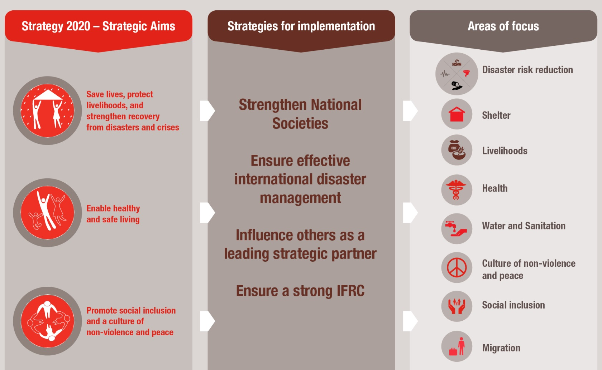
IFRC plan & budget 2016 - 2020
Notes:
This slide gives an overview of the IFRC plan and budget – the next slide shows the location & links with disability inclusion

Slide 14
Eight “Areas of Focus”
- DI mainstreamed in areas 1-6 & 8 & managed in area 7
disability inclusion
Disaster risk reduction
Shelter
Livelihoods
Health
Water and sanitation
Social Inclusion [disability inclusion]
Culture of non-violence and peace
Migration
Notes:
Disability inclusion issues is “hosted” and managed from the Social Inclusion area of focus, but cuts across all 7 other areas of focus.

Slide 15
Disability Inclusion: key focus of Social Inclusion and Gender & Diversity
Social Inclusion
Culture of
non-violence & peace
Human
Dignity
DISABILITY INCLUSION
Gender and Diversity
Notes:
Disability inclusion is a major focus of our work to promote Social Inclusion.
It is also a focus of our work on Gender and Diversity, and represents one of the themes that cross over between Gender and Diversity sensitive approach to programming (as covered in the Minimum Standard Commitments) and the longer-term, transformative Social Inclusion work of many National Societies.

Slide 16
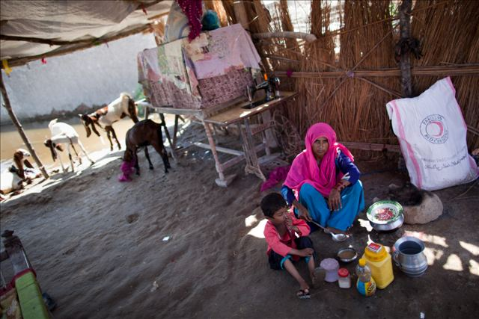
Looking forward ….
Dec 2015 – CoD adoption
Implementation overseeing committee
2017 – first progress report
2019 – final report
Notes:
So, we’ve gone through the content of the framework; now, you may be wondering, what happens next?
This framework should be endorsed at the next Council of Delegates, Geneva, just over a month away. There is a resolution currently in draft that accompanies this framework.
Once this framework has been officially adopted, it is up to every part of the Movement to start working through it, making it fit to its specific context and mandate.
The framework suggests that an implementation committee – with representation from all different

Slide 17
Draft plan of action
Proposed workstreams for Plan of Action:
  Data collection, systems and analysis
  Human resources and regular access audits
  Partnerships
  Programming/Operations
  Awareness
  Research
  Advocacy
But implementation requires a significant boost…

Slide 18
Progress on implementation
Limited coordinated collection of information on progress so far
2017 needs scale-up in coordination of efforts and reporting
Hiring of coordinator & establishing coordination group a priority – but not achieved yet
Good progress in December & momentum is growing!

