Slide 1
Understanding gender and diversity
SEA Regional Gender and Diversity
Training of Trainers
5-8th October

Slide 2
Session learning objectives
By the end of this session
Define the concepts ‘sex’, ‘gender’, ‘diversity’ and gender equality
Know IFRC’s approach to addressing gender and diversity
Know some key considerations for planning and delivering gender and diversity-sensitive training

Slide 3
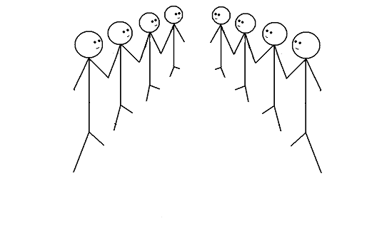
Group exercise
Speed debating
Notes:
All participants stand in two lines facing each other
Facilitator reads the statement

Slide 4
Group exercise
Gender is just another word for women

Slide 5
Group exercise
In disaster response, the tyranny of the urgent trumps everything. Addressing gender and diversity must wait.

Slide 6
Group exercise
In a disaster response, trying to meet the distinct needs of people with a disability represents an unacceptable burden on limited resources.

Slide 7
Group exercise
In disasters the elderly are dependent and always need help

Slide 8
Group exercise
Men and women can never be equal because they are biologically different.

Slide 9

Discussion
This is a good exercise to get people to think about their own beliefs when it comes to gender and diversity
We have all grown up with some kind of bias and when we work in stressful situations it is important to know what we think and also what others may think
To understand ways in which gender and diversity influence decisions and policies
In training you can give one row of people to argue one way and the other row to argue another. This is more challenging as people may have to argue against their beliefs but it puts you in the shoes of someone who has that perspective.

Slide 10
Gender vs Sex
Sex: refers to the biological differences between men and women
Gender (as a concept): refers to the social differences between men and women and relate to the attitudes, behaviors, roles and expectations put on men and women as a result of being male or female
When we speak of ‘Gender’ we do not just mean women
Gender – provides us an analytical tool
Notes:
Gender as a concept refers to the social differences between men and women and relate to the attitudes, behaviors, roles and expectations placed on men and women as a result of being male or female
Gender provides us with an analytical framework to understand better the needs and capacities of all groups in a community and ensure these are addressed

Slide 11
How is gender influenced?
Gender is socially constructed, learned and has the ability to change over time and between situations
It is influenced by …
Tradition
Values and beliefs
Attitudes
Culture
Social influences
Behavior

Slide 12
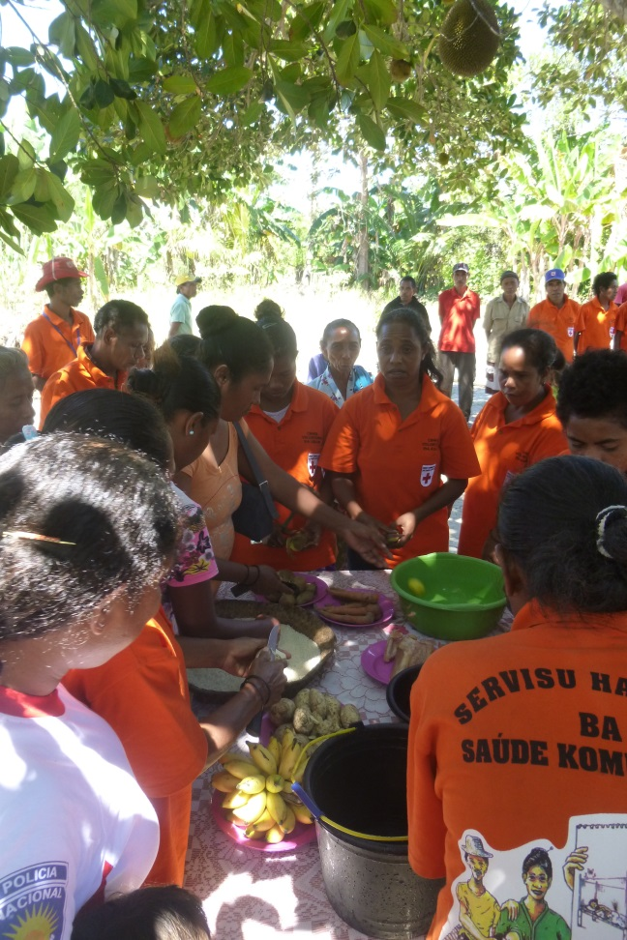
Gender equality
Gender Equality exists when males and females are able to equally share the distribution of power and have equal opportunities both in the home and in the community.
Gender Equality does not mean that males and females are the same – it means that their rights, responsibilities and opportunities do not depend on their sex.

Slide 13

Sexual and Gender-based Violence (S/GBV)
An umbrella term for any harmful act that results in, or is likely to result in, physical, sexual or psychological harm or suffering to a person on the basis of their gender.
A result of gender inequality and abuse of power.
Includes but not limited to sexual violence, domestic violence, trafficking, forced/early marriage, forced prostitution, sexual exploitation and abuse and denial of resources, opportunities and services.
Another confusing and contested term
Sexual violence, sexual and gender-based violence, violence against women and girls
Notes:
Sourced from IFRC Seven Moves Training

Slide 14


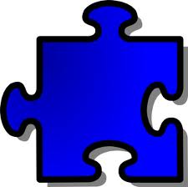
Diversity
Diversity refers to the acceptance and respect for the differences between people
Ethnic Origin
Health e.g.
Sexual Orientation
HIV Status
Diversity
Age
Religious affiliation
Socio-economic status
Nationality
Disability

Slide 15
Interactions between gender and diversity
Diversity refers to the acceptance and respect for the differences between people
Ethnic Origin
Health e.g.
Sexual Orientation
HIV Status
Diversity
Age
Religious affiliation
Socio-economic status
Nationality
Disability

Slide 16
Diversity
You can adapt this slide during training to make it more culturally appropriate to your audience and to the context.
Ask people to add to the slide to know what is important in their context
Ethnic Origin
Health e.g.
HIV Status
Diversity
Religious affiliation
Socio-economic status

Slide 17
IFRC’s approach
The IFRC’s gender and diversity work is not a separate or new component
It is rooted in its humanitarian mandate to prevent and alleviate human suffering without discrimination and to protect human dignity.
The RCRC recognizes that women and men have different capacities, strengths, needs and vulnerabilities which can impact their resilience to disasters

Slide 18
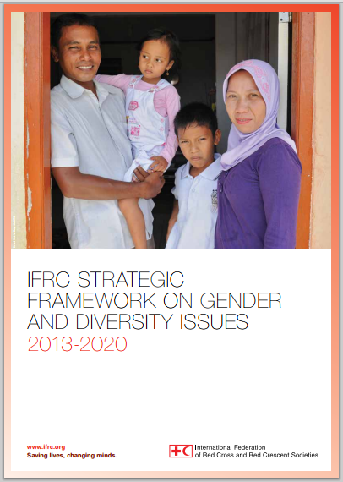
IFRC Strategic Framework on Gender and Diversity issues
1
Systematic incorporation of gender and diversity in all programs, services and tools (planning, monitoring, evaluation and reporting).
2
Improved gender and diversity composition at all levels (governance, management, staff and volunteers).
3
Reduced gender- and diversity-based inequality, discrimination and violence through the active promotion of fundamental principles and humanitarian values.

Slide 19
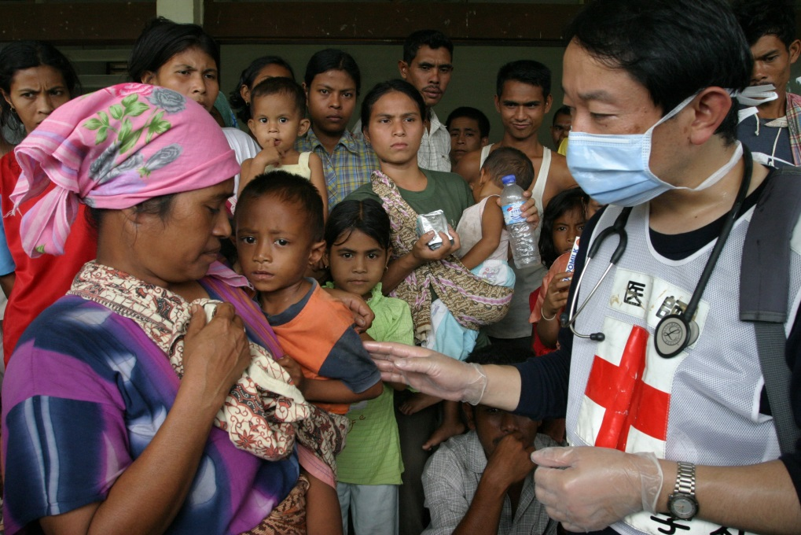
Fundamental Principles
Fundamental principle of impartiality: The RCRC Movement makes no discrimination as to:
Nationality
Race
Religious beliefs
Class
Political opinions
…Whilst giving priority to the most urgent cases of distress

Slide 20
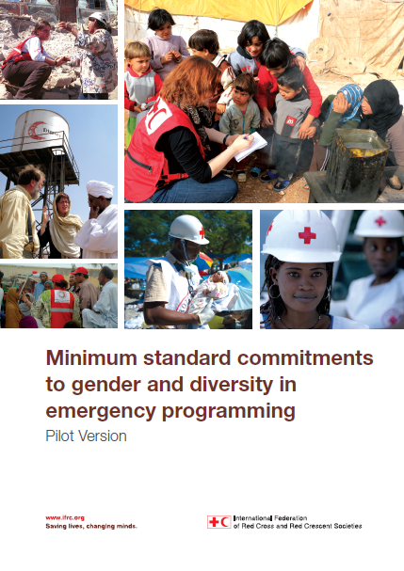
Minimum Standard Commitments….
DAPS Framework:
Dignity
Access
Participation
Safety
Sectoral standards
Emergency Health
Food Security
WASH
Emergency Shelter Livelihoods
Non-food Items
Disaster Risk Reduction

Slide 21

Quiz time!

Slide 22
Gender and Diversity Quiz
Sex
Of the 232 Million international migrant (3.2% of the world’s population), what percentage are women?
25% 38% 48% or 60%

Slide 23
Gender and Diversity Quiz
Sex
Of the 232 Million international migrant (3.2% of the world’s population), what percentage are women?
25% 38% 48% or 60%

Slide 24
Gender and diversity quiz
Pregnancy
___% of women of reproductive age (15 – 45 years), including refugees and IDPs, are pregnant at any given time.
Is it 7%, 10%, 20% or 25%?

Slide 25
Gender and Diversity Quiz
Pregnancy
20% of women of reproductive age (15 – 45 years), including refugees and IDPs, are pregnant at any given time.
Is it 7%, 10%, 20% or 25%?
Notes:
Source: Cooperative for Assistance and Relief Everywhere Inc. (2002) Moving from Emergency Response to Comprehensive Reproductive Health Programs: A Modular Training Series. Washington, DC: CARE.

Slide 26
Gender and diversity quiz
LGBTI
Being lesbian, gay, bisexual, transgender or intersex is illegal in how many countries? Is it 25, 47 or 76?

Slide 27
Gender and diversity quiz
LGBTI
Being lesbian, gay, bisexual, transgender or intersex is illegal in how many countries? Is it 25, 47 or 76?
Notes:
Source: “State-sponsored homophobia: a world survey of laws criminalising same-sex sexual acts between consenting adults”, International Lesbian, Gay, Bisexual, Transgender and Intersex Association (ILGA), Brussels, May 2011, p. 9
See the countries here http://76crimes.com/76-countries-where-homosexuality-is-illegal/

Slide 28
Gender and diversity quiz
LGBTI
How many countries impose the death penalty on LGBTI people? Is it 2, 7 or 15?
Notes:
Source: ILGA 2010
Read more: http://deathpenaltynews.blogspot.com/2010/06/ilga-76-countries-ban-gay-sex-7-have.html#ixzz3e5E2Fper

Slide 29
Gender and diversity quiz
LGBTI
How many countries impose the death penalty on LGBTI people? Is it 2, 7 or 15?
Notes:
Source: ILGA 2010
Read more: http://deathpenaltynews.blogspot.com/2010/06/ilga-76-countries-ban-gay-sex-7-have.html#ixzz3e5E2Fper

Slide 30
Gender and diversity quiz
Violence
What % of women worldwide have experienced either physical and/or sexual violence? 20, 25 or 35%
Notes:
Source: UN Women Facts and Figures on Violence Against Women and Girls
http://www.unwomen.org/en/what-we-do/ending-violence-against-women/facts-and-figures

Slide 31
Gender and diversity quiz
Violence
What % of women worldwide have experienced either physical and/or sexual violence? 20, 25 or 35%
Notes:
Source: UN Women Facts and Figures on Violence Against Women and Girls
http://www.unwomen.org/en/what-we-do/ending-violence-against-women/facts-and-figures

Slide 32
Gender and diversity quiz
Violence
What % of the 4.5 million people forced into sexual exploitation are women and girls? 75, 88 or 98%

Slide 33
Gender and diversity quiz
Violence
What % of the 4.5 million people forced into sexual exploitation are women and girls? 75, 88 or 98%
Notes:
Sources:
UN Women Facts and Figures on Violence Against Women and Girls
http://www.unwomen.org/en/what-we-do/ending-violence-against-women/facts-and-figures
UNICEF 2014

Slide 34
Gender and diversity inclusive
training

Slide 35
Why is this important
In addition to raising awareness of gender and diversity via the delivery of your training,
It is important to ensure that the training itself is as inclusive as possible and takes into consideration and adapts to the needs of your participants.

Slide 36
Creating an inclusive training environment
Participants
Aim to get a representative group…and record, sex, job description
e.g. Try to ensure an equal number of men and women and diversity in the room
…..and accommodate to ensure this can happen
e.g. Make extra provisions to overcome barriers: e.g. include in the budget if women may need child care to attend the training. Or if women may need people to accompany them to the training

Slide 37
Creating an inclusive training environment
Understanding diversity and specific needs
Have you circulated a special requirements form?
Diet/allergies? Disability (physical, visual, auditory)?
Religious requirements? Accommodation requirements?
If the answer to any of these is yes, what extra access or provisions would they require during the training?

Slide 38
Creating an inclusive training environment
An inclusive meeting area
Visit the venue.
Conduct an audit e.g. check for disabled access (are there ramps at the entrance? Are the lifts large enough for wheelchair access?)
Will the venue accommodate specific food requirements?
Ensure the venue has adequate sound systems if participants have hearing impairments

Slide 39
Creating an inclusive training environment
What languages do your participants speak?
If there are minority groups in the room, it could be important to translate key documents or Powerpoint slides so as not to lessen participants access to information during the training.

Slide 40
Creating an inclusive training environment
Training on gender and diversity
Confidentiality
No questions are wrong
Be contextual: use examples, case studies and pictures from the country/region
Know the National Society or group’s strategic plan, aims and goals. This will help make connections between the theory and practice.
Research facts about the country/community e.g. laws relating to domestic violence, views on homosexuality. If there is a topic that is particularly sensitive, introduce this in innovative ways. You can use different language or methods to deliver messages.

Slide 41
Gender and Diversity…Building on what we are already doing
Addressing the needs of the most vulnerable is not new for National Societies
Disaster Management
Health
Community-based maternal & child health
Assisting people with HIV and outreach to vulnerable groups
Integrating gender approach in WASH activities
Assisting the elderly in their access to health services
First aid and PSP – specifically addressing needs of elderly, women, girls and PWD
Focus on gender and working with ethnic minorities for DRR
Development of policies and strategies for social inclusion / gender / disability
Tools e.g. VCA, risk mapping, baseline surveys are gender sensitive
Working with the elderly in disaster preparedness activities

Slide 42
Build on the diversity in the room….
Ensure every participant is encouraged to participate
Ensure diversity within groups, mix up the seating arrangements to encourage people to meet others and exchange ideas
Highlight the diversity amongst ourselves - what does gender and diversity mean in each person’s culture?
Try to inject icebreakers if you notice the participants feeling concerned or overwhelmed. Some topics can include subject matter that may be heavy or uncomfortable

Slide 43
Creating an inclusive training environment
After the training
Information given during the training may resonate differently with different people and participants may not wish to discuss this during the training.
May need time to digest information
It is important to have communication channels after the training if participants have follow-up questions.

Slide 44
Mainstreaming in other training
It is important to have specific gender and diversity awareness training within National Societies
It is also important to mainstream the concepts within other training:
e.g. HR training ask to do one hour on prevention of sexual exploitation and abuse and the code of conduct
e.g. If you are running a community assessment in the field – do a 30 minute session showing how to ensure the assessment tool and environment is inclusive

Slide 45
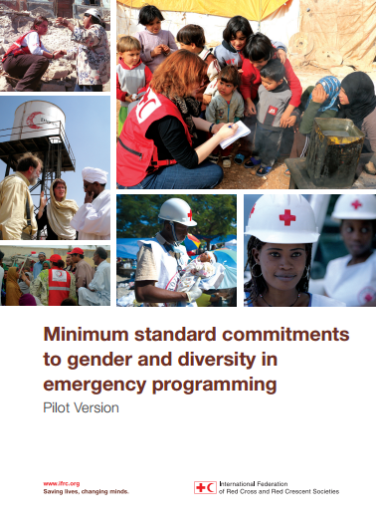
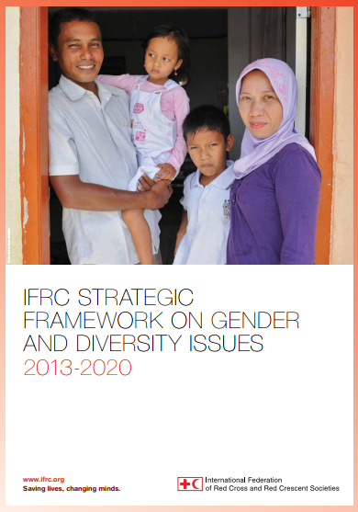
Gender and Diversity Resource Library
For resources for ‘Understanding gender and diversity’ follow this link:
Link:
https://sites.google.com/site/drrtoolsinsoutheastasia/gender-and-diversity/gender-and-diversity-for-resilience-toolkit/ifrc-frameworks-and-policies

Slide 46
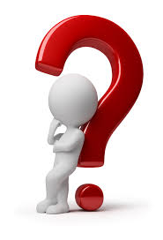
Any questions?

