Slide 1
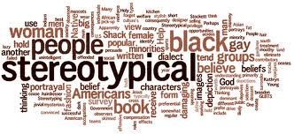
That’s just so typical!
A way of behaving, an attitude or a characteristic that would be considered typical for your sex/gender
Notes:
Overgeneralisation of the characteristics of one group of people. Often polarising in that it attributes +ve characteristics to one group and –ve attributes to another.
Sourced from the IFRC Seven Moves: Gender and Diversity in Emergency Programming Training.

