Slide 1
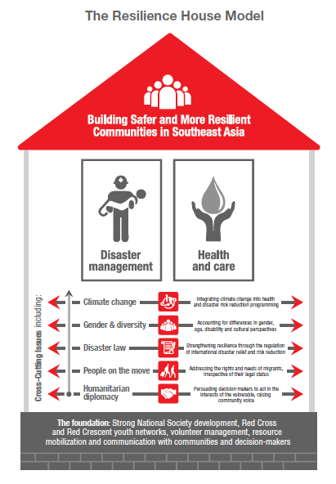

Slide 2
The roadmap
Current roadmap 2012-2015
Next roadmap will cover 2016 – 2020
A roadmap for regional cooperation (adding value to the national agenda)
Promoting peer-to-peer learning and joint initiative

Slide 3
Main areas / expectations
Policies and tools for programme integration
Regional Disaster Response Team (RDRT)
Community Safety and Resilience
Pandemic preparedness
Contingency Planning
Sharing information / peer to peer learning
Cooperation with ASEAN and other partners
Disaster Law
Youths and Volunteers development
Gender and Diversity, migration and beneficiary communication integrated in programming
Red Cross / Red Crescent branch development
Violence Prevention

