Slide 1
School Safety in the Post-2015 Framework on Disaster Risk Reduction Toward Sendai and Beyond www.wcdrr.org

Slide 2
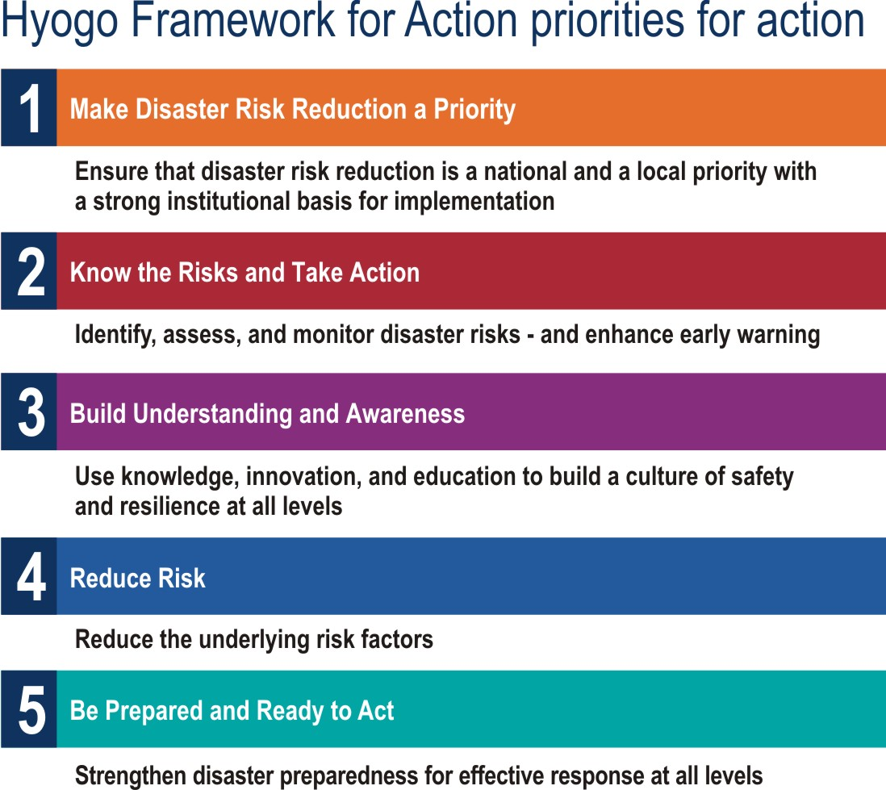
I
Why the post-2015 framework for DRR (HFA2)
The Hyogo Framework for Action 2005-2015 ends its timeframe
UN General Assembly Resolutions: convene the World Conference on DRR and adopt post-2015 framework
Disaster risk management seen as integral to sustainable development
Recognized need for coherence of HFA2, post-2015 Sustainable Development Goals and Climate Change Arrangements

Slide 3
Preparatory Process
Two years of consultations (March 2012 – May 2014) among governments, local governments, stakeholders and organizations
Regional Platforms/Ministerial Conferences as key for deliberations
Intergovernmental Preparatory Committees (PrepComs) are to be held
1st PrepCom 14-15 July 2014
2nd PrepCom 17-18 November 2014
3rd PrepCom 13 March 2015 in Sendai as needed.
Informal Consultation meetings: September - October 2014 and December – January.
Nine major groups: Business and Industry, Children and Youth, Farmers, Indigenous Peoples, Local Authorities, NGOs, Science and Technology, Women, Workers and Trade Unions

Slide 4
Education and School Safety in Consultation Process
Africa: Integrate DRR into education, comprehensive school safety frameworks, community education and awareness, greater attention to higher education
Asia: school safety as critical for enhancing resilience at local levels, DRR education and awareness, promote higher education, improve risk-sensitive public investments
Central Asia: Promote education, school safety and public awareness, scale up education policies and plans related to disaster risk reduction.
Americas: protect equitable access to education
Europe: implementation of safe school policies and programs, access to education…as contribution to achieving MDGs
Arab States: silent about education/school safety although emphasize the link between DRR and sustainable development

Slide 5
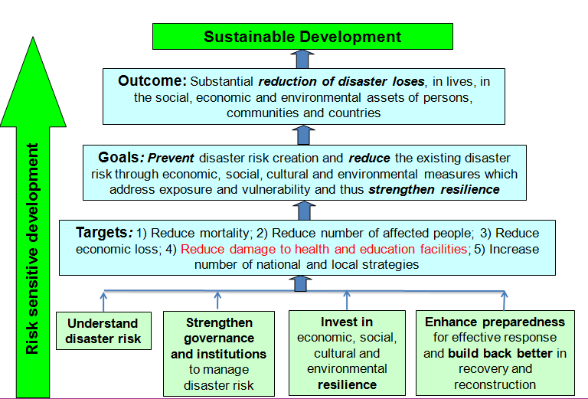
The Zero Draft of HFA2

Slide 6
Education and Resilience in the Post-2015 SDGs
Goal 4. Ensure inclusive and equitable quality education and promote life-long learning opportunities for all: access to education, safe facilities
Goal 9. Build resilient infrastructure, promote inclusive and sustainable industrialization and foster innovation: affordable and equitable access for all
Goal 11. Make cities and human settlements inclusive, safe, resilient and sustainable: reduce number of deaths and affected people; decrease by y% the economic losses ; ensure universal access to safe, inclusive and accessible, green public spaces, particularly for …and children…
Goal 13. Take urgent action to combat climate change and its impacts: promote education…human and institutional capacity building

Slide 7
The Worldwide Initiative On School Safety
Why?
Deliver commitments made at 2009 Global Platform, High-level Communiqué at 2013 Global Platform for DRR
Synthesize initiatives and promote coherent approach: the Comprehensive Framework for School Safety
To be an important part of HFA2 implementation
Components:
Safe Learning Facilities
School Disaster Management
Disaster Risk Reduction and Resilience Education
Building political commitments, monitoring and reporting

Slide 8
Outcomes of the Istanbul Meeting
Sharing of experiences
Discussed challenges and lessons learned such as: meeting the needs of refugee children, evidence and data to secure political support and resources, reinforcement of building codes, safety of private schools, make school safety an obligation through legal framework
Endorsed the WWISS as good global framework to set vision and guide implementation
Validated the three-pillar approach and welcomed the cooperation with technical partners

Slide 9
Outcomes of the Istanbul Meeting
Called for increasing social demand and engagement of private sector
Recommended to develop “school safety index” to facilitate rating
Agreed to develop a “Roadmap to Sendai”, targeting all countries, not only high risk ones
Agreed on Voluntary Commitments to WWISS to form the Roadmap and ensure its implementation

Slide 10
Elements of the Roadmap to Sendai
Global objectives and goals
Standard indicators
National targets based on respective situations
Continuous sharing of good practices
Cohesive support from development partners

Slide 11
Voluntary Commitments to The Worldwide Initative for Safe Schools
National plans towards safe schools in respective countries
Advocacy to engage other countries
Assistance to other countries

Slide 12
Ways Forward
Agree on name the roadmap – e.g. the “Istanbul Roadmap” on School Safety
Drafting the Roadmap
Hosting the next meeting to discuss the Roadmap and solicit commitments (January 2015)
Agenda and attendance for the launch of the Worldwide Initiative with commitments at WCDRR

Slide 13
How ASEAN can lead the way?
Make voluntary commitments for school safety to implement HFA2
http://www.wcdrr.org/preparatory/commitments
Join the January 2015 meeting to finalize the Roadmap
Engage your Ministers of Education at WCDRR
Showcase ASSI at WCDRR

Slide 14
Voluntary Commitments

Slide 15
At WCDRR

