Slide 1
CREATING A CULTURE OF SAFETY AND RESILIENCE IN SCHOOLS: THE SEAMEO INITIATIVES
Elaissa Marina E. Mendoza, SEAMEO INNOTECH
ASEAN Safe School Initiative Workshop
24 November 2014, Jakarta

Slide 2
SEA countries share common characteristics of hazards
Source: Economy and Environment Program for Southeast Asia

Slide 3
Type of Hazards per SEAMEO Member Countries
Source: Country paper presentations, Regional Conference on EiE and Disaster Preparedness, 10-12 Dec. 2013, Phil. Dep’t of Education

Slide 4

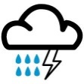





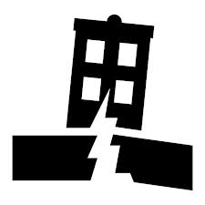
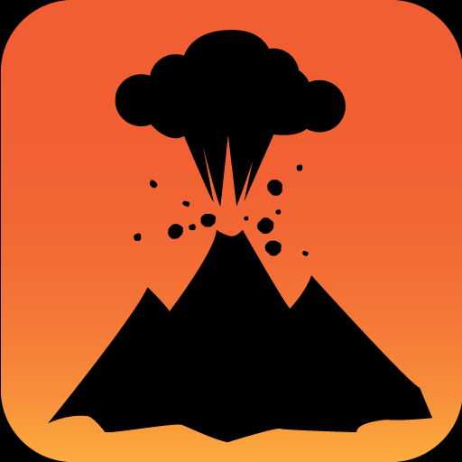


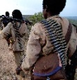



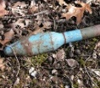

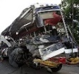
Type of Hazards per SEAMEO Member Countries
Brunei Darussalam
Cambodia
Philippines
Timor-Leste
Lao PDR
Malaysia
Singapore
Vietnam
Myanmar
Indonesia
Thailand
Images sourced from various websites
Human-Induced Hazard
Natural Hazards

Slide 5
Over 100 million children (0-17 y.o.) in Southeast Asia
are at risk in schools annually

Slide 6
What do we have as a region?
Spirit as one SEAMEO community
Existing mechanisms for disaster management
Binding commitment to reaching the unreached

Slide 7
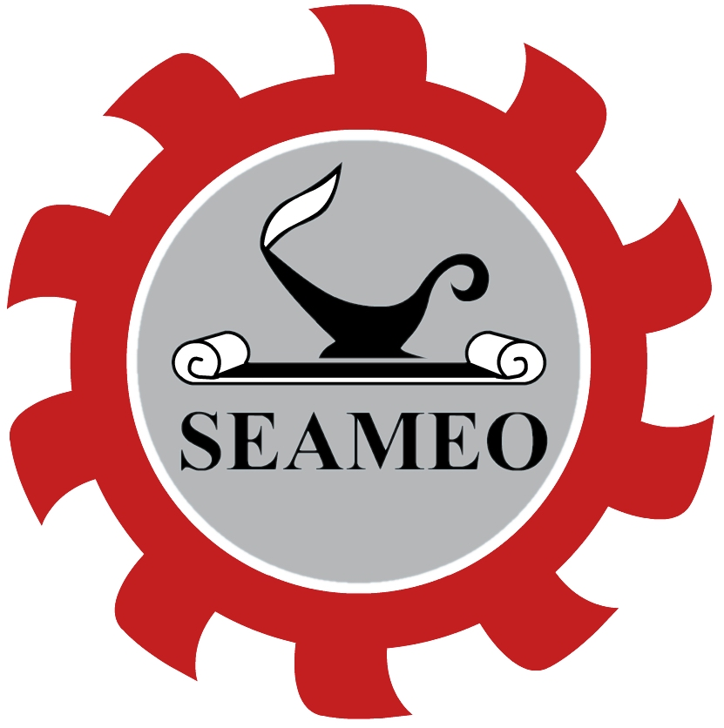
regional inter-governmental organization among governments of Southeast Asian countries
promote cooperation in education, science and culture in the region
established on 30 November 1965
20 Centers all over the region and 1 Network (TROPMED)

Slide 8
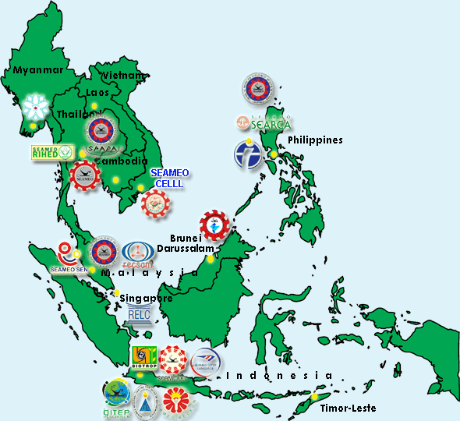

SEAMEO Member Countries
Brunei
Cambodia
Indonesia
Lao PDR
Malaysia
Myanmmar
Philippines
Singapore
Thailand
Timor Leste
Vietnam

Slide 9
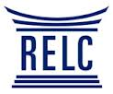









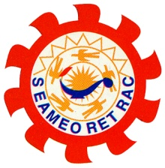


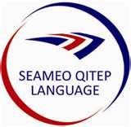

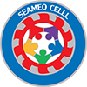

SEAMEO Regional Centers
EDUCATION
SCIENCE
CULTURE AND HISTORY
Microbiology, Parasitology and Entomology
Public Health
Tropical Medicine

Slide 10
10 Collaborative Projects to
Reach the Unreached
proponents
SEAMEO in coordination with ASEAN secretariat and UNESCO
Aim
To address the needs of various unreached and disadvantaged population groups in Southeast Asia
Target
10 prioritized unreached groups

Slide 11
At a Glance
.

Slide 12
Philippines and Indonesia are the lead countries
Target Group : Children in difficult circumstances
Project Components :
  Provision of kits and guidelines
  Teacher and community involvement
  Refurbishment of structures
  Advocacy

Slide 13
Review of SEAMEO member countries’ strategies on DRR
Policies - R.A. 10121: Philippine DRRM Act and MoEC’s Decree on Mainstreaming DRR
Children’s kits and Guidelines on Emergency Preparedness & Safety
Teacher and community involvement in emergencies
Philippine Education Cluster (DepEd, UNICEF, Save the Children, Plan International
Regional Conference on Education in Emergencies and Disaster Preparedness (Dec. 10-12, 2013)
Activities Conducted

Slide 14
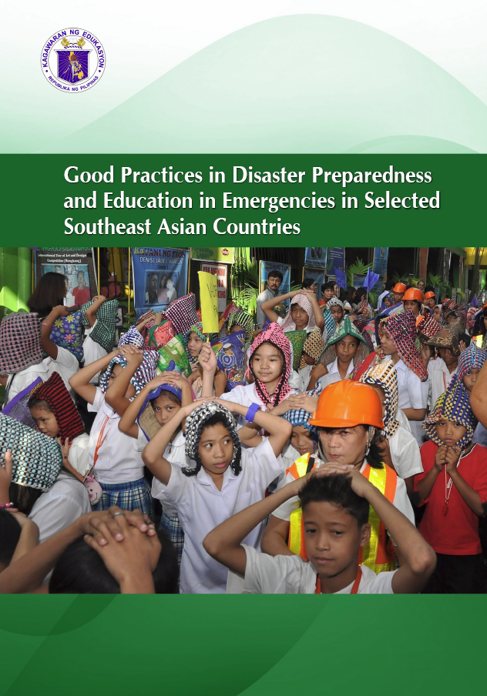
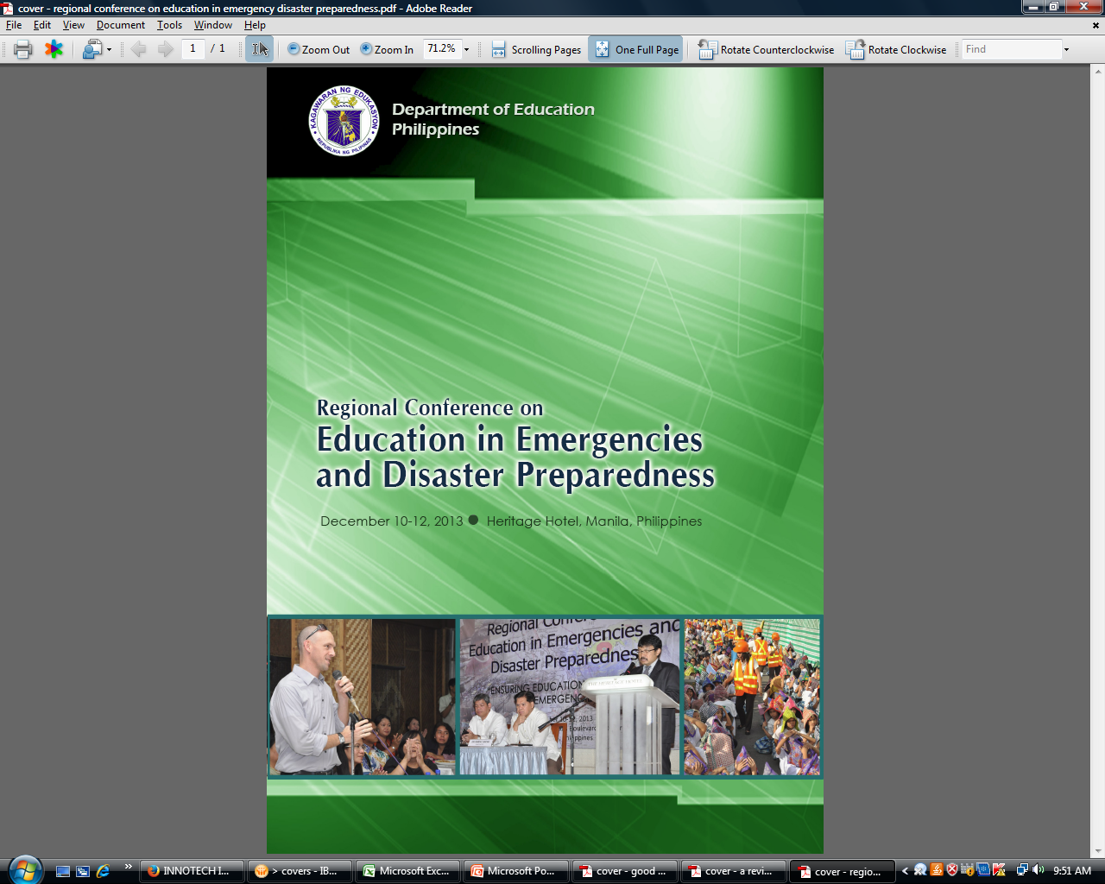
Outputs

Slide 15
DRR Framework
harmonize and integrate current DepEd initiatives on climate change adaptation and disaster management for educators, administrators, policy makers, school managers, student development partners, NGOs and CSOs to reduce vulnerability of schools and the entire community
Source: Phil. Department of Education, 2014

Slide 16

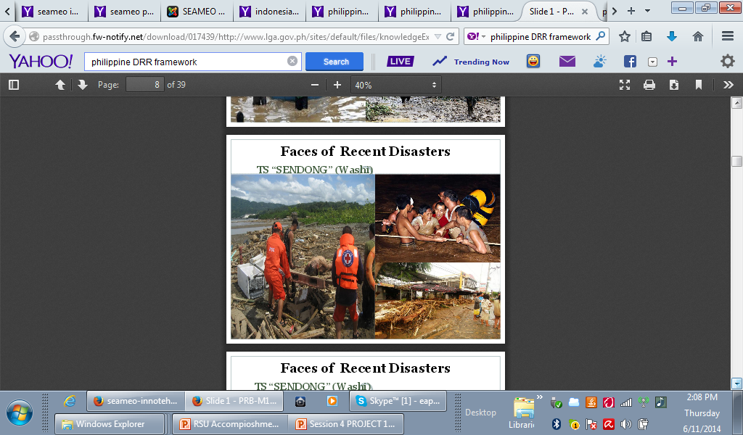
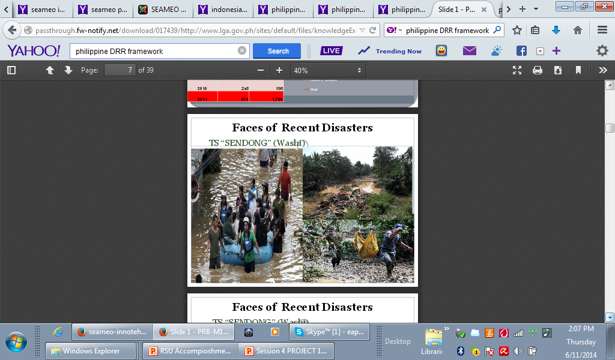
Integrating Climate Change Issues in Southeast Asian Schools: A Teachers’ Guidebook
A collaborative effort of eight SEAMEO Centers
Aimed to provide teachers with useful initial resources to facilitate the capacity building of young people on the issues
Covers a range of related climate change concerns such as poverty, health and nutrition, and food security

Slide 17

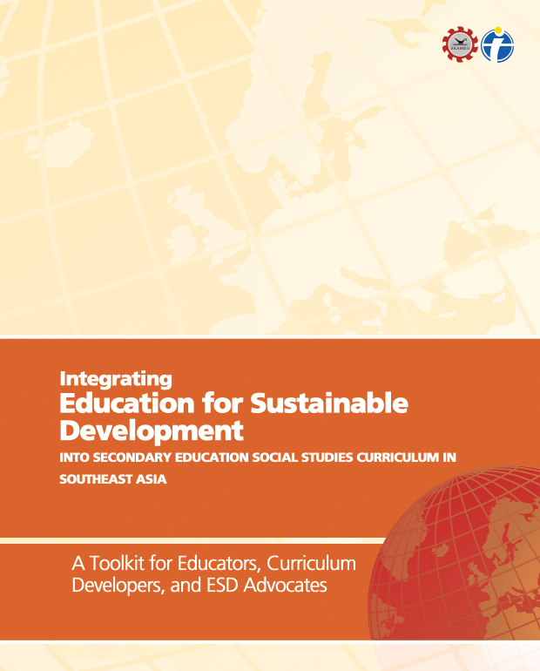
Integrating Education for Sustainable Development into Secondary Education Social Studies Curriculum in Southeast Asia: A Toolkit for Educators, Curriculum Developers and ESD Advocates
Aimed at providing specific strategies, methods and activities to integrate ESD in secondary school social studies curriculum content and delivery in Southeast Asia
Helps teachers gain understanding of their critical role in promoting education for sustainable development

Slide 18
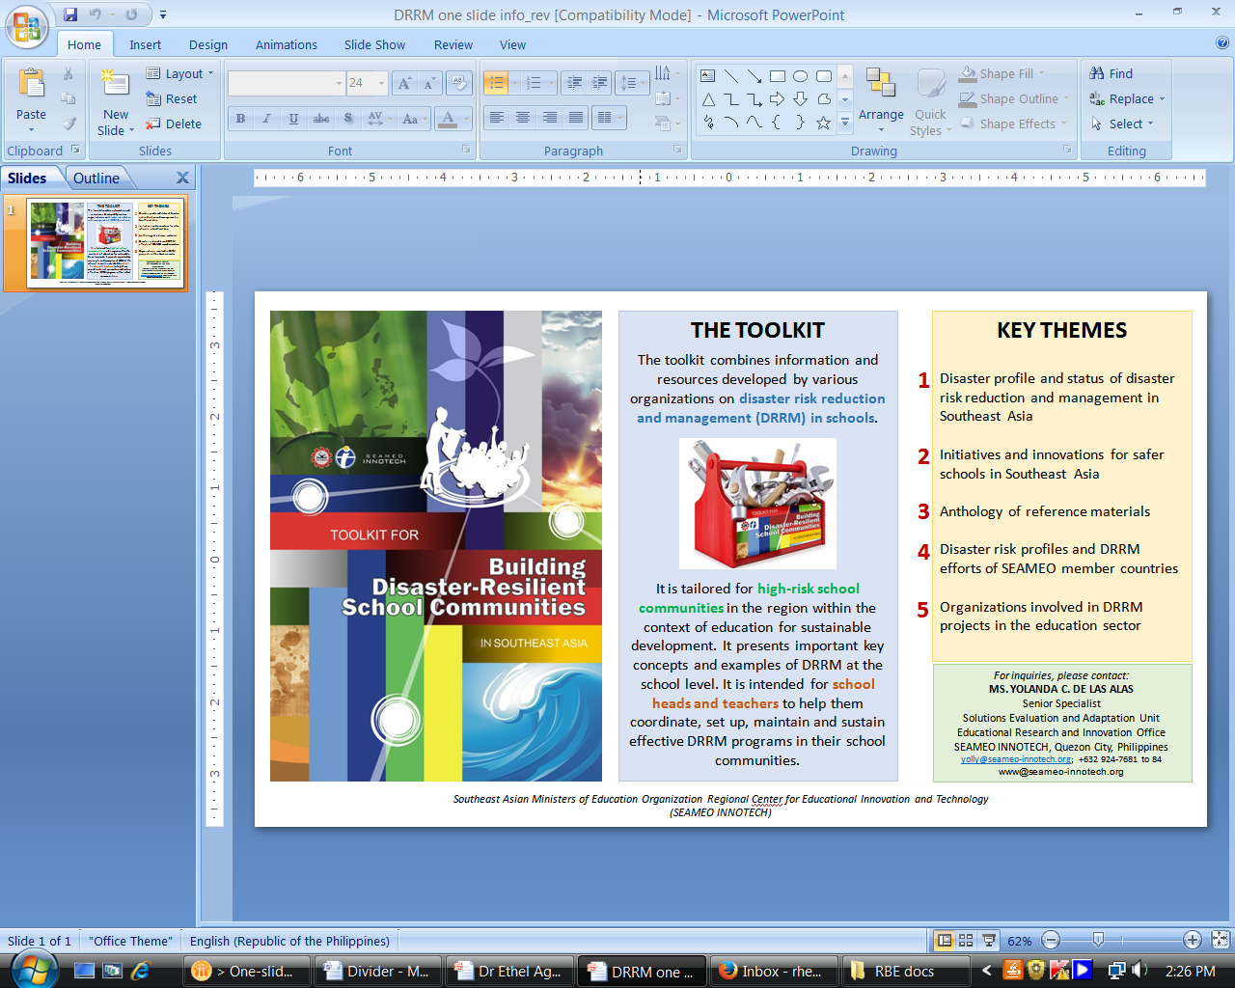
Toolkit for Building Disaster-Resilient Schools Communities

Slide 19
Toolkit for Building Disaster-Resilient Schools Communities
Scope of the Toolkit
DRM initiatives from over 40 schools in 9 SEAMEO member countries
Great East Japan earthquake experiences from selected schools

Slide 20
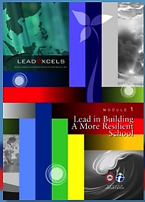
“Schools and school leaders play a central role in the life of communities.”
LEADeXCELS
(Excellence in Leading Education in Emergency Situations)
strengthen the capacity of SEA school heads in preparing for, and responding to, natural and human-made disasters
ensure that education and learning continue even in emergency situations

Slide 21
Competency Framework for Southeast Asian School Heads
Managerial Leadership:
  Supervises facilities and equipment management to ensure a safe and conducive learning environment
  Engages the community in creating a safe, healthy, resilient and learner-centered environment
Instructional Leadership:
  Ensures that school facilities and learning resources are accessible to all learners
  Maintains a school environment that is safe, clean, and hazard-free
  Puts in place a system for disaster mitigation and resiliency
  Assesses impact of school environment to students’ learning outcomes
Source: SEAMEO INNOTECH, 2014

Slide 22
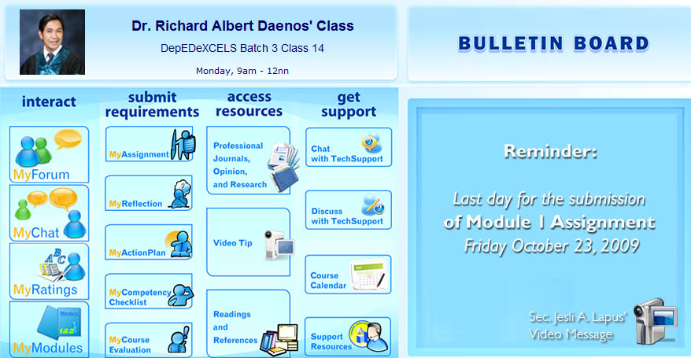
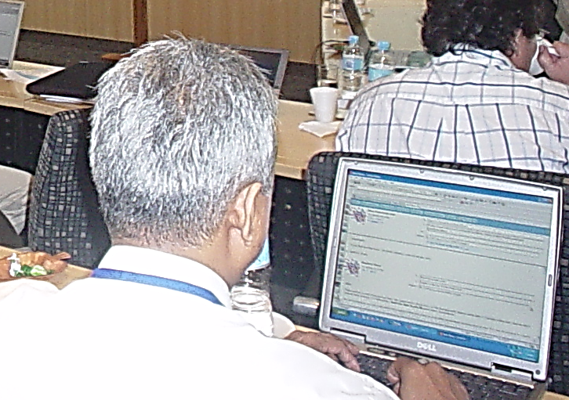
LEADeXCELS Implementation
Self-instructional modules
(print, CD, web-based)
Use of webinars and live chat discussions
Certified flexible learning tutors
Internet-based chat and discussion forums in iFLEX
(INNOTECH Flexible Learning System)

Slide 23


Integrating Disaster Risk Reduction and Management in Mathematics Education
  SEAMEO QITEP in Mathematics is developing e-textbooks on integrating emergency preparedness in Mathematics education.
  Utilizes mathematical modeling of the disaster process and impact so that students can learn both mathematics and the nature of disasters

Slide 24
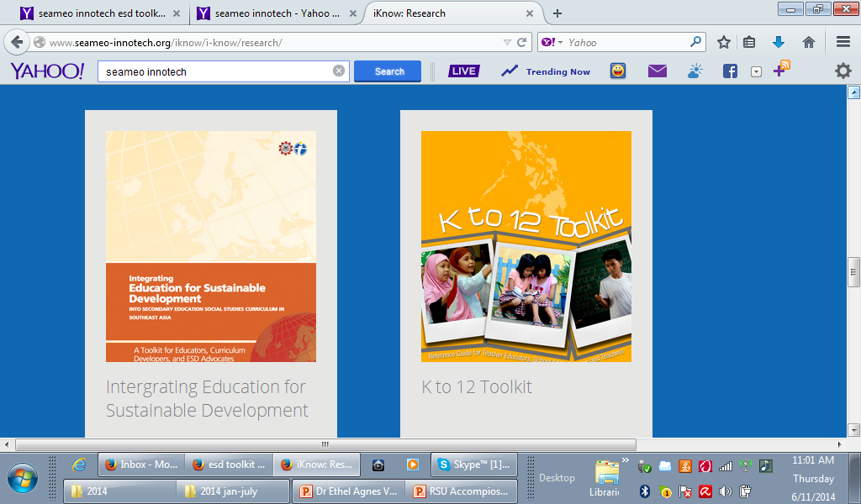
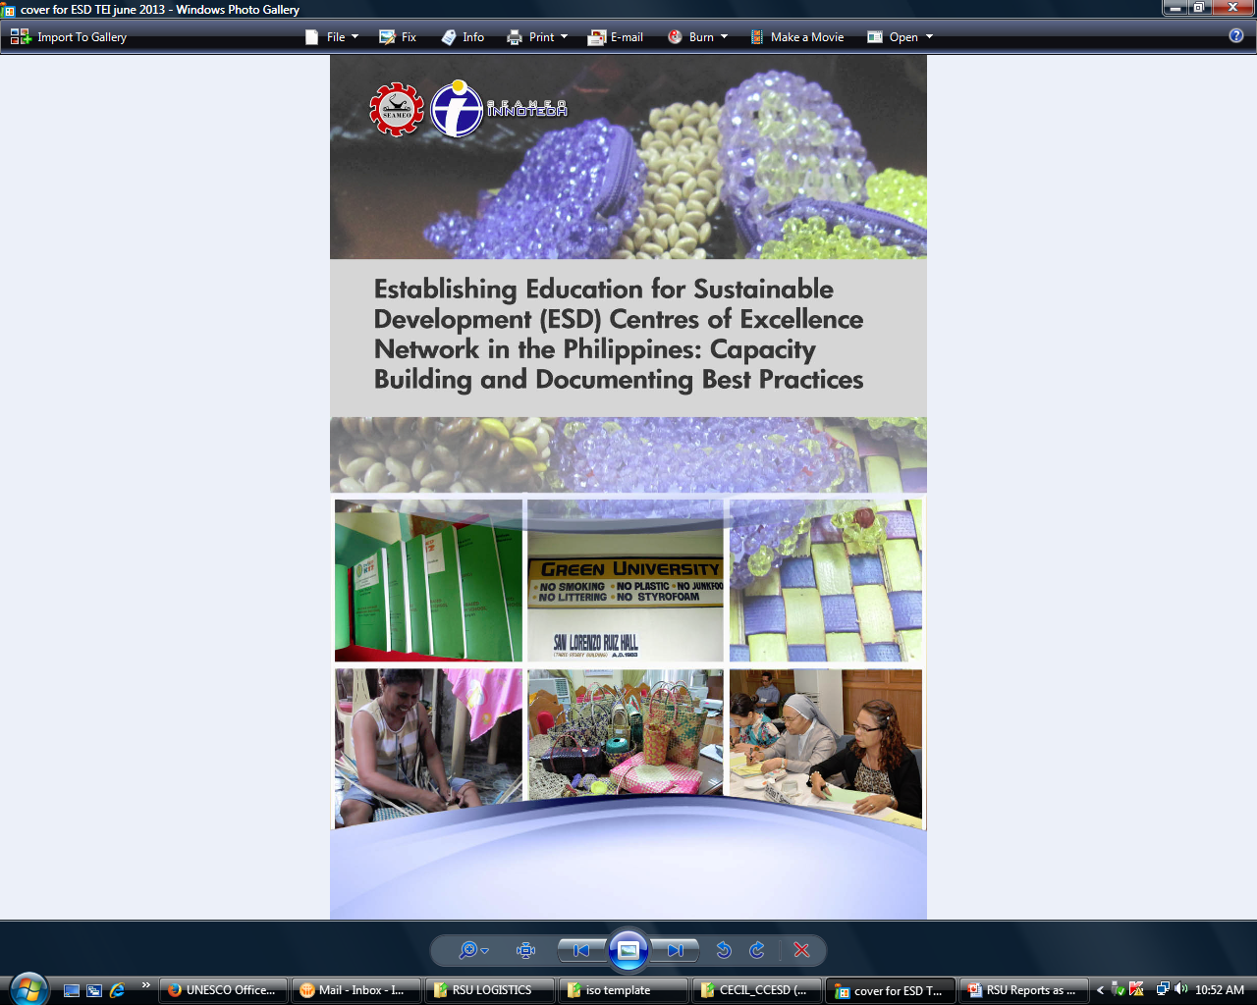
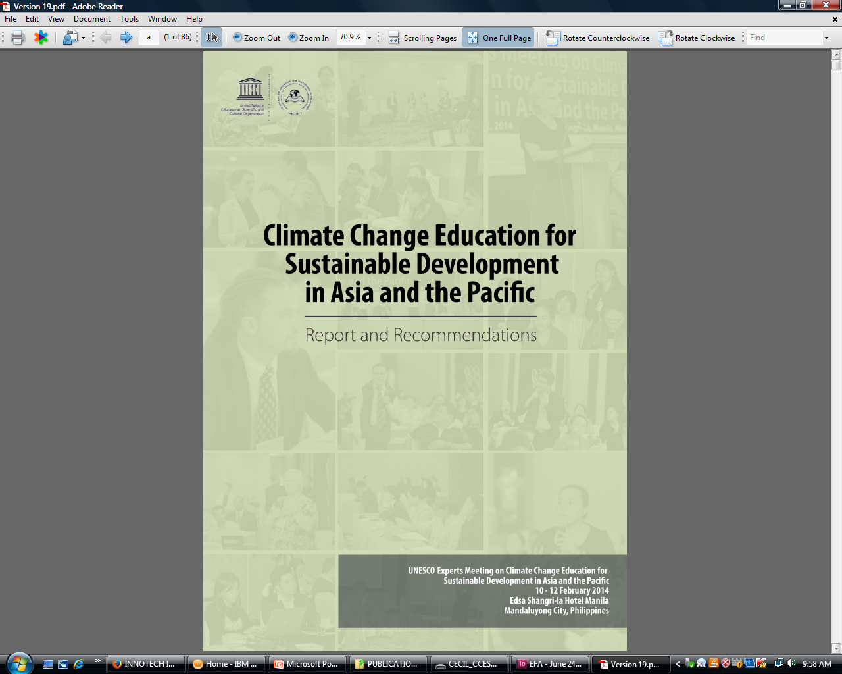
SEAMEO Advocacy
  The education system should integrate measures on DRRM and CCA as failure to do so can stall and impair the development of the education sector as a whole.

Slide 25
Lessons Learned
1
collaborative nature inherent in a regional and multi-country approach demands that the commitment and support, including the clear delineation of roles, are present at all stages of project implementation
2
mapping and sharing of resources and expertise, which are essential given the tight budgets, resource shortages, and increased accountabilities, can help facilitate the DRR and safe school initiatives within the region
3
strong policies and legal frameworks are critical in coordinating, harmonizing, and spurring the various efforts that would strategically and efficiently prepare and assist schools

Slide 26

Moving Forward
Regional Discussions on the Development of Post-2015 Education Scenarios and Post-EFA Agenda in Southeast Asia
  Regional discussion on the conduct of a foresight study applying methodologies that would find out possible and preferable depiction of post-2015 education in Southeast Asia.
  EiE and DRR education figures into this post-2015 agenda.

Slide 27
Moving Forward
Strategic Ministerial Dialogue (Vientiane, Lao PDR, 13 Sept.2014)
  In a joint statement issued by Ministers of Education as output of the Dialogue, one of the priority areas for collaboration is “resiliency in the face of emergencies.”
  Asia-Pacific Regional Education Conference (Bangkok, Thailand, Aug.2014)
  Joint Asia-Pacifc Statement on Education Beyond 2015 issued by the Ministers of Education that included commitments to addressing all forms of marginalization, disparities and inequalities in access to education and learning opportunities and outcomes, including in conflict and crisis situations

Slide 28


