Slide 1
Sexual and Gender Based Violence 32nd International Conference of Red Cross and Red Crescent
SEA Regional Gender and Diversity
Training of Trainers
5-8th October

Slide 2
What can we do now to address SGBV
Root cause is gender inequality so raising awareness of gender equality, concepts and mainstreaming will work towards reducing SGBV
Conduct a training specifically on SGBV in your National Society. If you are interested let me know and we can discuss this.
Use the MSCs to integrate into programmes standards that address safety
Advocacy (through reporting, social media (twitter)

Slide 3
Training materials on SGBV response
IFRC Psychosocial Support Reference Centre online training materials on SGBV response.
http://pscentre.org/topics/sgbv-training/
We could pilot such a course in your NS in 2016 – it would be good to include in country and activity plans
Learning platform: Gender equality in programming planning: different needs equal opportunities.

Slide 4
32nd International Conference of the Red Cross and Red Crescent
http://rcrcconference.org/international-conference/themes-and-topics/sexual-and-gender-based-violence/

Slide 5
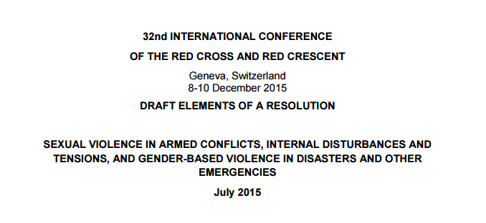
32nd International Conference of the Red Cross and Red Crescent
http://rcrcconference.org/wp-content/uploads/sites/3/2015/04/32IC-draft-elements-of-resolution-sexual-gender-violence-20150716.pdf
Notes:
Adapted from Council of Delegates of the International Red Cross and Red Crescent Movement Geneva, Switzerland 7 December 2015 Draft “0” Resolution on “Adoption of the Disability Inclusion Strategic Framework by the International Red Cross and Red Crescent Movement”
http://rcrcconference.org/wp-content/uploads/sites/3/2015/03/CoD15_disability_draft-0-resolution_20150916-EN.pdf

Slide 6
Key points in the IC resolution
Growing evidence of SGBV in disasters
That any person can be a victim of SGBV and factors such as age, sex, disability etc can increase the risk of violence.
Incidences of SGBV are often invisible due to shame, feelings of guilt, lack of information or support
RCRCs basic mission is to prevent and alleviate human suffering

Slide 7
Key points in the IC resolution
Calls to look at existing research and to continue research and develop guidance and tools for preventing and responding to disasters
Call upon states to look at their laws, plans and procedures to asses if they adequately prevent and respond to SGBV
Call upon states to engage community members in particular women, in decision making about DRR
Ensure appropriate efforts to integrate GBV into DRR and response activities

Slide 8
What can NSs do in the lead up to the IC?
Use your role as auxiliary to the government and work together/strengthen your relationship to outline this as a priority.
Work towards a joint pledge with your government
This IC conference will share our areas of work for the next 4 years so it is essential that SGBV is seen as, and made a priority.
Voices to Action platform is a way to make your views and the views of your government heard.

Slide 9
What can NSs do in the lead up to the IC?
Meet your government counterpart and find out who will attend the conference (e.g. Ministry of Foreign affairs)
Find out what your Gov’t priorities are
Explain the aims and objectives of the resolution as well as priorities of your NS
Are they willing to support the resolution or make a joint pledge with your NS?

