Slide 1
SFDRR
and
IFRC
Sendai Framework for Disaster Risk Reduction (SFDRR), IFRC contribution and implementation in Asia Pacific
From Managing Disasters to Managing Risks
Prepared by: Indira Kulenovic, Resilience Coordinator, DMU, Asia Pacific Zone

Slide 2
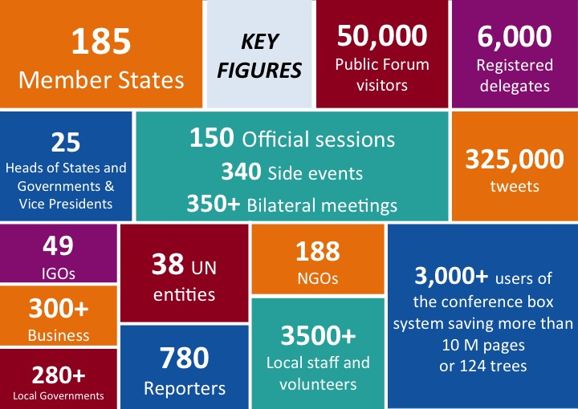

Slide 3
Expected Outcome
“The substantial reduction of disaster risk and losses in lives, livelihoods and health and in the economic, physical, social, cultural and environmental assets of persons, businesses, communities and countries”
Sendai Framework for DRR

Slide 4
Goal
Focus on preventing new disaster risks, reducing existing disaster risks that also strengthen resilience
Calls for various measures to prevent and reduce hazard exposure and vulnerability, increase preparedness and recovery
Calls for integrated and inclusive economic, structural, legal, social, health, cultural, educational, environmental, technological, political and institutional measures
Calls for increase in preparedness for response and recovery,
Sendai Framework for DRR

Slide 5
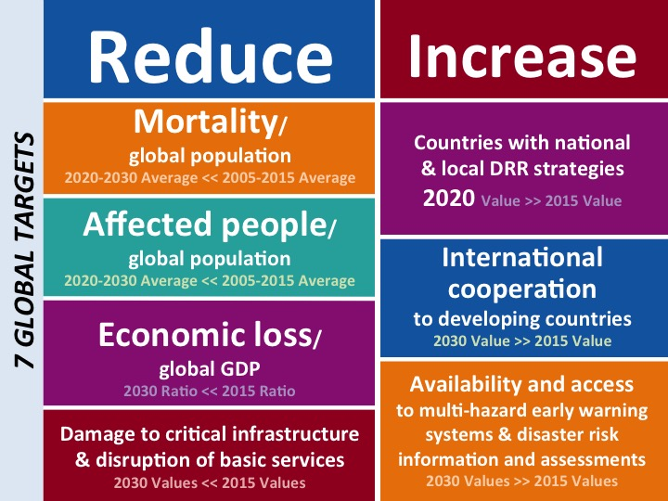

Slide 6

Key areas of Sendai Framework for DRR
Focus on Prevention of new risks
Importance of Health
Role of Women and Human rights
Focus on local level and stakeholders
Focus on Stakeholders and inclusive approach
Clear link with financing for development, climate change and the post 2015-develoment agenda
Focus on recovery, rehabilitation and reconstruction and DRR mainstreaming / Build Back Better

Slide 7
SFDRR Innovations
Shift from disaster loss to disaster risk
Shift from disaster management to disaster risk management;
Shift from “what to do?” to “how to do?”
Focus on people-centered preventive approach to DRR
Primary responsibility of States for DRR
Shared responsibility for DRR with stakeholders
Scope includes slow-onset, man-made and bio hazards;
Set of global targets;
Set of guiding principles;

Slide 8
SFDRR Innovations
Articulation of governance to manage disaster risk, including role of national platforms;
Understanding, tackling disaster risk drivers;
Preparedness to “build back better”;
Strengthened accountability for disaster risk management;
Recognition of stakeholders and their roles;
Mobilization of risk-sensitive investment;
Global and Regional Plans for coherence, monitoring and periodic reviews;
Resilience of health systems, cultural heritage, and work places;

Slide 9
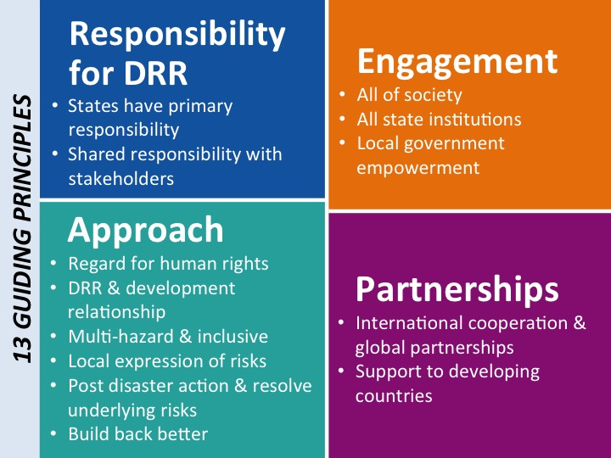

Slide 10
Role of Stakeholders
Shift from considering stakeholders as victims and vulnerable to agents of change and focus on empowerment and inclusion
Adds indigenous people engagement, and voluntary commitments
Specific focus on:
Civil society, volunteers, organized voluntary work & community-based organizations
Academia, scientific and research entities and networks
Business, professional associations & private sector financial institutions
Media
Parliamentarians

Slide 11
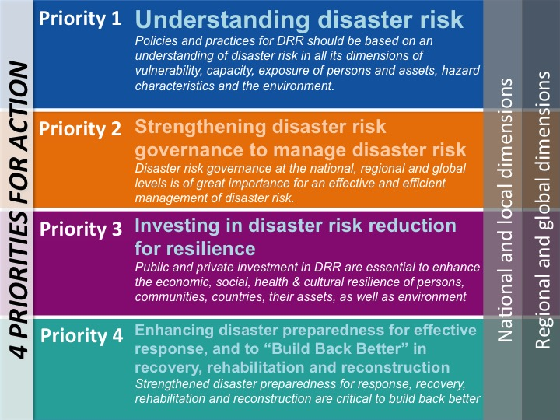

Slide 12
SFDRR - PA 1.Understanding disaster risk.
Addressing Policies and Practices for DRR
National and Local Level
Global and Regional Level
Mapping
Methodologies and tools for development and dissemination
Systems development
Campaigns for public awareness and education (i.e. Safe Steps)
Access & support for innovative technologies
Risk mapping, analysis, use/dissemination of obtained information,
awareness raising and education,
access to information through traditional and innovative technologiesand education
integration in policies and strategies
Sendai Framework for DRR

Slide 13
IFRC Contribution to Priority Area 1.
Addressing Policies and practices for DRR
National and Local Level
Global and Regional Level
Vulnerability and Capacity Assessment
Sectoral assessment
GIS / MRA (PMI)
RMS
Community Resilience programming
Public awareness and public education
Formal and informal school education
Rollout of the Framework for Community Resilience
Development of tools and guidelines for assessment, PAPE
One Billion Coalition for Resilience
Road to/from Sendai
AMCDRR
Sendai Framework for DRR

Slide 14
SFDRR - PA 2.Strengthening disaster risk governance to manage disaster risk.
Addressing disaster risk governance at all levels
National and Local Level
Global and Regional Level
Mainstream DRR within and across all sectors
Implement DRR strategies and policies
Assess DRM capacity
Ensure compliance with laws and regulations
Strengthen mechanism to monitor implementation of national/local plans
Clear roles and responsibilities
National and local DRR platforms
Empower local authorities
Global and Regional Strategies and mechanisms for KIM and sharing systems
DRR platforms at global/regional levels
Trans boundary cooperation
Monitoring and Assessment of disaster risks / promote exchange of information
Sendai Framework for DRR

Slide 15
IFRC Contribution to Priority Area 2
Addressing disaster risk governance at all levels
National and Local Level
Global and Regional Level
Mainstream DRR into RCRC policies and plans
NS DRR Frameworks / DRM Strategies
Integrated NS development strategies /plans
National DRR Platforms
Integrated multisectoral community based initiatives/programmes
Disaster Laws (DRR&DR)
Gender sensitive DRR
Beneficiary communication
GPDRR
IASC
AMCDRR & Asia Pacific Road map for implementation of SFDRR
RCC
GADR3ES / APCSS/CFSS
ASEAN/SAARC
Regional Road Maps (SEA, EA)
Sendai Framework for DRR

Slide 16
SFDRR - PA 3.Investing in Disaster Risk Reduction for Resilience.
Addressing Public & Private investments in DRR to build resilience of individuals, communities, countries
National and Local Level
Global and Regional Level
Governments to allocate resources at all levels for DRR
Increase PP investment in disaster resilient structures
Promote mainstreaming of DRR into policies land-use, rural development / Building Codes
Design/Implementation of inclusive policies integrated with livelihood, health, housing, educations
Strengthen the protection of livelihoods and productive assets
Coherence across organizations related to sustainable development and DRR in policies, plans, programmes and processes
Enhance cooperation btwn Health and other stakeholders to improve DRM for Health and other sectors as well
Promote / Support Social Safety nets as DRR measures link to livelihoods at household and community levels
Strengthen international efforts for hunger and poverty eradication through DRR
Sendai Framework for DRR

Slide 17
IFRC Contribution to Priority Area 3
Addressing Public & Private investments in DRR to build resilience of individuals, communities, countries
National and Local Level
Global and Regional Level
Allocation of 10% of EA for DP/DRR
Promotion of DRR legislation at national and community level
Community Resilience Building initiatives /programming (integrated /multi-sectoral i.e: CBDRR, CBHFA, PASSA, PHAST)
Partnerships in resilience building
Various livelihoods initiatives (cash distribution, IG projects, etc)
One Billion Coalition for Resilience
Call for Innovation / Beijing Declaration
Regional Voluntary Commitments
AP Resilience Road map
Sendai Framework for DRR

Slide 18
SFDRR - PA 4.Enhancing disaster preparedness for effective response, and to “Build Back Better” in recovery, rehabilitation and reconstruction
Addressing strengthening of disaster preparedness for response, integration of DRR in response preparedness and capacity building
National and Local Level
Contingency policies/plans/programs
People centered Multi-hazard, multi-sectoral EWS
Emergency stock-piling
Post-emergency planning
Capacity building in disaster preparedness and response
Simulation exercises
Mainstreaming DRR into recovery and longer-term development
Collaboration between all stakeholders
Evacuation
Dead Body Management
PSP Support
Disaster response Laws
Sendai Framework for DRR

Slide 19
IFRC Contribution to Priority Area 4 at National and Local levels
Addressing strengthening of disaster preparedness for response, integration of DRR in response preparedness and capacity building
National Disaster Preparedness and response mechanism (NDPRM) which include the below points:
National Society Contingency plans
HCT/Cluster Coordination, Pre-disaster meetings
People centered Multi-hazard, multi-sectoral EWS
Emergency stock-piling/buffer stocks
Post-emergency planning
Capacity building in disaster preparedness and response (National Disaster Response Teams –NDRT, BDRTs)
Simulation exercises/Mock drills
Mainstreaming DRR into recovery & Build Back Better approach
Mainstreaming Gender and diversities into all programming tools and implementation
Promote IDRL
Sendai Framework for DRR

Slide 20
SFDRR – PA. 4.Enhancing disaster preparedness for effective response, and to “Build Back Better” in recovery, rehabilitation and reconstruction
Addressing strengthening of disaster preparedness for response, integration of DRR in response preparedness and capacity building
Global and Regional Levels
Regional response mechanisms
Standards, Codes, Guidelines
Regional multi-hazard EWM
Awareness raising on hydrological issues and impact on society
Regional cooperation in Disaster Preparedness including simulation exercises
Sharing response and resources during and after disasters
Sendai Framework for DRR

Slide 21
IFRC Contribution to Priority Area 4 at Global and Regional Levels
Addressing strengthening of disaster preparedness for response, integration of DRR in response preparedness and capacity building
Principles and Rules for Humanitarian Assistance
Asia Pacific Standard Operating Procedures
Global and regional response tools (FACT, ERU, RDRT, DREF)
Support National Disaster Preparedness and Response Mechanisms (NDPRM)
Regional Logistics Centers
DRR mainstreaming in Emergency and Recovery Appeals
Participation in DiREX, ARDEX,
IASC
Disaster Law (i.e. ASEAN/SAARC) including studies
Sendai Framework for DRR

Slide 22
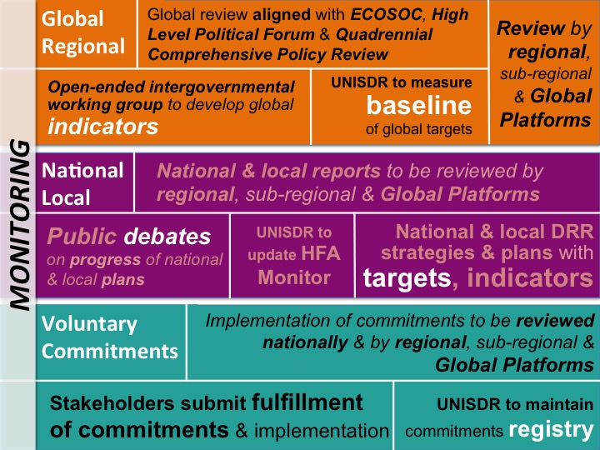

Slide 23
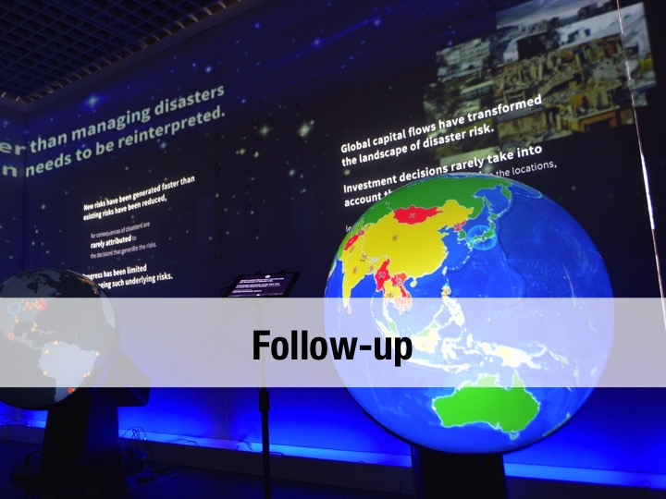

Slide 24

By States
Appoint national focal points
Nominate experts to open-ended inter-governmental working group for development of indicators & terminology
Update: risk information for biological, man-made hazards,
national & local & regional DRR strategies & plans,
Report status of implementation of plans
Identify baselines & set targets for risks and DRR action
Review and update relevant national legislation
Promote local platforms on DRR and coherence across agreements

Slide 25
By Stakeholders
Support development of guide to implementation
Implement over 200 commitments made
Integrate SFDRR in their work
Support States in implementation
Support inter-governmental process to update DRR terminology & plan to support implementation
Promote coherence across conferences
Prepare for the 2017 Global Platform & regional platforms

Slide 26
By UNISDR
Implement activities as mandated in Sendai Framework
Participate in work of Inter-Agency and Expert Group on Sustainable Development Indicators
Lead revision of the United Nations Plan of Action on Disaster Risk Reduction for Resilience
Update the HFA monitor
Maintain inventory of commitments
Prepare next cycle of regional and Global Platforms
Define five-year strategy and two-year work plan

Slide 27

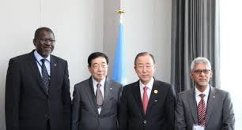
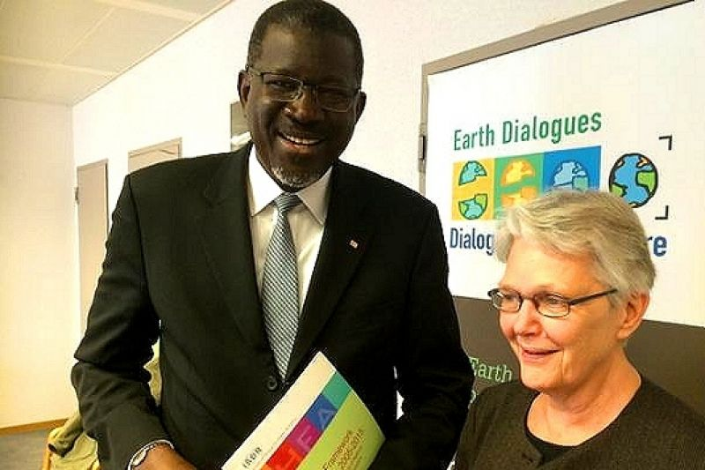
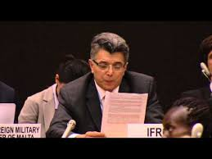
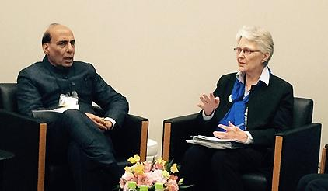


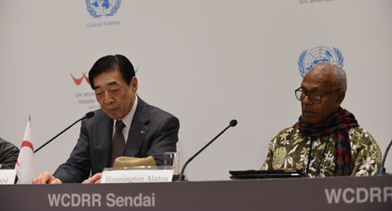
Implementation of the sfdrr in asia – From Sendai to Delhi
Regional platform led by UN ISDR

Slide 28
National & Local
Sub-regional/IGOs
Regional
National & local DRR strategies & plans
ADDMER Work Programme
SAARC roadmaps
Other frameworks
Regional Implementation Plan of SFDRR
Baseline, Targets
Update risk information
Ten Stakeholder Groups Voluntary Commitments; UN Plan of Action
Sub-regional Platforms/IGO Governance meetings
AMCDRR
2016 in India
2018 in …
2020 in ….
National & Local Platforms
Progress reviewed nationally and at sub-regional and
regional platforms

Slide 29
Ten stakeholders groups in Asia
Parliamentarians
Group on Gender Equality and Women’s Empowerment in Disaster Risk Management and Regional Resilience Building
Science, Technology and Academia
Children, Youth and Child Centered Organizations
Asian Civil Society Organizations
National Societies of Red Cross and red Crescent - IFRC
Media
Private Sector
Mayors and Local Government Authorities
Individuals and organizations concerned with disability

Slide 30
The objectives of regional platform is to:
    Provide policy framework for SFDRR implementation in Asia and the Regional Road Map for Implementation
    Provide policy guidelines for governments and stakeholders
    Serve as reference for monitoring the SFDRR progress

Slide 31
Building on HFA regional strategies through AMCDRR
Beijing 2005
Highlighted the relevance of DRR for poverty reduction and sustainable development in Asia. Called for National Plans for Action and strengthening of existing regional collaboration mechanisms
Delhi 2007
Agreed on biennial Ministerial Conference as a multi-stakeholder Regional Platform for DRR. Called for the enhancement of partnership in DRR. Affirmed UNISDR role to provide secretarial support to Regional Platform
Kuala Lumpur
2008
Emphasized multi-stakeholder partnerships and private sector role. Recognized the role of local authorities. Called for capacity building of local authorities and communities
Yogyakarta, 2012
Called for capacity building for local risk assessment, mainstreaming local DRR into national development, financing DRR. Inputs for the post-2015 framework for DRR. Ten Stakeholder Groups statements of commitments
Bangkok, 2014
Called to strengthen local resilience, investments in disaster and climate risk management and PPP. Adopted Asia-Pacific Inputs for the post-2015 framework for DRR. Agreed to prepare Regional Implementation Plan.
Stakeholders commitments
Incheon 2010
Regional Roadmap on DRR through CCA (REMAP): to make DRR and CCA priorities in national policies and build synergies between them at the national, regional, and global levels
Notes:
From Yogyakarta AMCDRR – IFRC joined as Stakeholder Group on RCRC NSs among other 9 stakeholder groups

Slide 32
Timeline
2015
2016
IAP, Feb (TBC)
Country DRM status evaluations, National Implementation Plans
1st draft Regional Road Map for Implementation
IAP, June
Roadmap, initial outline of AMCDRR, identified contributions
UNGA Sept
Adopt WCDRR outcomes
IAP, August (TBC)
Final Draft Regional Road Map for Implementation
IAP, Nov + Ministerial Dialogue (TBC)
First Country DRM status evaluations, National/Local Implementation Plans
Initial draft Policy Dialogue and Sector Briefs
1st AMCDRR, New Delhi, Nov 2016
Adopt Regional Road Map for Implementation
December
Define SFDRR periodic review

Slide 33
Thank You

