Slide 1
10th Annual South-East Asia
Red Cross Red Crescent
Leaders Meeting 2013
Anne E. Leclerc
Head of Regional Delegation, SEARD

Slide 2
South East Asia Regional Focus
  Support SEA NS on their Development agenda
    Community Preparedness /Resilient Communities (DRR, CBH. Organizational and Response Preparedness
  NS Development (OCAC, Financial Development, PMER, HR, Youth)
  Communication and advocacy including BenCom
  Strategic Partnership / regional Mechanisms (ASEAN, Mekong River Basin Cooperation
  Movement Cooperation (harmonization of approaches)

Slide 3
Consultation process
SEARD is supporting 11 NS, proposing a portfolio in term of support and services in line with S2020 and the 5 Business lines defines by the SG Objectives
6 NS are closely supported by country delegations, SEARD focus on complementarity and added value bringing specific expertise
Specific attention to the NS not supported by country delegatios.Out of the 5 NS. Plans and budget could be worked out for 3 NS (Malaysia, Thailand, Laos)
Brunei D RC is supported on its strategic planning but support is still at an early stage

Slide 4
Consultation Process
Consultations are made through different type approaches:
  Regional Working Groups (RDMC,Health, OD/Youth)
  Country Delegations and Zone Plans
  SEARD acting as country Delegation in countries like Lao, Cambodia, Thailand, Malaysia, Brunei or Singapore on basis of contact/request

Slide 5
Planning process: Review of LTPF 2014 - 2015
LPTF 2012 2015. 4 years document was posted in December 2011
Plans and budget were approved for 2012-2013 and next two years P&B will be approved for the next two years by December
Yearly Development Plan 2013 posted and shared
Revision of 2014 – 2015 Plans and Budgets will start in June 2013 for approval

Slide 6
DOP - Budget 2013 South-East Asia Regional Delegation

Slide 8
Budget 2013 South-East Asia Regional Delegation

Slide 9
Workshops and trainings plan 2013 - Regional
 |  | Workshops 2013 - Region
Project Name | Position | No. of workshops | No. days per workshop | Workshop days total | Participants per workshop | Workshop participants total
HEALTH |  | 4 |  | 12 |  | 80
Health | Health team meeting | 1 | 3 | 3 | 20 | 20
Health | Non-communicable diseases/CBHFA | 1 | 3 | 3 | 20 | 20
Health | Blood donor recruitment | 1 | 3 | 3 | 20 | 20
Health | HIV | 1 | 3 | 3 | 20 | 20
DRR |  | 8 |  | 19 |  | 185
RDMC | Meeting | 2 | 3 | 6 | 25 | 50
RDMC | Subgroup meeting | 2 | 2 | 4 | 10 | 20
DRR Project | DRR coordination meeting (Mekong) | 1 | 1 | 1 | 25 | 25
DRR EWS Project | DRR&CCA workshop/meeting (country – Thailand) | 1 | 3 | 3 | 20 | 20
DIPECHO | RCRC- ECHO Coordination meeting | 1 | 2 | 2 | 20 | 20
DIPECHO | DRR Practitioner's Workshop | 1 | 3 | 3 | 50 | 50
OD |  | 3 |  | 10 |  | 90
NS development Unit | Youth & OD forum | 1 | 4 | 4 | 45 | 45
NS development Unit | Youth leaders forum | 1 | 3 | 3 | 25 | 25
NS development Unit | Finance Directors meeting | 1 | 3 | 3 | 20 | 20
 | TOTAL | 15 |  | 41 |  | 355

Slide 10
Workshops and trainings plan 2013 - Country
 |  | Workshops 2013 - Country
Project Name | Position | No. of workshops | No. days per workshop | Workshop days total | Participants per workshop | Workshop participants total
DRR |  | 38 |  | 97 |  | 1,105
DIPECHO | Thematic Seminars on integration | 1 | 2 | 2 | 20 | 20
DIPECHO | Thematic Seminars on Disaster Response | 1 | 2 | 2 | 20 | 20
DIPECHO | Thematic Seminars on integration | 1 | 2 | 2 | 20 | 20
DIPECHO | Thematic Seminars on Disaster Response | 1 | 2 | 2 | 20 | 20
DIPECHO | Thematic Seminars on integration | 1 | 2 | 2 | 20 | 20
DIPECHO | Thematic Seminars on Disaster Response | 1 | 2 | 2 | 20 | 20
DIPECHO | Thematic Seminars on integration | 1 | 2 | 2 | 20 | 20
Disaster Preparedness Project | RDRT / NDRT | 1 | 7 | 7 | 25 | 25
Flood Post Emergency | Finance training | 2 | 2 | 4 | 30 | 60
Flood Post Emergency | Incident command system training | 2 | 4 | 8 | 50 | 100
Flood Post Emergency | Donation management training | 1 | 1 | 1 | 30 | 30
Flood Post Emergency | Rapid Action Team training | 2 | 5 | 10 | 25 | 50
Flood Post Emergency | Central Region Disaster Response Team Seminar | 1 | 3 | 3 | 80 | 80
Flood Post Emergency | Refresher training program on Emergency medical skill | 1 | 2 | 2 | 30 | 30
Flood Post Emergency | Training and capacity building for communities level in VCA, DM&Health | 5 | 3 | 15 | 25 | 125
Flood Post Emergency | Project quarterly meeting | 4 | 2 | 8 | 30 | 120
Flood Post Emergency | Half year meeting | 1 | 2 | 2 | 30 | 30
Flood Post Emergency | Lesson learnt workshop | 1 | 2 | 2 | 50 | 50
CBDRR Project | CBDRR process lesson learn workshop | 3 | 3 | 9 | 40 | 120
CBDRR Project | Organise workahop/training related to EWS to targeted communities | 1 | 5 | 5 | 25 | 25
CBDRR Project | Regional lesson learnt workshop to create platform for knowledge and experiences sharing amoung LRC,CVTL,PMI and TRC | 1 | 2 | 2 | 20 | 20
CBDRR Project | Conduct community drill in the each communities in 5 province | 5 | 1 | 5 | 20 | 100
OD |  | 1 |  | 3 |  | 40
NS development Unit | LRC Branch RM workshop | 1 | 3 | 3 | 40 | 40
 | TOTAL | 39 |  | 100 |  | 1,145

Slide 11
Workshops and trainings plan 2013 (region and country)

Slide 12
Budget 2013 : Personnel – International staff (9/10)

Slide 13
Budget 2013 : Personnel – Local staff (22/11 SS /8 IFRC Programme/3 PNS Staff)

Slide 14
Budget 2013 : Personnel (local and international)

Slide 15
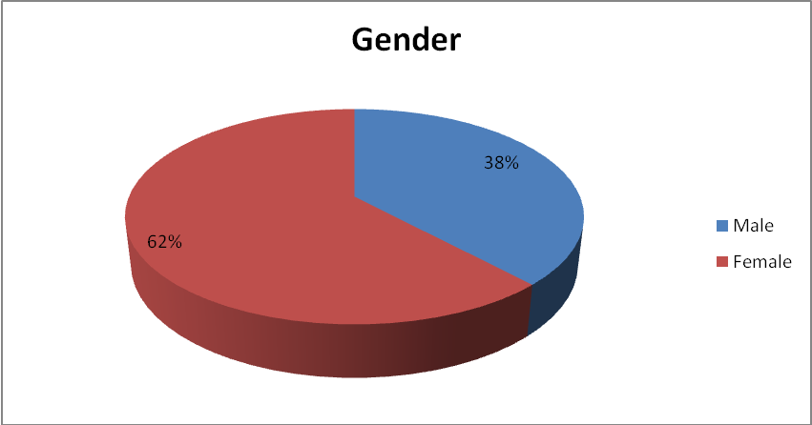
Personnel : SEARD team in February 2013

Slide 16
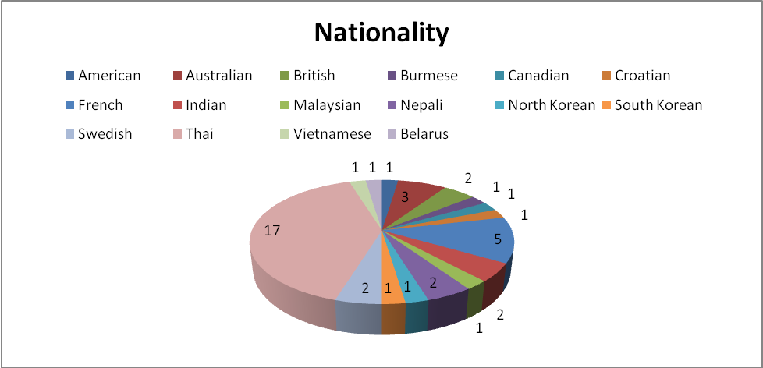
Personnel : SEARD team in February 2013
16 Nationalities / 41 staff / 17 Thai

Slide 17
SEARD Allocation of income 2012-2013

Slide 18
SEARD LTPF 2012 -2015 : Projection of Financial support
Programs | BL | 2012 | 2013 | 2014 | 2015 | Total
CSR | 02 | 4,455,768 | 5,459,703 | 3,655,000 | 2,135,000 | 15,705,471
NSD/CB | 03 | 536,444 | 828,183 | 833,750 | 833,750 | 3,032,127
Com/Adv | 04 | 47,232 | 65,504 | 60,000 | 60,000 | 232,736
Coordination | 05 | 11,590 | 0 | 0 | 0 | 11,590*
Total |  | 5,051,034 | 6,353,390 | 4,548,750 | 3,028,750 | 18,981,924
* Coordination is integrated into programme areas

Slide 19
SEA financial projections for country delegations and SEARD
Budgets 2012 – 2015: CHF 111,957,054

Slide 20
SEARD - Financial Projections for core areas

