Slide 1
RCRC and Climate Change

Slide 2
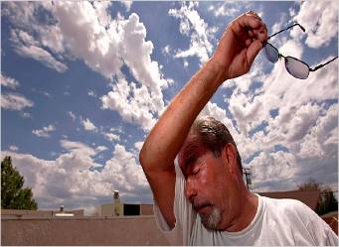
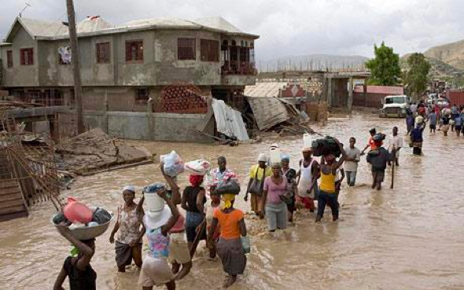
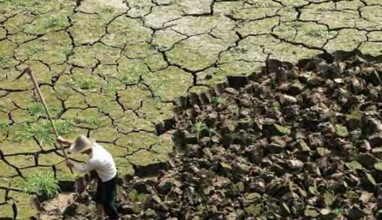
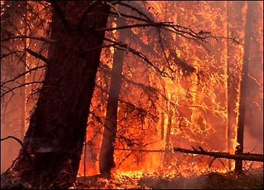
Notes:
Ask the participants why the Red Cross should be worried about climate change.
Take a few answers (likely to involve things such as drought, floods, etc.), and then explain: climate change is likely to cause humanitarian impacts around the world, and click through to have these worrying pictures appear.
2

Slide 3
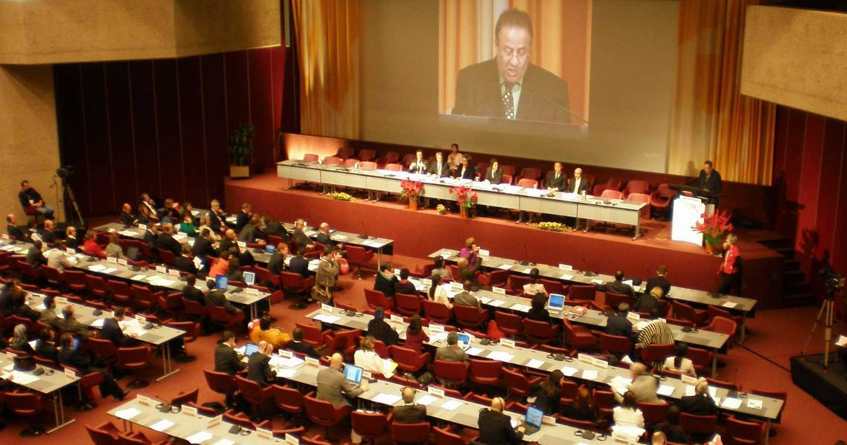
The Red Cross Red Crescent commitments
At the RCRC International Conference 2007 – ‘Together for Humanity’
[…] commitments were made to address climate change in the following ways:
raise awareness on climate change
provide humanitarian assistance
improve capacity to respond
decrease vulnerability of communities most strongly affected
integrate climate risk management into policies and plans
mobilise human and financial resources, giving priority to actions for the most vulnerable
International
conference
2007
Geneva,
November 2007
RCRC International Conference
Photo: IFRC
Notes:
3
3
Of course, any humanitarian organisation will have to consider how it will adapt to changes in the occurrence of disaster events and risk patterns and prepare for “more work and challenges.”
The Red Cross Movement has raised the issue at the highest level: The International Conference of the Red Cross and Red Crescent, which brings together the world’s largest humanitarian network and the world’s governments in a conference to debate major humanitarian challenges. It is attended by the International Committee of Red Cross (ICRC), the International Federation of Red Cross and Red Crescent Societies (IFRC) and the187 National Red Cross and Red Crescent Societies; on the government side, all 194 States that are party to the Geneva Conventions attend.
The International Conferences (IC) normally take place every 4th year, and in 2007 climate change was one of the four main subjects of this conference, and in 2011 “Humanitarian consequences of climate change” was the theme for one of the 8 “workshops” at the International Conference.
In 2007, workshops were very well visited and Secretary Generals kept bringing forward their experiences of erratic weather in their countries. With the final Declaration and the commitment of the NSs, ICRC, IFRC and governments, climate change now needs to be implemented in the policy plans and programs of all National Societies.
Commitments were made to address climate change in the following ways (see slide):
raise awareness on climate change
provide humanitarian assistance
improve capacity to respond
decrease vulnerability of communities most strongly affected
integrate climate risk management into policies and plans
mobilise human and financial resources, giving priority to actions for the most vulnerable

Slide 4

International Conference 2007
Together for Humanity (Resolution 1), Governments and National Societies acknowledged the threats posed in humanitarian terms by environmental degradation and climate change.
https://fednet.ifrc.org/en/newsevents/events/ifrc-events/international-conference/30th-international-conference-november-2007/reports-adopted-declaration-and-resolutions

Slide 5
The Red Cross Red Crescent Commitments
Commitments were made to address climate change in the following ways:
raise awareness on climate change
provide humanitarian assistance
improve capacity to respond
decrease vulnerability of communities most strongly affected
integrate climate risk management into policies and plans
mobilise human and financial resources, giving priority to actions for the most vulnerable

Slide 6
Strategy 2020 and Climate Change
IFRC’s mission of building safer and resilient communities and addressing climate change is clearly stated as a priority under the Strategic Aim 2 of the IFRC Strategy 2020 “Enable Healthy and Safe Living”.

Slide 7
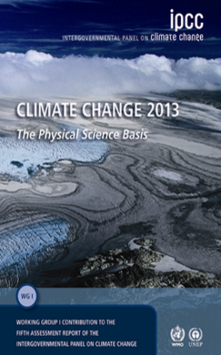
IPCC – the ‘key reference’ on climate change
Main findings
Climate change is already happening
It is mostly caused by man
It will continue
The rate of change is alarming
Extreme weather is getting more frequent
It is urgent to stop further warming
IPCC Fifth Assessment Report, 2013
Notes:
7
7
The IPCC is the Intergovernmental Panel on Climate Change, the leading international body for the assessment of climate change, established by the United Nations Environment Programme and the World Meteorological Organization in 1988. Thousands of scientists worldwide contribute to it and their highly detailed reports are accompanied by a “Summary for Policymakers” (SPM), approved line-by-line at formal UN meetings and endorsed by all governments. The SPM then becomes the agreed scientific basis for international negotiations about climate change and is used for national policy-making on climate by many countries.
The latest report – launched in September 2013 – added considerable strength to the previous (2007) report, which was already an eye-opener to the larger public. Its statements were clear and alarming: climate change is now unequivocal, it is bound to continue at an alarming rate unless substantial measures are taken to reduce greenhouse gas emissions and it already is and will continue to bring the world more extreme weather events.
Find the full report – and shorter summaries especially for the Red Cross Red Crescent – on www.climatecentre.org/AR5
and further background on the IPCC at www.ipcc.ch or www.climatechange2013.org

Slide 8






Second Question: Along with the GHG the earth is getting warmer – what does that mean?
Rising temperatures, heat waves
Sea level rise
Scientists very sure
Melting ice
Ocean acidification
Changing rainfall patterns
Less clear, and regional differences
Changes in extreme events
Notes:
Walk through an overview of the expected changes, using the points below. Explain that the rest of the presentation will cover impacts on human society in more detail.
It is a fact that Greenhouse Gas concentrations is increasing, but the effects following from that have different levels of “certainty”:
1) Rising temperatures – with heat waves:
We know that at the “global scale” (i.e. for most land areas with sufficient data)
It is very likely that there has been an overall DECREASE in the number of cold days and nights.
It is very likely that there’s been an overall INCREASE in the number of warm days and nights.
In the future, for most land areas, this trend is expected to continue.
Sea surface temperatures are also rising; “minimum” temperature extremes have risen.
Heat waves are expected to become more frequent and more intense.
Source: http://www.climatechange2013.org/images/uploads/WGIAR5_WGI-12Doc2b_FinalDraft_Chapter02.pdf
2) Sea level rise
-Ocean thermal expansion and glacier melting have been the dominant contributors to 20th century global mean sea level rise.
-Thermal expansion: ocean temperatures have been increasing, water expands as it warms → sea level rise
-Glacier melting: land based ice that melts and flows into the ocean, increasing mass of water in the ocean → sea level rise.
-Higher sea levels put coastal cities at risk from flooding, more intense storm surges, and coastal erosion.
-Higher sea levels also increase risks for salt-water contamination of farmland and freshwater sources.
Source: http://www.climatechange2013.org/images/uploads/WGIAR5_WGI-12Doc2b_FinalDraft_Chapter13.pdf; http://www.ipcc.ch/publications_and_data/ar4/wg1/en/faq-5-1.html
3) Melting ice (sea ice and glaciers)
Sea ice = frozen sea water that floats on the ocean’s surface
Glaciers = dense ice exceeding a surface area of 0.1 km² constantly moving under its own gravity. Example: Greenland ice sheet
- Rising temperatures have caused glaciers and sea ice (espcially around the North Pole) to melt faster than many scientific projections
- Melting ice has implications for sea level rise and ocean chemistry.
Source: http://www.climatechange2013.org/images/uploads/WGIAR5_WGI-12Doc2b_FinalDraft_Chapter13.pdf
4) Ocean acidification – and its effects
-The ocean has absorbed more CO2 as emissions have risen, this increases the pH of the water and has serious implications for marine life. Biodiversity is under pressure due to increasingly inhospitable environmental conditions (e.g., coral bleaching because of acidifying oceans).
Source: http://www.climatechange2013.org/images/uploads/WGIAR5_WGI-12Doc2b_FinalDraft_Chapter03.pdf
5) Changing rainfall patterns
Data limitations make it difficult to say with certainty what the rainfall trends will be in all regions of the globe
BUT, on average, places that have currently have heavy precipitation can expect to see the intensity of rainfall events increase, places that are dry can expect less frequent rainfall (but more intense rain when it falls).
Or in other words: “The wet get wetter and the dry get drier”; this means drought becomes more frequent in many places around the world.
Sources: http://www.gfdl.noaa.gov/cms-filesystem-action/user_files/kd/pdf/gfdlhighlight_vol1n5.pdf; http://www.ipcc.ch/news_and_events/docs/ar5/ar5_wg1_headlines.pdf
6) Changes in extreme events
-Heat waves and droughts have become more frequent, and in some places, more intense.
-It is difficult to measure the frequency and intensity of floods, but generally there has been an increasing trend.
-Climate change is expected in increase the frequency of high-intensity tropical storms. -Very difficult to identify trends with tornados, dust storms, hail, and other severe local events because data reliability is low and current climate models don’t simulate these phenomenon. BUT, risks are expected to increase with demographic and land use changes increase people’s exposure to these events.
Sources: (http://ipcc-wg2.gov/SREX/images/uploads/SREX-SPMbrochure_FINAL.pdf) (http://www.nature.com/nclimate/journal/v2/n3/full/nclimate1357.html) (http://www.ipcc.ch/publications_and_data/ar4/wg1/en/ch3s3-8-4-2.html) (http://www.ipcc.ch/pdf/special-reports/srex/SREX_Full_Report.pdf)
(explain that this presentation will go through these points in more detail)
“Melting ice” picture: http://www.flickr.com/photos/worldresourcesinstitute/3525024219/ ; Photo by Linda Shaffer, World Resources Institute, 2009.
“Other changes” picture (bleached coral): http://www.flickr.com/photos/worldresourcesinstitute/5476510553/ ; Photo by Mark Spalding, World Resources Institute, 2011.
8

Slide 9
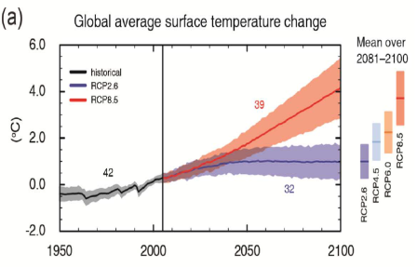
Warming will continue, but how much is our choice
In the next few decades, temperatures will continue to rise, even if we almost completely stop emissions of GHGs today (blue line)
This is because GHGs, especially CO₂, stay in the atmosphere for a long time
Therefore, we have further climate change “in the pipeline” because of the emissions already in the atmosphere
Notes:
As you can see from the chart, both the best case (Blue line) and worst case (Red line) scenarios show temperature increases.
Temperatures are bound to rise even if we stop emissions immediately!
Climate change will still continue for centuries due to the time scales associated with climate processes and feedbacks.
This means we are bound to at least 30 more years of temperature increase (and other climate change impacts); so, we have to prepare!
IPCC 2013 concluded: “Most aspects of climate change will persist for many centuries even if emissions of CO2 are stopped. This represents a substantial multi-century climate change commitment created by past, present and future emissions of CO2”
Blue line and uncertainty zone (RCP2.6) = rapid stop for further CO2 emissions into the atmosphere (virtually impossible)
Red Line and uncertainty zone (RCP8.5) = continued very high greenhouse gas emissions
Even if we stop emitting CO2 immediately (which we won't!) climate change will still
Facilitator note: Intermediate options are marked to the right of the graph only
9

Slide 10
Warming will continue, but how much is our choice
But if, and only if, we cut the global amount of GHG emissions quickly, we may avoid escalating warming in the second half of this century (the red line)
If we act now to reduce global emissions, it is still possible to keep changes within a “manageable range” for our children
Notes:
As you can see from the chart, both the best case (Blue line) and worst case (Red line) scenarios show temperature increases.
Temperatures are bound to rise even if we stop emissions immediately!
Climate change will still continue for centuries due to the time scales associated with climate processes and feedbacks.
This means we are bound to at least 30 more years of temperature increase (and other climate change impacts); so, we have to prepare!
IPCC 2013 concluded: “Most aspects of climate change will persist for many centuries even if emissions of CO2 are stopped. This represents a substantial multi-century climate change commitment created by past, present and future emissions of CO2”
Blue line and uncertainty zone (RCP2.6) = rapid stop for further CO2 emissions into the atmosphere (virtually impossible)
Red Line and uncertainty zone (RCP8.5) = continued very high greenhouse gas emissions
Even if we stop emitting CO2 immediately (which we won't!) climate change will still
Facilitator note: Intermediate options are marked to the right of the graph only
10

Slide 11
Disaster Management
Health and Care
CLIMATE (CHANGE) RISKS
Water and Sanitation
Food Security
Notes:
II Addressing the consequences: integrating climate change in programmes is preferred above stand alone climate change programs, which are less effective. The core response should be to integrate the notion of the rising risks into the program areas that are most affected:
• Disaster Management
First and foremost, climate change will bring more and different disasters, affecting all aspects of disaster management, ranging from an increase in relief operations to a need for more and better disaster risk reduction (see the module Disaster Management).
• Community risk reduction
In particular, National Societies need to step up efforts to help communities address the rising risks, through community based risk reduction, using tools such as Vulnerability and Capacity Assessments. (see the community risk module)
• Health and Care
Changing disease patterns will require adjustments in programmes to address health risks and promote health and care at the community level (see the health and care module)
• Food Security
Climate change is a major threat to food security, particularly in Africa, and will need to be addressed in food-security programmes, both through enhanced relief and better prevention. Few National Societies have explicitly integrated climate change into their food-security programmes. Over time, the Climate Centre will be developing additional guidance in this area.
• Water and Sanitation (Watsan)
Many National Societies are addressing water and sanitation issues, which are closely coupled to our priorities to promote better health and care. It is clear that climate change will have a major impact on water in many countries, and these changes will need to be factored into the design of Watsan programmes and infrastructure.

Slide 12
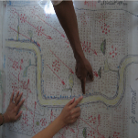
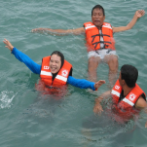
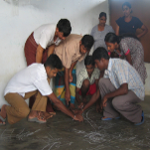

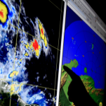
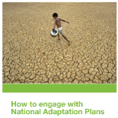
RC action: Improve climate risk management
Climate risk assessments – check how our programming should be adjusted to meet new risk patterns
More and better disaster preparedness at all levels: Early warning – Early action plans with pre-determined actions triggered by information at different time scales
Up-scaling of climate-smart community risk reduction activities
More flexible, climate-smart health programming
Partnerships with weather agencies and technical specialists on adaptation options
Influence climate change policies
Notes:
For the Red Cross Red Crescent some of the headline for how to act on the changing risk patterns are listed here
Note the Climate Training Kit modules will help go in depth with theses issues
Facilitator tip: review the Climate Guide for more specific information
12

Slide 13
Humanitarian Diplomacy:
International and National (Climate) Policy
- attention for the most vulnerable
- building on local capacity
- linking with disaster risk management (DRR and Response)
At the international level, including
    United National Framework Convention on Climate Change (UNFCCC)
    HFA and SFDRR
    Climate Smart DRR
    Resilience Building
At the national level (in developing countries)
    DM/DRR and CC Policies

Slide 14
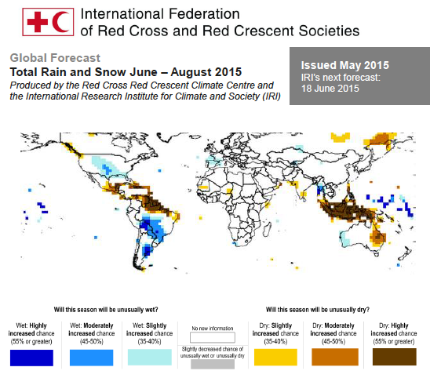

Slide 15
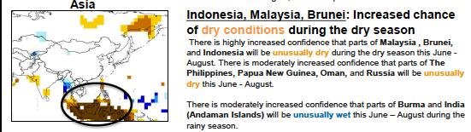


Slide 16
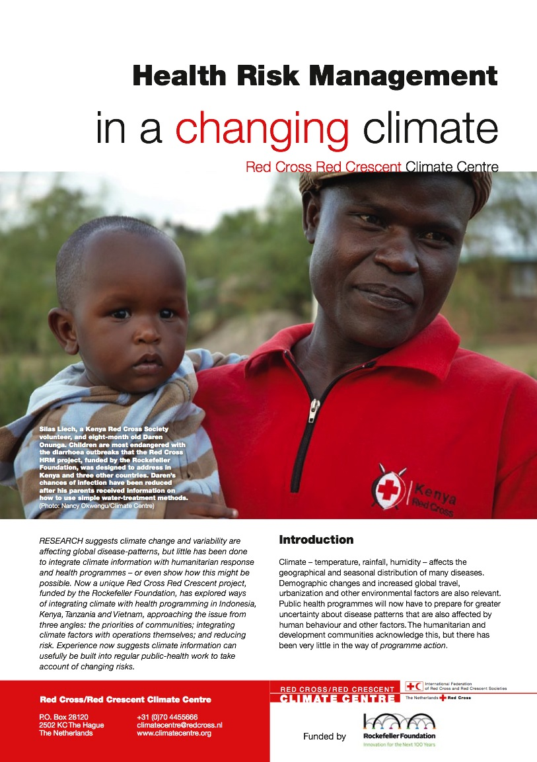
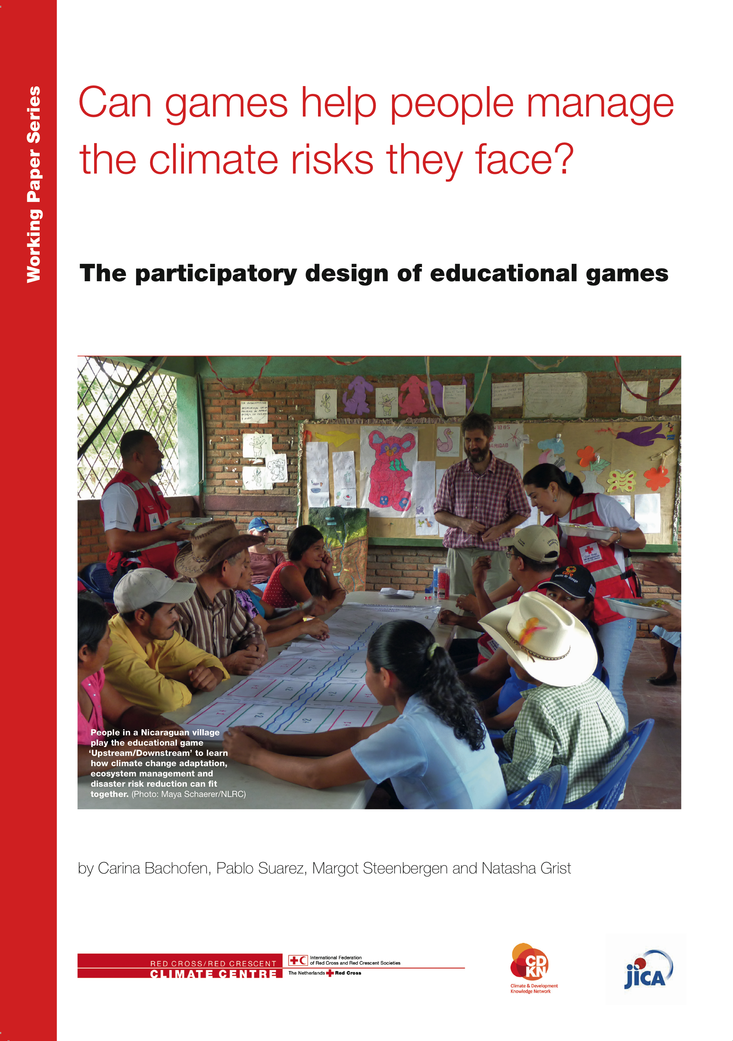
Raise Awareness – help people and institutions learn about climate change and its humanitarian consequences
Notes:
III Raising awareness
One important role of the Red Cross Red Crescent is to help people and institutions learn about climate change and its humanitarian consequences, and most importantly solutions to address it, both through community-based activities and public-awareness campaigns. Up to 60 National Societies have prepared materials for awareness campaigns. For a more extensive overview catalogue: please have a look at the communication module in this climate training KIT, under the section ‘experience of other National Societies’.

Slide 17
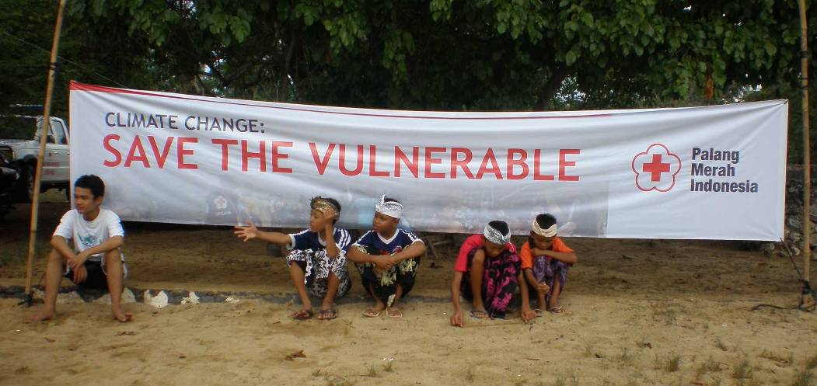
Photo: IFRC
Notes:
17
The rest of the Climate Training Kit modules will help with dealing with increasing climate risk in the regular programmes of the Red Cross Red Crescent Movement.

Slide 18


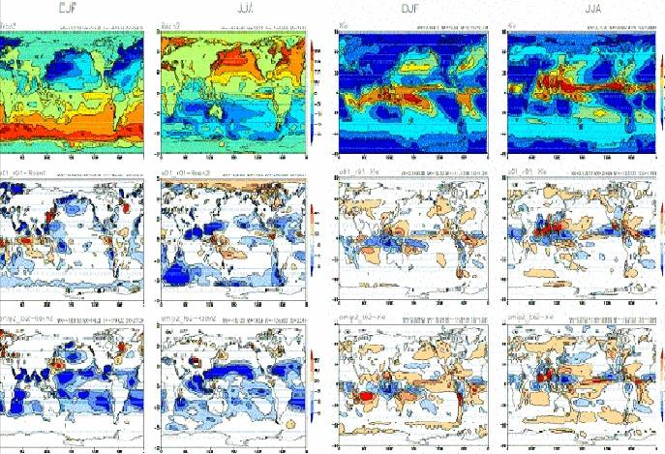
Paying for Predictions
A game on information, decisions and consequences
PARTICIPATORY!
(EXPECT CONFUSION)
Notes:
18
Clicks:
Start by introducing the Red Cross Red Crescent Movement
Wouldn’t it be great if the Movement had a crystal ball and could know in advance if a disaster was going to happen?
Actually, it is currently possible to have early warning of climate-related disasters! Scientists can make predictions about many things, including rainfall, up to months ahead, that can actually help us make decisions about how to prepare for potential disasters.
We have developed games to help explain this, but expect confusion.

Slide 19
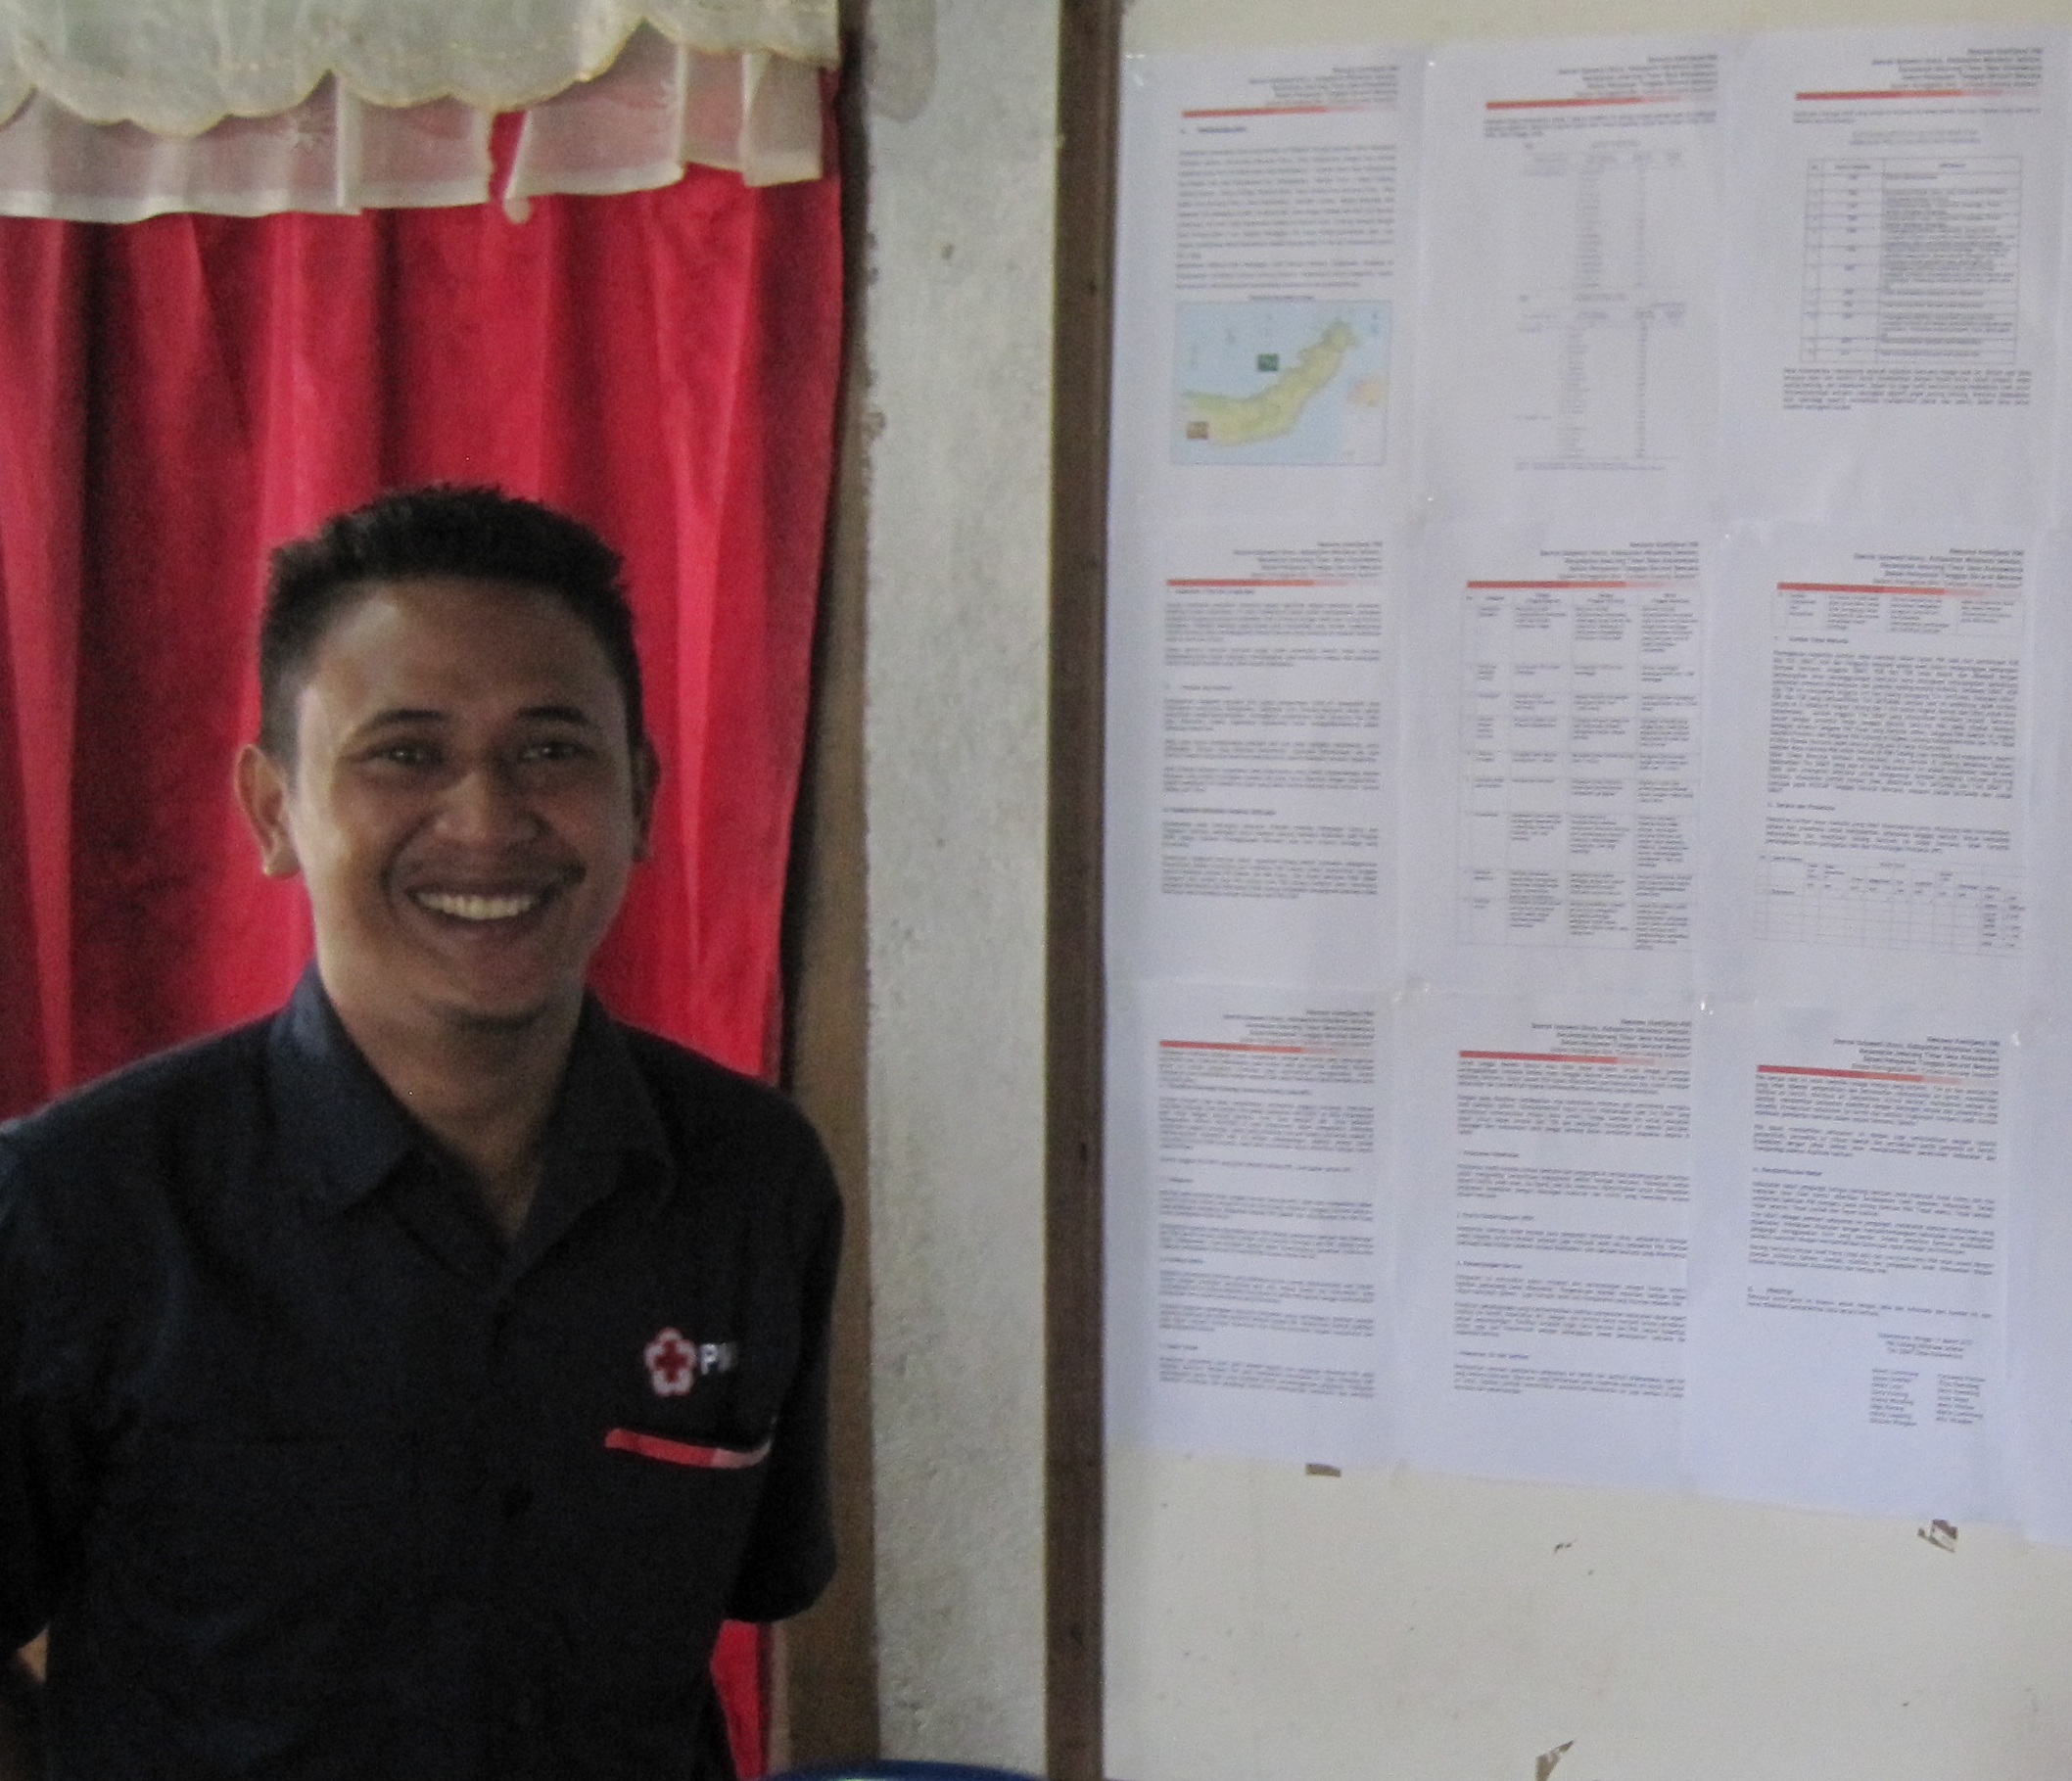
YOU
Country
You have your budget for disaster management = 7 beans
Notes:
19
You are a Red Cross Red Crescent in Worker.
If you are worried about flooding, is there anything you can do about it before the flood happens?
Click 1: Yes. You can prepare for a flood, but this will cost you 1 bean. You can only prepare for flood before the rainy season, so you will need to stand up before the dice is rolled.
Click 2: If you don’t want to prepare for the flood – and save the investment – you don’t have to pay anything, and you stay sitting down.

Slide 20
GROUND RULES
Game = simplified representation of reality
No questioning of game rules
Decisions are individual -- but consultation with team is encouraged
You pay with beans -- beans cannot be shared among players
Notes:
Explain that each group of 3 is a region, each person is a local branch. (Use consistent language throughout)
Beans represent the money/resources of your Red Cross Red Crescent Branch.

Slide 21
WINNERS & LOSERS
Need more beans than you have left?
--> you have a humanitarian crisis!
Winner: Country with Most Number of Beans Left
Notes:
You have a “humanitarian crisis” if you cannot pay what is necessary; you receive a red stone. Note that players who run out of beans do not die; don’t refer to death as a penalty – games that playfully invoke death are unacceptable to humanitarian workers who have seen it first hand.
Show prizes here.

Slide 22
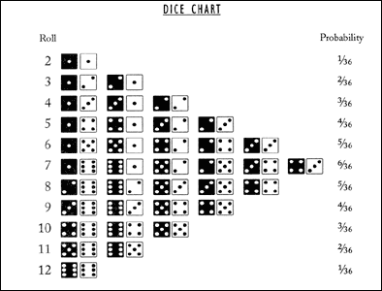


Local Climate in Regional Context
Local
Country
Flood if 10+
(~16% chance)
2
3
4
5
6
7
8
9
10
11
12
Notes:
In this game, each Red Cross/Crescent region is vulnerable to floods.
How do you get a flood? You roll the die.
Click 1: There is one die for the region, and one die for the local. If the sum is >10, there will be a flood!
How often do you think it will flood?
Click 2: Here are all the possible combinations of the die.
Click 3: According to probability, it will flood aoub 16% of the time.
Now, ask everyone to roll the die. Ask who got a flood? Make sure people get the concept.

Slide 23
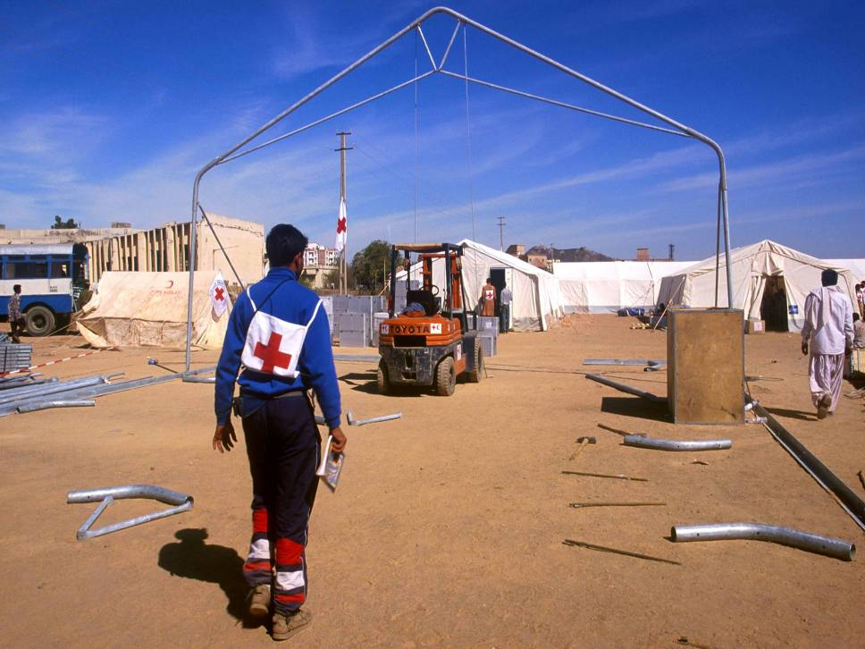
Stand up for Flood Preparedness:
Pay 1 bean before rains
Early Action
Stay sitting (doing non-disaster tasks):
Pay nothing
Wait & See
Notes:
23
You are a Red Cross Red Crescent in Worker.
If you are worried about flooding, is there anything you can do about it before the flood happens?
Click 1: Yes. You can prepare for a flood, but this will cost you 1 bean. You can only prepare for flood before the rainy season, so you will need to stand up before the dice is rolled.
Click 2: If you don’t want to prepare for the flood – and save the investment – you don’t have to pay anything, and you stay sitting down.

Slide 24
No problem
No disaster ?
<10
: No problem
: Pay 4 beans
Early Action
(paid 1 bean)
Flood ?
10+
Wait & See
Notes:
24
If you chose not to act, not to prepare, and there was no flood, you are fine. No problem.
BUT, if there was a flood, and you didn't prepare, you have to pay FOUR beans.

Slide 25
LET’S
PLAY!
PLAY!
Two practice rounds
Notes:
After the first roll, ask everyone to look and see what has happened. Find an example of people who acted in vain (wasted donor money!), prepared for a flood that actually happened (was a hero!), and didn’t act but there was a flood (had to pay a lot of beans). Ask each person what happened to them so others can see.
Then, ask everyone, who would like to know what was under the cup before they had to decide whether to invest in preparedness? Everyone will say yes.

